Slide 1
GES 317/417: GIS and Segregation
Prof. Scott Hegerty
Summer 2025
NEIU

Slide 2
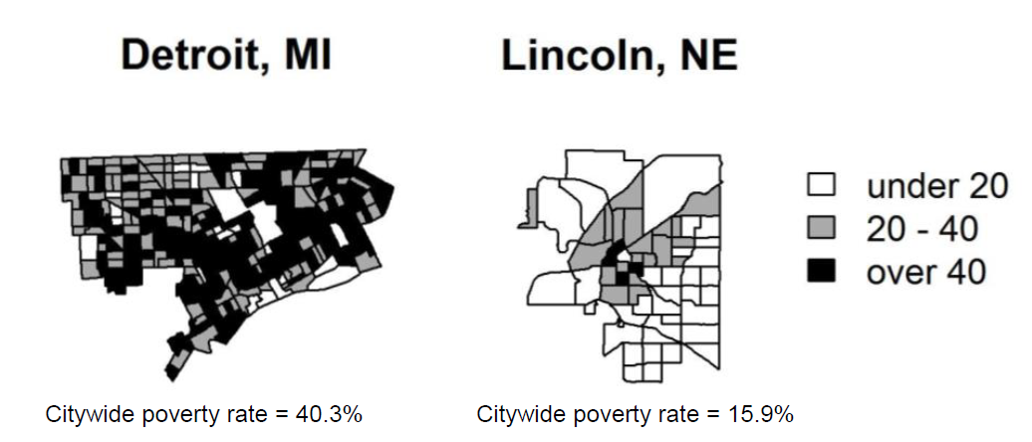
What is Segregation?
Measurable difference in location between groups
White/Black
Poor/Non Poor
Distance: Geographic? Social?
How to measure? Early studies: % differences Now more sophisticated

Slide 3
Causes of Segregation
Economics: Choice based on cost/benefit, Supply and Demand
Specific laws: Zoning Housing policy School policy
Restrictive Covenants

Slide 4
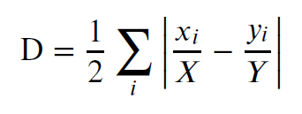
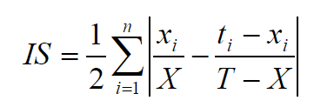
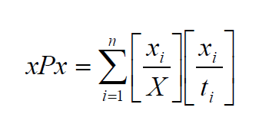
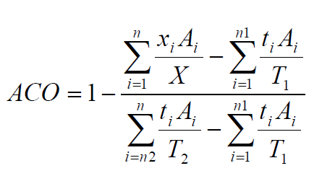
Some Measures of Segregation
Dissimilarity Index
Isolation
Exposure
Absolute Concentration
x = Pop. of group in tract X = Total Pop of Group t = Total Pop. In tract
T = Total Pop. in entire area
Often on a [0,1] scale
This one includes land area

Slide 5
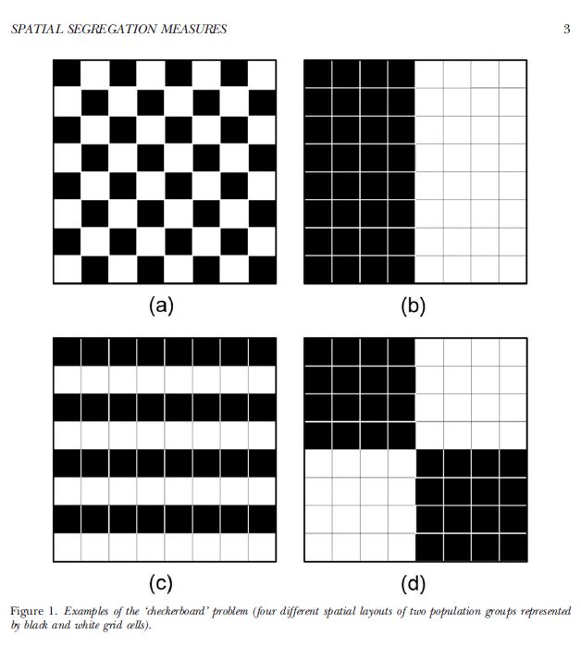
The “Checkerboard” Problem

Slide 6
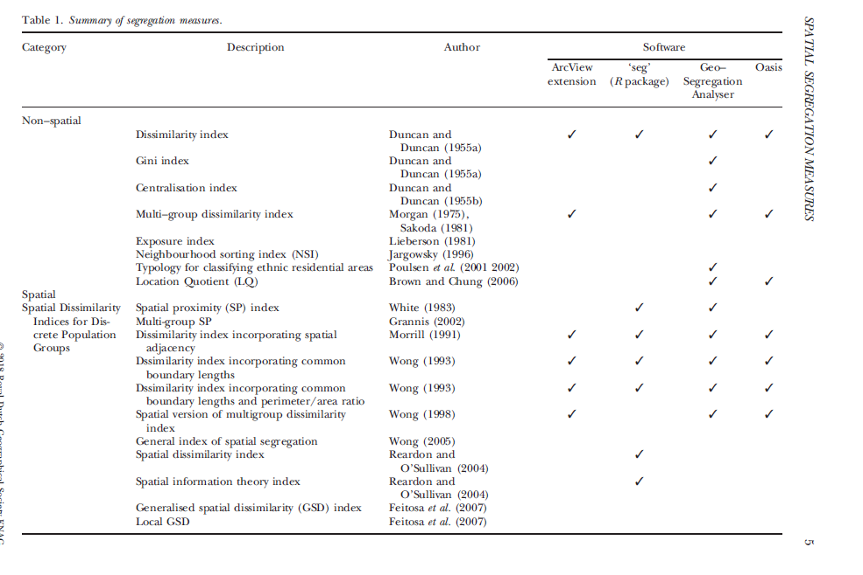
Eom: Summary of Measures

Slide 7
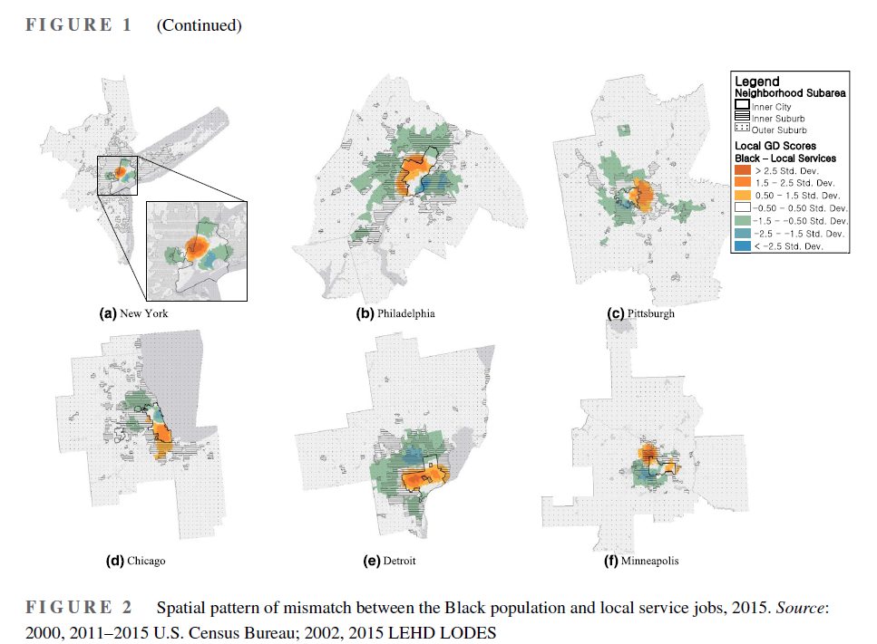
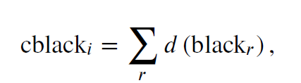
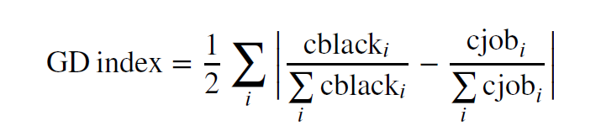
Eom: Spatial Mismatch
Wong (2005): “General Dissimilarity” (GD) Compares with neighborhood (d) to get a composite

Slide 8
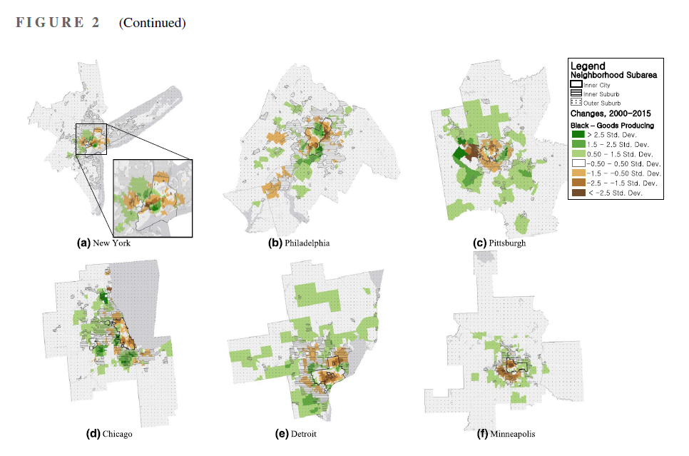
Eom: Spatial Mismatch

Slide 9
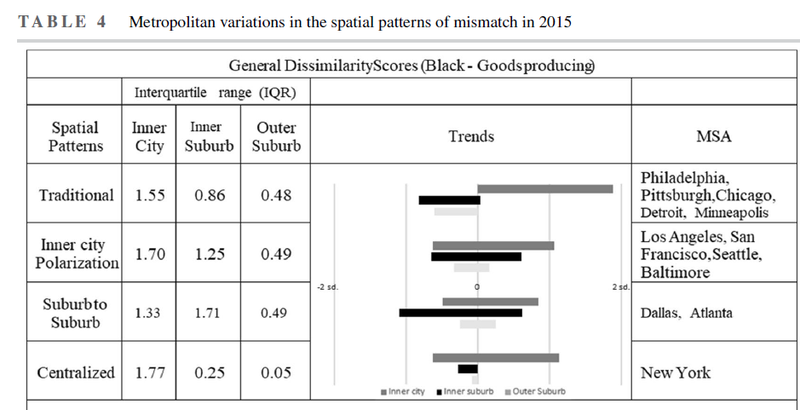
Eom: Typology of Spatial Mismatch

Slide 10
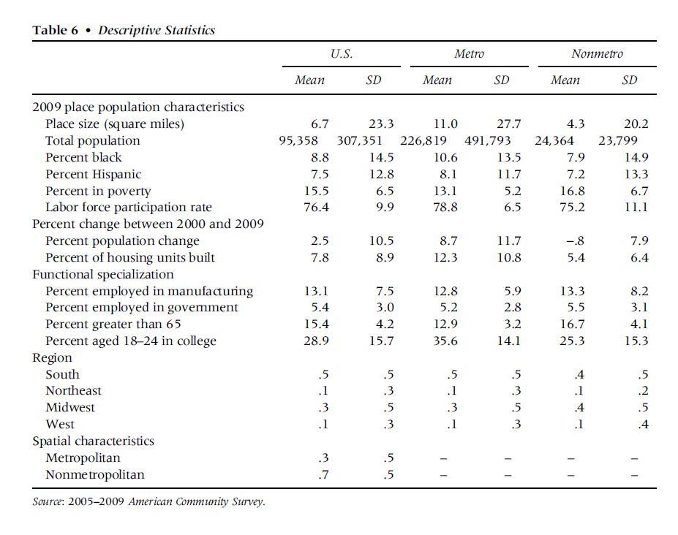
Lichter et al.: Poor People in Poor Places

Slide 11
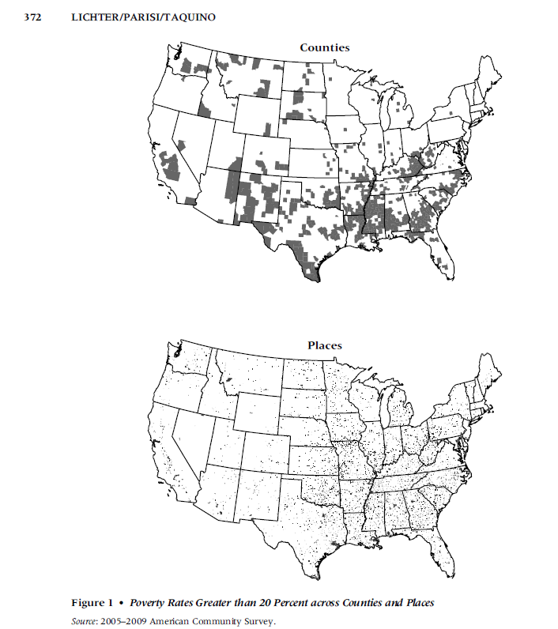

Slide 12
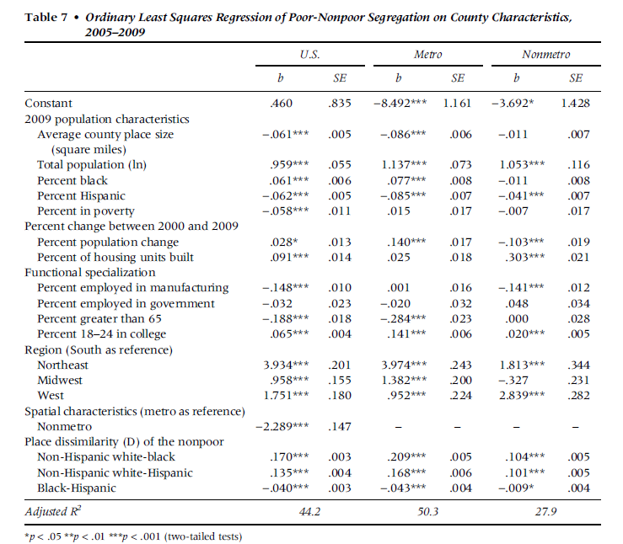
Lichter: Regression Analysis

Slide 13
Using GIS in Segregation Analysis
Mapping: Generate Measure and show where segregation occurs
“Hot Spot” analysis: G*, etc.
Relationships With Other Variables: Health, Income, Locations…

