Slide 1
GES 317/417: Urban Growth/Urban Change/Urban Sprawl
Prof. Scott Hegerty
Summer 2025
NEIU

Slide 2
Urban Growth
Increase in: Population Income Physical size
Models and mapping

Slide 3
Urban Growth: Causes
Increased inputs (labor, capital, technology)→ Production function
Trade/”exports” → Economic base, multiplier effect
Policy: Attract innovators, firms Build industries actively (e.g. film, medical, startups)

Slide 4
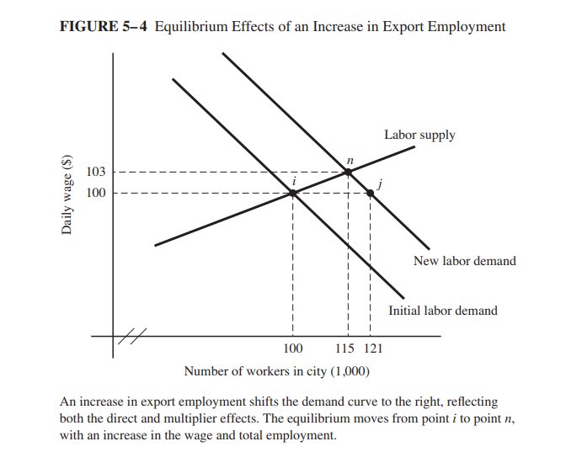
Multiplier Effect
(O’Sullivan, Urban Economics)

Slide 5
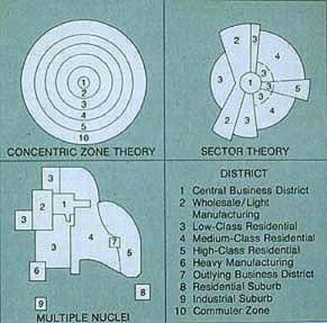
Recall the Theories:
Burgess (1925) Concentric zones
Hoyt (1939) Sectors
Harris & Ullman (1959) Multiple nuclei
Include costs, etc. and model growth Land and transportation costs

Slide 6
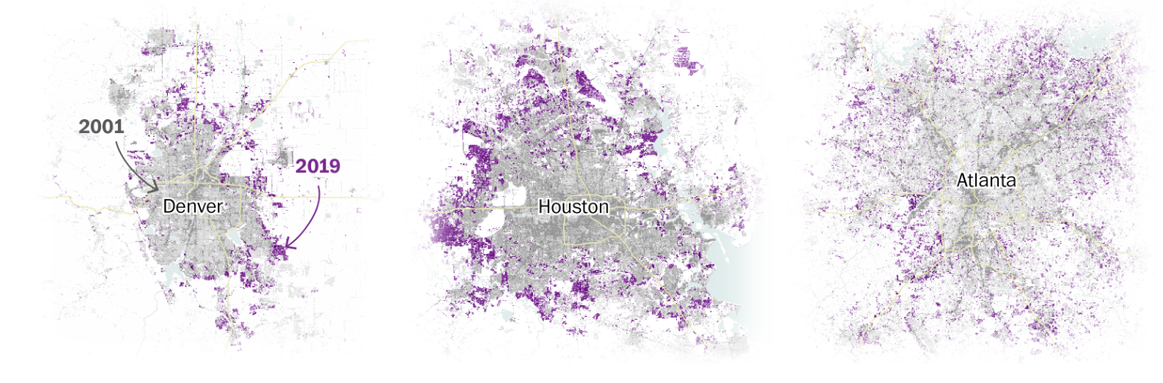
Urban Growth or Urban Sprawl?
https://www.washingtonpost.com/nation/interactive/2021/land-development-urban-growth-maps/

Slide 7
A few models
Transportation-based → Spatial Organization
Pred’s Model of Cumulative Causation
Borchert’s Five Epochs
The density gradient
Location quotients

Slide 8
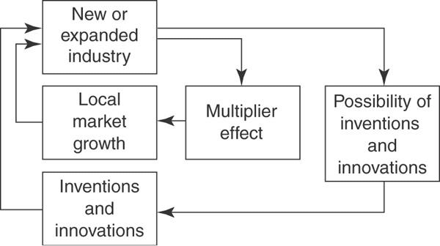
Pred’s Model of Cumulative Causation (1977)

Slide 9
Borchert’s Five Epochs
Transportation-based → Spatial Organization
Sail-Wagon Epoch (pre-1800 to 1830)
Iron Horse Epoch (1830-1870)
Steel Rail Epoch (1870-1920)
Auto-Air-Amenity Epoch (1920-1970)
Satellite-Electronic-Jet Propulsion Epoch (1970-present)
Streetcar suburbs/”Edge cities”

Slide 10
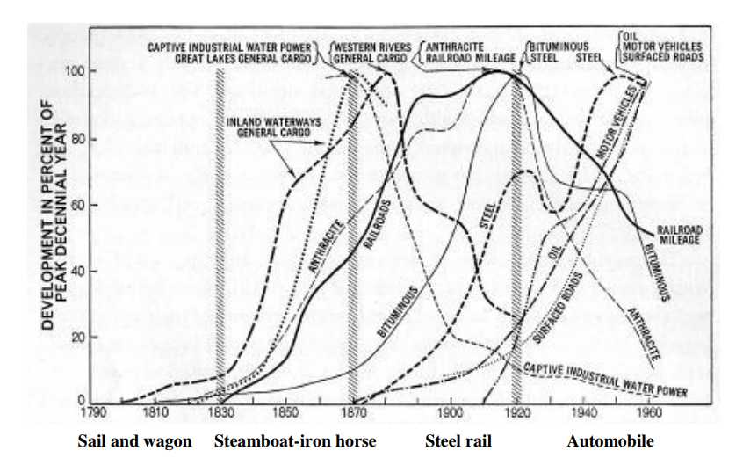
https://newellta.weebly.com/uploads/3/0/7/8/30789823/borchert_epochs_summary.pdf

Slide 11
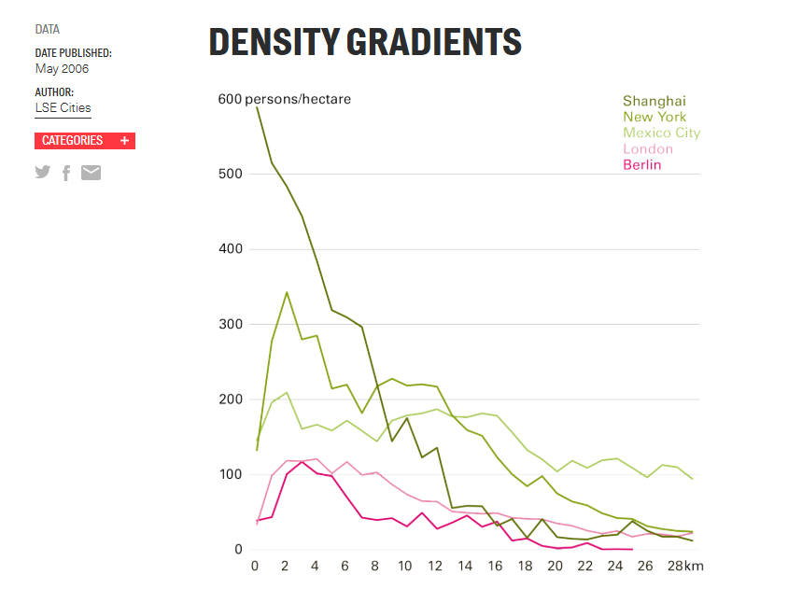
Y = Population density
X = distance from city center
(multiply by 259 to get per square mile)
https://urbanage.lsecities.net/data/density-gradients-2006

Slide 12
Urban Change
Commercial/Industrial/Residential -> Changing uses
Gentrification
U.S. over time: Repurposing Commercial-> Residential, post-covid
Warehouse -> Loft conversion
“Rails to trails” and the 606

Slide 13
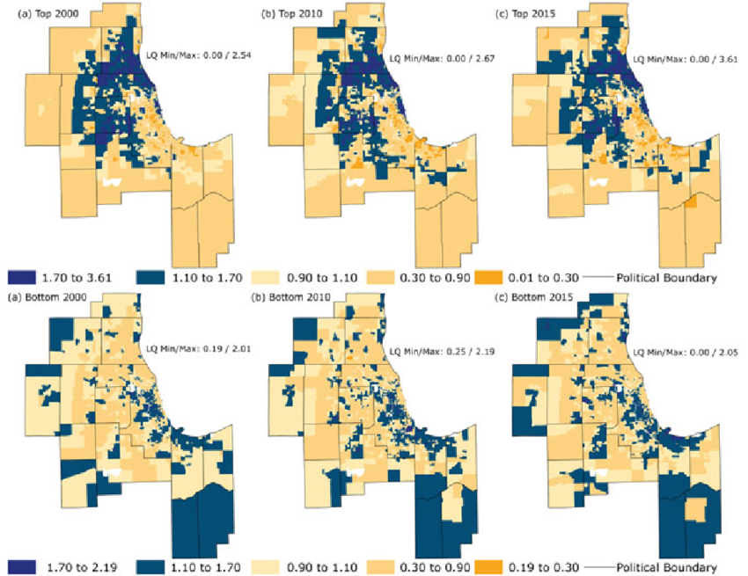
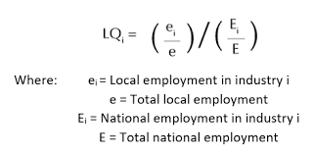
Location Quotient
Smith et al., 2021

Slide 14
Spatial restructuring in formerly planned economies
Had a different density gradient
“Labor Theory of Value: No land values!
Over-industrialized, little single-family housing, factory farms
Now: Factories-> Commercial Suburbanization Agricultural -> Forest

Slide 15
Marcinczak and Sagan (2011): Łódź, PL
Urban model, Location Quotient
Most attention given to higher-order cities
Less change in Łódź; maybe on periphery

Slide 16
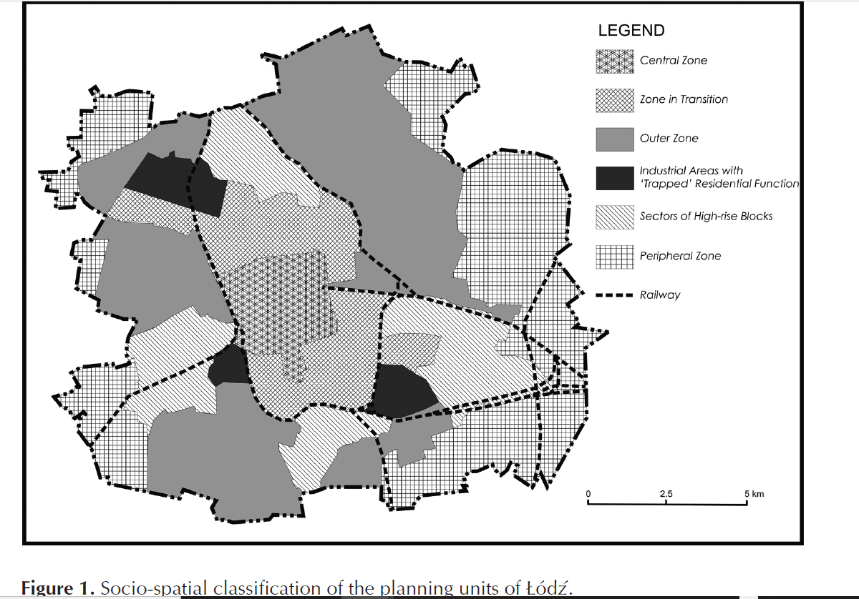

Slide 17
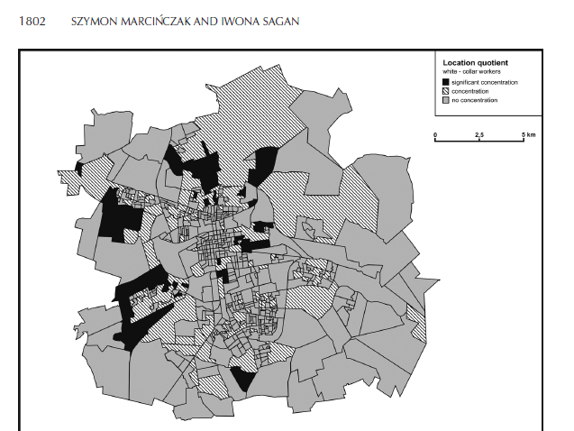
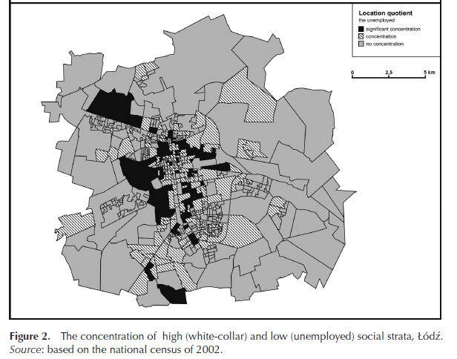

Slide 18
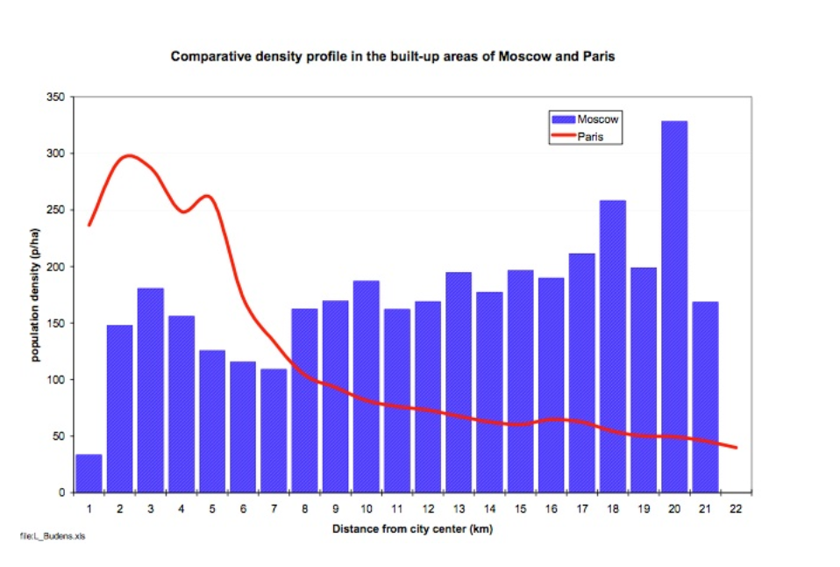
Urban Density Under Communism
https://marroninstitute.nyu.edu/blog/urban-density-under-communism

Slide 19
Urban Sprawl
Change in extent of development
Based on increased demand, zoning, automobiles?
Galster et al (2001): Six definitions: Example (such as LA) Aesthetic judgement Cause of related condition (cars, spatial mismatch, concentrated poverty) Effect of related condition (fragmented government, exclusionary zoning) Patterns of development (low density, “leapfrogging,” dispersion) Development process9e
-> Then quantifies eight measures (Density, continuous concentration, clustering, centrality, nuclearity, mixed uses, proximity)

Slide 20
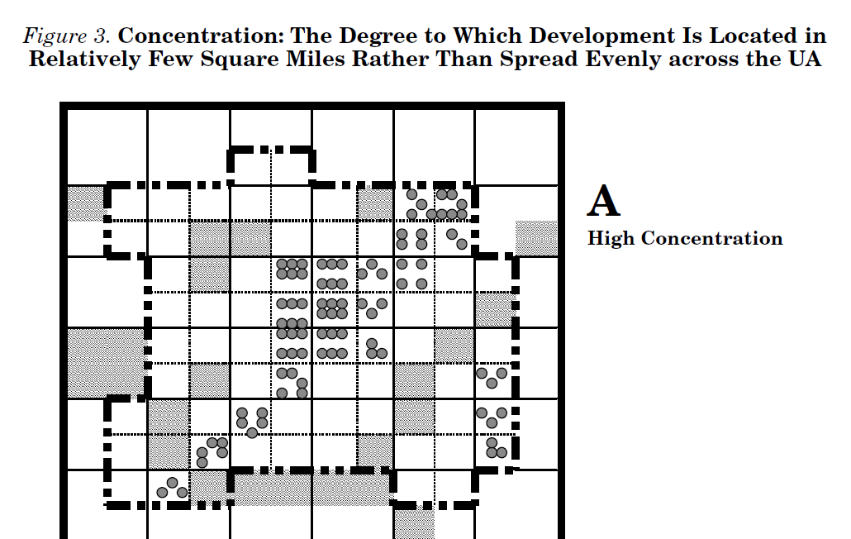
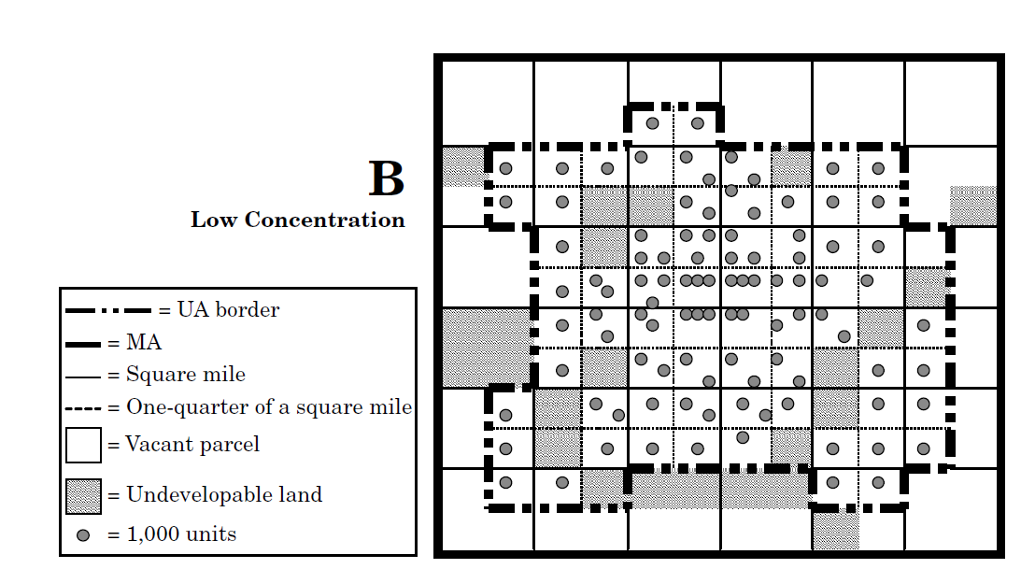

Slide 21
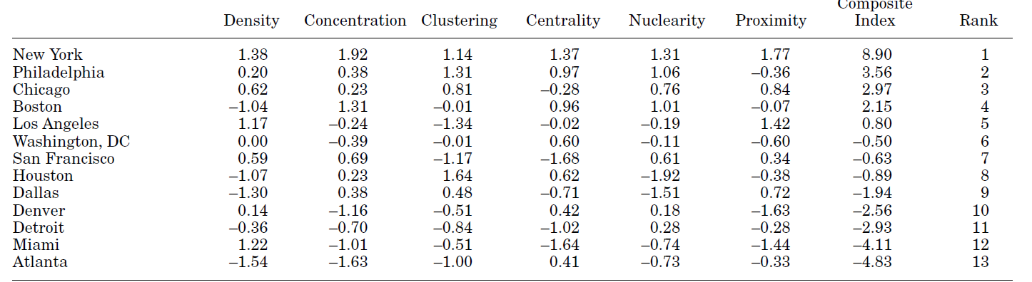

Slide 22
Sprawl Metrics
Composition (relative proportion) and configuration (distribution)
“Patches” (homogenous areas with a single land type)
Measure concentration and isolation Nearest neighbor distance between patches Size/perimeter/shape for each patch → and averages for all of same type
Scale, grain, and extent

Slide 23
Sprawl Metrics: Another example

Slide 24
Fragmentation/Dispersal/Compactness
In assigned lab!

