Slide 1
GES 317/417: GIS and Transportation
Prof. Scott Hegerty
Summer 2025
NEIU

Slide 2
Transportation: Questions
Station location → Consumer needs, socioeconomics
Best routes → Traffic, consumers, roadways
Type of transportation → Subways, buses, light rail
Connections and timing
Development around stations

Slide 3
Transportation: Measurements
“Straight-line distance”
Actual travel distance
Time cost →isochrones, etc.

Slide 4
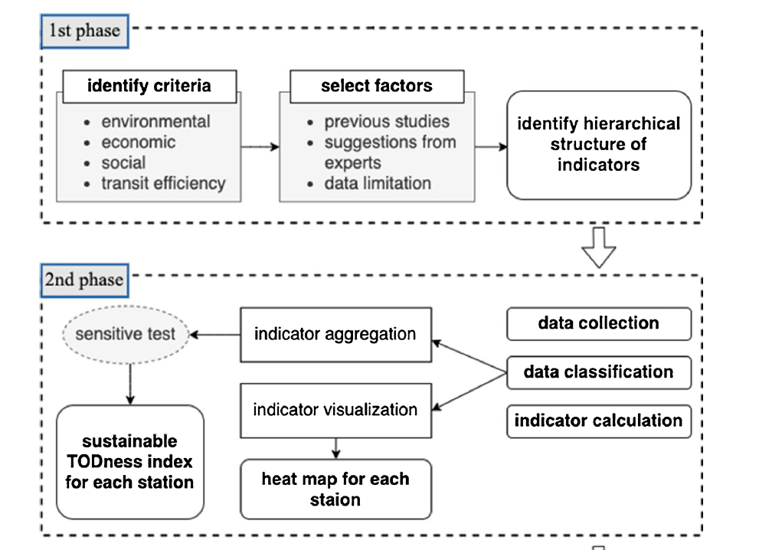
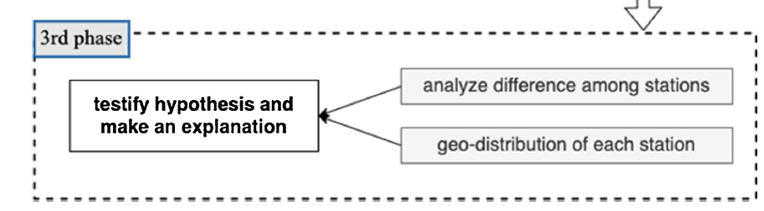
Ke at al.: The Process

Slide 5
Ke at al.: The Process

Slide 6
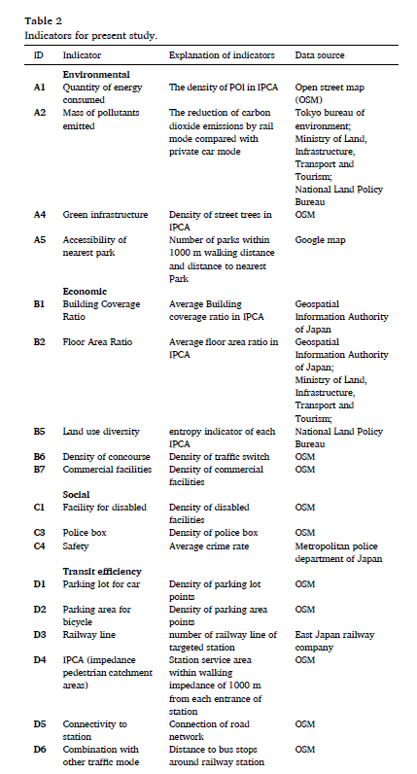
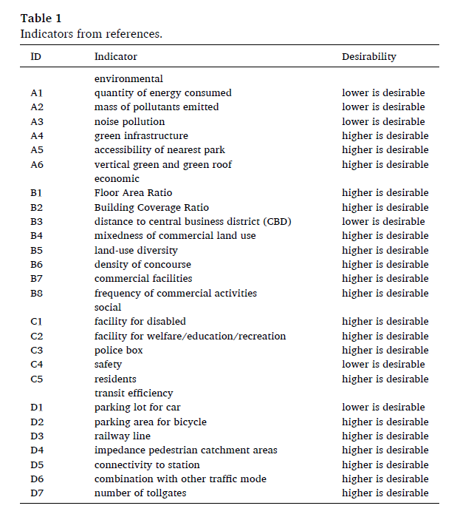
Ke at al.: Indicators

Slide 7
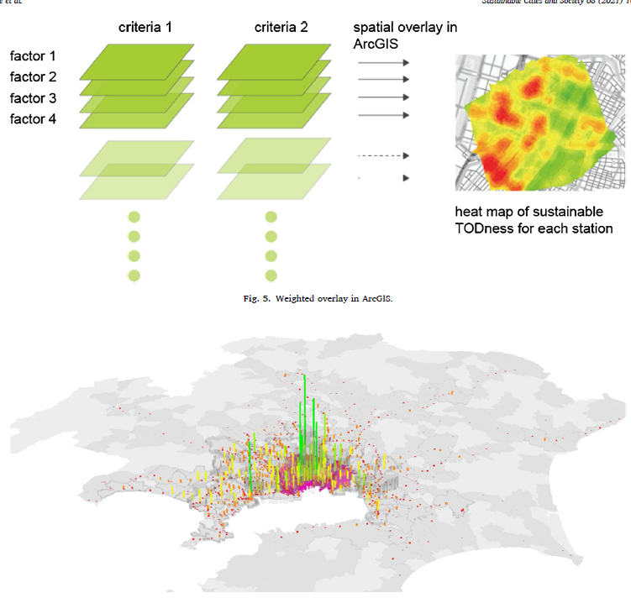

Slide 8
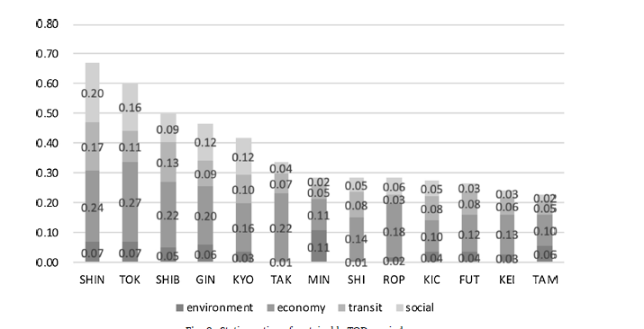
Ke at al.: Indicators

Slide 9
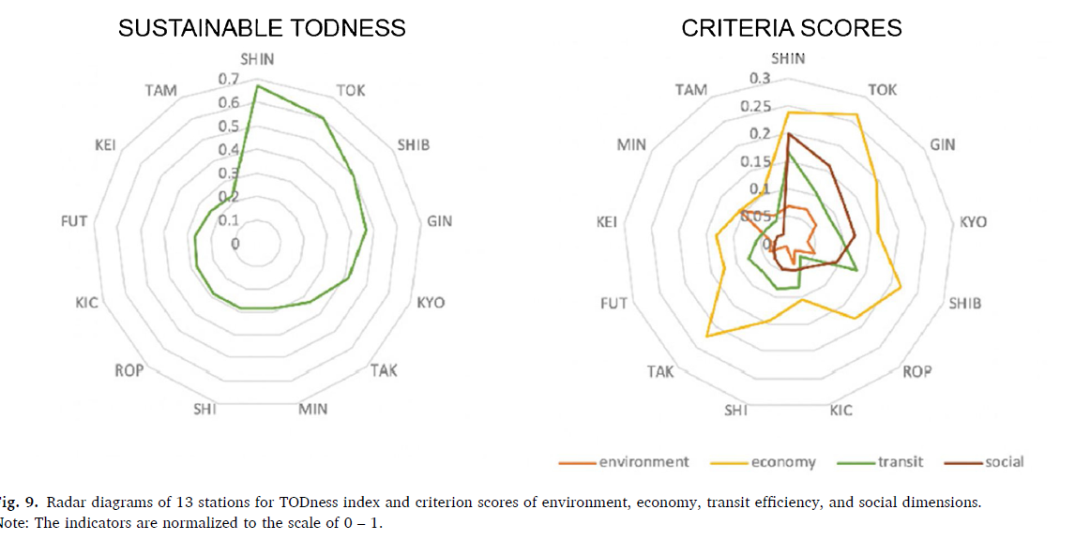
Ke at al.: Indicators

Slide 10
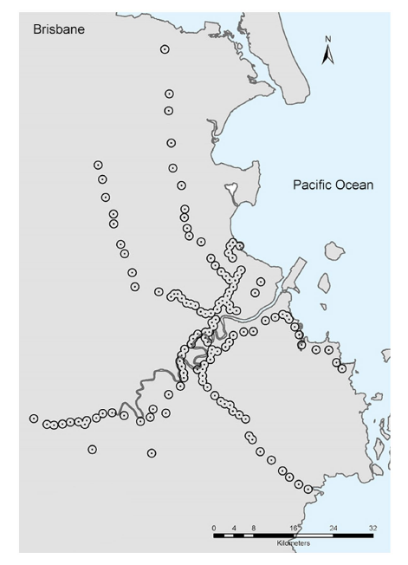
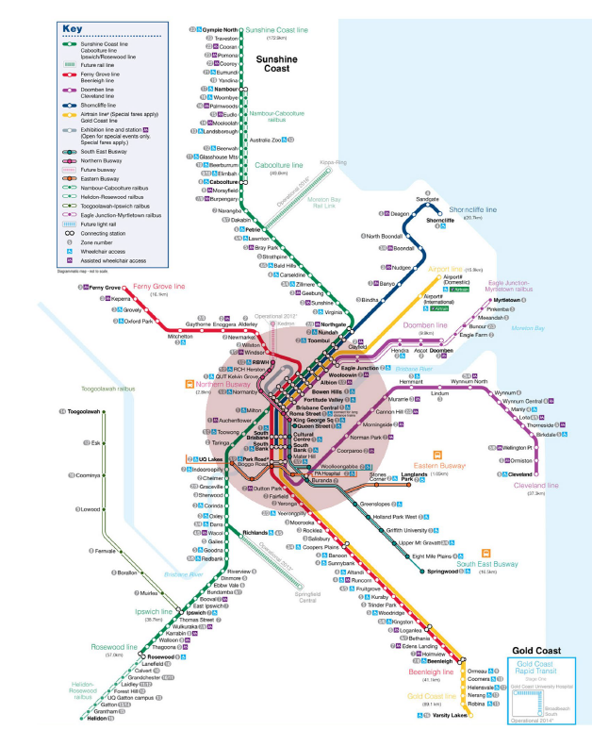
Yang and Pojani

Slide 11
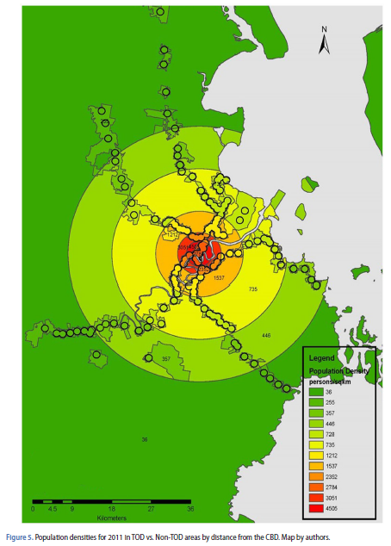
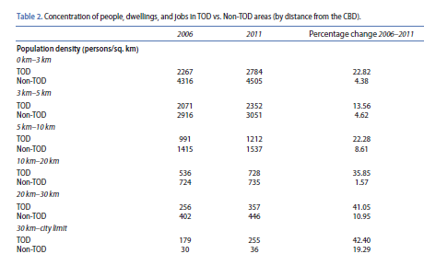
Yang and Pojani

Slide 12
Demand Forecasting Approaches
Demand studies for urban areas Developed in 1950s and 1960s Extensive databases, interview surveys
Demand studies for intercity travel Data is on a larger scale than urban (city population, average city income, travel time) Garber and Hoel Traffic & Highway Engineering (5e, 2015) , chapter 12 McDonald and McMillen Urban Economics and Real Estate (2e, 2011), Chapter 16

Slide 13
Factors Influencing Travel Demand
Location and intensity of land use Primary determinant of travel demand
Socioeconomic characteristics of inhabitants
Lifestyles and values influence the demand for transportation (public transportation vs own vehicle)
Extent, cost, and quality of transportation services
Supply and demand of resources

Slide 14
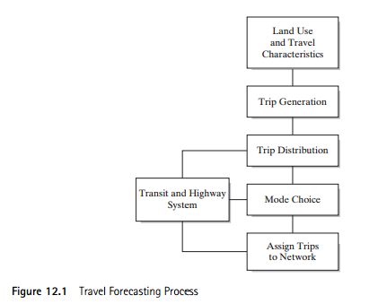
Sequential Steps for Travel Forecasting
“Four-step” model

Slide 15
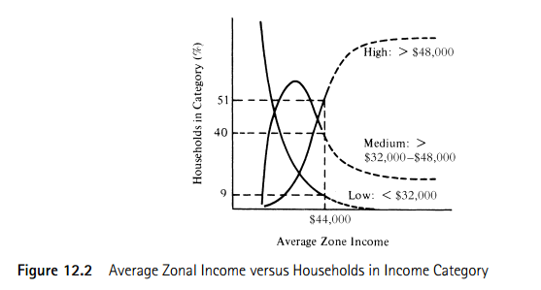
Trip Generation
Two Functions
1) Develop relationship between trip end production or attraction and land use
2) Use the relationship to estimate the number of trips generated in the future

Slide 16
Trip Distribution
Process by which the trips generated in one zone are allocated to other zones within the study area (internal-internal or internal-external)
Most widely used and documented distribution model is the gravity model

Slide 17
Gravity Models
Gravitational Force (Newton) Based on mass (attraction) Declines with distance

Slide 18
“Newtonian” Gravity
Example: Jupiter mass = 318 x Earth’s mass
But 5.2 times further away
→ Which planet does the Sun attract most?

Slide 19
“Newtonian” Gravity
GM1M2/D^2
4.15E+25 | Jupiter
3.54E+24 | Earth
11.71 | Ratio
G | M1 | M2 | d
6.67E-11 | 1.99E+30 |  |  | Sun
 |  | 1.90E+27 | 7.79E+10 | Jupiter
 |  | 5.97E+24 | 1.50E+10 | Earth
Force on Jupiter =
12x force on Earth

Slide 20
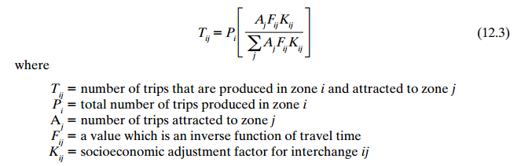
The Gravity Model

Slide 21
Econometric Gravity Model
Log-Linear:
O_{i} = # trips with i as origin
D_{j} = # trips with j as destination

