Slide 1

Inheritance
Tutorial 5
1500 JavaScript and AJAX- Comprehensive

Slide 2

Objectives
The concept most often discussed in relation to OO programming is inheritance. Many OO languages support two types of inheritance: interface inheritance, where only the method signatures are inherited, and implementation inheritance, where actual methods are inherited. Interface inheritance is not possible in ECMAScript, because, as mentioned previously, functions do not have signatures. Implementation inheritance is the only type of inheritance supported by ECMAScript, and this is done primarily through the use of prototype chaining.
As you already know, every function has a prototype property, which contains an object. When this function is invoked using the new operator, an object is created and this object has a secret link to the prototype object. The secret link (called __proto__ in some environments) allows methods and properties of the prototype object to be used as if they belong to the newly-created object.
For a recap :
1500 JavaScript and AJAX- Comprehensive
Tutorial 5

Slide 3


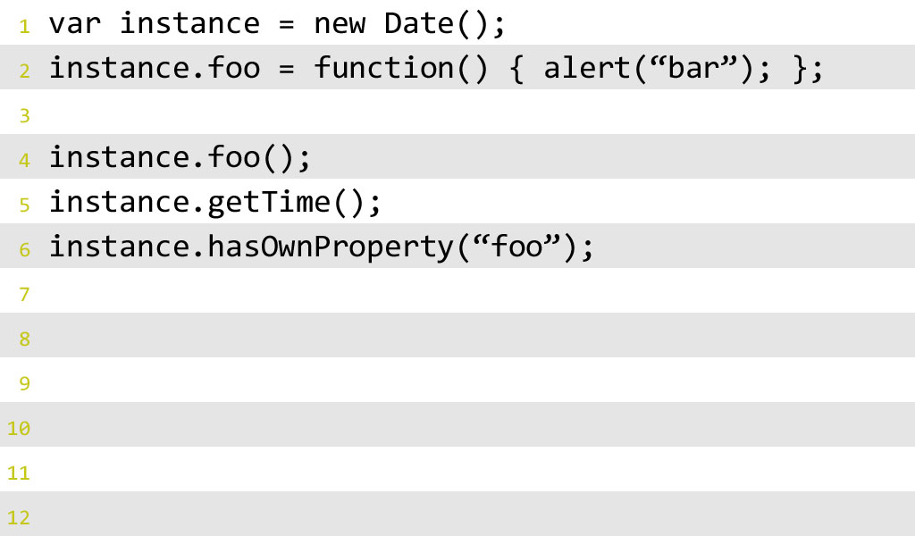
instance
Date
Object
JavaScript and AJAX- Comprehensive
Tutorial 5

Slide 4


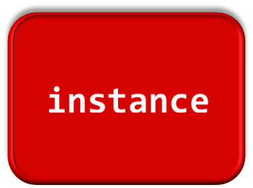

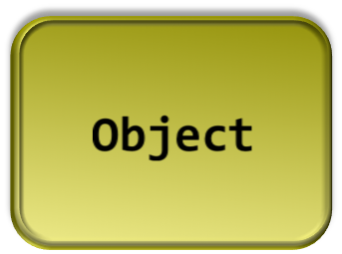
JavaScript and AJAX- Comprehensive
Tutorial 5
Notes:
Look up instance.foo
JS finds it on the var itself
Stops looking

Slide 5

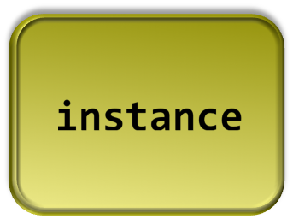

JavaScript and AJAX- Comprehensive
Tutorial 5
Notes:
Lookup instance.getTime
Doesn’t find it on the var
Finds it on Date
Stops looking

Slide 6

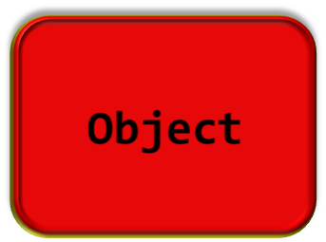
Property look Up Chain
JavaScript and AJAX- Comprehensive
Tutorial 5
Notes:
Lookup instance.hasOwnProperty
Doesn’t find it on var
Doesn’t find it on Date
Finds it on Object

Slide 7
Property look Up Chain With prototypes
In this illustration, an object A contains a number of properties. One of the properties is the hidden __proto__ property, which points to another object, B. B's __proto__ property points to C. This chain ends with the Object object, which is the highest-level parent, and every object inherits from it.
This is all good to know, but how does it help us? The practical side is that when object A lacks a property but B has it, A can still access this property as its own. The same applies if B also doesn't have the required property, but C does. This is how inheritance takes place: an object can access any property found somewhere up the inheritance chain.
C_proto_
B_proto_
A_proto_
1500 JavaScript and AJAX- Comprehensive
Tutorial 5

Slide 8
Prototype Chaining Example
Prototype chaining is the default way to implement inheritance, and is described in the ECMAScript standard. In order to implement our hierarchy, let's define three constructor functions.
  function Shape(){
  this.name = 'shape';
  this.toString = function() {return this.name;};
  }
  function TwoDShape(){
  this.name = '2D shape';
  }
  function Triangle(side, height) {
  this.name = 'Triangle';
  this.side = side;
  this.height = height;
  this.getArea = function(){return this.side * this.height / 2;};
  }
  TwoDShape.prototype = new Shape(); // It actual
  Triangle.prototype = new TwoDShape();
  var trianagle1 = new Triangle();
  trianagle1.toString();
1500 JavaScript and AJAX- Comprehensive
Tutorial 5

Slide 9
Prototype Chaining Example
What is happening here? You take the object contained in the prototype property of TwoDShape and instead of augmenting it with individual properties, you completely overwrite it with another object, created by invoking the Shape() constructor with new. The same for Triangle: its prototype is replaced with an object created by new TwoDShape(). The important thing to note, especially if you are already familiar with a language such as Java, C++, or PHP, is that JavaScript works with objects, not classes. You need to create an instance using the new Shape() constructor and after that you can inherit its properties; you don't inherit from Shape() directly. Additionally, after inheriting, you can modify Shape(), overwrite it or even delete it, and this will have no effect on TwoDShape, because all you needed was one instance to inherit from.
Lets see what happens now:
var my = new Triangle(5, 10);
my.getArea(); //25
my.toString(); //25
Although the my object doesn't have its own toString() method, it inherited one and can call it. Note how the inherited method toString() binds the this object to my.
1500 JavaScript and AJAX- Comprehensive
Tutorial 5

Slide 10
Prototype Chaining Example
It's interesting to note what the JavaScript engine does when you call my.toString():
It loops through all of the properties of my and doesn't find a method called toString().
It looks at the object that my.__proto__ points to; this object is the instance new TwoDShape() created during the inheritance process.
Now the JavaScript engine loops through the instance of TwoDShape and doesn't find a toString() method. It then checks the __proto__ of that object. This time __proto__ points to the instance created by new Shape().
The instance of new Shape() is examined and toString() is finally found!
This method is invoked in the context of my, meaning that this points to my.
1500 JavaScript and AJAX- Comprehensive
Tutorial 5

Slide 11
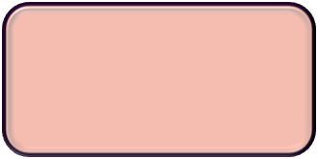
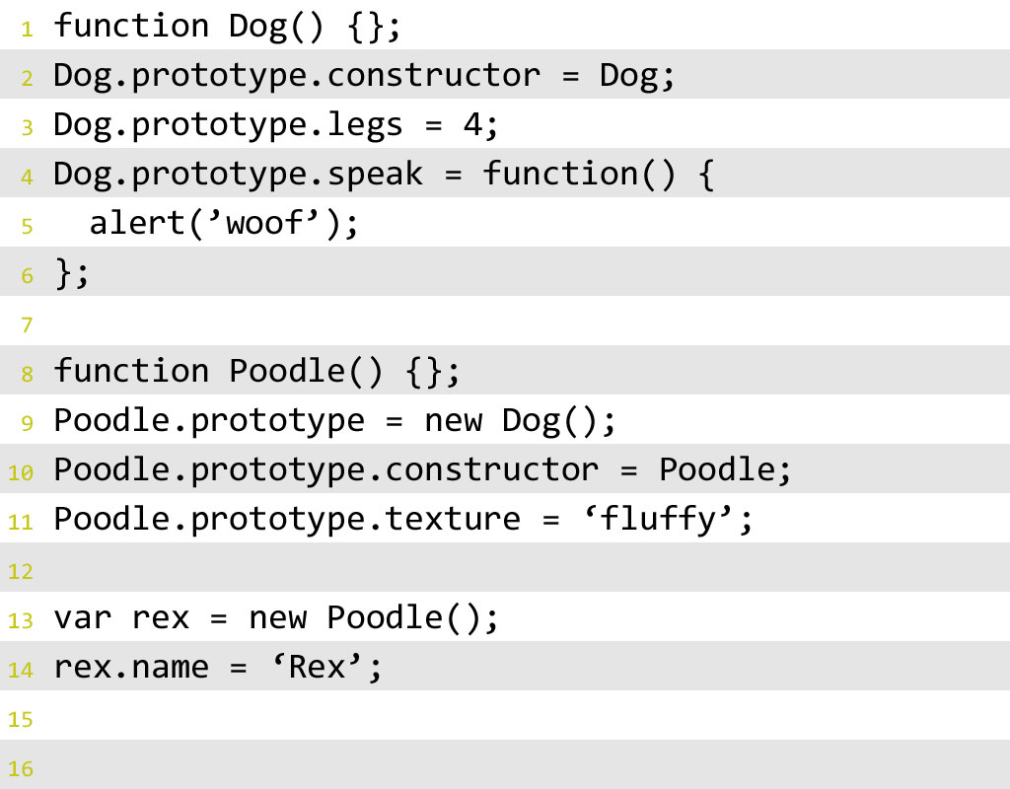



Anatomy of a prototype
rex
Poodle
Dog
Object
1500 JavaScript and AJAX- Comprehensive
Tutorial 5
Notes:
More complicated example
Rex is var instance of Poodle
Poodle prototype = Dog
Dog prototype = Object

Slide 12
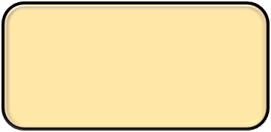
Anatomy of a prototype
Constructor
1500 JavaScript and AJAX- Comprehensive
Tutorial 5
Notes:
Closer look at Dog
Function
All functions have prototype property
Prototype defaults to Object
Constructor is Function paired with NEW operator
Used to create instances

Slide 13
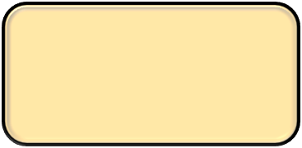

Anatomy of a prototype
Property
Method
1500 JavaScript and AJAX- Comprehensive
Tutorial 5
Notes:
Dog’s prototype property used to build the template
Functions on a prototype are methods
Non-functions on a prototype are properties
Anything defined on function’s prototype available to instances

Slide 14



Anatomy of Prototype
Constructor
Inheritance
1500 JavaScript and AJAX- Comprehensive
Tutorial 5
Notes:
Poodle is second type
Function, just like Dog
Inheritance
Set Poodle.prototype to new instance of Dog
Creates link between Poodle and Dog in PLC
Create properties on Poodle.prototype
Available to instances of Poodle

Slide 15
Anatomy of Prototype
Instance
Instance Property
1500 JavaScript and AJAX- Comprehensive
Tutorial 5
Notes:
Rex is instance of Poodle
Property “name” defined on rex – instance property
Has access to all of Poodle’s prototype properties
And to other properties up PLC

Slide 16
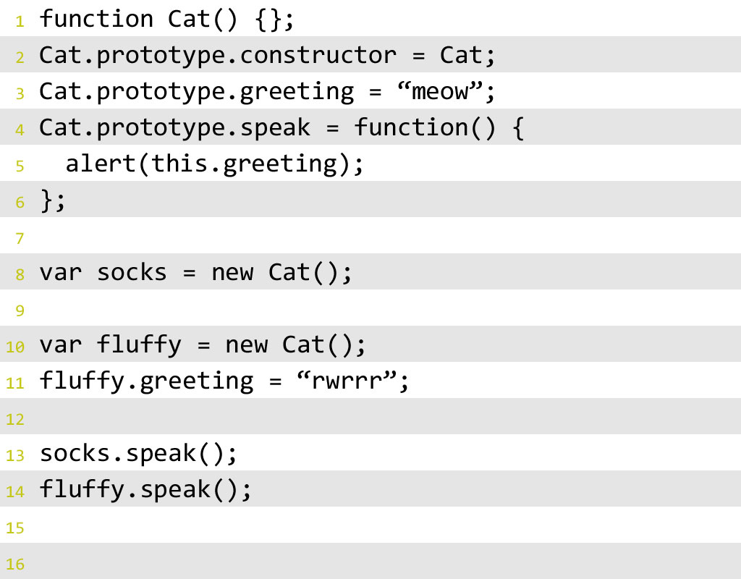




Anatomy of Prototype
socks
fluffy
Cat
Object
1500 JavaScript and AJAX- Comprehensive
Tutorial 5
Notes:
Probably recognize THIS operator
Look at how THIS interacts with prototype
In example:
Socks and fluffy both instances of Cat
Cat inherits from Object

Slide 17

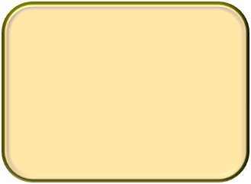



Anatomy of Prototype
socks
Cat
Object
1500 JavaScript and AJAX- Comprehensive
Tutorial 5
Notes:
When call socks.speak
Finds speak property on Cat.prototype
Inside of speak, encounter THIS
Properties on THIS walk PLC starting at instance
Greeting not a property of socks instance
Greeting is a property of Cat prototype

Slide 18
Anatomy of Prototype
fluffy
Cat
Object
1500 JavaScript and AJAX- Comprehensive
Tutorial 5
Notes:
When call fluffy.speak
Speak function found on Cat.prototype, same as socks
Unlike socks, fluffy has own greeting property
lookup stops at instance

Slide 19
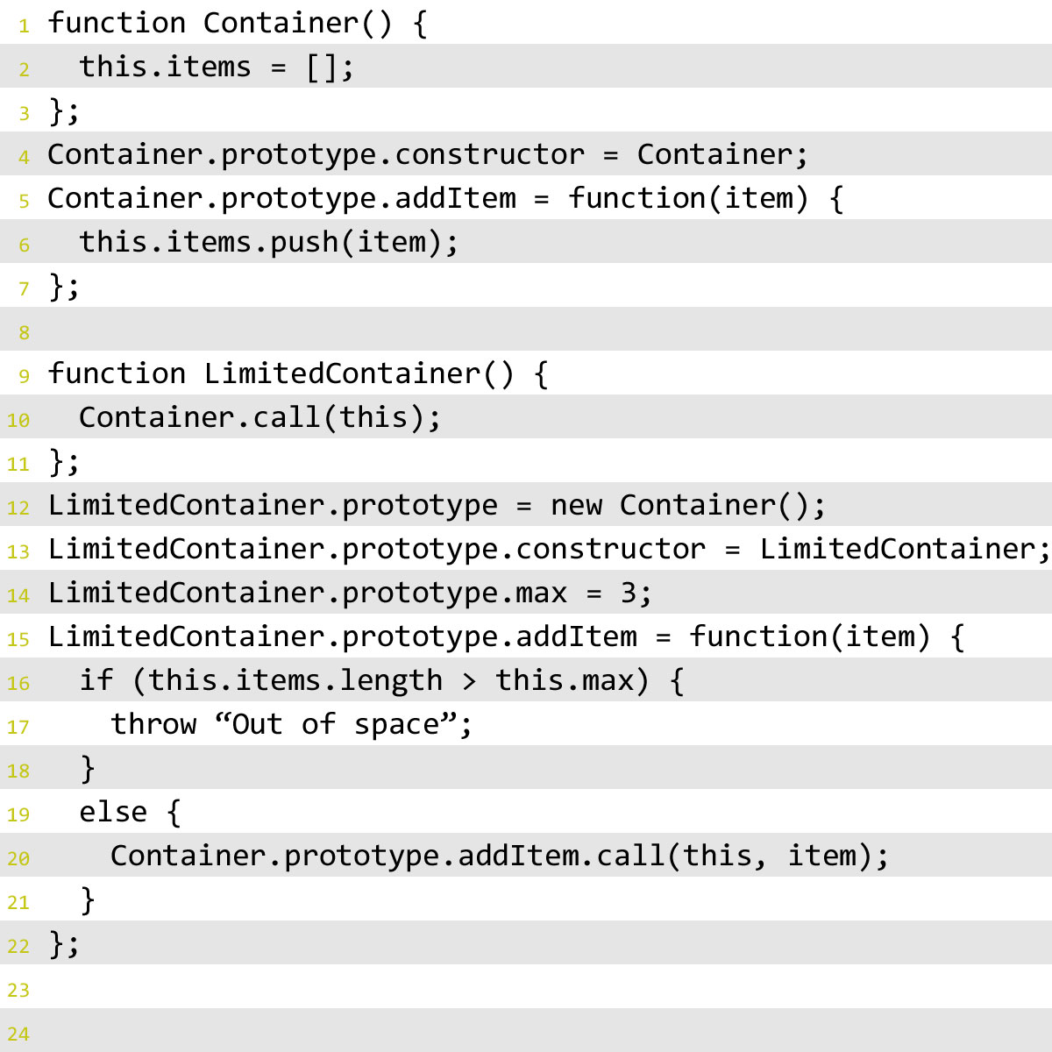
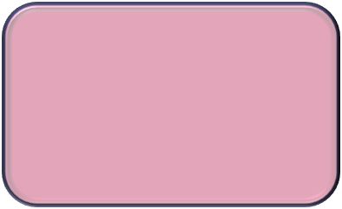
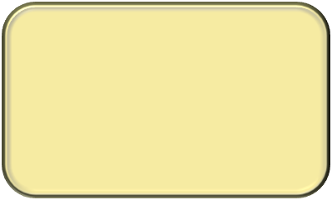

Working with Inherited Behavior
LimitedContainer
Container
Object
1500 JavaScript and AJAX- Comprehensive
Tutorial 5
Notes:
In example:
Container type has
array that it can store items in
Method to add items
inherits from Object
LimitedContainer
Inherits from Container
Changes inherited behavior to limit how many items can be in array

Slide 20
Working with Inherited Behavior
LimitedContainer
Container
Object
1500 JavaScript and AJAX- Comprehensive
Tutorial 5
Notes:
Behavior in Container constructor creates items array
To get LC to also have that behavior
CALL Container constructor with THIS as exec context within LC constructor

Slide 21
Working with Inherited Behavior
LimitedContainer
Container
Object
1500 JavaScript and AJAX- Comprehensive
Tutorial 5
Notes:
Container’s addItem method just pushes into array
Want to set a limit to how many items can be in array
Define new addItem method on LC prototype
The new addItem is higher in the PLC, so it will be found before old one
Add logic into new method to throw error if there are too many items
CALL Container’s addItem method with THIS as exec context to get original behavior

Slide 22

Prototypes do good things…
1500 JavaScript and AJAX- Comprehensive
Tutorial 5

Slide 23

Encourage Modularity and Reusability
1500 JavaScript and AJAX- Comprehensive
Tutorial 5

Slide 24

Keep Code to Minimum.
1500 JavaScript and AJAX- Comprehensive
Tutorial 5
Notes:
Code you write
Code loaded in memory
Moving Shared Properties to the Prototype
When you create objects using a constructor function, own properties are added using this. This could be inefficient in cases where properties don't change across instances. In the example above, Shape() was defined like so:
function Shape(){
this.name = 'shape';
}
This means that every time you create a new object using new Shape() a new name property will be created and stored somewhere in memory. The other option is to have the name property added to the prototype and shared among all the instances:
function Shape(){}
Shape.prototype.name = 'shape';
Now every time you create an object using new Shape(), this object will not have its own property name, but will use the one added to the prototype. This is more efficient, but you should only use it for properties that don't change from one instance to another. Methods are ideal for this type of sharing

Slide 25
JavaScript in Web Browsers
The first four tutorials described the core JavaScript language .
We now move on to JavaScript as used within web browsers, commonly called client-side JavaScript. Most of the examples we’ve seen so far, while legal JavaScript code, have no particular context; they are JavaScript fragments that run in no specified environment. This tutorial provides that context.
Before we begin talking about JavaScript, it is worth thinking about the web pages we display in web browsers.
Some pages present static information and can be called documents. (The presentation of that static information may be fairly dynamic— because of JavaScript—but the information itself is static.)
Other web pages feel more like applications than documents. These pages might dynamically load new information as needed, they might be graphical rather than textual, and they might operate offline and save data locally so they can restore your state when you visit them again.
Still other web pages sit somewhere in the middle of the spectrum and combine features of both documents and application
1500 JavaScript and AJAX- Comprehensive
Tutorial 5

Slide 26
Client – Side Java Script
The Window object is the main entry point to all client-side JavaScript features and APIs.
It represents a web browser window or frame, and you can refer to it with the identifier window . The Window object defines properties like location , which refers to a Location object that specifies the URL currently displayed in the window and allows a script to load a new URL into the window. // window.location = http://www.yahoo.com.
In client-side JavaScript, the Window object is also the global object. This means that the Window object is at the top of the scope chain and that its properties and methods are effectively global variables and global functions.
The Window object has a property named window that always refers to itself. You can use this property if you need to refer to the window object itself, but it is not usually necessary to use window if you just want to refer to access properties of the global window object.
Then comes the document which is again one of the most important properties of the document object.
The Document object has important methods such as getElementById() , which returns a single document element (representing an open/close pair of HTML tags and all of the content between them) based on the value of its id attribute.
Techniques for querying, traversing, and modifying document content would be covered while discussing DOM.
1500 JavaScript and AJAX- Comprehensive
Tutorial 5

Slide 27
Client – Side Java Script
Each Element object has style and className properties that allow scripts to specify CSS styles for a document element or to alter the CSS class names that apply to the element. The style and className properties, as well as other techniques for scripting CSS would be covered in tutorial 8.
Another set of important properties on Window, Document, and Element objects are the event handler properties. These allow scripts to specify functions that should be invoked asynchronously when certain events occur. Event handlers allow JavaScript code to alter the behavior of windows, of documents, and of the elements that make up those documents. This would be covered in the next tutorial.
A JavaScript program can traverse and manipulate document content through the Document object and the Element objects it contains. It can alter the presentation of that content by scripting CSS styles and classes. And it can define the behavior of document elements by registering appropriate event handlers. The combination of scriptable content, presentation, and behavior is called Dynamic HTML or DHTML.
1500 JavaScript and AJAX- Comprehensive
Tutorial 5

Slide 28
The Browser Object Model
Tutorial 5
1500 JavaScript and AJAX- Comprehensive

Slide 29
Objectives
Understanding the window object, the core of the BOM
Controlling windows, frames, and pop-ups
Page information from the location object
Using the navigator object to learn about the browser
1500 JavaScript and AJAX- Comprehensive
Tutorial 5

Slide 30
Introduction
The BOM provides objects that expose browser functionality independent of any web page content.
For years, a lack of any real specification made the BOM both interesting and problematic, because browser vendors were free to augment it as they saw fit.
At the core of the BOM is the window object, which represents an instance of the browser.
The window object serves a dual purpose in browsers, acting as the JavaScript interface to the browser window and the ECMAScript Global object.
1500 JavaScript and AJAX- Comprehensive
Tutorial 5

Slide 31
THE WINDOW OBJECT
This means that every object, variable, and function defined in a web page uses window as its Global object and has access to methods like parseInt() and alert() and the setInterval() etc. methods.
Being a global object means that the Window object is at the top of the scope chain and that its properties and methods are effectively global variables and global functions.
The Window object has a property named window that always refers to itself.
But it is not usually necessary to use window if you just want to refer to access properties of the global window object.
1500 JavaScript and AJAX- Comprehensive
Tutorial 5

Slide 32
Global Scope
Since the window object doubles as the ECMAScript Global object, all variables and functions declared globally become properties and methods of the window object.
Another thing to keep in mind: attempting to access an undeclared variable throws an error, but it is possible to check for the existence of a potentially undeclared variable by looking on the window object.
//this throws an error because is undeclared
var newValue = oldValue;
//this doesn’t throw an error, because it’s a property lookup
//newValue is set to undefined
var newValue = window.oldValue;
1500 JavaScript and AJAX- Comprehensive
Tutorial 5

Slide 33
Navigating and Opening Windows
The window.open() method can be used both to navigate to a particular URL and to open a new browser window.
This method accepts four arguments: the URL to load, the window target, a string of features, and a Boolean value indicating that the new page should take the place of the currently loaded page in the browser history.
If the second argument passed to window.open() is the name of a window or frame that already exists, then the URL is loaded into the window or frame with that name.
//same as <a href=”http://www.wrox.com” target=”topFrame”></a>
window.open(“http://www.wrox.com/”, “topFrame”);
This line of code acts as if the user clicked a link with the href attribute set to http://www.wrox.com and the target attribute set to “topFrame”. If there is a window or frame named “topFrame”, then the URL will be loaded there; otherwise, a new window is created and given the name “topFrame”. The second argument may also be any of the special window names: _self, _parent, _top, or _blank.
1500 JavaScript and AJAX- Comprehensive
Tutorial 5

Slide 34
Popping Up Windows
When the second argument doesn’t identify an existing window or frame, a new window or tab is created based on a string passed in as the third argument. If the third argument is missing, a new browser window (or tab, based on browser settings) is opened with all of the default browser window settings. (Toolbars, the location bar, and the status bar are all set based on the browser’s default settings.) The third argument is ignored when not opening a new window.
The third argument is a comma-delimited string of settings indicating display information for the new window.
window.open(“http://www.wrox.com/”,”wroxWindow”, “height=400,width=400,top=10,left=10,resizable=yes”);
The window.open() method returns a reference to the newly created window. This object is the same as any other window object except that you typically have more control over it. For instance, some browsers that don’t allow you to resize or move the main browser window by default may allow you to resize or move windows that you’ve created using window.open().
1500 JavaScript and AJAX- Comprehensive
Tutorial 5

Slide 35
The window opened by window.open() methid can also be closed by closed method as mentioned below:
var wroxWin =window.open(“http://www.wrox.com/”,”wroxWindow”,
“height=400,width=400,top=10,left=10,resizable=yes”);
wroxWin.close();
The newly created window object has a reference back to the window that opened it via the opener property. This property is defined only on the topmost window object (top) of the pop-up window and is a pointer to the window or frame that called window.open().
alert(wroxWin.opener == window); //true
Even though there is a pointer from the pop-up window back to the window that opened it, there is no reverse relationship. Windows do not keep track of the pop-ups that they spawn, so it’s up to you to keep track if necessary.
1500 JavaScript and AJAX- Comprehensive
Tutorial 5

Slide 36
Security Restrictions
Pop-up windows went through a period of overuse by advertisers online.
Pop-ups were often disguised as system dialogs to get the user to click on an advertisement.
Since these pop-up web pages were styled to look like system dialogs, it was unclear to the user whether the dialog was legitimate.
To aid in this determination, browsers began putting limits on the configuration of pop-up windows.
Firefox 3 forces the location bar to always be displayed on pop-up windows. Opera opens pop-up windows only within its main browser window but doesn’t allow them to exist where they might be confused with system dialogs.
Additionally, browsers will allow the creation of pop-up windows only after a user action. A call to window.open() while a page is still being loaded, for instance, will not be executed and may cause an error to be displayed to the user. Pop-up windows may be opened based only on a click or a key press.
Chrome uses a different approach to handling pop-up windows that aren’t initiated by the user. Instead of blocking them, the browser displays only the title bar of the pop-up window and places it in the lower-right corner of the browser window.
1500 JavaScript and AJAX- Comprehensive
Tutorial 5

Slide 37
Pop Up Blockers
Most browsers have pop-up–blocking software built in, and for those that don’t, utilities such as the Yahoo! Toolbar have built-in pop-up blockers.
The result is that most unexpected pop-ups are blocked.
When a pop-up is blocked, one of two things happens:
If the browser’s built-in pop-up blocker stopped the pop-up, then window.open() will most likely return null. In that case, you can tell if a pop-up was blocked by checking the return value, as shown in the following example:
  var wroxWin = window.open(“http://www.wrox.com”, “_blank”);
  if (wroxWin == null){
  alert(”The popup was blocked!”);
  }
When a browser add-on or other program blocks a pop-up, window.open() typically throws an error.
1500 JavaScript and AJAX- Comprehensive
Tutorial 5

Slide 38
Intervals and Timeouts
JavaScript execution in a browser is single-threaded, but does allow for the scheduling of code to run at specific points in time through the use of timeouts and intervals.
Timeouts execute some code after a specified amount of time, whereas intervals execute code repeatedly, waiting a specific amount of time in between each execution.
Intervals work in the same way as timeouts except that they execute the code repeatedly at specific time intervals until the interval is canceled or the page is unloaded.
. The difference between setTimeout and setInterval is that setTimeout performs an action only once once after the specified time period elapses, and setInterval keeps repeating the action. The actions started by setTimeout and setInterval can be stopped by using the methods clearTimeout and clearInterval respectively
The setInterval() method lets you set up intervals, and it accepts the same arguments as setTimeout(): the code to execute (string or function) and the milliseconds to wait between executions.
Both setInterval and setTimeOut mehtods return an interval ID which can be used to cancel the interval at some point in the future.
1500 JavaScript and AJAX- Comprehensive
Tutorial 5

Slide 39
System Dialogs
The browser is capable of invoking system dialogs to display to the user through the alert(), confirm(), and prompt() methods.
These dialogs are not related to the web page being displayed in the browser and do not contain HTML.
Their appearance is determined by operating system and/ or browser settings rather than CSS.
Additionally, each of these dialogs is synchronous and modal, meaning code execution stops when a dialog is displayed, and resumes after it has been dismissed.
Alert dialogs are typically used when users must be made aware of something that they have no control over, such as an error. A user’s only choice is to dismiss the dialog after reading the message.
A confirm dialog looks similar to an alert dialog in that it displays a message to the user. The main difference between the two is the presence of a Cancel button along with the OK button, which allows the user to indicate if a given action should be taken.
The final type of dialog is displayed by calling prompt(), which prompts the user for input. Along with OK and Cancel buttons, this dialog has a text box where the user may enter some data.
1500 JavaScript and AJAX- Comprehensive
Tutorial 5

Slide 40
THE LOCATION OBJECT
Provides information about the document that is currently loaded in the window, as well as general navigation functionality.
The location object is unique in that it is a property of both window and document; both window.location and document.location point to the same object.
It also parses the URL into discrete segments that can be accessed via a series of properties.
Most of the information in location is easily accessible from these properties. The one part of the URL that isn’t provided is an easy-to-use query string.
1500 JavaScript and AJAX- Comprehensive
Tutorial 5

Slide 41
Manipulating the Location
The browser location can be changed in a number of ways using the location object.
Assign() method. //location.assign(“http://www.gmail.com”);
location.href or window.location can be set to a URL
window.location = http://www.wrox.com; location.href = “http: www.wrox.com”;
Of these three approaches to changing the browser location, setting location.href is most often seen in code.
When the URL is changed using one of the previously mentioned approaches, an entry is made in the browser’s history stack so the user may click the Back button to navigate to the previous page.
It is possible to disallow this behavior by using the replace() method.
This method accepts a single argument, the URL to navigate to, but does not make an entry in the history stack.
reload(), which reloads the currently displayed page. if specified an argument true it is forced to go to the server to reload itself.
1500 JavaScript and AJAX- Comprehensive
Tutorial 5

Slide 42

The Navigator Object
Scripts sometimes need to obtain information about the web browser in which they are running or the desktop on which the browser appears. This section describes the navigator and screen properties of the Window object. Those properties refer to Navigator and Screen objects, respectively, and these objects provide information that allows a script to customize its behavior based on its environment.
The navigator object is the standard for browse identification on the client
Navigator object is common among all JavaScript-enabled web browsers.
In the past, the Navigator object was commonly used by scripts to determine if they were running in Internet Explorer or Netscape.
This “browser-sniffing” approach is problematic because it requires constant tweaking as new browsers and new version of existing browsers are introduced.
The better approach is feature testing.
Browser sniffing is sometimes still valuable, however, such as when you need to work around a specific bug that exists in a specific version of a specific browser.
1500 JavaScript and AJAX- Comprehensive
Tutorial 5

Slide 43
The Navigator Object
The Navigator object has four properties that provide information about the browser that is running, and you can use these properties for browser sniffing:
appName:
The full name of the web browser. In IE, this is “Microsoft Internet Explorer”. In Firefox, this property is “Netscape”. For compatibility with existing browsersniffing code, other browsers often report the name “Netscape” as well.
appVersion :
This property typically begins with a number and follows that with a detailed string that contains browser vendor and version information. The number at the start of this string is often 4.0 or 5.0 to indicate generic compatibility with fourth- and fifth generation browsers. There is no standard format for the appVersion string, so parsing it in a browser-independent way isn’t possible.
1500 JavaScript and AJAX- Comprehensive
Tutorial 5

Slide 44
The Navigator Object
userAgent :
The string that the browser sends in its USER-AGENT HTTP header. This property typically contains all the information in appVersion and may contain additional details as well. Like appVersion, there is no standard format. Since this property contains the most information, browser-sniffing code typically uses it.
platform :
A string that identifies the operating system (and possibly the hardware) on which the browser is running.
The complexity of the Navigator properties demonstrates the futility of the browser sniffing approach to client-side compatibility. In the early days of the Web, lots of browser-specific code was written that tested properties like navigator.appName. As new browsers were written, vendors discovered that in order to correctly display existing websites, they had to set the appName property to “Netscape”. A similar process caused the number at the start of the appVersion to lose meaning, and today browser-sniffing code must rely on the navigator.userAgent string and is more complicated than it once was.
1500 JavaScript and AJAX- Comprehensive
Tutorial 5

Slide 45
The Navigator Object
onLine
The navigator.onLine property (if it exists) specifies whether the browser is currently connected to the network. Applications may want to save state locally while they are offline.
geolocation
A Geolocation object that defines an API for determining the user’s geographical location.
javaEnabled()
A nonstandard method that should return true if the browser can run Java applets.
cookiesEnabled()
A nonstandard method that should return true if the browser can store persistent cookies. May not return the correct value if cookies are configured on a site-by-site basis.
1500 JavaScript and AJAX- Comprehensive
Tutorial 5

Slide 46
Detecting Plug-ins
One of the most common detection procedures is to determine whether the browser has a particular plug-in installed.
For browsers other than Internet Explorer, this can be determined using the plugins array. Each item in the array contains the following properties:
name — The name of the plug-in
description — The description of the plug-in
filename — The fi lename for the plug-in
length — The number of MIME types handled by this plug-in.
Typically, the name contains all of the information that’s necessary to identify a plug-in, though this is not an exact science.
1500 JavaScript and AJAX- Comprehensive
Tutorial 5

Slide 47
THE SCREEN OBJECT
The screen object (also a property of window) is one of the few JavaScript objects that have little to no programmatic use; it is used purely as an indication of client capabilities.
The screen property of a Window object refers to a Screen object that provides information about the size of the user’s display and the number of colors available on it. The width and height properties specify the size of the display in pixels. The availWidth and availHeight properties specify the display size that is actually available; they exclude the space required by features such as a desktop taskbar. The colorDepth property specifies the bits-per-pixel value of the screen. Typical values are 16, 24, and 32.
The window.screen property and the Screen object to which it refers are both nonstandard but widely implemented. You might use the Screen object to determine whether your web app is running in a small form factor device such as a netbook computer. If screen space is limited, you might choose to use smaller fonts and images, for example.
1500 JavaScript and AJAX- Comprehensive
Tutorial 5

Slide 48
THE HISTORY OBJECT
The history object represents the user’s navigation history since the given window was first used. Because history is a property of window, each browser window, tab, and frame has its own history object relating specifically to that window object.
For security reasons, it’s not possible to determine the URLs that the user has visited.
It is possible, however, to navigate backwards and forwards through the list of places the user has been without knowing the exact URL.
The go() method navigates through the user’s history in either direction, backward or forward. This method accepts a single argument, which is an integer representing the number of pages to go backward or forward. A negative number moves backward in history (similar to clicking the browser’s Back button), and a positive number moves forward (similar to clicking the browser’s Forward button).
The go() method argument can also be a string, in which case the browser navigates to the first location in history that contains the given string.
1500 JavaScript and AJAX- Comprehensive
Tutorial 5

Slide 49
THE HISTORY OBJECT
Two shortcut methods, back() and forward(), may be used in place of go(). As you might expect, these mimic the browser Back and Forward buttons as follows:
  //go back one page
  history.back();
  //go forward one page
  history.forward();
The history object also has a property, length, which indicates how many items are in the history stack. This property reflects all items in the history stack, both those going backward and those going forward. For the fi rst page loaded into a window, tab, or frame, history.length is equal to 0. By testing for this value as shown here, it’s possible to determine if the user’s start point was your page:
  if (history.length == 0){
  //this is the first page in the user’s window
  }
1500 JavaScript and AJAX- Comprehensive
Tutorial 5

Slide 50
THE HISTORY OBJECT
Though not used very often, the history object typically is used to create custom Back and Forward buttons and to determine if the page is the first in the user’s history. HTML5 further augments the history object.
1500 JavaScript and AJAX- Comprehensive
Tutorial 5

Slide 51
Summary
The Browser Object Model (BOM) is based on the window object, which represents the browser window and the viewable page area. The window object doubles as the ECMAScript Global object, so all global variables and functions become properties on it, and all native constructors and functions exist on it initially. This chapter discussed the following elements of the BOM:
When frames are used, each frame has its own window object and its own copies of all native constructors and functions. Each frame is stored in the frames collection, indexed both by position and by name.
To reference other frames, including parent frames, there are several window pointers.
The top object always points to the outermost frame, which represents the entire browser window.
The parent object represents the containing frame, and self points back to window.
1500 JavaScript and AJAX- Comprehensive
Tutorial 5

Slide 52
Summary
The location object allows programmatic access to the browser’s navigation system. By setting properties, it’s possible to change the browser’s URL piece by piece or altogether.
The replace() method allows for navigating to a new URL and replacing the currently displayed page in the browser’s history.
The navigator object provides information about the browser. The type of information provided depends largely on the browser being used, though some common properties, such as userAgent, are available in all browsers.
Two other objects available in the BOM perform very limited functions. The screen object provides information about the client display. This information is typically used in metrics gathering for websites. The history object offers a limited peek into the browser’s history stack, allowing developers to determine how many sites are in the history stack and giving them the ability to go back or forward to any page in the history.
1500 JavaScript and AJAX- Comprehensive
Tutorial 5

