Slide 1
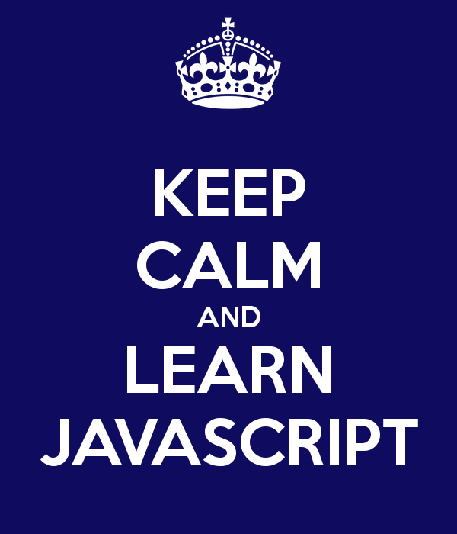

Slide 2
Before we start off.
Introduction.
Grading/ Assignments.
About the Class. [BASIC/ PROFESSIONAL]
Software Tools.[Web Storm, Eclipse, Aptana]
PACE.
Interview Preparation.
LABS.

Slide 3
Introducing JavaScript

Slide 4
What is Java Script Really ?
When introduced in 1995, its main purpose was to handle some of the input validation that had previously been left to server-side languages.
Now, it interacts with nearly all aspects of the browser window and its contents.
Now a full blown language with all the complex programming features.
Handles the complex calculations and is used in scripting nearly all the pages being produced at this point.

Slide 5
HISTORY OF JAVASCRIPT
Main Contributing companies : Sun, Netscape , Microsoft.
1992
Oak, Gosling at Sun & First Person [Startup for developing technology for interactive web applications for television].
1995
Hot Java
LiveScript, Branden Eich at Netscape.
1996
Jscript at Microsoft.
1998
ECMAScript
Notes:
In 1992 Jim Gosling is sitting in his office working on a language which would be a successor to C++. He was an smart man but wasn’t good at naming the languages which is apparent from the fact that he intended to call the language C++++.
His friends told him you cannot do that ao he looked out of the window, saw an oak tree and from that point his language was called OAK.
Then Gosling spun out to a start up called first person, a company which intended to create technology for interactive TV applications. OAK was to be used in those applications. That company failed and he eventually rolled back into SUN.
After having failed with interactive media they were sitting around trying to figure out what do they do with OAK.
While discussing it in a coffee shop they decided that the language needed a new name and at that point Jim looking at the menu, decided to call it JAVA. At the same time they decided that the first application that they would demonstrate this language would be a browser because WEB at that point in time was going hot and there was a huge hype around it.
They decided to name the browser HOT JAVA. Having the browser have the almost the same name as the language it was written in caused a confusion which worked in their favor since there was a huge hype around how wonderful the browsers were , how wonderful the HOT JAVA was that it gave an added advantage to the language itself.
Meanwhile at Netscape they were looking at JAVA and decided that this isn’t going to work in the webpages. It is way to heavy, it is way too clumsy to do APIs in Web Pages and to do Form Validations in the sort of applications that they had anticipated, they wanted something much much lighter.
Brenden Eich was at the Netscape at the time and his first idea was do a dialect or scheme type of a thing in the browser but his manager said no. There is no way market is going to accept those parenthesis. Just do something like Java or Visual Basic, nice little scripting language and we would let you do that. So he based his syntax and he created something which was called Livescript.
Livescript became the first scripting language to be put in the web browser and also became the first scripting language to be put in a webserver. The live wire platform the Netscape was developing was base upon the livescript.
The reason why Java and LiveScript was so popular at that time

Slide 6
By the Time it was….
2004
Notes:
In 1992 Jim Gosling is sitting in his office working on a language which would be a successor to C++. He was an smart man but wasn’t good at naming the languages which is apparent from the fact that he intended to call the language C++++.
His friends told him you cannot do that ao he looked out of the window, saw an oak tree and from that point his language was called OAK.
Then Gosling spun out to a start up called first person, a company which intended to create technology for interactive TV applications. OAK was to be used in those applications. That company failed and he eventually rolled back into SUN.
After having failed with interactive media they were sitting around trying to figure out what do they do with OAK.
While discussing it in a coffee shop they decided that the language needed a new name and at that point Jim looking at the menu, decided to call it JAVA. At the same time they decided that the first application that they would demonstrate this language would be a browser because WEB at that point in time was going hot and there was a huge hype around it.
They decided to name the browser HOT JAVA. Having the browser have the almost the same name as the language it was written in caused a confusion which worked in their favor since there was a huge hype around how wonderful the browsers were , how wonderful the HOT JAVA was that it gave an added advantage to the language itself.
Meanwhile at Netscape they were looking at JAVA and decided that this isn’t going to work in the webpages. It is way to heavy, it is way too clumsy to do APIs in Web Pages and to do Form Validations in the sort of applications that they had anticipated, they wanted something much much lighter.
Brenden Eich was at the Netscape at the time and his first idea was do a dialect or scheme type of a thing in the browser but his manager said no. There is no way market is going to accept those parenthesis. Just do something like Java or Visual Basic, nice little scripting language and we would let you do that. So he based his syntax and he created something which was called Livescript.
Livescript became the first scripting language to be put in the web browser and also became the first scripting language to be put in a webserver. The live wire platform the Netscape was developing was base upon the livescript.
The reason why Java and LiveScript was so popular at that time

Slide 7
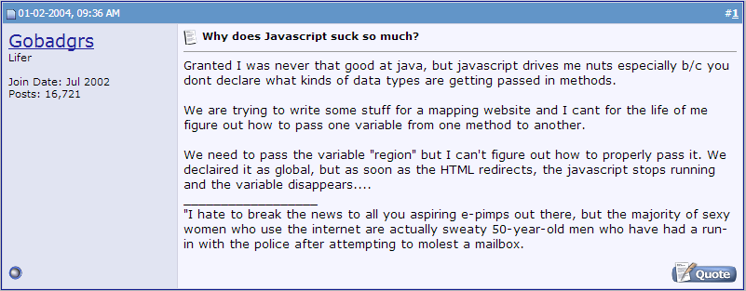
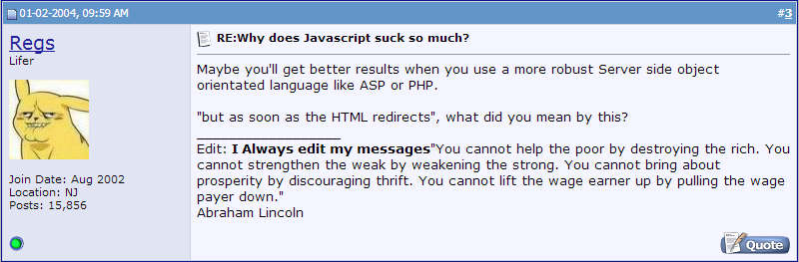

Slide 8
By the Time it was….
2005
Notes:
In 1992 Jim Gosling is sitting in his office working on a language which would be a successor to C++. He was an smart man but wasn’t good at naming the languages which is apparent from the fact that he intended to call the language C++++.
His friends told him you cannot do that ao he looked out of the window, saw an oak tree and from that point his language was called OAK.
Then Gosling spun out to a start up called first person, a company which intended to create technology for interactive TV applications. OAK was to be used in those applications. That company failed and he eventually rolled back into SUN.
After having failed with interactive media they were sitting around trying to figure out what do they do with OAK.
While discussing it in a coffee shop they decided that the language needed a new name and at that point Jim looking at the menu, decided to call it JAVA. At the same time they decided that the first application that they would demonstrate this language would be a browser because WEB at that point in time was going hot and there was a huge hype around it.
They decided to name the browser HOT JAVA. Having the browser have the almost the same name as the language it was written in caused a confusion which worked in their favor since there was a huge hype around how wonderful the browsers were , how wonderful the HOT JAVA was that it gave an added advantage to the language itself.
Meanwhile at Netscape they were looking at JAVA and decided that this isn’t going to work in the webpages. It is way to heavy, it is way too clumsy to do APIs in Web Pages and to do Form Validations in the sort of applications that they had anticipated, they wanted something much much lighter.
Brenden Eich was at the Netscape at the time and his first idea was do a dialect or scheme type of a thing in the browser but his manager said no. There is no way market is going to accept those parenthesis. Just do something like Java or Visual Basic, nice little scripting language and we would let you do that. So he based his syntax and he created something which was called Livescript.
Livescript became the first scripting language to be put in the web browser and also became the first scripting language to be put in a webserver. The live wire platform the Netscape was developing was base upon the livescript.
The reason why Java and LiveScript was so popular at that time

Slide 9
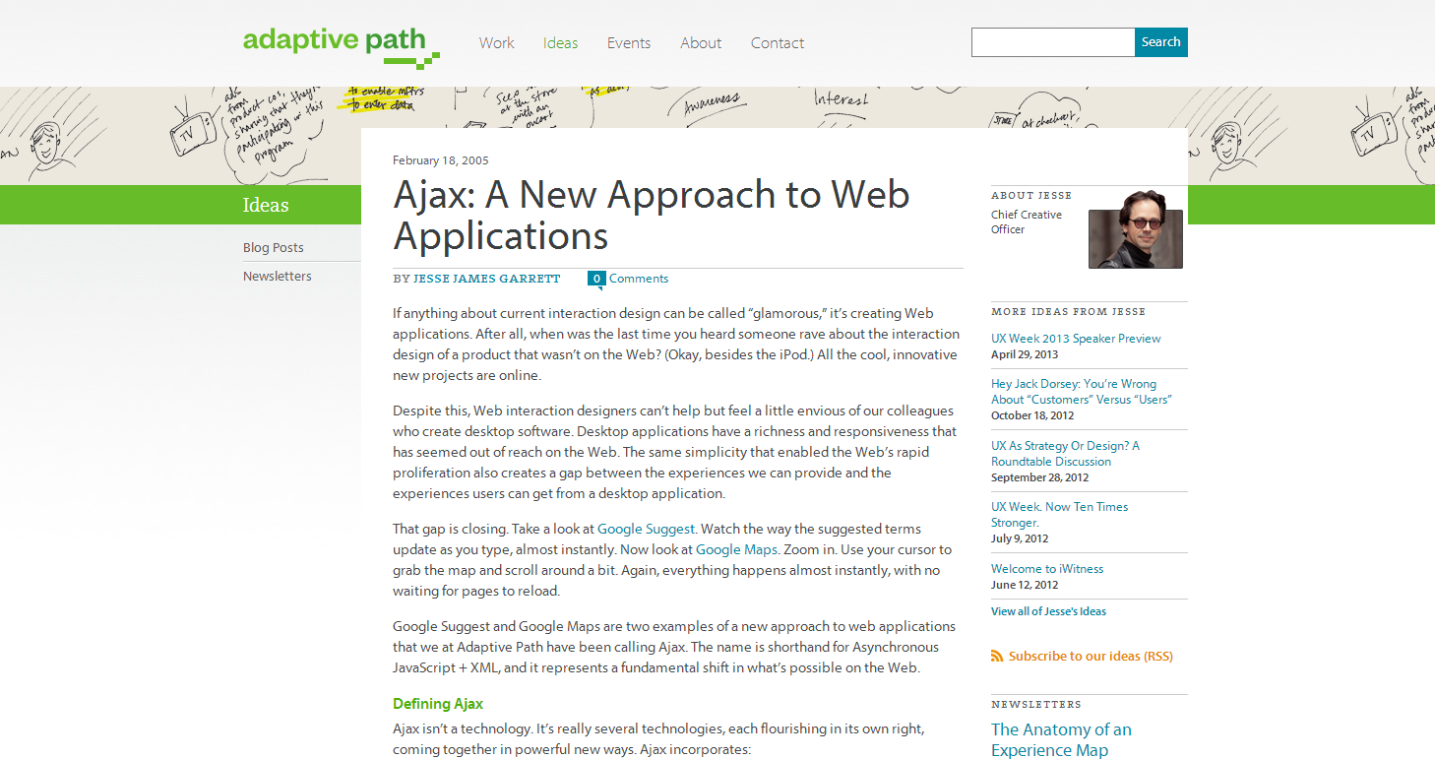
http://www.adaptivepath.com/ideas/ajax-new-approach-web-applications

Slide 10
A big change for JavaScript was the development of Ajax (Asynchronous JavaScript and XML). Ajax allowed developers to perform web requests as mentioned earlier, but instead of doing a full-page reload, they could asynchronously grab XML from a server and then cause the page to react. Later, developers started formatting data using the much-simpler JSON (JavaScript Object Notation). Today, JSON is virtually the only format used. We still use the term Ajax to refer to this functionality because the object used for this task is called XMLHttpRequest, but it doesn’t require XML.
Google’s Gmail and Google Maps were two of the first applications to leverage Ajax, and they were groundbreaking. Before Google Maps, looking at a map website involved clicking arrow keys that would do a slow (several-second) page reload to show a new area; there was no panning whatsoever.

Slide 11
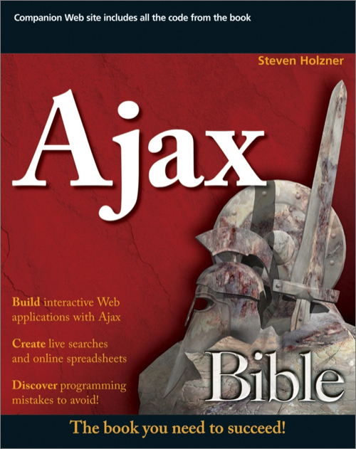
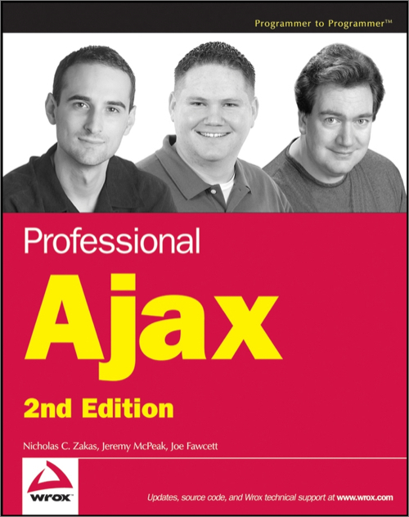



Slide 12
By the Time it was….
2006
Notes:
In 1992 Jim Gosling is sitting in his office working on a language which would be a successor to C++. He was an smart man but wasn’t good at naming the languages which is apparent from the fact that he intended to call the language C++++.
His friends told him you cannot do that ao he looked out of the window, saw an oak tree and from that point his language was called OAK.
Then Gosling spun out to a start up called first person, a company which intended to create technology for interactive TV applications. OAK was to be used in those applications. That company failed and he eventually rolled back into SUN.
After having failed with interactive media they were sitting around trying to figure out what do they do with OAK.
While discussing it in a coffee shop they decided that the language needed a new name and at that point Jim looking at the menu, decided to call it JAVA. At the same time they decided that the first application that they would demonstrate this language would be a browser because WEB at that point in time was going hot and there was a huge hype around it.
They decided to name the browser HOT JAVA. Having the browser have the almost the same name as the language it was written in caused a confusion which worked in their favor since there was a huge hype around how wonderful the browsers were , how wonderful the HOT JAVA was that it gave an added advantage to the language itself.
Meanwhile at Netscape they were looking at JAVA and decided that this isn’t going to work in the webpages. It is way to heavy, it is way too clumsy to do APIs in Web Pages and to do Form Validations in the sort of applications that they had anticipated, they wanted something much much lighter.
Brenden Eich was at the Netscape at the time and his first idea was do a dialect or scheme type of a thing in the browser but his manager said no. There is no way market is going to accept those parenthesis. Just do something like Java or Visual Basic, nice little scripting language and we would let you do that. So he based his syntax and he created something which was called Livescript.
Livescript became the first scripting language to be put in the web browser and also became the first scripting language to be put in a webserver. The live wire platform the Netscape was developing was base upon the livescript.
The reason why Java and LiveScript was so popular at that time

Slide 13

Then Came…..

Slide 14
Enter the Thick Client
Knowing that you can now generally depend on JavaScript being enabled in browsers, a new way to develop applications has begun. You can build thick clients that will do the heavy lifting (rather than the server doing most of that work) and interact with a server via an API (much in the way of a mobile client).
How Modern Web Architecture Works
The user’s browser requests a static HTML page.
The HTML page contains JavaScript that builds the base structure of the page.
The JavaScript then performs Ajax to load content (typically JSON) via an API.
JavaScript then takes this content and modifies the DOM to represent the content.

Slide 15
The main difference with this method is that the angle brackets (HTML) are generated on the client, not on the server. This is a huge difference from the way applications were built in the past.
The Benefits of Modern Web Architecture
Simpler back end: As applications require only a single API to transmit/receive content, the same API used for mobile apps can now be used for the browser as well. It also turns out to be much easier to build software that speaks JSON than that speaks HTML.
Performance: Most of the work that servers do is building HTML pages. Moving that work to the client saves a tremendous amount of effort. The front-end code can be easily served by a CDN (content delivery network) that can quickly deliver the bootstrapping content anywhere in the world. Since the client no longer has to download and render complete pages, the performance on the user’s end can be much greater as well.

Slide 16
Standardized tools: Static applications are built with heavy amounts of JavaScript, HTML, and CSS. These are the building blocks of the Web and understood by all web developers.
Rapid prototyping: Because the only requirement to build an application is front-end JavaScript, it is easy to mock up a web application. All the server data can be stubbed (or simply not saved), and you can focus on the user’s experience. Later you can fill in the functionality with an API.
Increased modularity: Since you no longer have one giant codebase (known in the Rails world as the monorail), you can break your application into logical pieces, each well suited to perform its specific task.

Slide 17
By the Time it was….
2007
Notes:
In 1992 Jim Gosling is sitting in his office working on a language which would be a successor to C++. He was an smart man but wasn’t good at naming the languages which is apparent from the fact that he intended to call the language C++++.
His friends told him you cannot do that ao he looked out of the window, saw an oak tree and from that point his language was called OAK.
Then Gosling spun out to a start up called first person, a company which intended to create technology for interactive TV applications. OAK was to be used in those applications. That company failed and he eventually rolled back into SUN.
After having failed with interactive media they were sitting around trying to figure out what do they do with OAK.
While discussing it in a coffee shop they decided that the language needed a new name and at that point Jim looking at the menu, decided to call it JAVA. At the same time they decided that the first application that they would demonstrate this language would be a browser because WEB at that point in time was going hot and there was a huge hype around it.
They decided to name the browser HOT JAVA. Having the browser have the almost the same name as the language it was written in caused a confusion which worked in their favor since there was a huge hype around how wonderful the browsers were , how wonderful the HOT JAVA was that it gave an added advantage to the language itself.
Meanwhile at Netscape they were looking at JAVA and decided that this isn’t going to work in the webpages. It is way to heavy, it is way too clumsy to do APIs in Web Pages and to do Form Validations in the sort of applications that they had anticipated, they wanted something much much lighter.
Brenden Eich was at the Netscape at the time and his first idea was do a dialect or scheme type of a thing in the browser but his manager said no. There is no way market is going to accept those parenthesis. Just do something like Java or Visual Basic, nice little scripting language and we would let you do that. So he based his syntax and he created something which was called Livescript.
Livescript became the first scripting language to be put in the web browser and also became the first scripting language to be put in a webserver. The live wire platform the Netscape was developing was base upon the livescript.
The reason why Java and LiveScript was so popular at that time

Slide 18

Atwood’s Law
Any application that can be written in JavaScript, will eventually be written in JavaScript.
http://www.codinghorror.com/blog/2007/07/the-principle-of-least-power.html

Slide 19
By the Time it was….
2014
Notes:
In 1992 Jim Gosling is sitting in his office working on a language which would be a successor to C++. He was an smart man but wasn’t good at naming the languages which is apparent from the fact that he intended to call the language C++++.
His friends told him you cannot do that ao he looked out of the window, saw an oak tree and from that point his language was called OAK.
Then Gosling spun out to a start up called first person, a company which intended to create technology for interactive TV applications. OAK was to be used in those applications. That company failed and he eventually rolled back into SUN.
After having failed with interactive media they were sitting around trying to figure out what do they do with OAK.
While discussing it in a coffee shop they decided that the language needed a new name and at that point Jim looking at the menu, decided to call it JAVA. At the same time they decided that the first application that they would demonstrate this language would be a browser because WEB at that point in time was going hot and there was a huge hype around it.
They decided to name the browser HOT JAVA. Having the browser have the almost the same name as the language it was written in caused a confusion which worked in their favor since there was a huge hype around how wonderful the browsers were , how wonderful the HOT JAVA was that it gave an added advantage to the language itself.
Meanwhile at Netscape they were looking at JAVA and decided that this isn’t going to work in the webpages. It is way to heavy, it is way too clumsy to do APIs in Web Pages and to do Form Validations in the sort of applications that they had anticipated, they wanted something much much lighter.
Brenden Eich was at the Netscape at the time and his first idea was do a dialect or scheme type of a thing in the browser but his manager said no. There is no way market is going to accept those parenthesis. Just do something like Java or Visual Basic, nice little scripting language and we would let you do that. So he based his syntax and he created something which was called Livescript.
Livescript became the first scripting language to be put in the web browser and also became the first scripting language to be put in a webserver. The live wire platform the Netscape was developing was base upon the livescript.
The reason why Java and LiveScript was so popular at that time

Slide 20
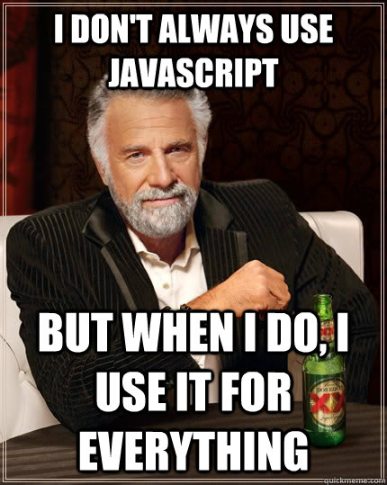

Slide 21









I mean really…
Can we have a Full-Stack JavaScript
Answer : Yes we can..!!!!!!
1
Middleware
6
Client
5
2
1. User Interactions
2. HTTP Requests
3. DB Queries
4. DB Response / JS Objects
5. JSON
6. DOM Updates
Server
3
4
Database

Slide 22
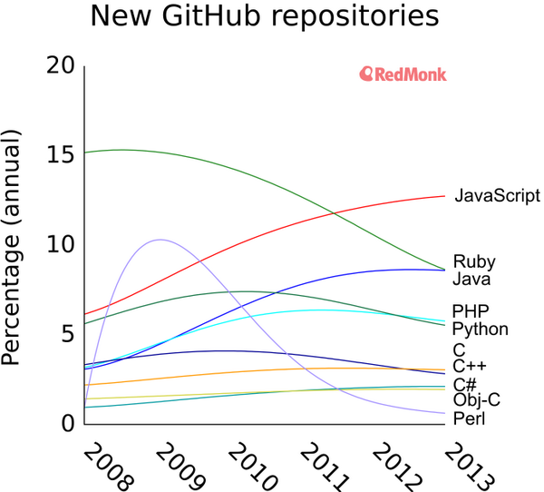
JavaScript has an enthusiastic community, which has quickly grown into the largest open source community by far. Chart below shows a graph of how popular different languages have been over the years.

Slide 23
The Big Myth
Live Script Java Script ECMA Script
Self
Lisp
Java
Scheme

Slide 24
The Big Myth
Java Script is a subset of Java.
Java Script is an interpreted form of Java.
None of that is true.
Java Script is a completely different language with different implementation.
JavaScript supports most of Java’s expression syntax and basic control flow constructs.
for (var i = 0; i < 10; ++i)
Now take a look at the Java equivalent:
for (int i = 0; i < 10; ++i)
Notice the similarity. The only difference is the variable declaration (JavaScript is loosely typed).

Slide 25
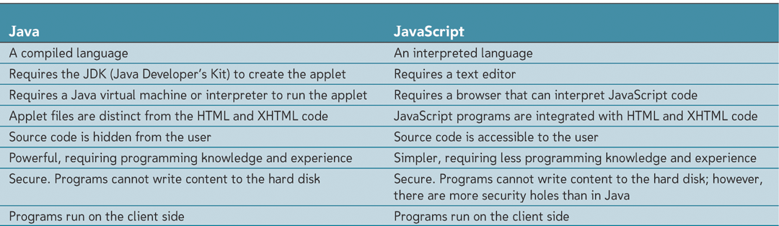
Comparing Java and JavaScript

Slide 26
What JavaScript Is
JavaScript is a popular general-purpose scripting language.
JavaScript has been described as the glue that holds Web pages together.
It runs on most platforms and is hardware independent. JavaScript is built directly into the browser (although not restricted to browsers).
In syntax, JavaScript is similar to C, Perl, and Java; i.e. if statements, while and for loops, are almost identical. Like Perl, it is an object-oriented, interpreted language, not a compiled language.
Because JavaScript is associated with a browser, it is tightly integrated with HTML. While HTML is handled by its own networking library and graphics renderer, JavaScript programs are executed by a JavaScript interpreter normally built right into the browser. When the browser requests such a page, the server sends the full content of the document, including HTML and JavaScript statements, over the network to the client. When the page loads, HTML content is read and rendered line by line until a JavaScript opening tag is read, at which time, the JavaScript interpreter takes over. When the closing JavaScript tag is reached, the HTML processing continues.

Slide 27
What Java Script is Not ?
JavaScript is not Java.
JavaScript is not HTML. But JavaScript code can be embedded in an HTML document and is contained within HTML tags. JavaScript has its own syntax rules and expects statements to be written in a certain way. JavaScript doesn’t understand HTML, but it can contain HTML content within its statements. All of this will become clear as we proceed.
JavaScript is object based but not strictly object oriented because it does not support the traditional mechanism for inheritance and classes found in object oriented programming languages, such as Java and C++. The terms private, protected, and public do not apply to JavaScript methods as with Java and C++.
JavaScript is not the only language that can be embedded in an application. VBScript, for example, developed by Microsoft, is similar to JavaScript, but is embedded in Microsoft’s Internet Explorer.

Slide 28
Not a Web Toy
It is a real Language.
Small, but sophisticated.
It is not a subset of Java.

Slide 29
Not a Web Toy
What is it used for today?
- Handling User Interaction
– Doing small calculations
– Checking for accuracy and appropriateness of data entry from forms
– Doing small calculations/manipulations of forms input data
– Search a small database embedded in the downloaded page
– Save data as cookie so it is there upon visiting the page
• Generating Dynamic HTML documents
• Examples – Bookmarklets – Google Maps – Google Suggest

Slide 30
What JavaScript Can Do(Client JavaScript)
The most common use of JavaScript is to write functions that are embedded in or included from HTML pages and that interact with the Document Object Model (DOM) of the page. Some simple examples of this usage are:
Loading new page content or submitting data to the server via AJAX without reloading the page (for example, a social network might allow the user to post status updates without leaving the page)
Animation of page elements, fading them in and out, resizing them, moving them, etc.
Interactive content, for example games, and playing audio and video
Validating input values of a web form to make sure that they are acceptable before being submitted to the server.
Transmitting information about the user's reading habits and browsing activities to various websites. Web pages frequently do this for web analytics, ad tracking, personalization or other purposes.

Slide 31
Where does Java Script Fit In: Server-Side & Client-Side Programming
Server-side programming
Program placed on server that hosts Web site
Program then used to modify contents and structure of Web pages.
Client-side programming
Runs programs on user’s computer
Programs likely to be more responsive to users
Can never completely replace server-side programming

Slide 32
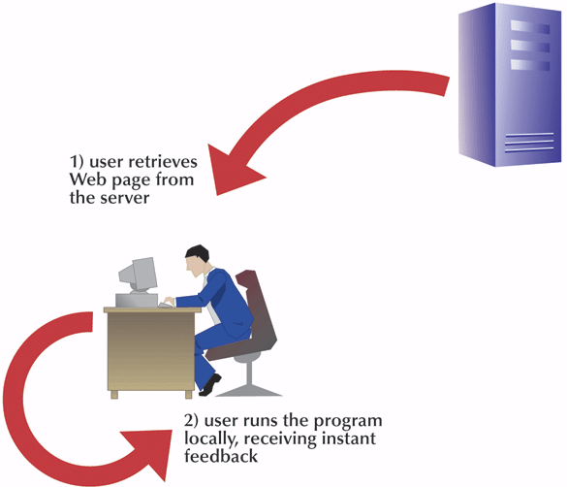
Client-Side Programming

Slide 33
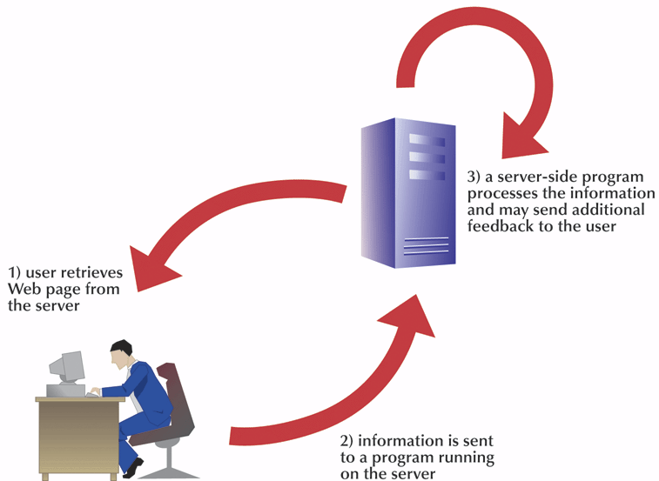
Server-Side Programming

Slide 34
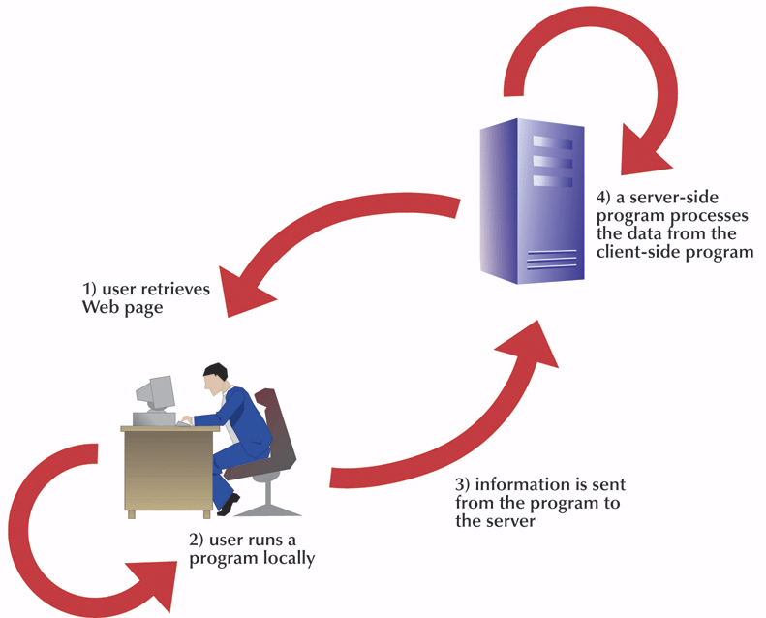
Combining Client-Side and Server-Side Programming

Slide 35
The Three Layers of A Web Page
The content or structural layer.
In Web development, HTML/XML markup makes up the content layer, and it also structures the Web document. The content layer is what a viewer sees when the comes to your Web page. Content can consist of text or images and include the links and anchors a viewer uses to navigate around your Web site.
The style or presentation layer.
The style or presentation layer is how the document will appear and on what media types. This layer is defined by CSS, Cascading Style sheets. Prior to CSS, nearly all of the presentation was contained within the HTML markup; all font colors, background styles, element positions and alignments, borders, etc. had to be explicitly, often repeatedly, included in the HTML markup for the page. CSS works with JavaScript and the DOM to a create a dynamic presentation, often known as DHTML.
The behavior layer.

Slide 36
The Three Layers
The behavior layer.
The behavior layer is the layer of a Web page that makes the page perform some action. For most Web pages, the first level of behavior is JavaScript. JavaScript allows you to dynamically control the elements of the Web page based on user interaction such as an individual keystroke, moving a mouse, submitting form input, etc. JavaScript also makes it easy to perform style changes on the fly. Although traditionally CSS and JavaScript are separate layers, now with the DOM, they work so closely together that the lines are somewhat blurred. JavaScript programs are often stored in external files which are then put in libraries where other programmers can share them.

Slide 37
Server
HTML
CSS
JavaScript
Rendering HTML
Constructing URLs
Calculating dependencies
Redirecting
Document structure
Native functionality
Accessibility
Layout
Colors
Visibility
Animation
Handling Events
Ajax
Changing UI

Slide 38
Server
HTML
CSS
JavaScript
Rendering HTML
Constructing URLs
Calculating dependencies
Redirecting
Document structure
Native functionality
Accessibility
Layout
Colors
Visibility
Animation
Handling Events
Ajax
Changing UI

Slide 39
Server
HTML
CSS
JavaScript
Rendering HTML
Constructing URLs
Calculating dependencies
Redirecting
Document structure
Native functionality
Accessibility
Layout
Colors
Visibility
Animation
Handling Events
Ajax
Changing UI

Slide 40
JAVASCRIPT IMPLEMENTATION
JAVA SCRIPT
The Core[ECMA SCRIPT].
The Document Object Model. [DOM]
The Browser Object Model.[BOM]
ECMA SCRIPT
DOM
BOM

Slide 41
Document Object Module [DOM]
Application programming interface (API) for XML that was extended for use in HTML.
Maps out an entire page as a hierarchy of nodes.
<html>
<head>
<title>Sample Page</title>
</head>
<body>
<p>Hello World!</p>
</body>
</html>
By creating a tree to represent a document, the DOM allows developers an unprecedented level of control over its content and structure.
Nodes can be removed, added, replaced, and modified easily by using the DOM API.
HTML
head
title
Sample Page
body
p
Hello World

Slide 42
More on DOM…..
Developers, using DOM, can alter the appearance and content of a web page without reloading it. JavaScript can come in handy doing so.
Since Netscape and Microsoft was supporting the different versions of the DHTML the W3C consortium stepped in to standardize the DOM.
Dom Levels:
Dom Level :
The Core: Provides a way to map the structure of an XML-based document to allow for easy access to and manipulation of any part of a document.
The DOM HTML: DOM HTML, which extended the DOM Core by adding HTML-specific objects and methods.
DOM Level 2:
DOM Views — Describes interfaces to keep track of the various views of a document (the document before and after CSS styling, for example).
DOM Events — Describes interfaces for events and event handling.
DOM Style — Describes interfaces to deal with CSS-based styling of elements.
DOM Traversal and Range — Describes interfaces to traverse and manipulate a document

Slide 43
Browser Object Model *
BOM allowed access and manipulation of the browser window.
Primarily deals with the browser windows and frames.
Following are some of the things developers can do using the BOM:
pop up new browser windows.
move, resize, and close browser windows.
Provided the Navigator object which provides detailed information about the browser.
Provided the Location Object which provides information about the page loaded in the browser.
Provided the Screen Object which provides the details about the user’s screen resolution.
Support for cookies.
Custom objects such as XMLHttpRequest and Internet Explorer’s ActiveXObject.

Slide 44
Where Does Java Script Fit in HTML
Using the <script> element:
Primary method to add Java Script to the HTML page.
async — Optional. Indicates that the script should begin downloading immediately but should not prevent other actions on the page such as downloading resources or waiting for other scripts to load. Valid only for external script files.
charset — Optional. The character set of the code specified using the src attribute. This attribute is rarely used, because most browsers don’t honor its value.
defer — Optional. Indicates that the execution of the script can safely be deferred until after the document’s content has been completely parsed and displayed.
language — Deprecated. Originally indicated the scripting language being used by the code block(such as “JavaScript”, “JavaScript1.2”, or “VBScript”).
src — Optional. Indicates an external file that contains code to be executed.
type — Optional. Replaces language; indicates the content type (also called MIME type) of the scripting language being used by the code block.
There are two ways to use the <script> element: embed JavaScript code directly into the page or include JavaScript from an external file.

Slide 45
Where Does Java Script Fit in HTML
<script type=”text/javascript”>
function sayHi(){
alert(“Hi!”); }
</script>
To include JavaScript from an external fi le, the src attribute is required. The value of src is a URL linked to a fi le containing JavaScript code, like this:
<script type=”text/javascript” src=”example.js”></script>
To include the js file form some outside domain:
<script type=”text/javascript” src=”http://www.somewhere.com/afile.js”></script>
Code from an external domain will be loaded and interpreted as if it were part of the page that is loading it. Can be dangerous though.

Slide 46
JavaScript Beyond the Browser
Mozilla’s Firefox browser and Thunderbird email client use JavaScript for some application processes
Flash ActionScript is based on JavaScript
PDF files can have JavaScript embedded
Many Microsoft and Apple desktop widgets use JavaScript
OpenOffice.org provides JavaScript support
webOS, used in Palm mobiles, uses JavaScript for its application framework
JavaScript can be used as an application programming language on the GNOME desktop and as a scripting language in Windows.
Rhino
Mongo DB
PhoneGap

Slide 47
INLINE CODE VERSUS EXTERNAL FILES
As a good coding practice it is always advisable to load the js code from the external js files rather than writing it inline. Arguments favoring the external files:
Maintainability — JavaScript code that is sprinkled throughout various HTML pages turn code maintenance into a problem. It is much easier to have a directory for all JavaScript files so that developers can edit JavaScript code independent of the markup in which it’s used.
Caching — Browsers cache all externally linked JavaScript files according to specific settings, meaning that if two pages are using the same file, the file is downloaded only once. This ultimately means faster page-load times.
To Summarize:
To include external JavaScript files, the src attribute must be set to the URL of the file to include, which may be a file on the same server as the containing page or one that exists on a completely different domain.
You can defer a script’s execution until after the document has rendered by using the defer attribute. Deferred scripts always execute in the order in which they are specified.
For non-deferred scripts, the browser must complete interpretation of the code inside a <script> element before it can continue rendering the rest of the page. For this reason, <script> elements are usually included toward the end of the page, after the main content and just before the closing </body> tag.

Slide 48
Supporting Non-JavaScript Browsers
noscript element
Used by browsers that do not support scripts
Syntax
<noscript>
alternative content
</noscript>

Slide 49
Language Basics
Objectives:
Reviewing syntax
Working with data types
Working with flow-control statements
Understanding functions

Slide 50
Understanding JavaScript Rules and the Use of White Space
JavaScript
Is case sensitive
Ignores most occurrences of extra white space
Line breaks occurring within a statement can cause error
Good practice to not break a statement into several lines

Slide 51
Keywords
Following are the keywords that have specific uses & hence cannot be used as identifiers or property names.
break | do | instanceof | typeof
case | else | new | var
catch | finally | return | void
continue | for | switch | while
debugger* | function | this | with
default | if | throw
delete | in | try

Slide 52
Reserved Words
Following are the reserved words that have specific future uses & hence cannot be used as identifiers or property names.
abstract | enum | int | short
boolean | export | interface | static
byte | extends | long | super
char | final | native | synchronized
class | float | package | throws
const | goto | private | transient
debugger | implements | protected | volatile
double | import | public

Slide 53
Working with Variables
Variable
Loosely Typed.
A named item/placeholder in a program that stores any type of data.
Values can change as the program runs.
the var operator to define a variable makes it local to the scope in which it was defined. [refer to example variable_scope].
By removing the var operator from the example, the message variable becomes global.

Slide 54
Declaring a Variable
Statement to declare a variable
var variable;
Declaring three variables
var emLink, userName, emServer;
var message = “hi”, found = false, age = 29;// they can be defined and initialized in the same line.
Value = undefined
Variable declared without a value will have the value undefined.

Slide 55
Declaring a Variable [Naming Conventions]
Limits on variable names
First character must be either a letter or an underscore character ( _ )
Remaining characters can be letters, numbers, or underscore characters
Variable names cannot contain spaces
Reserved words cannot be used

Slide 56
Variable Scope
ES5 has only function scope
function foo() {
var num = 1;
// ... too many statements
if (true_condition) {
// same scope! overwrite above `num`!
var num = 2;
// .. some process
}
console.log(num);
// 2 !!!
}

Slide 57
Weird Hoisting
ES5 has only function scope
var a = 'outer';
function bar() {
console.log(a);
var a = 'inner';
}
bar();
// undefined !!!

Slide 58
Use ES6 let or const anytime!
let and const create block scope
no hoisting
no more "var"!
var a = 'outer';
function bar() {
console.log(a);
var a = 'inner';
}
bar();
// undefined !!!

Slide 59
Use ES6 let or const anytime!
let and const create block scope
no hoisting
no more "var"!
var a = 'outer';
function bar() {
console.log(a);
var a = 'inner';
}
bar();
// undefined !!!

Slide 60
const
immutable value (not immutable object)
use like Java's final
const foo = 1;
foo = 100; // Error!
const foo = 1000; // Error!
// properties are mutable
const obj = {};
obj.foo = 1; // No error

Slide 61
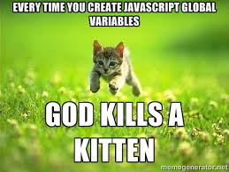

Slide 62
Types of Languages
Weakly/Loosely typed language
Variables are not strictly tied to specific data types
Strongly typed languages
Force programmer to explicitly identify a variable’s data type.
Java Script is a Loosely typed Language

Slide 63
Statements
Statements in ECMA Script are terminated by a semicolon.
var sum = a + b //valid even without a semicolon - not recommended
var diff = a - b; //valid – preferred.
Control statements, such as if, require code blocks only when executing multiple statements.
if (test)
alert(test); //valid, but error-prone and should be avoided
if (test){ //preferred
alert(test);
}

Slide 64
Working with Data Types
There are five simple data types (also called primitive types) in
ECMAScript which is the type of information stored in a variable:
Number
Any number, such as 13, 22.5, or -3.14159
String
Any group of text characters, such as “Hello”
Boolean
Indicates the truth or falsity of a statement.
Null value
Value has not yet been assigned to variable.
Undefined
the value is undefined

Slide 65
The typeof Operator
The typeof operator gives us a way to determine the data type of agiven variable.
“undefined” if the value is undefined
“boolean” if the value is a Boolean
“string” if the value is a string
“number” if the value is a number
“object” if the value is an object (other than a function) or null
“function” if the value is a function

Slide 66
The Undefined Value
The Undefined type has only one value, which is the special value undefined.
When a variable is declared using var but not initialized, it is assigned the value of undefined.
TypeOf operator has an interesting behavior though.

Slide 67
The Null Value
The Null type is the second data type that has only one value: the special value null.
Logically, a null value is an empty object pointer, which is why typeof returns “object” when it’s passed a null.
var car = null;
alert(typeof car); //”object”
When defining a variable that is meant to later hold an object, it is advisable to initialize the variable to null as opposed to anything else
if (car != null){
//do something with car
}
The value undefined is a derivative of null, hence alert(null == undefined); //true

Slide 68
The Boolean Type
Only two literal values: true and false.
Interesting fact : Though there are just two literal Boolean values, all types of values have Boolean equivalents in ECMAScript.
The following table outlines the various data types and their specific conversions.
DATA TYPE
Boolean | true | false
String | Any nonempty string | “” (empty string)
Number | Any nonzero number | 0, NaN
Object | Any object | null
Undefined | N/A | undefined

Slide 69
The Number Type *
Represent both integers and floating-point values.
Integers can also be represented as octal and hexadecimal numbers.
For an octal literal, the first digit must be a zero (0) followed by a sequence of octal digits (numbers 0 through 7). If a number out of this range is detected in the literal, then the leading zero is ignored and the number is treated as a decimal.
var octalNum1 = 070; //octal for 56
var octalNum2 = 079; //invalid octal - interpreted as 7
To create a hexadecimal literal, you must make the fi rst two characters 0x (case insensitive):
var hexNum1 = 0xA; //hexadecimal for 10

Slide 70
More on Numbers…
The smallest number that can be represented in ECMAScript is stored in Number.MIN_VALUE.
the largest number is stored in Number.MAX_VALUE and is 1.7976931348623157e+308 on most browsers.
NaN, short for Not a Number, which is used to indicate when an operation intended to return a number has failed (as opposed to throwing an error).
Two unique properties:
First, any operation involving NaN always returns NaN (for instance, NaN /10), which can be problematic in the case of multistep computations.
NaN is not equal to any value, including NaN. alert(NaN == NaN); //false
For this precise reason we have the function isNaN() which returns us true or false depending upon if we the argument passed could be converted to a number.

Slide 71
Strings
The String data type represents a sequence of zero or more 16-bit Unicode characters.
Can be delineated by “” or ‘’.
Unlike PHP both the strings are exactly the same.
Includes several character literals to represent nonprintable or otherwise useful characters.
Strings are immutable in ECMAScript.
toString() method is used to convert almost all the value has except null and undefined.
If you’re not sure that a value isn’t null or undefined, you can use the String() casting function, which always returns a string regardless of the value type.

Slide 72
The Object Type
Non Specific group of data and functionality.
Created by using the new operator followed by the name of the object type to create. var o = new Object();
The Object type in ECMAScript is the base from which all other objects are derived.
constructor : The function that was used to create the object. In the previous example, the constructor is the Object() function
hasOwnProperty(propertyName) — Indicates if the given property exists on the object instance (not on the prototype).
isPrototypeOf(object) — Determines if the object is a prototype of another object.
toString() — Returns a string representation of the object.
valueOf() — Returns a string, number, or Boolean equivalent of the object. It often returns the same value as toString().

