Slide 1
Extra Class
Topics to be covered:
  1) EXT JS.
  2) Interview Questions
  3) What's the take away - After Class
  4) Higher Order Functions
  5) Node.js
  6) Server Side Coding
Tutorial 8
New Perspectives on JavaScript, Comprehensive

Slide 2
EXT JS
Ext JS is a JavaScript library that makes it (relatively) easy to create cross-platform browser and desktop-style user interfaces in a web application. It supports the following:
  Component model
  Layouts
  Plugin free charting
  Drawing
  CSS theming
JavaScript is a classless, prototype-oriented language but Ext JS follows a class-based approach to make the code extensible and scalable over time. Class names can be grouped into packages with namespaces using the object property dot-notation (.). Namespaces allow developers to write structured and maintainable code, use libraries without the risk of overwriting functions, avoid cluttering the global namespace, and provide an ability to encapsulate the code.
Tutorial 8
New Perspectives on JavaScript, Comprehensive

Slide 3
EXT JS
The strength of the framework lies in its component design. The bundled, basic default components can be easily extended as per your needs and the extended components can be re-used. A new component can also be created by combining one or more default components.
The framework includes many default components such as windows, panels, toolbars, drop-down menus, menu bars, dialog boxes, grids, trees, and much more, each with their own configuration properties (configs), component properties, methods, events, and CSS classes.
The configs are user-configurable at runtime while instantiating, whereas component properties are references to objects used internally by class. Component properties belong to the prototype of the class and affect all the instances of the class. The properties of the individual components determine the look and feel. The methods help in achieving a certain action. The user interaction triggers the equivalent Ext JS events apart from triggering the DOM events.
Tutorial 8
New Perspectives on JavaScript, Comprehensive

Slide 4
EXT JS
A cross-browser web application with header, footer, left column section with links, a content with a CSS grid/table (with add, edit, and delete actions for each row of the grid), and a form with few text fields and a submit button can be created with ease using Ext JS's layout mechanism, few default components, and the CSS theme.
For the preceding application, the border layout can be used with the north region for the header, south region for the footer, west region for the left column links, and center region for the content. The content area can have a horizontal layout, with the grid and form panel components with text fields and buttons.
Creating the preceding application from scratch without using the framework will take a lot more time than it would take by using it. Moreover, this is just one screen, and as the development progresses with more and more features, incorporating new layouts and creating new components will be a tedious process.
Tutorial 8
New Perspectives on JavaScript, Comprehensive

Slide 5
EXT JS
All the components or a group of components with their layout can be made a custom component and re-used with different data (that is, the grid data can be modified with new data and re-used in a different page).
Developers need not worry about the cross-platform compatibility issues, since the framework takes care of this, and they can concentrate on the core logic.
The helper functions of the Ext.DomQuery class can be used for querying the DOM. The error handling can be done by using the Ext.Error class, which is a wrapper for the native JavaScript Error object.
A simple webpage with a minimal UI too can make use of this framework in many ways.
Native JavaScript offers utility classes such as Array, Number, Date, Object, Function, and String, but is limited in what can be done with it across different browsers. Ext JS provides its own version of these classes that works in all the browsers along with offering extra functionality.
Tutorial 8
New Perspectives on JavaScript, Comprehensive

Slide 6
EXT JS
Any Ext JS component can be added to an existing web page by creating an instance of it. For example, a tab feature can be added to an existing web page by creating a new Ext JS Ext.tab tab component and adding it to an existing div container, by referring the div elements id attribute to the renderTo config property of the tab. The backend communication with your server-side code can be done by using simplified cross-browser Ext.Ajax class methods.
Ext JS 4 supports all major web browsers, from Internet Explorer 6 to the latest version of Google Chrome. The recommended browsers for development and debugging are Google Chrome 10+, Apple Safari 5+, and Mozilla Firefox 4+.
Both commercial and open source licenses are available for Ext JS.
Tutorial 8
New Perspectives on JavaScript, Comprehensive

Slide 7
Ext JS Startup
Installation and environment setup
Step 1 – What do you need?
You need the following components for the installation and environment setup:
Web browser: Any of the leading browsers mentioned in previous section. For this book, we will consider Mozilla Firebug with the Firebug debugger plugin installed.
Web server: To start with, a local web server is not required, but it will be required if communication with a server is required to make AJAX calls.
Ext JS 4 SDK: Download the Ext JS bundle from http://www.sencha.com/products/extjs/download/.
Click on the Download button on the left side of the page.
Tutorial 8
New Perspectives on JavaScript, Comprehensive

Slide 8
Ext JS Startup
Installation and environment setup
Step 1 – What do you need?
You need the following components for the installation and environment setup:
Web browser: Any of the leading browsers mentioned in previous section. For this book, we will consider Mozilla Firebug with the Firebug debugger plugin installed.
Web server: To start with, a local web server is not required, but it will be required if communication with a server is required to make AJAX calls.
Ext JS 4 SDK: Download the Ext JS bundle from http://www.sencha.com/products/extjs/download/.
Click on the Download button on the left side of the page.
Tutorial 8
New Perspectives on JavaScript, Comprehensive

Slide 9
Ext JS Startup
Step 2 – Installing the browser and debugger
Any supported browser mentioned in the previous section can be used for the tutorial. For simplicity and debugging options, we will use the latest Firefox and Firebug debugger plugin. Download the latest Firefox plugin from http://www.mozilla.org/en-US/firefox/fx/#desktop and Firebug from https://getfirebug.com/.
Note
Other browser debugging options are as follows:
Google Chrome: Chrome Developer Tools (Tools | Developer tools)
Safari: Go to Settings | Preferences |Advanced, select Show Develop menu in menu bar; navigate to Develop | Show Web Inspector.
Internet Explorer: Go to Tools | Developer Tools
Tutorial 8
New Perspectives on JavaScript, Comprehensive

Slide 10
Ext JS Startup
Step 3 – Installing the web server
Tutorial 8
New Perspectives on JavaScript, Comprehensive

Slide 11
Ext JS Startup
Step 4 – Unpacking Ext JS
Unpack the EXT JS in any of the folders of your choice.
Go back to your STS/Eclipse installation where you have configured the Tomcat runtime.
Open the server view and you should see a Tomcat server configured.
Double click on the server and it should open the server configuration.
In the server configuration, click on the modules tab.
Click on the Add External Web Module button.
In the pop up browse to the EXT JS unpacked directory.
In the path give any name e.g. /EXTJSDoc
Then save the configuration.
Start the Tomcat installation.
Open the URL to your local installation : http://localhost:8080/ExtJS/.
You should now be able to see the examples.
Tutorial 8
New Perspectives on JavaScript, Comprehensive

Slide 12
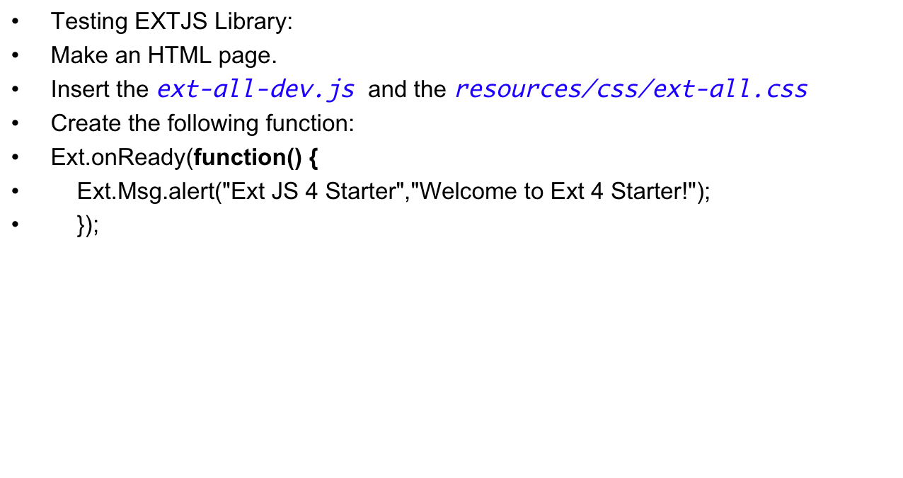
Ext JS Startup
Tutorial 8
New Perspectives on JavaScript, Comprehensive

Slide 13
Creating and defining your Ext JS application
Step 1 – Preparing for an Ext JS application
ext.js: This is the production version, which is minified and compressed
ext-debug.js: This is the unminified development version
ext-dev.js: This is the unminified development version, but outputs detailed error messages and warnings
Look at the project structured and how we have included the ext-all.css and the
ext-all-dev.js
Tutorial 8
New Perspectives on JavaScript, Comprehensive

Slide 14
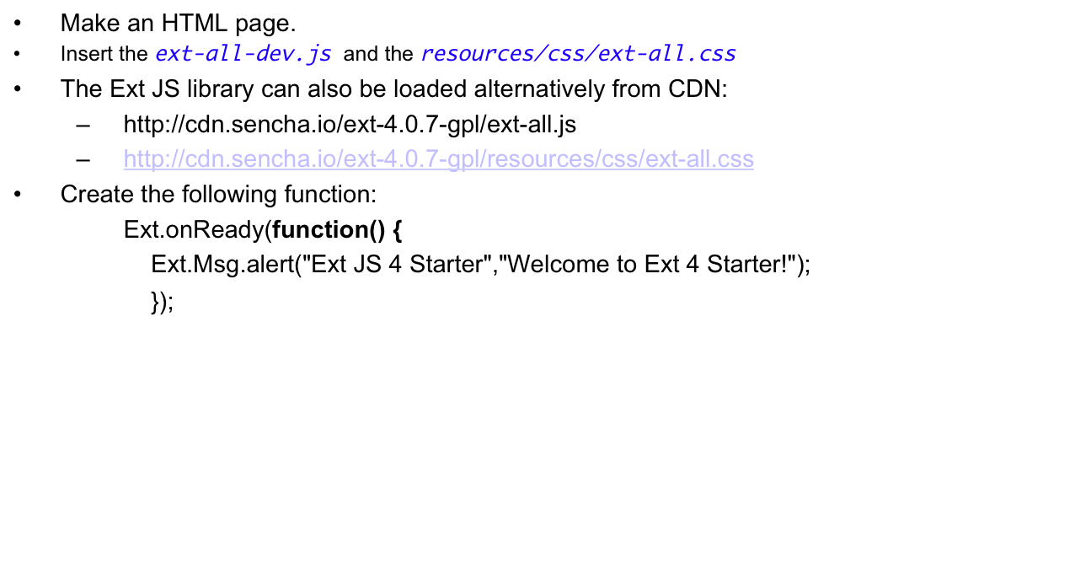
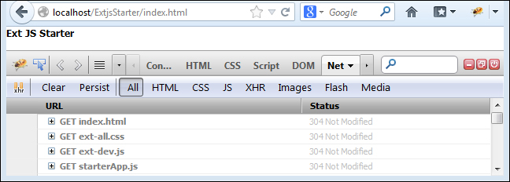
Step 1: Testing EXTJS Library
Tutorial 8
New Perspectives on JavaScript, Comprehensive

Slide 15
Step 2 – The MVC architecture
Model View Controller (MVC) is a well-known software architecture pattern, which separates the representation of information from the user's interaction with it. Ext JS comes with this architecture by default, and defines the architecture as follows.
Model: It is collection of data fields, which persist through the data package. A model can be linked to another model using association and data steams, using proxy. It updates views when the data changes.
View: A view requests the information from the model that it needs to generate an output representation.
Controller: It holds application logic. It also instantiates models, stores, and views. It listens for events and modifies models and views.
Ext JS provides controllers with the refs property to gain reference to components inside the app, and a control method to take action based on the events that the referenced components fire. The Top features you will want to know about section deals in detail about handling events with controllers.
Tutorial 8
New Perspectives on JavaScript, Comprehensive

Slide 16
Step 3 – Defining your Ext JS application
Every Ext JS application starts with a call to Ext.application() to provide global settings, root namespace, references to other JavaScript files, and a launch function to execute the application.
Inside starterApp.js, define an application named app for the global namespace.
Define a launch function that outputs Welcome to Ext Starter Tutorial in the console and in the alert box.
The Firebug console appears similar to the following code snippet:
    Ext.application({
    name :'app',
    requires:['Ext.window.MessageBox'],
    launch:function(){
    console.log("Welcome to Ext Starter Tutorial");
    Ext.Msg.alert("Message"," Welcome to Ext Starter Tutorial");
    }
    });
The preceding code snippet creates a global variable named app, and adds a requires property to load the Ext JS message box class on demand. All that the Ext JS application uses is only a single global variable. All application classes reside in this single namespace. When the page is ready, it calls the launch function and executes the console.log and Ext.Msg.alert() statement.
Tutorial 8
New Perspectives on JavaScript, Comprehensive

Slide 17
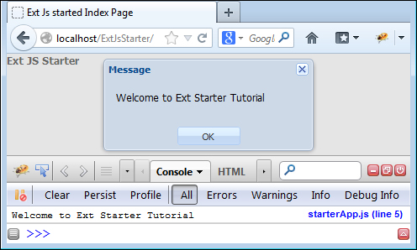
Continued
Using namespaces in JavaScript is a recommended practice to reduce the number of objects and functions that are added to the global scope in our applications. Namespaces are not built into the language, but the same benefits can be achieved by creating a single object (that is, app) and adding all our objects and functions to this object. It also helps to avoid the object collision, when using one JavaScript library with another one:
Tutorial 8
New Perspectives on JavaScript, Comprehensive

Slide 18
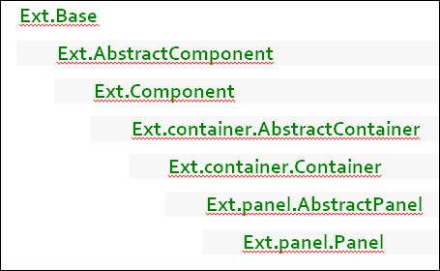
Step 4 – Understanding the Ext JS class hierarchy
The Ext JS framework is bundled with many well-organized classes that provide encapsulation and strong typing. Many classes in Ext JS are implemented as singletons with a set of static methods.
The class hierarchy starts from Ext.Base and drills down to various other class/components. A panel component is defined as Ext.panel.panel, and the class hierarchy will be similar to the following:
Tutorial 8
New Perspectives on JavaScript, Comprehensive

Slide 19
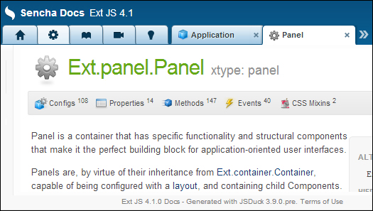
Continued
Please refer to the following links for API reference:
  Offline API: http://yourservername.com/extjs4/ docs/index.html
  Online API: http://docs.sencha.com/ext-js/4-0/
The API provides an easy "search" text field to search for a particular component. Searching for panel reveals a list of items that matches the word panel. Clicking on Ext.panel.Panel loads the panel API document. The top section shows links to configs, properties, methods, and events supported by the panel class. Explore all the provided options and get familiar with its usage.
As an example, search for the Ext. application that was used to launch an application in the previous step in the Search field, and get familiar with the API:
Tutorial 8
New Perspectives on JavaScript, Comprehensive

Slide 20
Step 5 – Defining and creating the Ext JS class
A class in Ext JS 4 is defined using Ext.define(). Ext.define() detects and creates a new namespace as required, extends a class, and defers the creation of a new class if the class being extended has not been defined.
A class definition for app.extJsBook with its properties can be illustrated by the following code snippet:
  Ext.define('app.extJsBook'){
  config:{
  title:'',
  price:'',
  author:''
  },
  constructor:function(config){
  this.initConfig(config)
  }
  };
Config: This allows to specify parameters that can be changed while instantiation
Constructor: This is called during instantiation of the objects
initConfig(config): This creates setter and getter methods for config properties (that is, setTitle(), getTitle(), setprice(), getPrice(), setAuthor(), and getAuthor())
Tutorial 8
New Perspectives on JavaScript, Comprehensive

Slide 21
Continued
The app.extJsBook class can be instantiated by using the Ext.create() method as illustrated in the following code snippet:
//Setting values using setter methods.
  var book = Ext.create('app.extjsBook');
  book.setTitle("ExtJSStarter");
  book.setPrice("10$");
  book.setAuthor('John');
  console.log("Message 1 - ",book.getTitle());
  //This message will be overridden by the second message
  Ext.Msg.alert("Message 1 - ",book.getTitle());
// Setting values during instantiation
  var book2 = Ext.create('app.extjsBook',{
  title:'Ext JS Upgrade',
  author:'Alex',
  price:'20$'
  });
  Ext.Msg.alert("Message 2 - ",book2.getTitle());
  Add the code snippet of class definition and creation inside the launch method of Ext.application that was created in step 3.
Tutorial 8
New Perspectives on JavaScript, Comprehensive

Slide 22
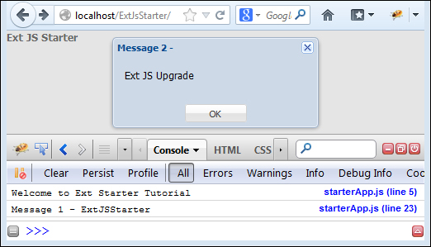
Continued
Executing index.html will output something similar to the following screenshot. Please note that the message box shown is only the third message, and all previous messages have been overridden but are shown in the console for clarity:
Tutorial 8
New Perspectives on JavaScript, Comprehensive

