Slide 1
What does the section cover:
What is Angular.
What do we have here?
Angular Architecture.
Application Scaffolding.

Slide 2
What is Angular
What was it developed for ????

Slide 3
Angular
Angular is Google’s massively popular MVX Framework.
Written in and enables to write the code in Typescript.
Helps us extend the vocabulary of the HTML.
Comes as a single stop shop having the tools to develop complicated browser as well as the mobile apps.
Not a strict MVC framework but is component based.
Modular
A complete UI framework and not a library like React.

Slide 4
Course Overview : ANGULAR Part [UI]
Introducing Typescript
Typescript Concepts.
Angular Components
Angular Services.
Angular Modules.
Angular Routing.
Angular Styling
Angular Directives and Pipes

Slide 5
Our Dev Environment
Webstorm.
Download Webstorm from :
https://www.jetbrains.com/webstorm/download/#section=mac
Angular CLI tool.
Scaffolds a base project for us.
Install using the following command in your terminal:
npm install –g angualr-cli

Slide 6

Closure Look at the Structure

Slide 7
Angular Architecture
How is a an application in Angular Structured

Slide 8
Component
Class{}
Metadata
Directive
Class {}
Metadata{}
Service
Dependency Injection
Injector
Template </>
Routing
Component
Component

Slide 9
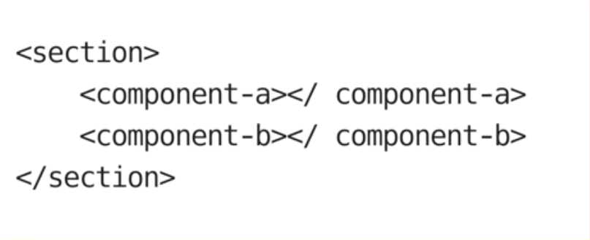
Boot Strap
Component
Component
Component
Component
Component
Component
Component
Component

Slide 10
Boot Strap
Component
Component
Component
Component
Component
Component
Component
Component

Slide 11
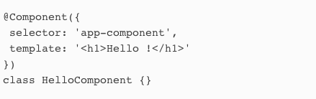
Component
To create a component, declare a class and attach the @Component annotation to it.
Each @Component annotation must define
selector and
template (or templateUrl) properties

Slide 12
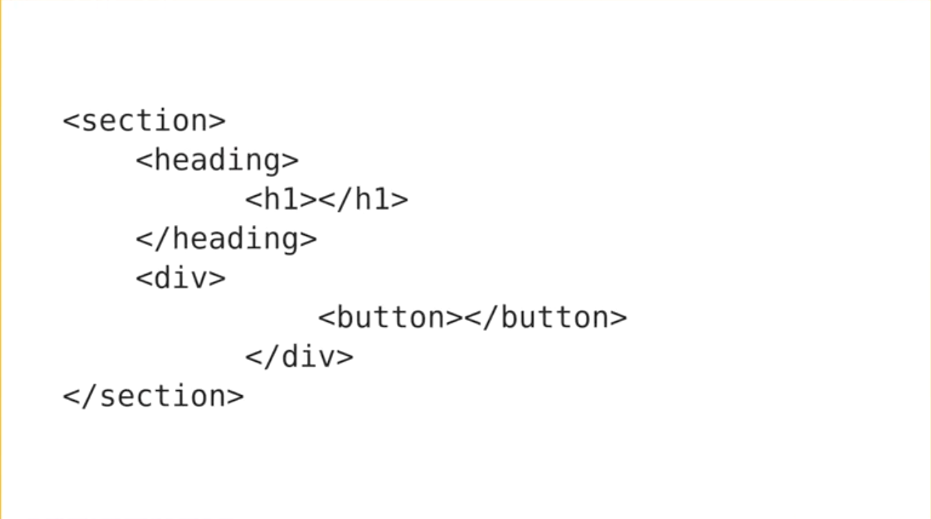

Slide 13
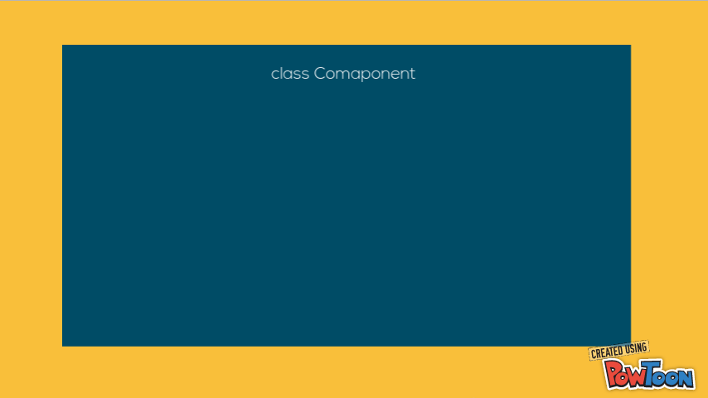

Slide 14
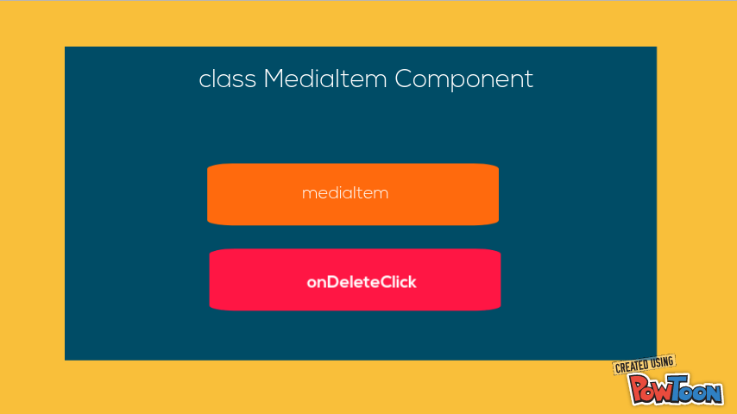

Slide 15
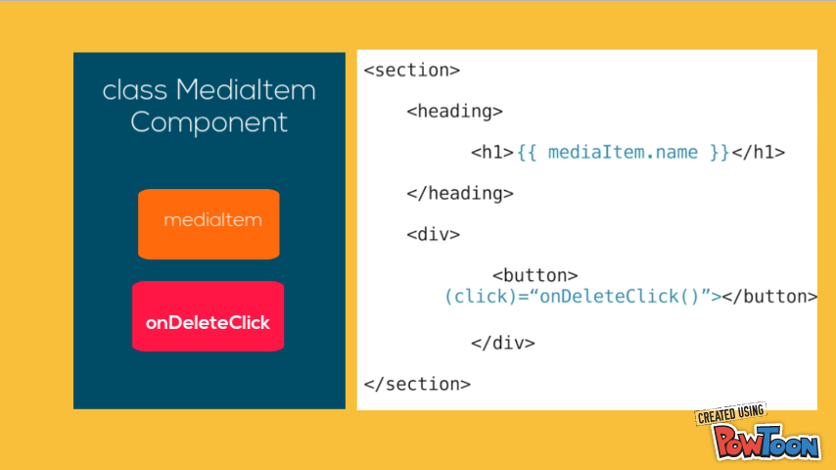

Slide 16
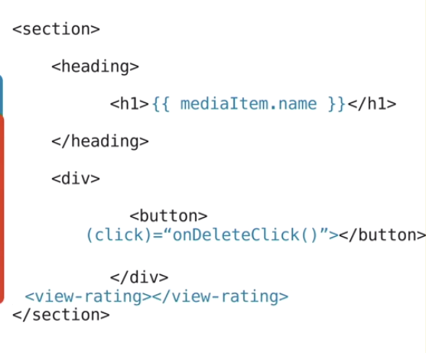
Class MediaItem Component
Class ViewRating Component
selector : ‘view-rating’

Slide 17
Directives and pipes

Slide 18
Angular directives
Structural
Attribute.

Slide 19
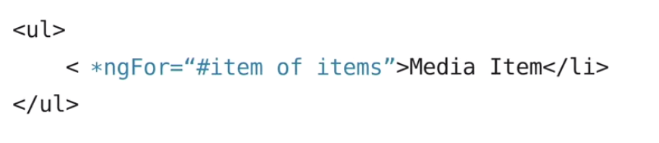
Media Item
Media Item
Media Item
Media Item

Slide 20
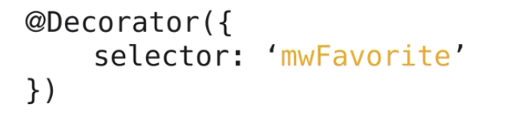
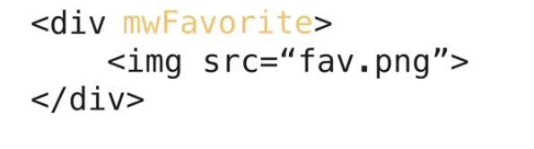
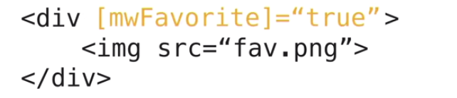
ngIf
ngFor
routerLinks

Slide 21
Angular PIPE

Slide 22
Data Binding

Slide 23
<h1> {{movie.title}} <h1>
<h1> 50 First Dates <h1>

Slide 24



Slide 25
Expression and Statements
Value Binding
Event Binding
Expresion Operators

Slide 26
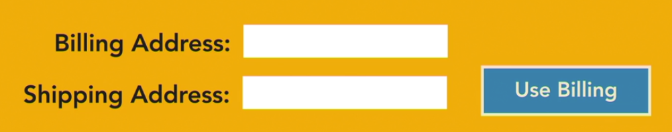
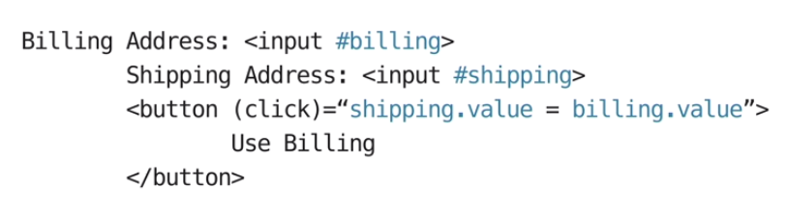
6121 Hyde Park
6121 Hyde Park

Slide 27
Dependency injection

Slide 28
Address Validate
GetZipCode
Address Manager
new Address Validate()
new GetZipCode()

Slide 29
Component
I need a FormBuilder
Component
I need Http Service
Component
I need Router Module

Slide 30



Slide 31
Services Etc.

Slide 32
services
Singleton Objects.
Wired through the DI.
Scoped across the application.
Lazily instantiated.*
Have a lot of inbuilt services and custom service can easily be developed.*
Use “provider” metadata to introduce services. *
DI FW injects the services when needed.

Slide 33
class DeviceService{
getDeviceByID(id){}
}
Service
Component
addDevice()
removeDevice()
DeviceComponent

Slide 34

Service
Service
Service
Component
Component
Component
Service
Service
Service

Slide 35
Data persistence

Slide 36
Data Repositories
In Memory
Browser Local Storage.
Server Side

Slide 37
Component
add(device)
In-Memory Data Store
device
device
Component
get()

Slide 38
Component
add(device)
Data Store Service
device
Local Storage Service
device
Component
get()

Slide 39
Data Store Service
Component
add(device)
Http
device
XHR
JSONP
Component
get()
device

Slide 40
Routing

Slide 41
John Doe
6121 Promenade Avenue
Anytown, CA
95020
List
Add
View Orders
Edit

Slide 42
Angular Router
Route Configuration
Routing Links
Router Outlets
Routing Events

Slide 43
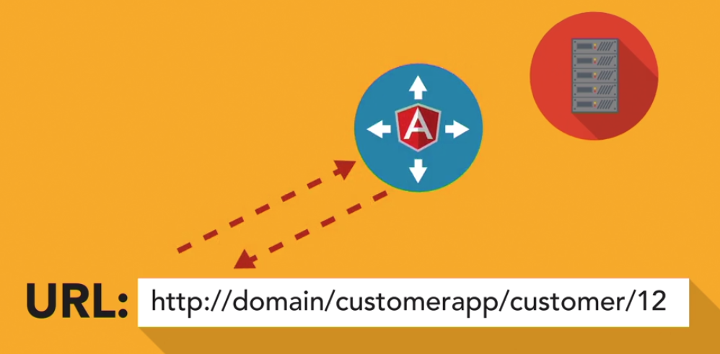


Angular Router

Slide 44
Modules
Modules internally comprises of :
Components:
The UI is created in the Angular are the angularized HTML templates.
Backed by Components.
Services :
Any additional logic is encapsulated by services.

Slide 45
Modules
platformBrowserDynamic().bootstrapModule(AppModule);

Slide 46
Closer Look

Slide 47
An Application’s View
Code Supporting the View
Data accessed from a rest API.
Application Scope
An Applications ‘s View :
HTML rendered in the browser where the User Interacts.
Templates are HTML angularified to allow DOM transformation which can be achieved using the following two approaches:
Directives
Components
Directives:
Part of component Metadata.
Tells DOM how to to transform.
For us (Developers) : Classes with a @Directive decorator.
Are inserted into HTML as tags.
Can apply logic : Conditional and Iteration.
Data Binding:
One Way.
Two way
Metadata*:
Properties of a class Decorator.
Decorator: Function that modifies the JS classes.
Components:
Extended from the Directive class.
Declare properties which can be bound to the HTML templates.*
Binding is achieved through the double mustaches. “{{}}”.
“selector” is the metadata that identifies the component on the HTML

Slide 48
Working with components
The main building blocks.

Slide 49
decorators
Decorator
Expression that evaluates to a function allowing annotation of classes at design time.
@Component()
Arguments Goes Here
Decorator Indicator
Decorator Name

Slide 50
High level view
Binds data and logic to its templates. *
An Angular application can be viewed as big old component tree.
The class representing a component would have @component annotation prior to class declaration which converts the class to a component.
@component {
ModuleId
Selector
tempalteURL
StyleURL
Providers
}
Properties that choreograph the component’s unique behavior *

Slide 51
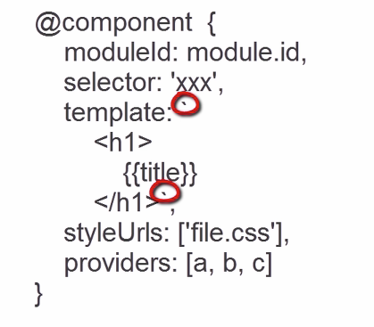
What does it mean to a developer
A class file.
@component {
moduleID,
selector
}
A template File
<h1>
{{title}}
</h1>

Slide 52
Lets create some components
Using the angualr CLI Tools

Slide 53
Lets create some components now
Open the terminal in the app directory.
mkdir components
cd components/
ng g component movies-list
ng g component characters-list
Circle back to the project structure to observe that we have corresponding directories for our newly created components.
Notes:
We now have a brad new project with out components which took us very little time.

Slide 54
Lets Make those components WORK
Nest the controller in a parent child relationship to compose an Angular App
Notes:
Let’s now circle back to our newly created components.
Next Slide Please

Slide 55
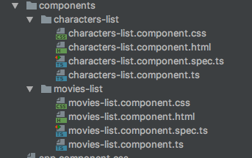
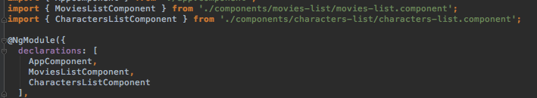
Each component has the four leemnts out of which three we are concerned about :
TS file
HTML File
CSS File *
Another thing to note is that when we create the components using the Angular CLI tool it also update the root component. *

Slide 56
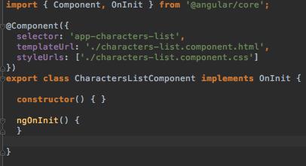
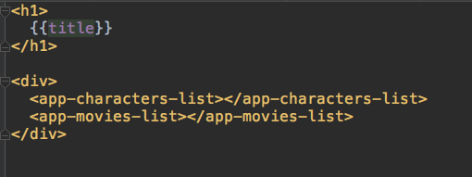
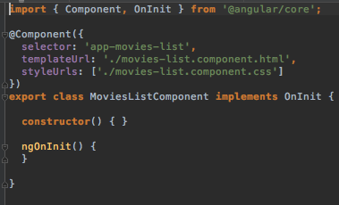

Slide 57
Bootstrap Process Revisited
In the wake of the current inclusions.

Slide 58

