Slide 1
Generating voronoi diagrams
Heghedus Razvan

Slide 2
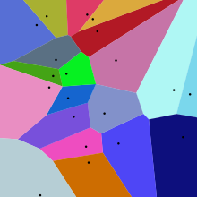
What is a voronoi diagram?
Voronoi diagram is a partitioning of a plane into regions based on distance to points in a specific subset of the plane. That set of points (called seeds or generators) is specified beforehand, and for each seed there is a corresponding region consisting of all points closer to that seed than to any other

Slide 3
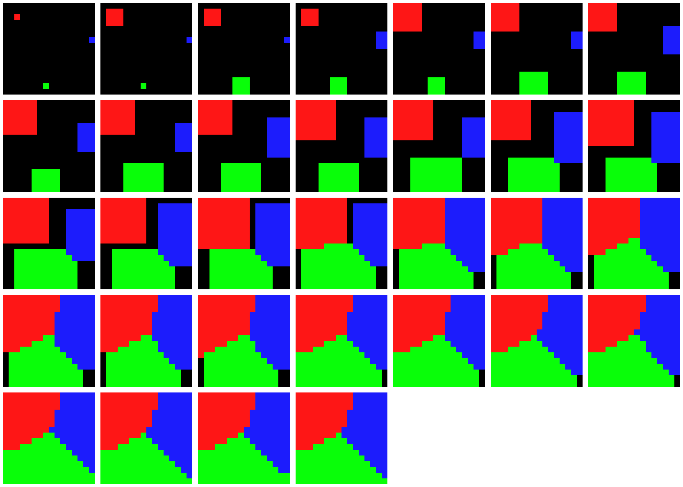
Sequential
For the sequence implementation I choose to use the classic flood fill algorithm. The ideea of this algorithm is we put the seeds in a queue, and while there are elements in the queue we take the first element from the queue go to it’s neighbours, update them an put them in the queue

Slide 4
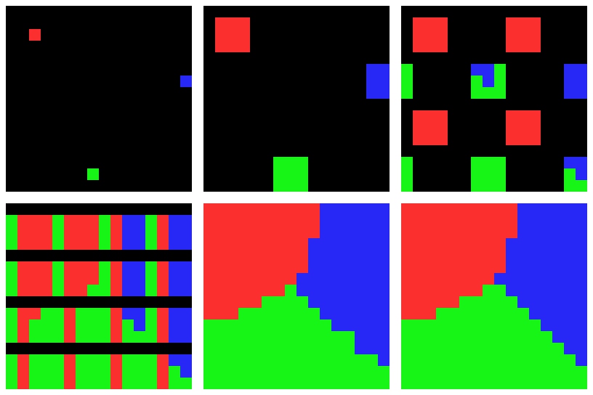
Parallel
For the multithreading implementation I choose to use a modified version of Jump Flooding Algorithm (aka JFA). The ideea behind JFA is that instead of going to the neighbourn elements, we choose the next element in the following way: for each current element at <x,y> the next element is positioned at <x+i,y+j>where i,j∈{−k,0,k} and k takes values from X2,X4,...,2,1

Slide 5
Results
Machine specs:
Intel(R) Core(TM) i7-4720HQ CPU @ 2.60GHz
4 cores 8 threads
8GB memory
Kingstom SSD 120GB

Slide 6
Conclusion
My adaptation of a GPU parallel algorithm to CPU multithreading is not so efficient.
Posible improvements:
Reduce critical path
If a mutex is locked, don’t wait for it, just skip it and come back later
Try some alternative aproach where there is no need of a mutex for each pixel, maybe some Atomic updates

