Slide 2
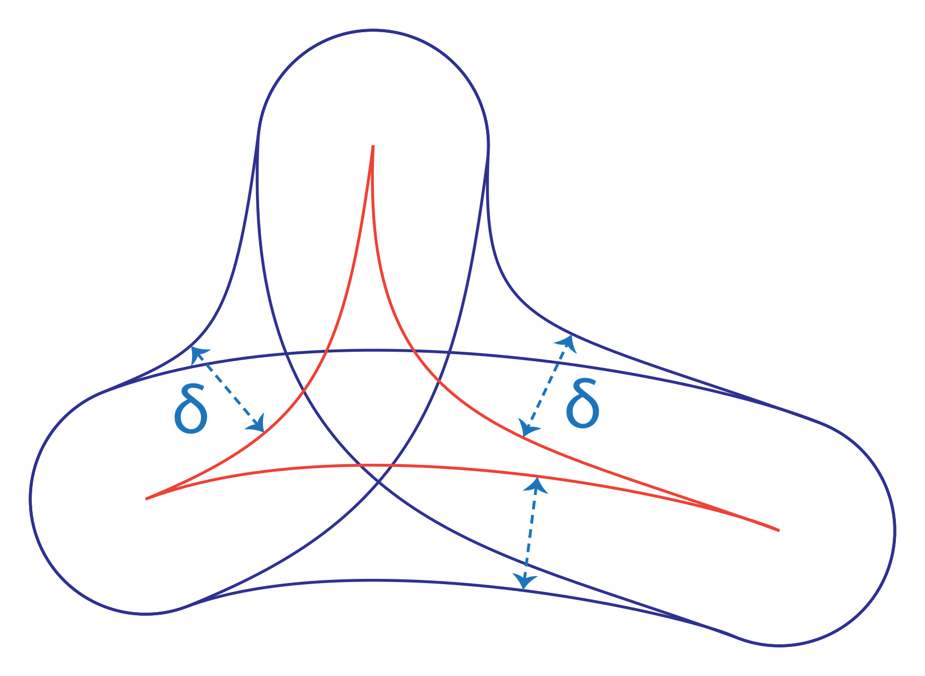
https://commons.wikimedia.org/wiki/File:Delta_thin_triangle_condition.svg#mw-jump-to-license

Slide 3






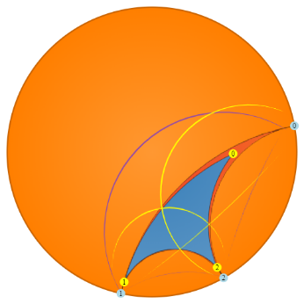








Slide 4














Slide 5


Slide 8


Slide 9
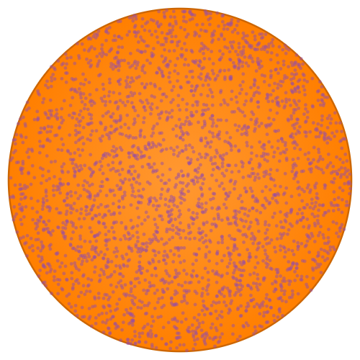

Slide 10
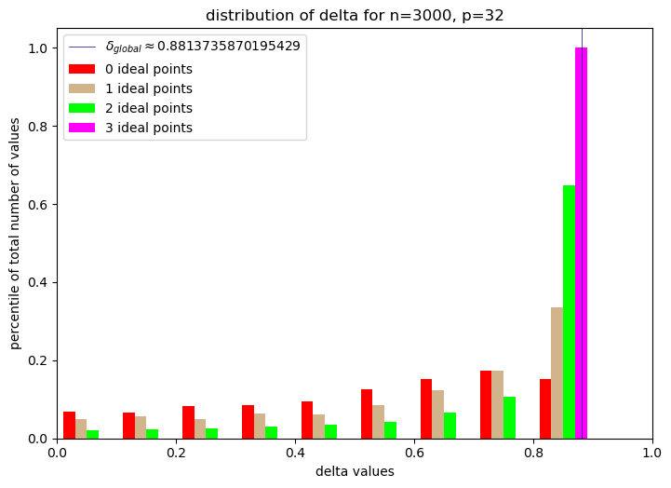

Slide 12





