Slide 1
Velodyne screen test
Gengchen (Mark) Liu

Slide 2
Overview
This slide contains information regarding
My design of the given task.
Steps to recreate the obtained result.
Contacts.

Slide 3
Task decompose
Calculate Poly coeff with Matlab, save the coeff as .dat for RTL MEM.
Matlab fixed point numerical module, check output with kstest(), save as .dat for RTL verification.
RTL coding, behavior simu, compare with Matlab’s output.
Synthesis, implementation, etc.

Slide 4
Spec
Outer segments: 8.
Offset bits: 5. (32 uniform inner segments)
Sign bit: 1.
Polynomial input: 15 bit (15 LSB of 3.22 format).
Polynomial coefficients: 18 bits (3.15 format).
Kstest result: pass.
FPGA: Virtex-7 690T.
Clock: 156.25 MHz.

Slide 5
Schematic
Latency1
Latency2
63:56
LZD
Latency3
Latency4
ROM0
64
MEM
5:1
z⁻¹
+
z⁻¹
z⁻¹
ROM1
x
x
∑
20:6
z⁻¹
z⁻¹
x
This schematic doesn’t show the sign bit.
But the sign bit is included in the actual RTL design.
Overall latency = 4 clock cycle.
The TG generator is implemented in Matlab instead of FPGA. (Since it is relatively trivial here…)
MEM

Slide 6
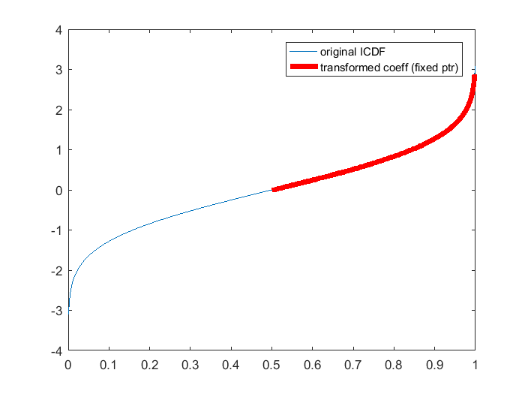
Result (Coefficients calculation)
Run Cheb_cor1.m
Obtain fit_coeff.dat
Here we are obtaining the fitting coefficients!
Due to memory overflow (of my PC), only 8 outer segments is used.
In the original paper, the authors used a python package (mpmath) to achieve the extreme precision (page 3, bottom-left) with 60 outer segments.

Slide 7
Result (TG generation)
Run URNG_gen.m
Obtain unif_input.dat and unif_in.txt
The 10,000 64-bit uniform distributed data are obtained from 64 independent PRBS sequences.
Th resulting data are stored in the FPGA’s ROM as the input of the proposed gaussian noise generator.

Slide 8
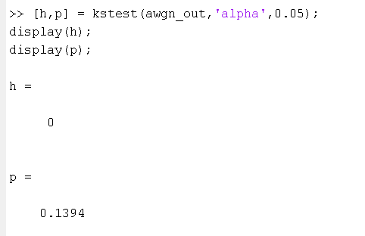
Result (Matlab module)
Run simu_mod.m
Obtain matlab_result.dat
This program is the matlab version of the implemented module.
Passed the Kstest!

Slide 9
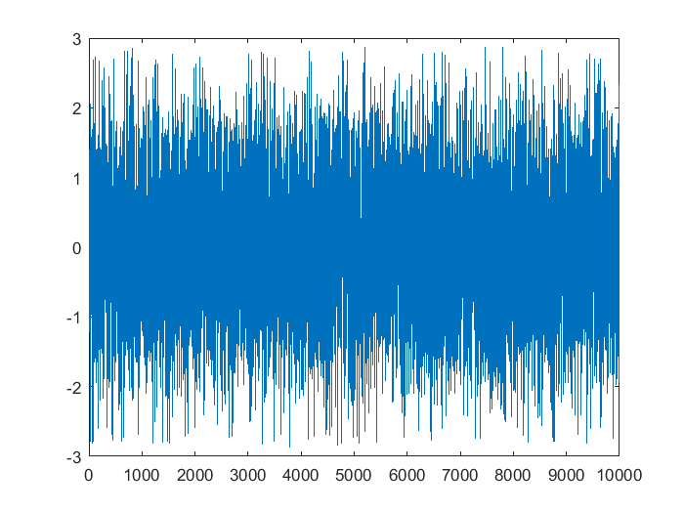
Result (Matlab module)
Output waveform

Slide 10
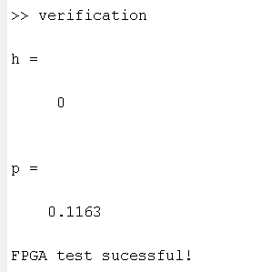
Result (FPGA)
Run behavior simulation (of project super_gaus_noise.xpr)
Obtain RTL_output.txt
Run verification.m
Passed the Kstest!

Slide 11
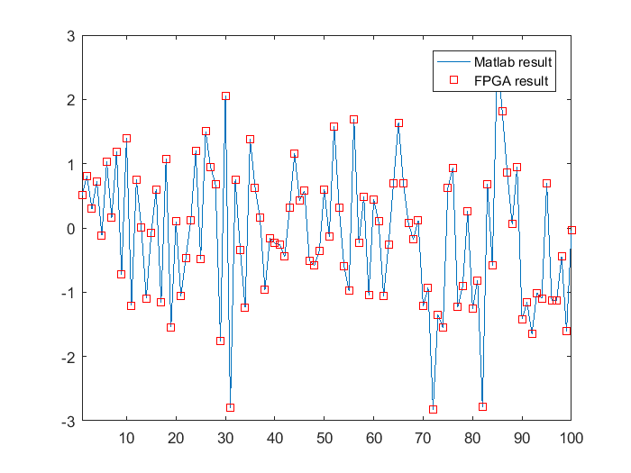
Result (FPGA)
Verification is successful!

Slide 12
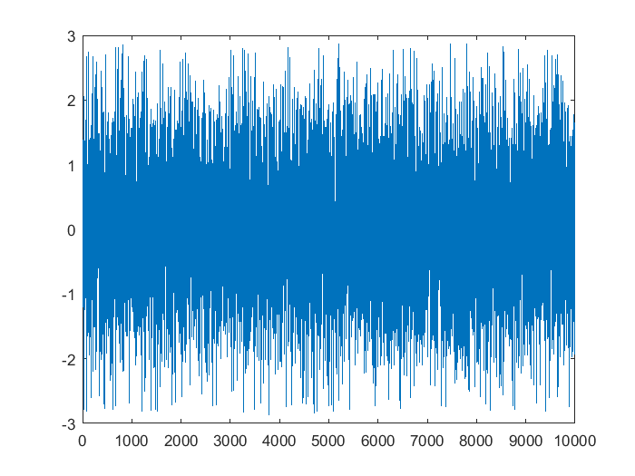
Result (FPGA)
FPGA output waveform

Slide 13
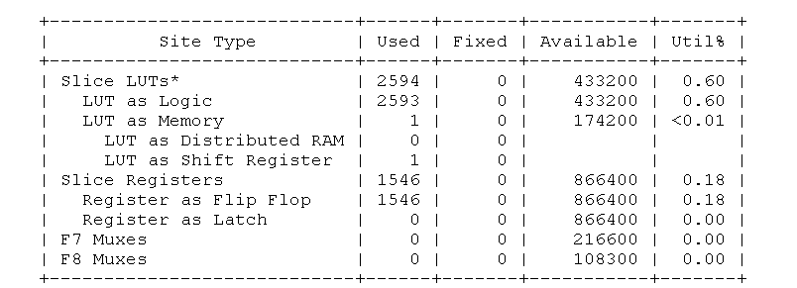
Result (FPGA)
Run synthesis.
Generate FPGA_utilization.txt.

Slide 14
Remarks
I used less outer segments but more inner segments. (with 5 offset bits) to achieve satisfactory performance and pass the kstest.
The verification process is done in MATLAB (just my personal preference).
The RTL implementation can be further optimized to save one more multiplier.

Slide 15
Contact Information
Gengchen (Mark) Liu
PhD student at UC Davis.
(989)-954-3553
genliu@ucdavis.edu
https://www.linkedin.com/in/gengchen-mark-liu-67a700b7/

