Slide 1
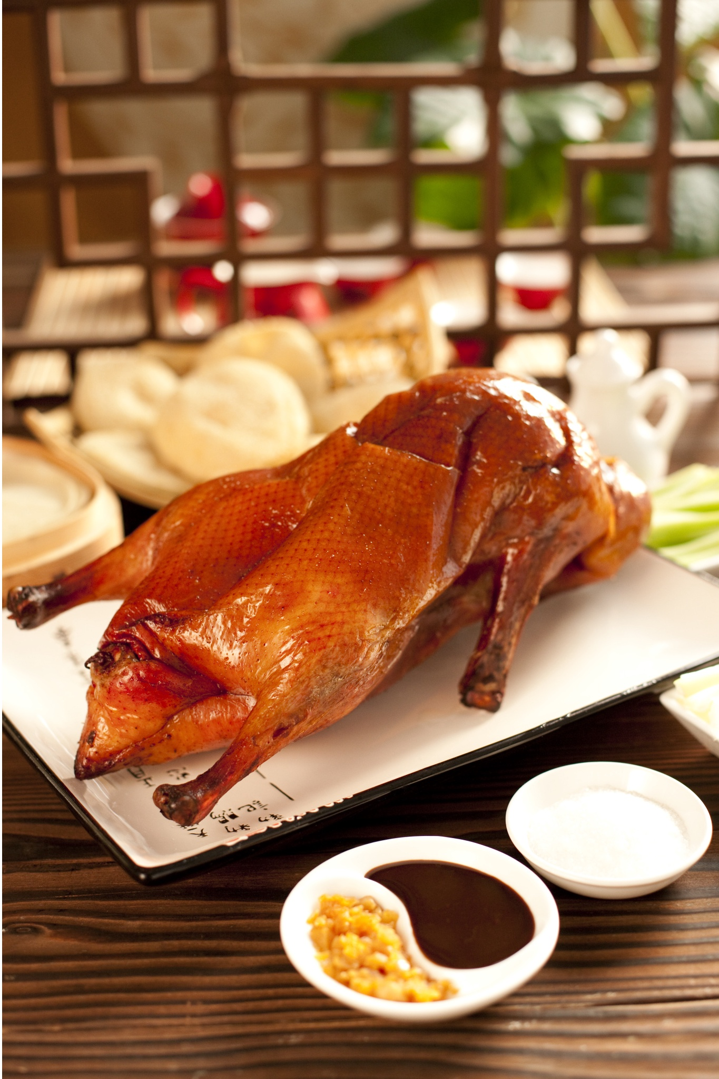
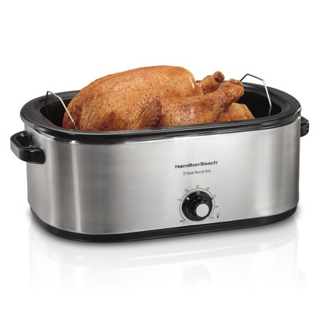

EEC 201 Final Project
Team Duck Roaster
Gengchen Liu

Slide 2

Outline
Code/File architecture – brief overview
Go through each steps
Testing-sets results

Slide 3
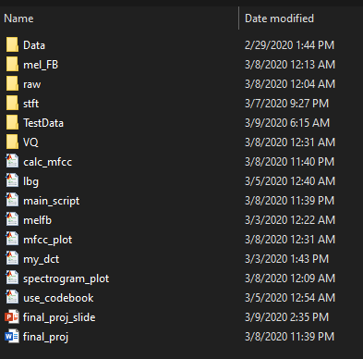
Code/File architecture
Contains the training set
Contains the testing set

Slide 4
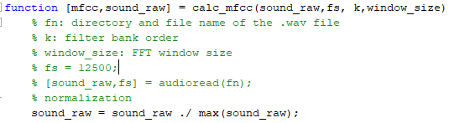
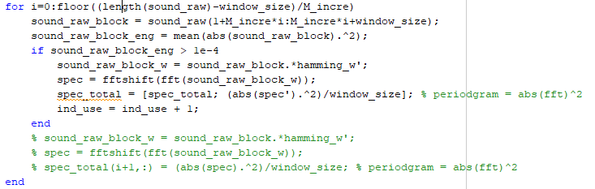
Calc_mfcc()
Normalize the input voice signal according to its maximum amplitude.
When calculating the periodogram, we only consider the time-domain block that has higher energies => bypassing the “quite” segments of the input voice signal
Dependencies: relying on melfb() and my_dct()

Slide 5
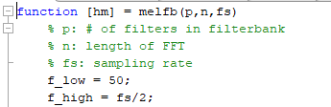
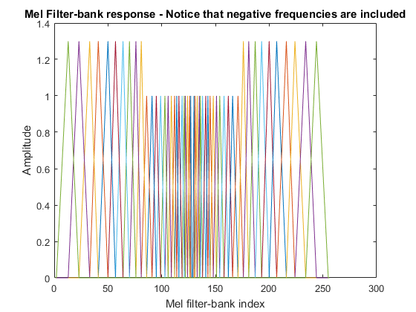
melfb()
Generate the filter bank responses based on # of filter banks, spectral length, and sampling rate.
A pre-emphasis on high frequency components of the filter banks is applied.

Slide 6

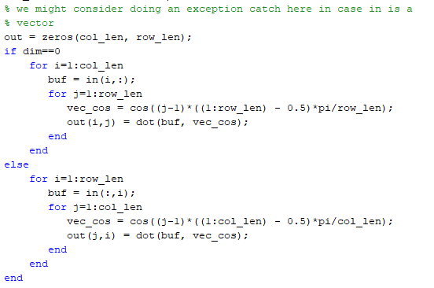
my_dct()
Perform DCT on the logarithm of the wrapped periodogram of the input voice signal

Slide 7


lbg()
Generate a codebook contains M centroids based on the training datasets.
MFCC coefficients should be normalized to achieve better performance.
Hyper-parameters:
# of centroids used
Stepsize: 1e-2
Error threshold: 11
Error metric: L2-ecludian distance

Slide 8
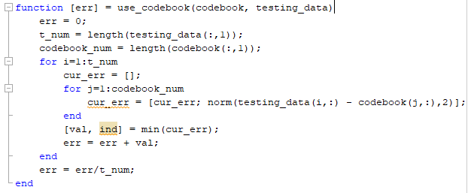
use_codebook()
Calculate the average L2 Euclidian distance between the given testing datasets and the nearest centroided stored in the given codebook.
We will be using this average L2 Euclidian distance from different codebooks to do speaker identification

Slide 9
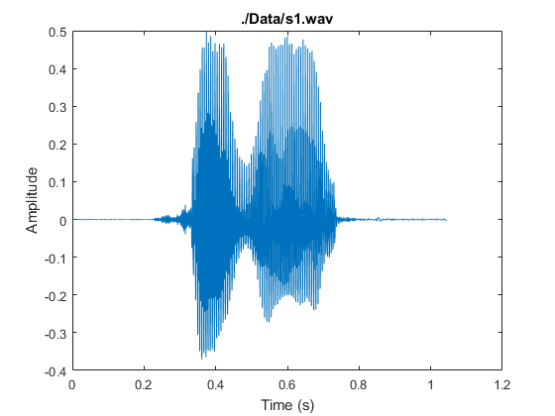
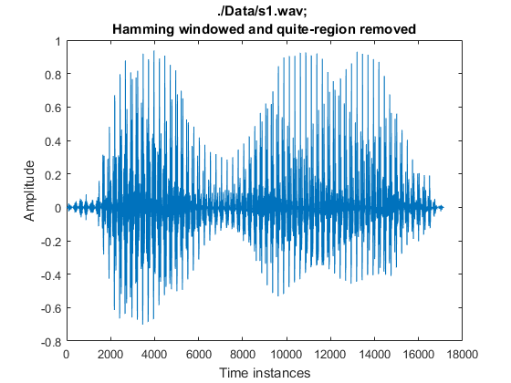
Step 1 – input normalization and processing
Subtract mean;
Normalize amplitude;
Remove block of symbols whose RMS value is too small;
Raw input
Processed input with overlap
We will use this waveform to compute STFT

Slide 10
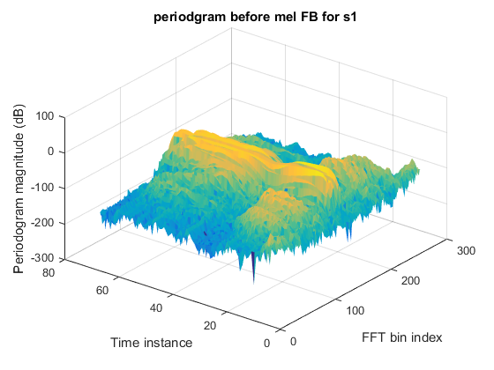
Step 2 – periodogram calculation
FFT#1
FFT#2
FFT#67
…..
STFT
Processed input with overlap
We will use this waveform to compute STFT

Slide 11
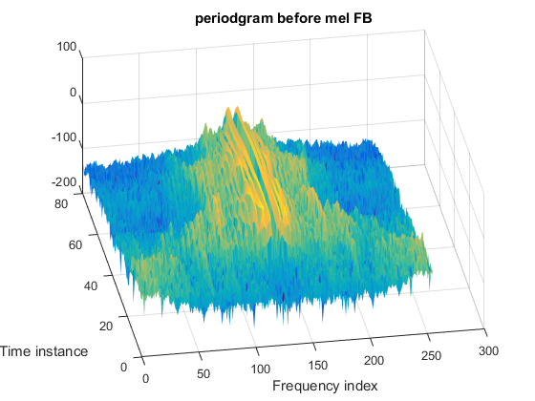
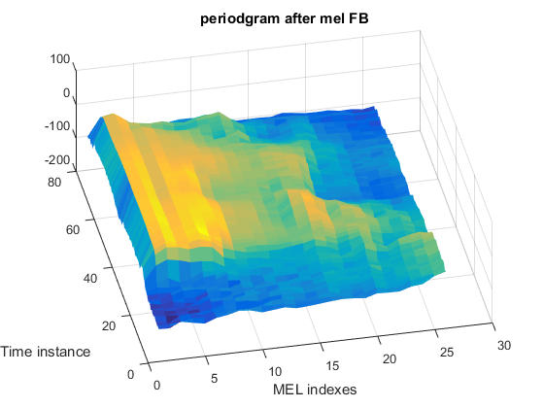
Step 3 – Applying Mel-FB
Apply MEL-FB
Notice that MEL FB “smooth” out the periodogram but preserves the temporal-spectral shape info.

Slide 12
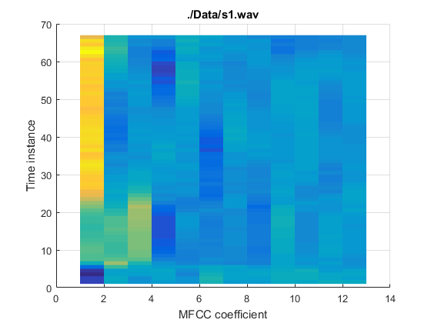
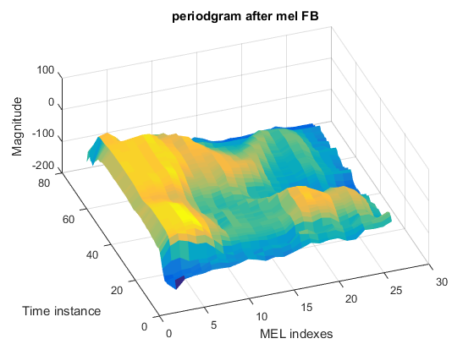
Step 4 – use DCT to get the MFCC coefficients
DCT
Note: For the obtained 26 (from 1 to 26) MFC coefficients, we only keep the 2-15 coefficients, as shown in the feature map.

Slide 13
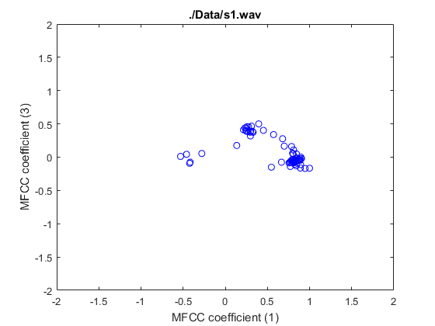
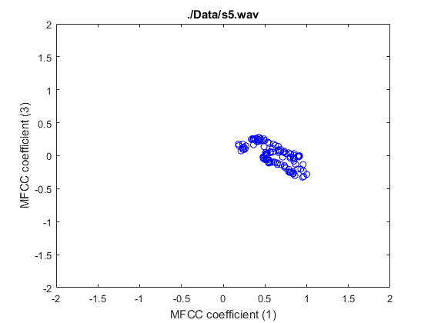
Step 5 – visualize MFCC coefficients…
Visualizing the MFCC coefficients distribution for the training set signal S1 and S5.

Slide 14
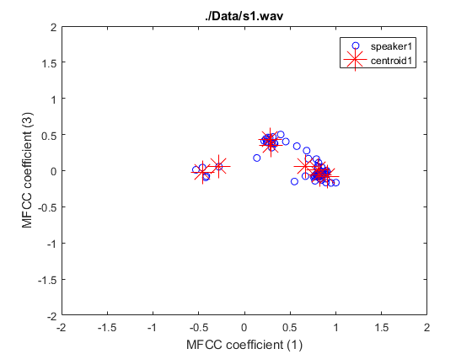
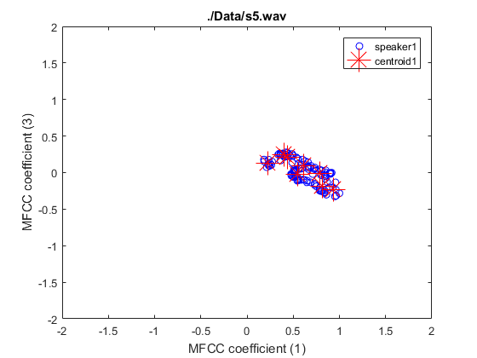
Step 6 – Generate the codebooks with LBG
Centroids in each codebook=8, in this case

Slide 15
Voice recognition evaluation
Evaluation based on the testing-sets provided by Prof. Ding
Evaluation based on noise-corrupted training-sets
Evaluation based on ~100/300/500 Hz notch filtered training-sets centered at DC, 500 Hz, 1000 Hz, 3000 Hz

Slide 16
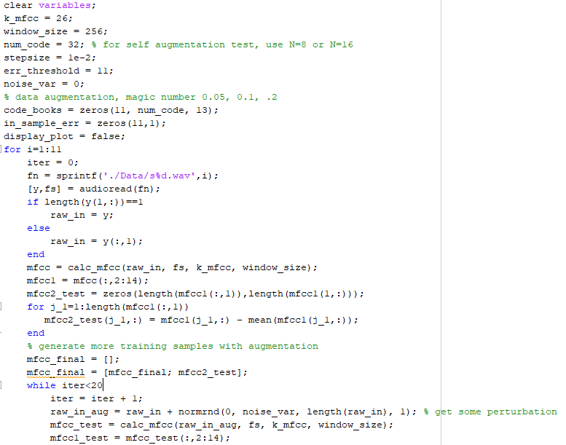
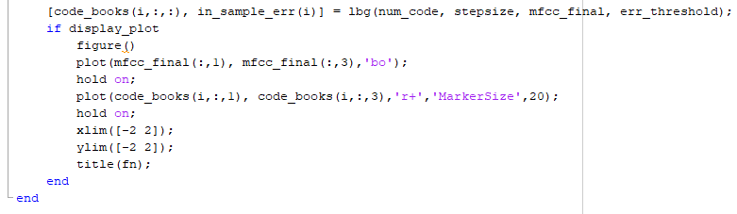
Evaluation based on the testing-sets provided by Prof. Ding
Use main_script.m
Generate the 11 codebooks using the training sets
Add some small variance random noise to the original input to create more training sets (optional)

Slide 17
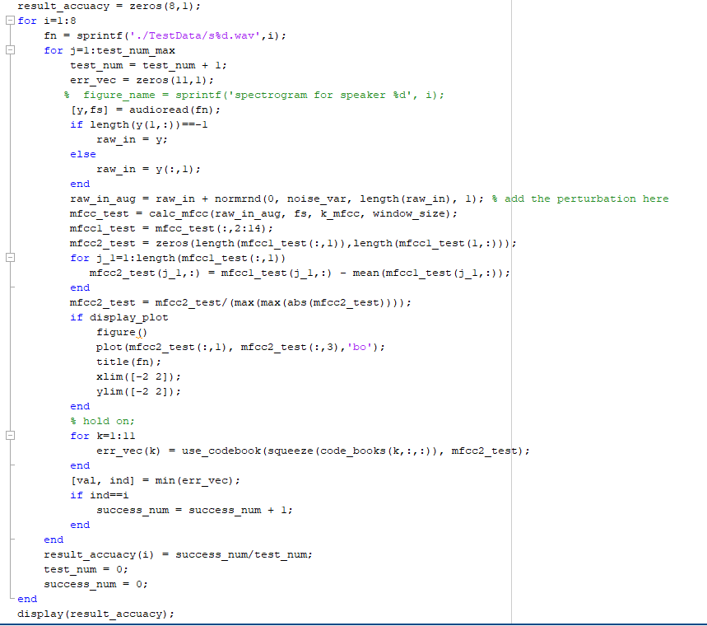
Evaluation based on the testing-sets provided by Prof. Ding
Calculate the MFCC features from Prof. Ding’s given testing samples.
Calculate the average L2 distance for one speaker to each of the 11 codebook
If the “correct” codebook yields the lowest L2 error, a success recognition is registered..

Slide 18
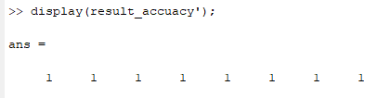
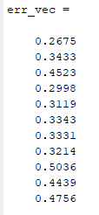
Evaluation based on the testing-sets provided by Prof. Ding
100% recognition success rate is achieved!
This makes sense because the MFCC coefficients distribution between the training and testing samples are quite similar.
L2 distance between testing sample #1 and the 11 codebooks;
Notice that codebook #1 gives the lowest error;

Slide 19
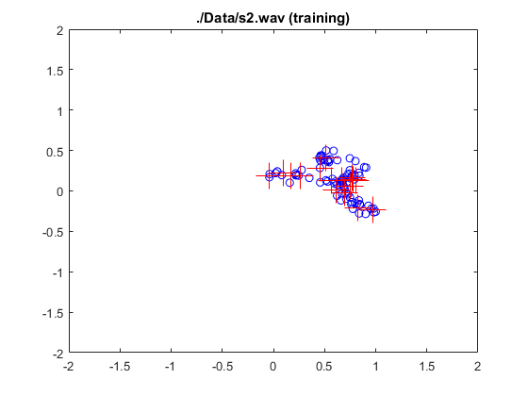
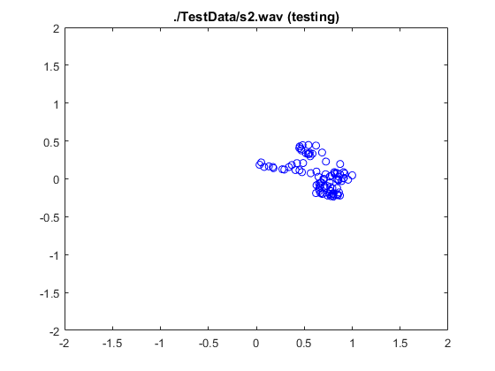
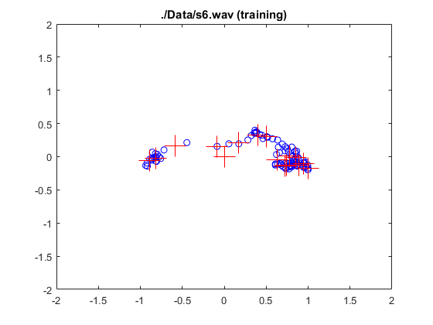
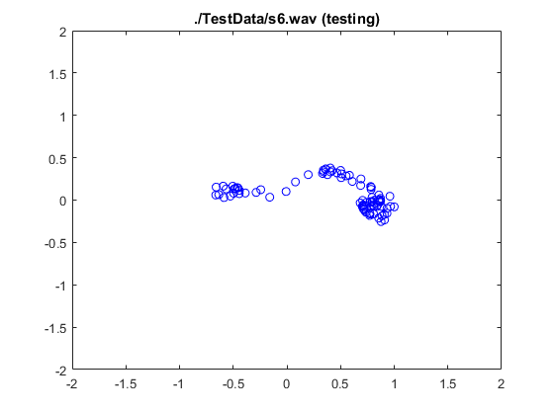
Evaluation based on the testing-sets provided by Prof. Ding – similarity between the training and testing sample
Training
Evaluation
Similarities of the MFCC features distribution between the training sample and evaluation sample of the same speaker indicates the robustness of these features!
Notice that different speakers INDEED has distinct MFCC features distribution even if they are saying the same word!
Training
Evaluation
Coefficient(3)
Coefficient(1)

Slide 20

Evaluation based on the noise-corrupted testing-sets
Original testing S1
Use main_script_gaussian.m
Generate the 11 codebooks using the training sets
Add some small variance (0.001, 0.01, 0.1, 0.2, 0.4) random noise to the original input to create more training sets
S1 with random noise (0.001 var)
S1 with random noise (0.01 var)
S1 with random noise (0.1 var)
S1 with random noise (0.2 var)
S1 with random noise (0.4 var)

Slide 21
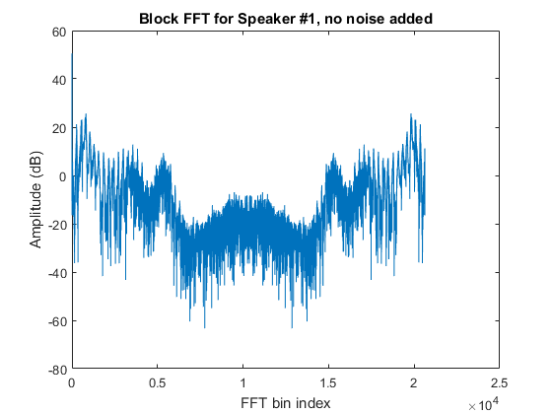
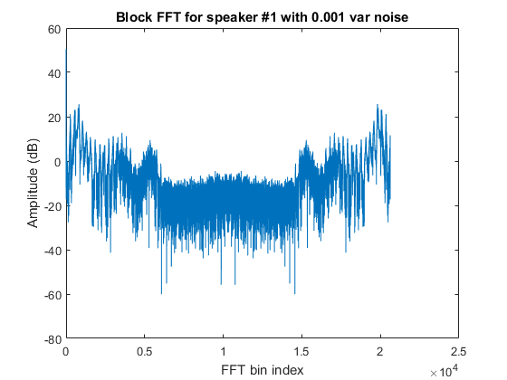
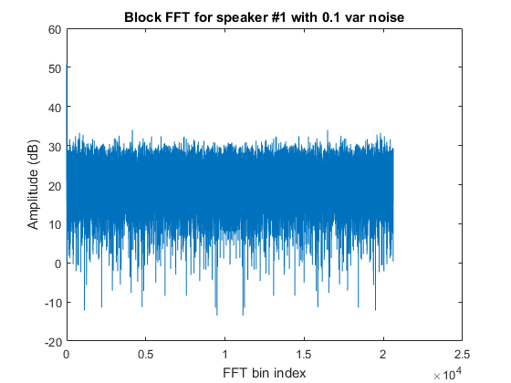
Evaluation based on the noise-corrupted testing-sets
Spectral shapes might “merge” under the noise floor…

Slide 22
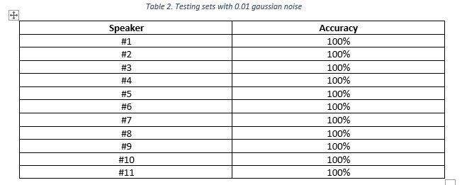
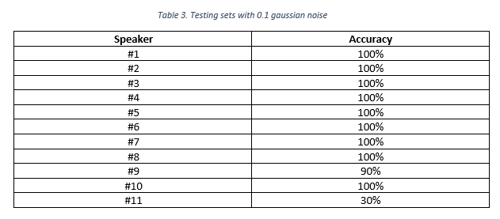
Evaluation based on the noise-corrupted testing-sets
3 dB SNR

Slide 23
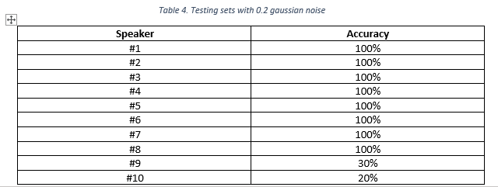
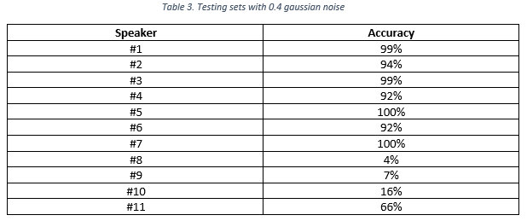
Evaluation based on the noise-corrupted testing-sets
~1 dB SNR
<0 dB SNR

Slide 24
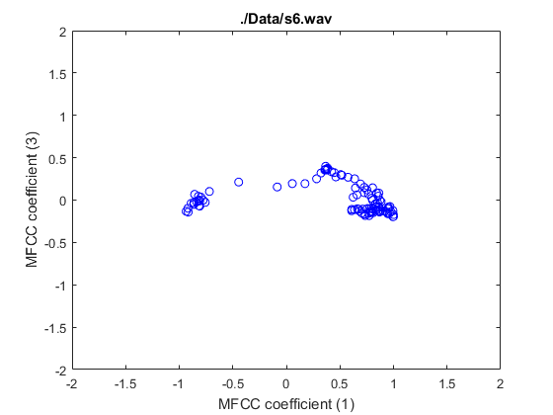
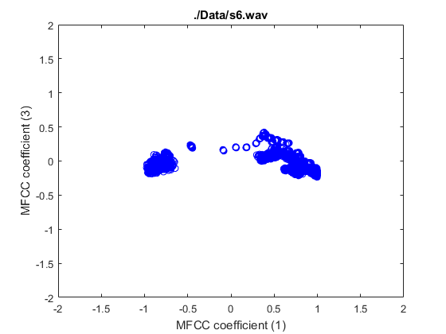
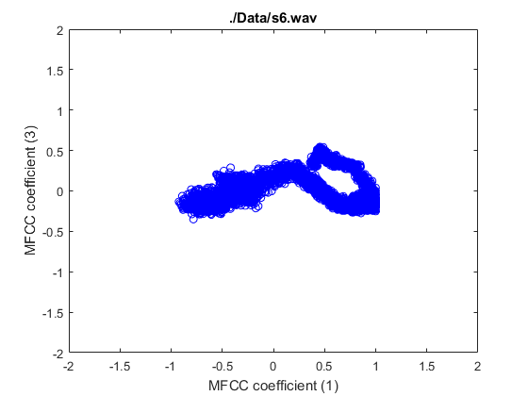
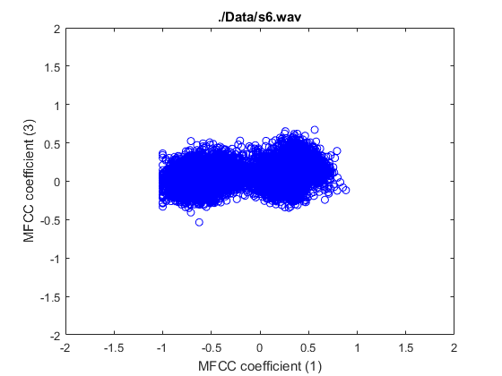
Effect of extensive noise on MFCC features…
No noise
Noise with 0.001 var
Noise with 0.01 var
Noise with 0.1 var
The heavy amount of the noise “hides” the distinct features of each speaker’s MFCC, resulting in reduced recognition accuracy

Slide 25
Evaluation based on the notch-filtered testing-sets
Use main_script_notch.m
Generate the 11 codebooks using the training sets
Applying 100 Hz BW notch filter centered at DC, 500 Hz, 1000 Hz, and 3000 Hz to the training sets, use the filtered voice signals as the testing sets.
Original testing S1
S1 filtered at DC
S1 filtered at 500 Hz
S1 filtered at 1kHz
S1 filtered at 3kHz

Slide 26
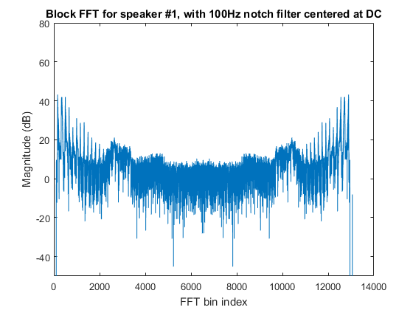
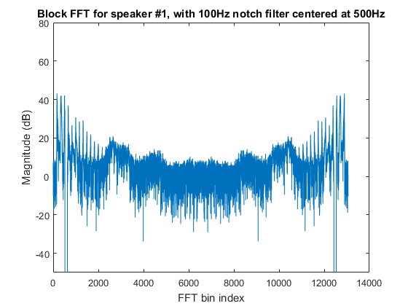
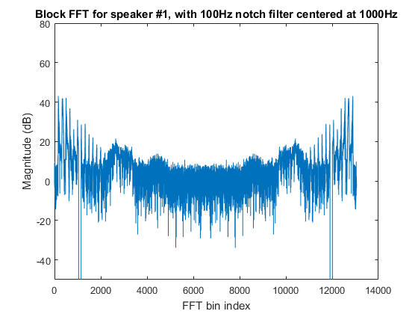
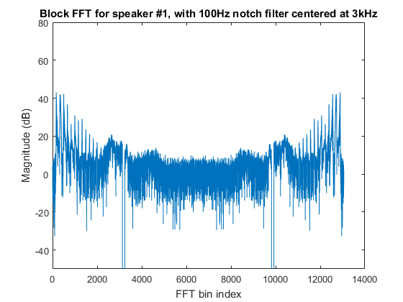
Evaluation based on the notch-filtered testing-sets
Applying notch filters to generate the testing sets..

Slide 27
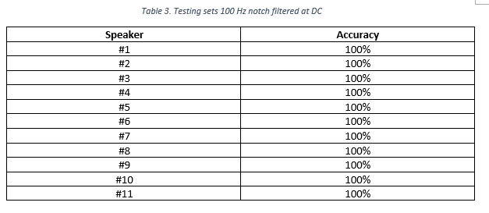
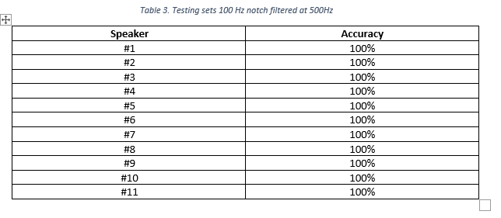
Evaluation based on the notch-filtered testing-sets

Slide 28
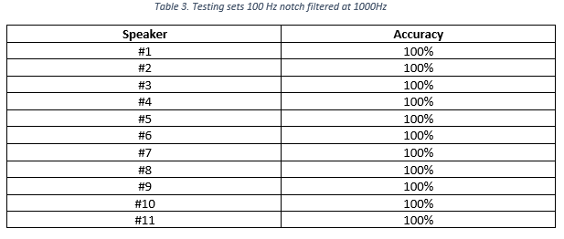
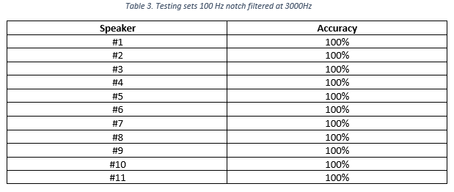
Evaluation based on the notch-filtered testing-sets

Slide 29
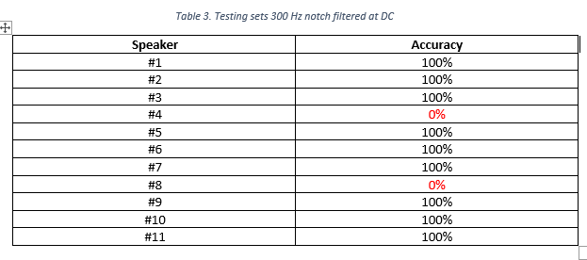
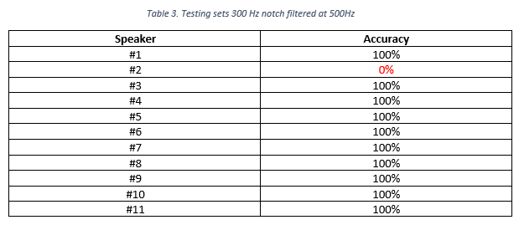
Pushed harder!! Increase notch BW to 300 Hz!

Slide 30


Pushed harder!! Increase notch BW to 300 Hz!
Seems low frequency components are more important in speaker recognition?

Slide 31


EVEN harder!! Increase notch BW to 500 Hz!
500 Hz
Lots of errors showing up, basically the system fails…

Slide 32


EVEN harder!! Increase notch BW to 500 Hz!
500 Hz
3000 Hz
If the 500Hz BW notch is applied at high frequencies (i.e, 3 kHz, its impact is minimum).
Again, this verifies our theory that the low frequency components are more important in speaker recognition

Slide 33

THANKS!!

Slide 34


Slide 35
6.25 kHz
3.125 kHz
-3.125 kHz
Frequency
-6.25 kHz

