Slide 1
WebGL Ocean Using Heightfield Method
Guanyu He
Hao Wu
CIS 565

Slide 2
Introduction
Simulate and shade an ocean using WebGL
Steps:
Simulate the ocean using heightfield method
Basic method
Fast Fourier Transformation method
Skybox: Cloud and the sunlight
Render:
Basic phong shading
Ray Tracing for reflection/refraction…SSBRDF

Slide 3
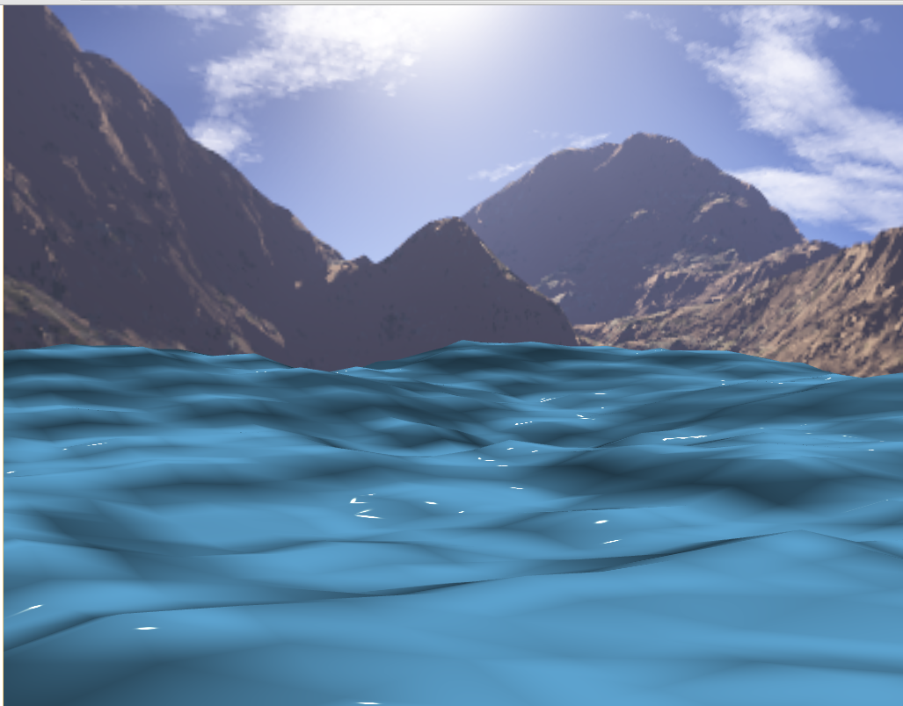
Demo
http://guanyuhe.com/oceanshader/water.html

Slide 4
Future Work
Water-Object interaction
Mouse interaction with ocean
Simulation with oceanographic model and FFT
Ray-tracing
Bump map for detailed surface
Infinite ocean size

