Slide 1
802.11 Trace Analysis

Slide 2
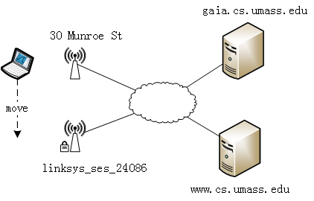
Packet Trace
Download “Wireshark_802_11.pcap” from bb.ustc.edu.cn

Slide 3
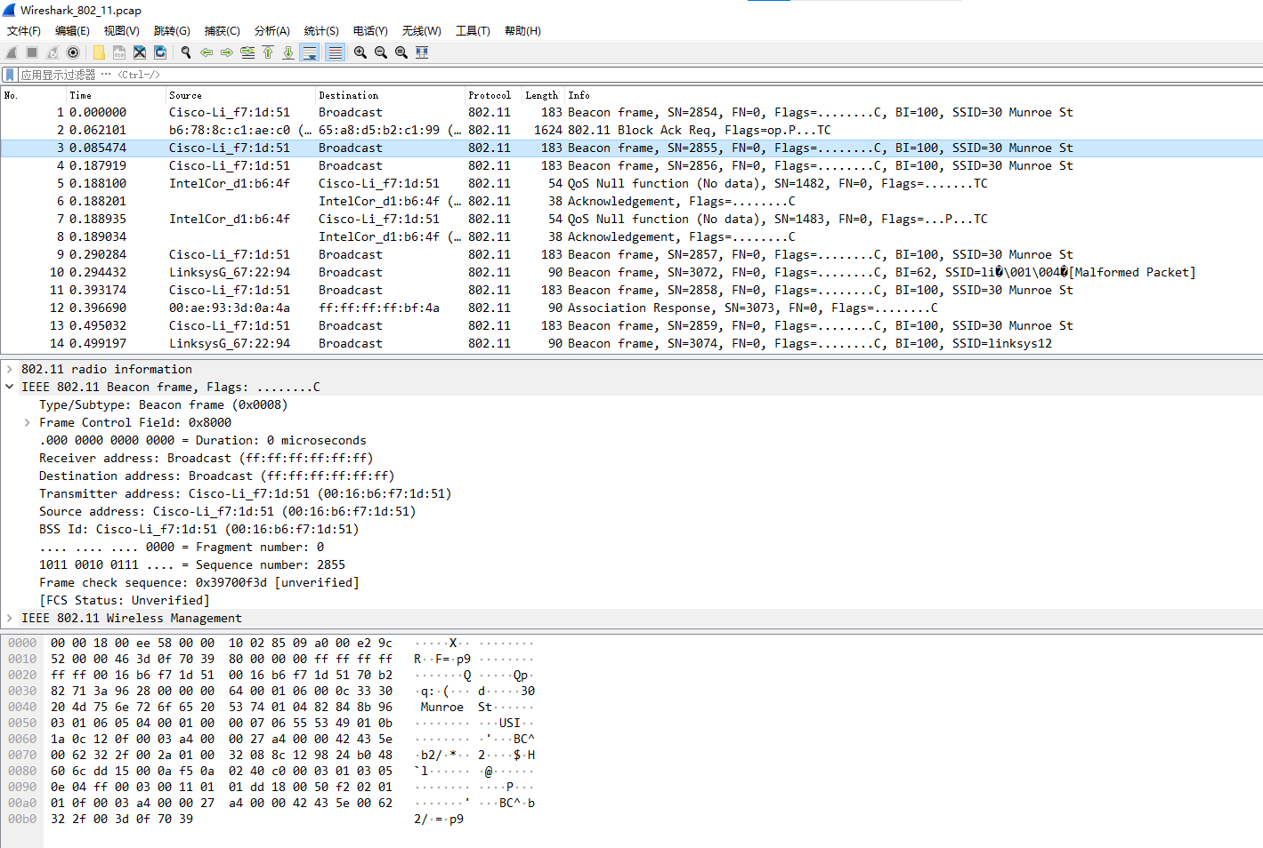
Packet Trace
Open “Wireshark_802_11.pcap” with Wireshark

Slide 4
Packet Trace
How this trace is captured?
The host is already associated with the 30 Munroe St AP when the trace begins.
At t = 24.82, the host makes an HTTP request to http://gaia.cs.umass.edu/wireshark-labs/alice.txt. The IP address of gaia.cs.umass.edu is 128.119.245.12.

Slide 5
Packet Trace
At t=32.82, the host makes an HTTP request to http://www.cs.umass.edu., whose IP address is 128.119.240.19.
At t = 49.58, the host disconnects from the 30 Munroe St AP and attempts to connect to the linksys_ses_24086. This is not an open access point, and so the host is eventually unable to connect to this AP.

Slide 6
Packet Trace
At t=63.0 the host gives up trying to associate with the linksys_ses_24086 AP, and associates again with the 30 Munroe St access point.

Slide 7
Questions
What are the SSIDs of the two APs that are issuing most of the beacon frames in this trace? [10%]
What are the three addresses in the Beacon frame from the two APs respectively. [15%]
2
2
6
6
6
2
6
0 - 2312
4
frame
control
duration
address
1
address
2
address
3
seq
control
address
4
payload
CRC

Slide 8
Questions
How many APs the wireless laptop has received Beacon frames from? List their MAC addresses. Why the laptop can receive frames from an AP even though it does not associate with the AP? [15%]
Find the 802.11 frame containing the SYN TCP segment for this first TCP session (that downloads alice.txt). What are the three MAC addresses in the frame, which is the address for wireless laptop / AP / first-hop router? [15%]

Slide 9
Questions
For the SYN-ACK segment of the first TCP session, what are the three MAC addresses in the frame, and which is the address for wireless laptop / AP / first-hop router? [15%]
For the above mentioned SYN-ACK segment, is the sender MAC address corresponds to the web server’s IP address? Why? [10%]

Slide 10
Questions
What two actions are taken (i.e., frames are sent) by the host in the trace just after t=49, to end the association with the 30 Munroe St AP? [10%]
Can you capture a similar trace? Why or why not? [10%]

Slide 11
Submission
Submit to bb.ustc.edu.cn
A pdf file named “id + name + Trace_analysis.pdf”
For Q1 – Q5, you need to give the answer and give a screenshot of the information of the beacon frame in Wireshark.
For Q6 – Q8, you need to give your answer and a brief explanation.
Deadline: 2022/01/25

