Slide 1
Packet Capture with Pingplotter

Slide 2
Preparation
Install Wireshark
Freeware from https://www.wireshark.org/
Install Pingplotter
Download a copy from www.bb.ustc.edu.cn
14 days trial
You can use it to perform traceroute, and configure things like packet size, transfer interval, etc.
Graphic output for network metrics

Slide 3
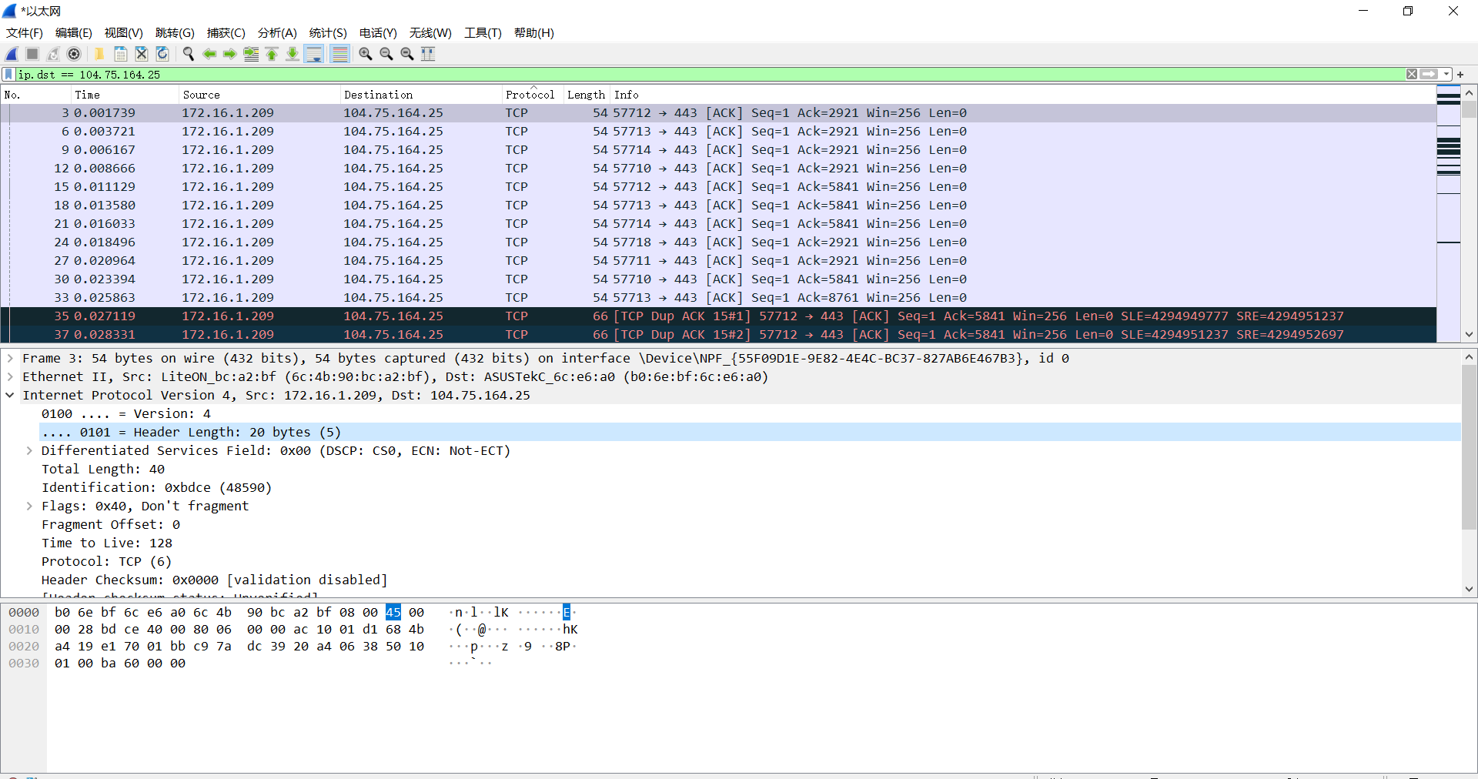
Wireshark
Notes:
wireshark 是一款开源的用于网络封包分析软件。在本实验中，我们将只用到wireshark的抓包和过滤功能

Slide 4
Wireshark
Learning material
wireshark_lecture.pdf from www.bb.ustc.edu.cn
https://wiki.wireshark.org/DisplayFilters
wireshark_Display_Filters cheat sheets from https://packetlife.net/media/library/13/Wireshark_Display_Filters.pdf
Notes:
wireshark 是一款开源的用于网络封包分析软件。在本实验中，我们将只用到wireshark的过滤功能。所列网址为学习wireshark filter的材料

Slide 5
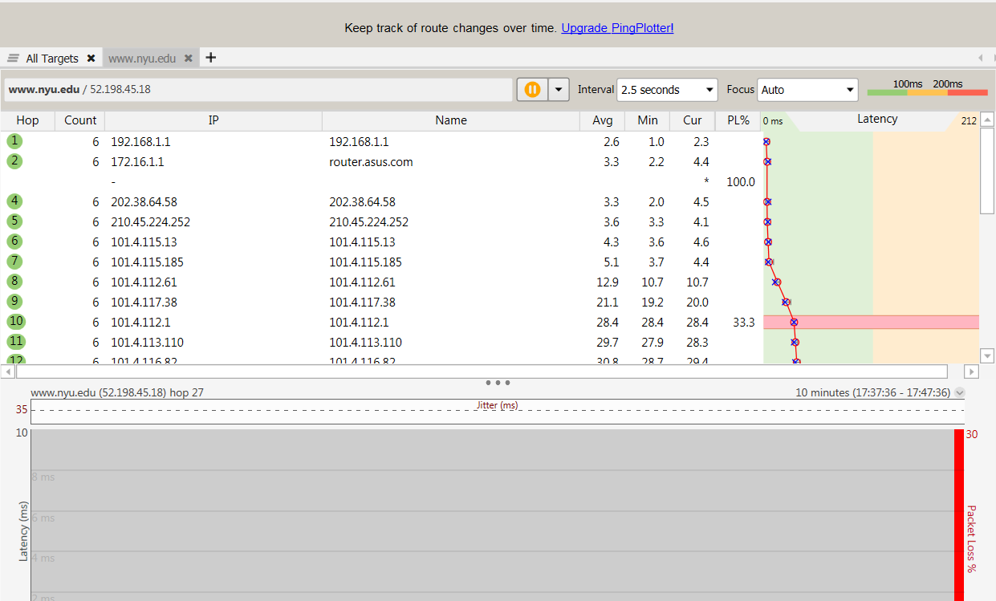
PingPlotter
Notes:
该例子是追踪纽约大学(www.nyu.edu)的路由信息

Slide 6
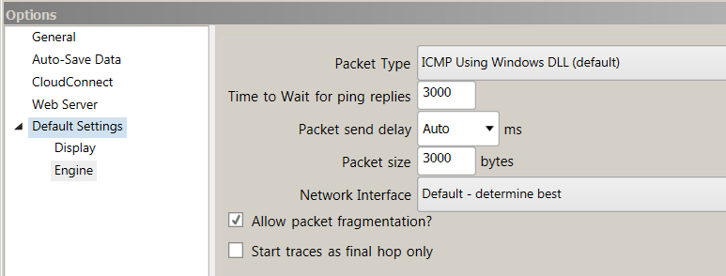
Packet Capture
Set packet size as 3000 bytes
Menu→edit→options
Keep “Allow packet fragmentation” checked

Slide 7
Packet Capture
Traceroute to gaia.cs.umass.edu, stop when the count is 3 or 4.
Meanwhile, capture the packets with wireshark

Slide 8
Questions
Display the rules to filter the IP and ICMP packets between source host and destination host. Are there any other Application-layer protocols when you traceroute gaia.cs.umass.edu?[15%]
How many hops between source and destination? Find the first ICMP Echo Request packet that has TTL=1, is this packet fragmented? If yes, how many fragments, and why is the packet fragmented? [25%]
How the packets are fragmented and reassembled? For each fragment, how to know if it is the last fragment, and how many bytes are contained in each fragment? Print the packets and answer by highlighting the relevant fields. [20%]

Slide 9
Questions
What packet is returned from the router when TTL expires? What is contained in the payload of the packet? [20%]
Which link crosses the Pacific, give the router addresses at the two ends of the link. Explained your reason. [10%]
How long is the trans-Pacific link? (given that a bit transmits 2*10^8 m/s in fiber). [10%]

Slide 10
Submission
Submit to bb.ustc.edu.cn
A pdf file named “id + name + traceroute.pdf”
The packet trace you have captured.
Your answers to the questions
For Q1, you need to give the screenshot of the result after performing filter rules and packet with the application-layer protocol.
For Q2- Q6, you need to give the corresponding screenshot and explanation.
deadline: 2021/11/30

