Slide 1
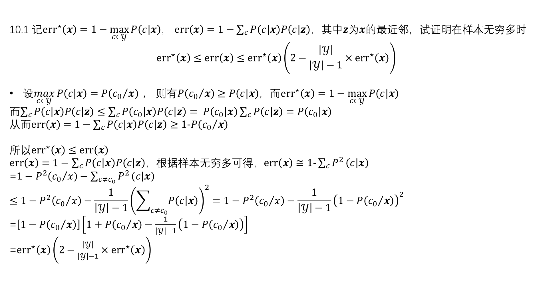
10.1 记${err}^{⋆}\left(x\right)=1−\max_{c∈𝒴}{P\left(c | x\right)}$， $err\left(x\right)=1−\sum_{c}{P\left(c | x\right)P\left(c | z\right)}$，其中$z$为$x$的最近邻，试证明在样本无穷多时
$${err}^{⋆}\left(x\right)≤err\left(x\right)≤{err}^{⋆}\left(x\right)\left(2−\frac{\left|𝒴\right|}{\left|𝒴\right|−1}×{err}^{⋆}\left(x\right)\right)$$
设$\max_{c∈𝒴}{P\left(c | x\right)}=P\left({c_{0}}/x\right) , 则有P\left({c_{0}}/x\right)≥P\left(c | x\right)$，而${err}^{⋆}\left(x\right)=1−\max_{c∈𝒴}{P\left(c | x\right)}$
而$\sum_{c}{P\left(c | x\right)P\left(c | z\right)}≤\sum_{c}{P\left(c_{0} | x\right)P\left(c | z\right)}= P\left(c_{0} | x\right)\sum_{c}{P\left(c | z\right)}=P\left(c_{0} | x\right)$
从而$err\left(x\right)=1−\sum_{c}{P\left(c | x\right)P\left(c | z\right)}≥1−P\left({c_{0}}/x\right)$
所以${err}^{⋆}\left(x\right)≤err\left(x\right)$
$err\left(x\right)=1−\sum_{c}{P\left(c | x\right)P\left(c | z\right)}$，根据样本无穷多可得，$err\left(x\right)≅1−\sum_{c}{P^{2}}\left(c | x\right)$
=$1−P^{2}\left({c_{0}}/x\right)−\sum_{c≠c_{0}}{P^{2}}\left(c | x\right)$
$$≤1−P^{2}\left({c_{0}}/x\right)−\frac{1}{\left|𝒴\right|−1}{\left(\sum_{c≠c_{0}}{P\left(c | x\right)}\right)}^{2}=1−P^{2}\left({c_{0}}/x\right)−\frac{1}{\left|𝒴\right|−1}{\left(1−P\left({c_{0}}/x\right)\right)}^{2}$$
=$\left[1−P\left({c_{0}}/x\right)\right]\left[1+P\left({c_{0}}/x\right)−\frac{1}{\left|𝒴\right|−1}\left(1−P\left({c_{0}}/x\right)\right)\right]$
=${err}^{⋆}\left(x\right)\left(2−\frac{\left|𝒴\right|}{\left|𝒴\right|−1}×{err}^{⋆}\left(x\right)\right)$

Slide 2
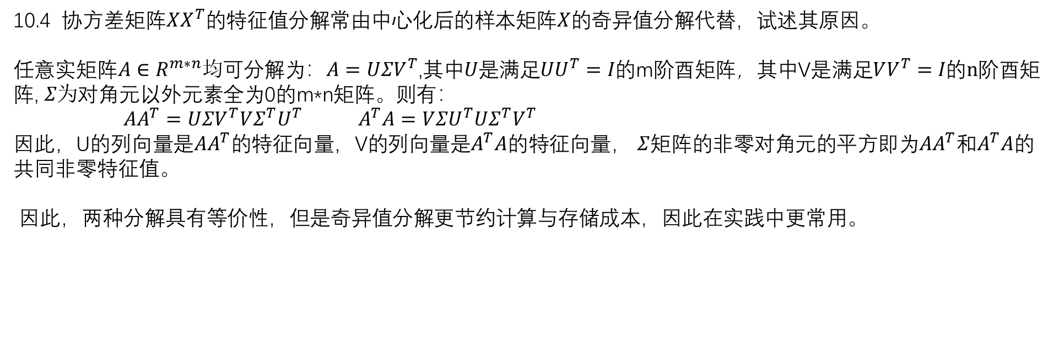
10.4 协方差矩阵$XX^{T}的$特征值分解常由中心化后的样本矩阵$X的$奇异值分解代替，试述其原因。
任意实矩阵$A∈R^{m∗n}均$可分解为：$A=UΣV^{T}$,其中$U是$满足$UU^{T}=I的$m阶酉矩阵，其中V$是$满足$VV^{T}=I的n$阶酉矩阵, $Σ为$对角元以外元素全为0的m*n矩阵。则有：
$AA^{T}=UΣV^{T}VΣ^{T}U^{T}$ $A^{T}A=VΣU^{T}UΣ^{T}V^{T}$
因此，U的列向量是$AA^{T}$的特征向量，V的列向量是$A^{T}A$的特征向量， $Σ$矩阵的非零对角元的平方即为$AA^{T}$和$A^{T}A$的共同非零特征值。
因此，两种分解具有等价性，但是奇异值分解更节约计算与存储成本，因此在实践中更常用。

Slide 3
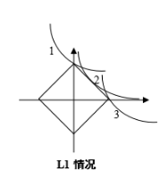

11.5 结合图11.2，举例说明L1 正则化在何种情况下不能产生稀疏解。
L1正则化产生稀疏解的原因是loss的等值线和正则化的等值线的交点更容易出现
在坐标轴上。因此，当交点不在坐标轴上时，则不会产生稀疏解，即误差等值
线存在斜率为1或-1的点，且与L1正则等值线相切。
11.7 试述直接求解L0范数正则化会遇到的困难。
L0范数等于非零元素的个数，不连续且非凸，很难通过优化直接求解，若特征数为N，则需要
在$2^{N}的$情况下分别求解，因此比较困难。

Slide 4
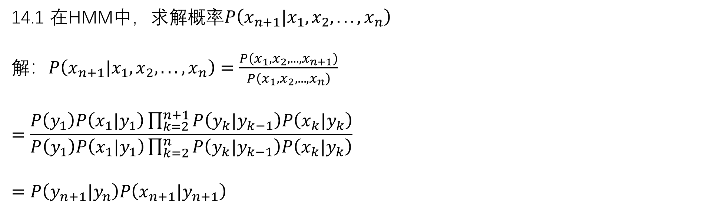
14.1 在HMM中，求解概率$P\left(x_{n+1}|x_{1}, x_{2}, . . . ,x_{n}\right)$
解：$P\left(x_{n+1}|x_{1}, x_{2}, . . . ,x_{n}\right)=\frac{P\left(x_{1}, x_{2}, . . . ,x_{n+1}\right)}{P\left(x_{1}, x_{2}, . . . ,x_{n}\right)}$
$$=\frac{P\left(y_{1}\right)P\left(x_{1}|y_{1}\right)\prod_{k=2}^{n+1}{P\left(y_{k}|y_{k−1}\right)P\left(x_{k}|y_{k}\right)}}{P\left(y_{1}\right)P\left(x_{1}|y_{1}\right)\prod_{k=2}^{n}{P\left(y_{k}|y_{k−1}\right)P\left(x_{k}|y_{k}\right)}}$$
$$=P\left(y_{n+1}|y_{n}\right)P\left(x_{n+1}|y_{n+1}\right)$$

Slide 5
14.1 在HMM中，求解概率$P\left(x_{n+1}|x_{1}, x_{2}, . . . ,x_{n}\right)$
解：$P\left(x_{n+1}|x_{1}, x_{2}, . . . ,x_{n}\right)=\frac{P\left(x_{1}, x_{2}, . . . ,x_{n+1}\right)}{P\left(x_{1}, x_{2}, . . . ,x_{n}\right)}$
$$=\frac{P\left(y_{1}\right)P\left(x_{1}|y_{1}\right)\prod_{k=2}^{n+1}{P\left(y_{k}|y_{k−1}\right)P\left(x_{k}|y_{k}\right)}}{P\left(y_{1}\right)P\left(x_{1}|y_{1}\right)\prod_{k=2}^{n}{P\left(y_{k}|y_{k−1}\right)P\left(x_{k}|y_{k}\right)}}$$
$$=P\left(y_{n+1}|y_{n}\right)P\left(x_{n+1}|y_{n+1}\right)$$

Slide 6
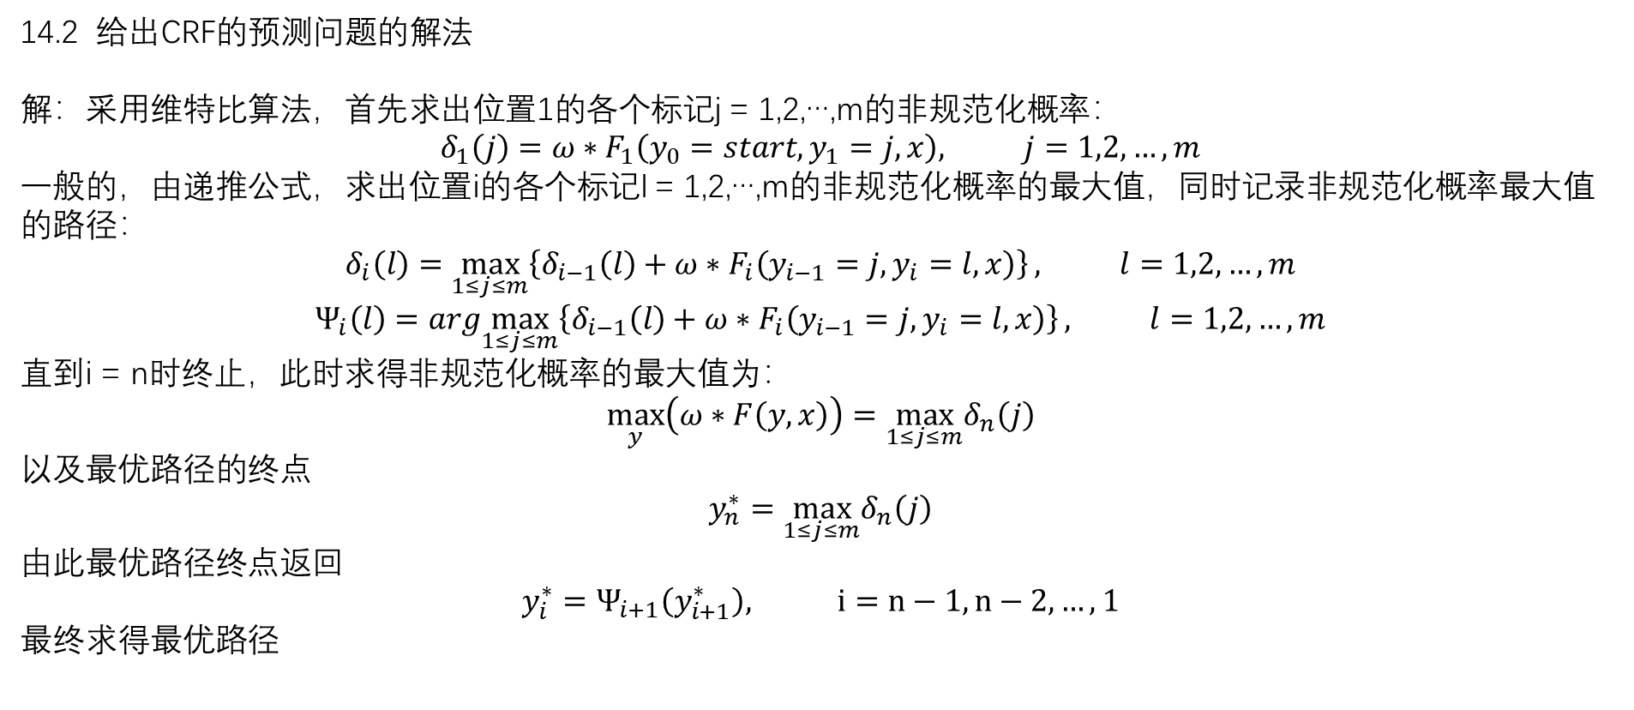
14.2 给出CRF的预测问题的解法
解：采用维特比算法，首先求出位置1的各个标记j = 1,2,…,m的非规范化概率：
$$δ_{1}\left(j\right)=ω∗F_{1}\left(y_{0}=start,y_{1}=j,x\right), j=1,2,…,m$$
一般的，由递推公式，求出位置i的各个标记l = 1,2,…,m的非规范化概率的最大值，同时记录非规范化概率最大值的路径：
$$δ_{i}\left(l\right)=\max_{1≤j≤m}\left\{δ_{i−1}\left(l\right)+ω∗F_{i}\left(y_{i−1}=j,y_{i}=l,x\right)\right\}, l=1,2,…,m$$
$$Ψ_{i}\left(l\right)=arg\max_{1≤j≤m}\left\{δ_{i−1}\left(l\right)+ω∗F_{i}\left(y_{i−1}=j,y_{i}=l,x\right)\right\}, l=1,2,…,m$$
直到i = n时终止，此时求得非规范化概率的最大值为：
$$\max_{y}\left(ω∗F\left(y,x\right)\right)=\max_{1≤j≤m}δ_{n}\left(j\right)$$
以及最优路径的终点
$$y_{n}^{∗}=\max_{1≤j≤m}δ_{n}\left(j\right)$$
由此最优路径终点返回
$$y_{i}^{∗}=Ψ_{i+1}\left(y_{i+1}^{∗}\right), i=n−1,n−2,…,1$$
最终求得最优路径

Slide 7
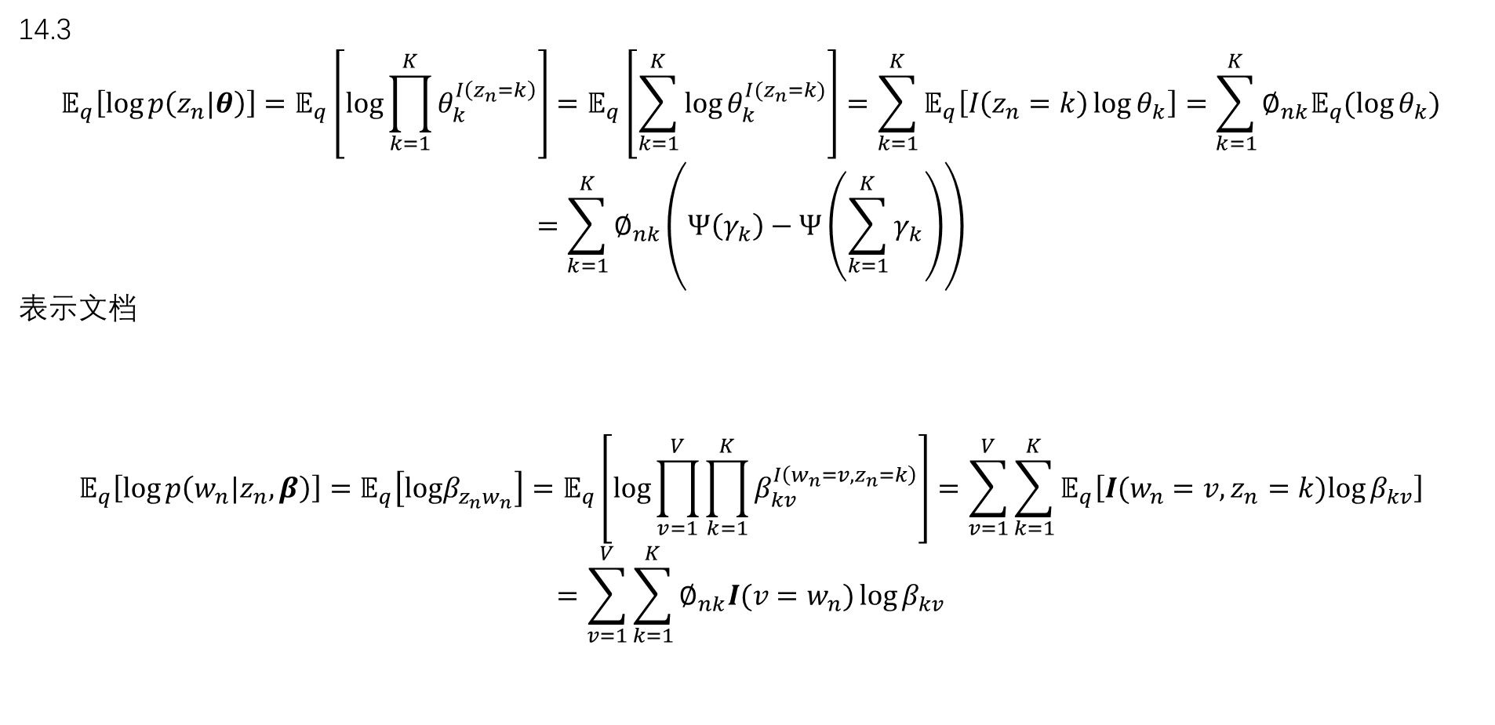
14.3
$$𝔼_{q}\left[log⁡p\left(z_{n}|θ\right)\right]=𝔼_{q}\left[log\prod_{k=1}^{K}{θ_{k}^{I\left(z_{n}=k\right)}}\right]=𝔼_{q}\left[\sum_{k=1}^{K}{log⁡θ_{k}^{I(z_{n}=k)}}\right]=\sum_{k=1}^{K}{𝔼_{q}\left[I\left(z_{n}=k\right)\log{θ_{k}}\right]=\sum_{k=1}^{K}{∅_{nk}𝔼_{q}(\log{θ_{k}})}}$$
$$=\sum_{k=1}^{K}{∅_{nk}}\left(Ψ\left(γ_{k}\right)−Ψ\left(\sum_{k=1}^{K}{γ_{k}}\right)\right)$$
表示文档
$$𝔼_{q}\left[log⁡p\left(w_{n}|z_{n},β\right)\right]=𝔼_{q}\left[logβ_{z_{n}w_{n}}\right]=𝔼_{q}\left[log\prod_{v=1}^{V}{\prod_{k=1}^{K}{β_{kv}^{I\left(w_{n}=v,z_{n}=k\right)}}}\right]=\sum_{v=1}^{V}{\sum_{k=1}^{K}{𝔼_{q}\left[I(w_{n}=v,z_{n}=k)log⁡β_{kv}\right]}}$$
$$=\sum_{v=1}^{V}{\sum_{k=1}^{K}{∅_{nk}I({v=w}_{n})}}log⁡β_{kv}$$

Slide 8
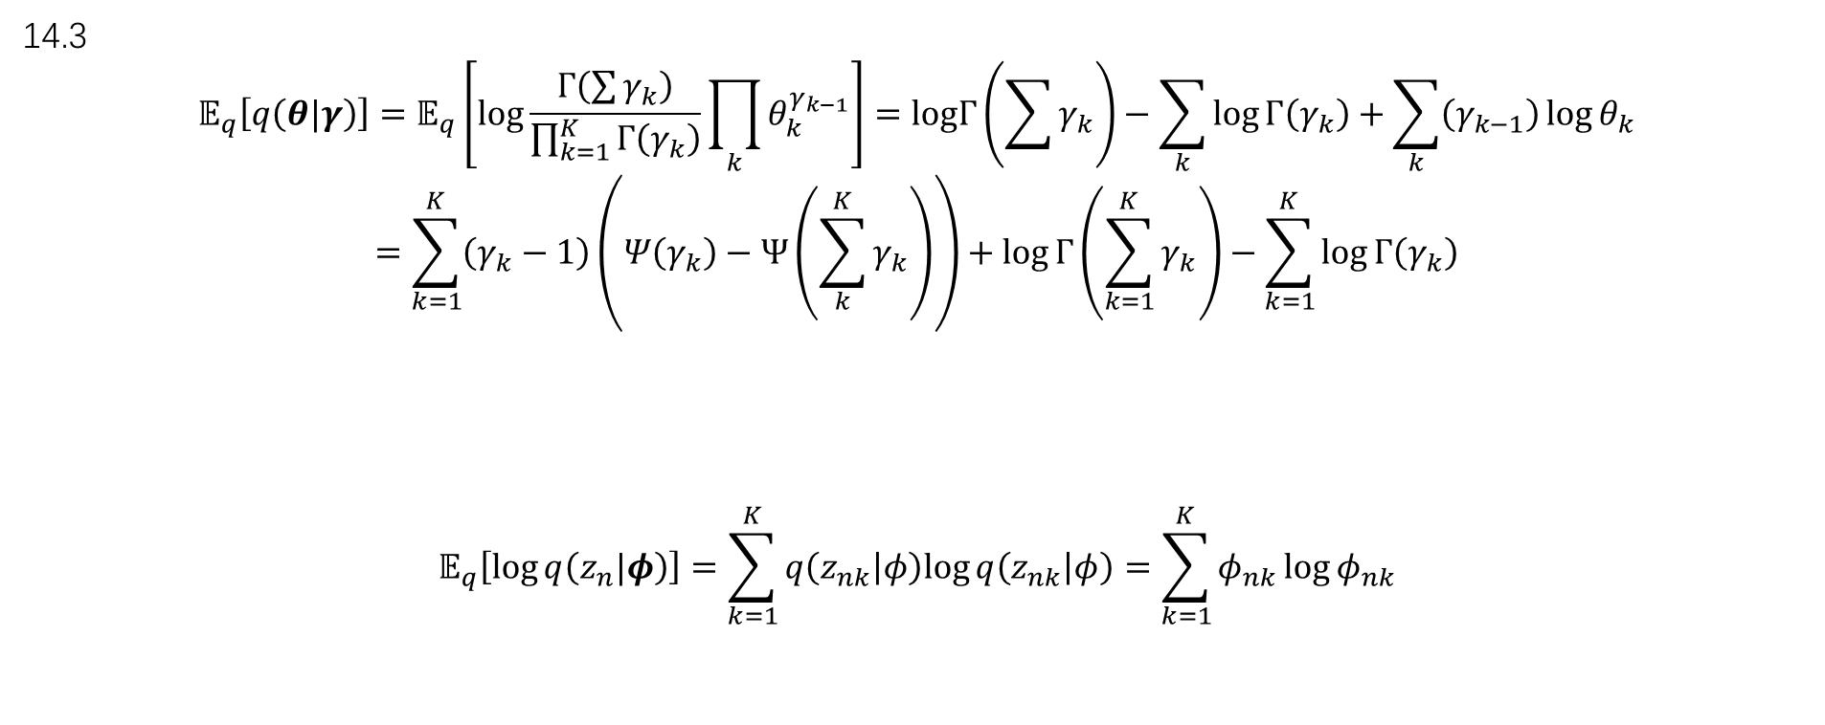
14.3
$$𝔼_{q}\left[q\left(θ|γ\right)\right]=𝔼_{q}\left[log\frac{Γ\left(\sum{γ_{k}}\right)}{\prod_{k=1}^{K}{Γ\left(γ_{k}\right)}}\prod_{k}{θ_{k}^{γ_{k−1}}}\right]=logΓ\left(\sum{γ_{k}}\right)−\sum_{k}{log}Γ\left(γ_{k}\right)+\sum_{k}{\left(γ_{k−1}\right)\log{θ_{k}}}$$
$$=\sum_{k=1}^{K}{\left(γ_{k}−1\right)\left(Ψ\left(γ_{k}\right)−Ψ\left(\sum_{k}^{K}{γ_{k}}\right)\right)}+\log{Γ\left(\sum_{k=1}^{K}{γ_{k}}\right)}−\sum_{k=1}^{K}{\log{Γ\left(γ_{k}\right)}}$$
$$𝔼_{q}\left[\log{q\left(z_{n}|φ\right)}\right]=\sum_{k=1}^{K}{q\left(z_{nk} | φ\right)log⁡}q\left(z_{nk} | φ\right)=\sum_{k=1}^{K}{φ_{nk}\log{φ_{nk}}}$$

Slide 9
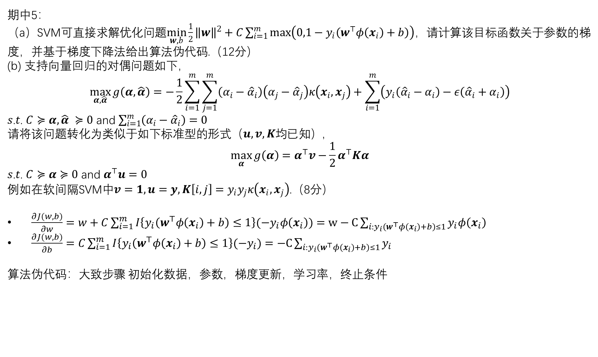
期中5：
（a）SVM可直接求解优化问题$\min_{w,b}{\frac{1}{2}{\left\|w\right\|}^{2}+C\sum_{i=1}^{m}{\max\left(0,1−y_{i}\left(w^{⊤}φ\left(x_{i}\right)+b\right)\right)}}$，请计算该目标函数关于参数的梯度，并基于梯度下降法给出算法伪代码.（12分）
(b) 支持向量回归的对偶问题如下，
$$\max_{α, \hat{α}}{g\left(α,\hat{α}\right)=−\frac{1}{2}\sum_{i=1}^{m}{\sum_{j=1}^{m}{\left(α_{i}−{\hat{α}}_{i}\right)\left(α_{j}−{\hat{α}}_{j}\right)κ\left(x_{i},x_{j}\right)}}+\sum_{i=1}^{m}{\left(y_{i}\left({\hat{α}}_{i}−α_{i}\right)−ε\left({\hat{α}}_{i}+α_{i}\right)\right)}}$$
𝑠.𝑡. $C≽α, \hat{α} ≽0$ and $\sum_{i=1}^{m}{\left(α_{i}−{\hat{α}}_{i}\right)}=0$
请将该问题转化为类似于如下标准型的形式（$u,v,K$均已知）,
$$\max_{α}{g\left(α\right)=α^{⊤}v−\frac{1}{2}α^{⊤}Kα}$$
𝑠.𝑡. $C≽α≽0$ and $α^{⊤}u=0$
例如在软间隔SVM中$v=1, u=y, K\left[i,j\right]=y_{i}y_{j}κ\left(x_{i},x_{j}\right)$.（8分）
$\frac{∂J(w,b)}{∂w}=w+C\sum_{i=1}^{m}{I\left\{y_{i}\left(w^{⊤}φ\left(x_{i}\right)+b\right)≤1\right\}(−y_{i}φ\left(x_{i}\right))}=w−C\sum_{i:y_{i}\left(w^{⊤}φ\left(x_{i}\right)+b\right)≤1}{y_{i}φ\left(x_{i}\right)}$
$\frac{∂J(w,b)}{∂b}=C\sum_{i=1}^{m}{I\left\{y_{i}\left(w^{⊤}φ\left(x_{i}\right)+b\right)≤1\right\}(−y_{i})}=−C\sum_{i:y_{i}\left(w^{⊤}φ\left(x_{i}\right)+b\right)≤1}{y_{i}}$
算法伪代码：大致步骤 初始化数据，参数，梯度更新，学习率，终止条件

Slide 10

期中5：
$$\max_{α, \hat{α}}{g\left(α,\hat{α}\right)=−\frac{1}{2}\sum_{i=1}^{m}{\sum_{j=1}^{m}{\left(α_{i}−{\hat{α}}_{i}\right)\left(α_{j}−{\hat{α}}_{j}\right)κ\left(x_{i},x_{j}\right)}}+\sum_{i=1}^{m}{\left(y_{i}\left({\hat{α}}_{i}−α_{i}\right)−ε\left({\hat{α}}_{i}+α_{i}\right)\right)}}$$
$$\max_{α}{g\left(α\right)=α^{⊤}v−\frac{1}{2}α^{⊤}Kα}$$
$$\sum_{i=1}^{m}{\sum_{j=1}^{m}{\left(α_{i}−{\hat{α}}_{i}\right)\left(α_{j}−{\hat{α}}_{j}\right)κ\left(x_{i},x_{j}\right)}}=\sum_{i=1}^{m}{\sum_{j=1}^{m}{α_{i}α_{j}k_{ij}−{\hat{α}}_{i}α_{j}k_{ij}−α_{i}{\hat{α}}_{j}k_{ij}+{\hat{α}}_{i}{\hat{α}}_{j}k_{ij}}}$$
令$α^{∗}=\left(\begin{matrix}α \\ \hat{α}\end{matrix}\right)$，则有$\sum_{i=1}^{m}{\sum_{j=1}^{m}{α_{i}α_{j}k_{ij}−{\hat{α}}_{i}α_{j}k_{ij}−α_{i}{\hat{α}}_{j}k_{ij}+{\hat{α}}_{i}{\hat{α}}_{j}k_{ij}}}={α^{∗}}^{T}Kα^{∗}$,其中，K=$\left[\begin{matrix}k & −k \\ −k & k\end{matrix}\right]$
令 $v=\left(\begin{matrix}−y−ε \\ y−ε\end{matrix}\right)$,则有$\sum_{i=1}^{m}{\left(y_{i}\left({\hat{α}}_{i}−α_{i}\right)−ε\left({\hat{α}}_{i}+α_{i}\right)\right)}={α^{∗}}^{T}v$
因此，原式形变为$\max_{α^{∗}}{g\left(α^{∗}\right)={α^{∗}}^{⊤}v−\frac{1}{2}{α^{∗}}^{⊤}Kα^{∗}}$ s.t. $C≥α^{∗}≥0,{α^{∗}}^{T}v=0$

Slide 11
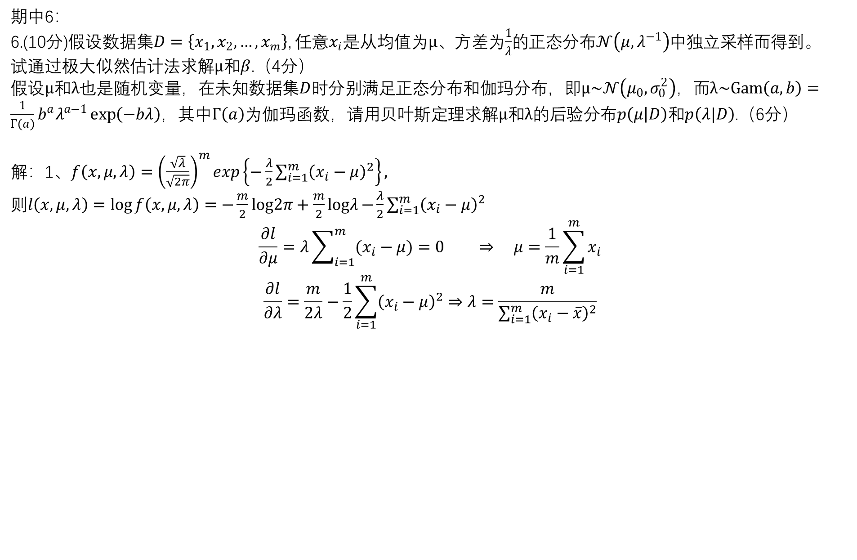
期中6：
6.(10分)假设数据集$D=\left\{x_{1},x_{2},…,x_{m}\right\}$, 任意$x_{i}$是从均值为$μ$、方差为$\frac{1}{λ}$的正态分布$𝒩\left(μ,λ^{−1}\right)$中独立采样而得到。
试通过极大似然估计法求解$μ$和$β$.（4分）
假设$μ$和$λ$也是随机变量，在未知数据集$D$时分别满足正态分布和伽玛分布，即$μ\sim 𝒩\left(μ_{0},σ_{0}^{2}\right)$，而$λ\sim Gam\left(a,b\right)=\frac{1}{Γ\left(a\right)}b^{a}λ^{a−1}\exp\left(−bλ\right)$，其中$Γ\left(a\right)$为伽玛函数，请用贝叶斯定理求解$μ$和$λ$的后验分布$p\left(μ | D\right)$和$p\left(λ|D\right)$.（6分）
解：1、$f\left(x,μ,λ\right)={\left(\frac{\sqrt{λ}}{\sqrt{2π}}\right)}^{m}exp\left\{−\frac{λ}{2}\sum_{i=1}^{m}{{\left(x_{i}−μ\right)}^{2}}\right\},$
则$l\left(x,μ,λ\right)=\log{f\left(x,μ,λ\right)}=−\frac{m}{2}log2π+\frac{m}{2}logλ−{\frac{λ}{2}\sum_{i=1}^{m}{{\left(x_{i}−μ\right)}^{2}}}$
$$\frac{∂l}{∂μ}=λ\sum_{i=1}^{m}{(x_{i}−μ)}=0 ⇒ μ=\frac{1}{m}\sum_{i=1}^{m}{x_{i}}$$
$$\frac{∂l}{∂λ}=\frac{m}{2λ}−\frac{1}{2}\sum_{i=1}^{m}{{\left(x_{i}−μ\right)}^{2}}⇒λ=\frac{m}{\sum_{i=1}^{m}{{\left(x_{i}−\overline{x}\right)}^{2}}}$$

Slide 12

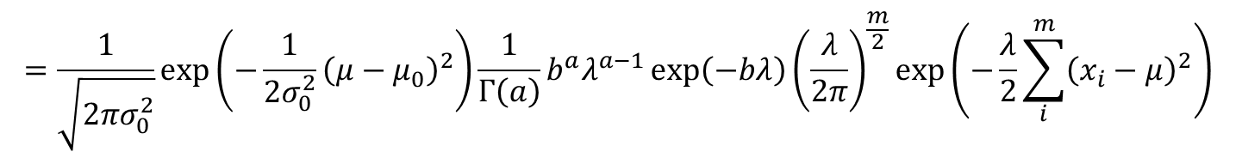


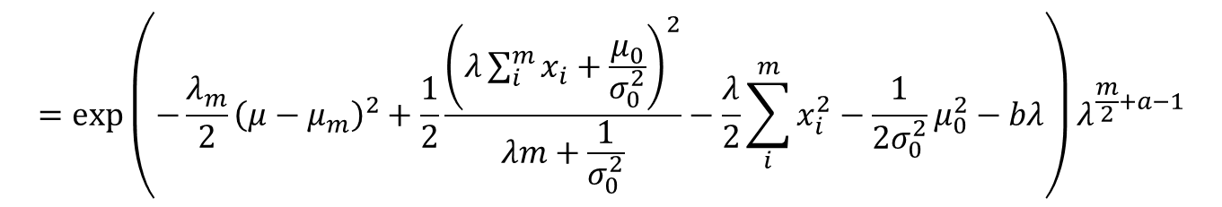
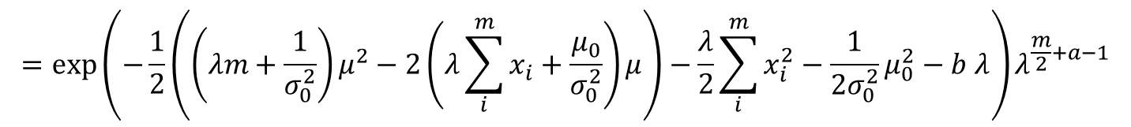
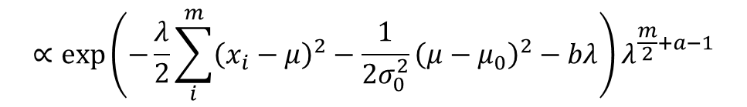
期中6：
6.(10分)假设数据集$D=\left\{x_{1},x_{2},…,x_{m}\right\}$, 任意$x_{i}$是从均值为$μ$、方差为$\frac{1}{λ}$的正态分布$𝒩\left(μ,λ^{−1}\right)$中独立采样而得到。
试通过极大似然估计法求解$μ$和$β$.（4分）
假设$μ$和$λ$也是随机变量，在未知数据集$D$时分别满足正态分布和伽玛分布，即$μ\sim 𝒩\left(μ_{0},σ_{0}^{2}\right)$，而$λ\sim Gam\left(a,b\right)=\frac{1}{Γ\left(a\right)}b^{a}λ^{a−1}\exp\left(−bλ\right)$，其中$Γ\left(a\right)$为伽玛函数，请用贝叶斯定理求解$μ$和$λ$的后验分布$p\left(μ | D\right)$和$p\left(λ|D\right)$.（6分）
解：2、$P\left(D,λ,μ\right)=P\left(D | μ,λ\right)p\left(λ\right)p\left(μ\right)=p\left(λ\right)p\left(μ\right)\prod_{i=1}^{m}{p\left(x_{i} | μ,λ\right)}$
$$=\frac{1}{\sqrt{2πσ_{0}^{2}}}\exp\left(−\frac{1}{2σ_{0}^{2}}{\left(μ−μ_{0}\right)}^{2}\right)\frac{1}{Γ\left(a\right)}b^{a}λ^{a−1}\exp\left(−bλ\right){\left(\frac{λ}{2π}\right)}^{\frac{m}{2}}\exp\left(−\frac{λ}{2}\sum_{i}^{m}{{\left(x_{i}−μ\right)}^{2}}\right)$$
$$∝\exp\left(−\frac{λ}{2}\sum_{i}^{m}{{\left(x_{i}−μ\right)}^{2}}−\frac{1}{2σ_{0}^{2}}{\left(μ−μ_{0}\right)}^{2}−bλ\right)λ^{\frac{m}{2}+a−1}$$
记$λ_{m}=λm+\frac{1}{σ_{0}^{2}}$
$$=\exp\left(−\frac{1}{2}\left(\left(λm+\frac{1}{σ_{0}^{2}}\right)μ^{2}−2\left(λ\sum_{i}^{m}{x_{i}}+\frac{μ_{0}}{σ_{0}^{2}}\right)μ\right)−\frac{λ}{2}\sum_{i}^{m}{x_{i}^{2}}−\frac{1}{2σ_{0}^{2}}μ_{0}^{2}−b λ\right)λ^{\frac{m}{2}+a−1}$$
$$μ_{m}=\frac{λ\sum_{i}^{m}{x_{i}}+\frac{μ_{0}}{σ_{0}^{2}}}{λm+\frac{1}{σ_{0}^{2}}}$$
$$=\exp\left(−\frac{λ_{m}}{2}{\left(μ−μ_{m}\right)}^{2}+\frac{1}{2}\frac{{\left(λ\sum_{i}^{m}{x_{i}}+\frac{μ_{0}}{σ_{0}^{2}}\right)}^{2}}{λm+\frac{1}{σ_{0}^{2}}}−\frac{λ}{2}\sum_{i}^{m}{x_{i}^{2}}−\frac{1}{2σ_{0}^{2}}μ_{0}^{2}−bλ\right)λ^{\frac{m}{2}+a−1}$$

Slide 13
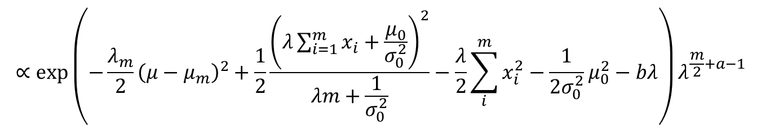
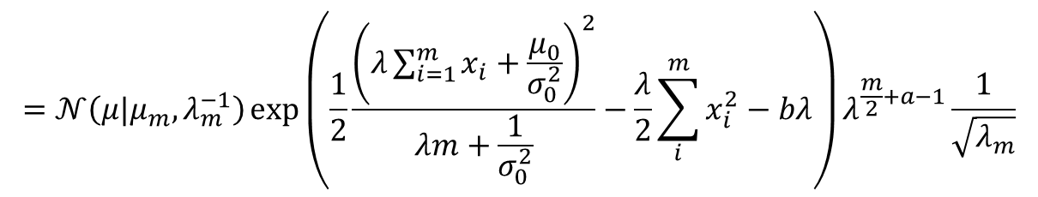

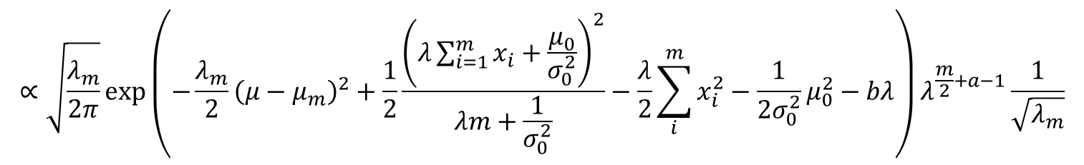


期中6：
6.(10分)假设数据集$D=\left\{x_{1},x_{2},…,x_{m}\right\}$, 任意$x_{i}$是从均值为$μ$、方差为$\frac{1}{λ}$的正态分布$𝒩\left(μ,λ^{−1}\right)$中独立采样而得到。
试通过极大似然估计法求解$μ$和$β$.（4分）
假设$μ$和$λ$也是随机变量，在未知数据集$D$时分别满足正态分布和伽玛分布，即$μ\sim 𝒩\left(μ_{0},σ_{0}^{2}\right)$，而$λ\sim Gam\left(a,b\right)=\frac{1}{Γ\left(a\right)}b^{a}λ^{a−1}\exp\left(−bλ\right)$，其中$Γ\left(a\right)$为伽玛函数，请用贝叶斯定理求解$μ$和$λ$的后验分布$p\left(μ | D\right)$和$p\left(λ|D\right)$.（6分）
解：2、$P\left(D,λ,μ\right)=P\left(D | μ,λ\right)p\left(λ\right)p\left(μ\right)=p\left(λ\right)p\left(μ\right)\prod_{i=1}^{m}{p\left(x_{i} | μ,λ\right)}$
记$λ_{m}=λm+\frac{1}{σ_{0}^{2}}$
$$∝\exp\left(−\frac{λ_{m}}{2}{\left(μ−μ_{m}\right)}^{2}+\frac{1}{2}\frac{{\left(λ\sum_{i=1}^{m}{x_{i}}+\frac{μ_{0}}{σ_{0}^{2}}\right)}^{2}}{λm+\frac{1}{σ_{0}^{2}}}−\frac{λ}{2}\sum_{i}^{m}{x_{i}^{2}}−\frac{1}{2σ_{0}^{2}}μ_{0}^{2}−bλ\right)λ^{\frac{m}{2}+a−1}$$
$$μ_{m}=\frac{λ\sum_{i}^{m}{x_{i}}+\frac{μ_{0}}{σ_{0}^{2}}}{λm+\frac{1}{σ_{0}^{2}}}$$
$$∝\sqrt{\frac{λ_{m}}{2π}}\exp\left(−\frac{λ_{m}}{2}{\left(μ−μ_{m}\right)}^{2}+\frac{1}{2}\frac{{\left(λ\sum_{i=1}^{m}{x_{i}}+\frac{μ_{0}}{σ_{0}^{2}}\right)}^{2}}{λm+\frac{1}{σ_{0}^{2}}}−\frac{λ}{2}\sum_{i}^{m}{x_{i}^{2}}−\frac{1}{2σ_{0}^{2}}μ_{0}^{2}−bλ\right)λ^{\frac{m}{2}+a−1}\frac{1}{\sqrt{λ_{m}}}$$
$$=𝒩\left(μ|μ_{m},λ_{m}^{−1}\right)\exp\left(\frac{1}{2}\frac{{\left(λ\sum_{i=1}^{m}{x_{i}}+\frac{μ_{0}}{σ_{0}^{2}}\right)}^{2}}{λm+\frac{1}{σ_{0}^{2}}}−\frac{λ}{2}\sum_{i}^{m}{x_{i}^{2}}−bλ\right)λ^{\frac{m}{2}+a−1}\frac{1}{\sqrt{λ_{m}}}$$

Slide 14
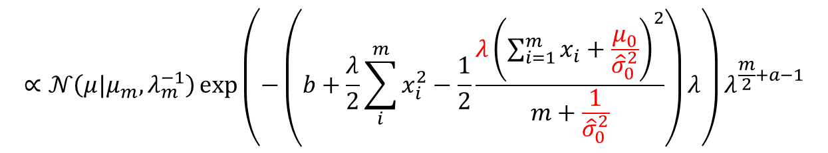

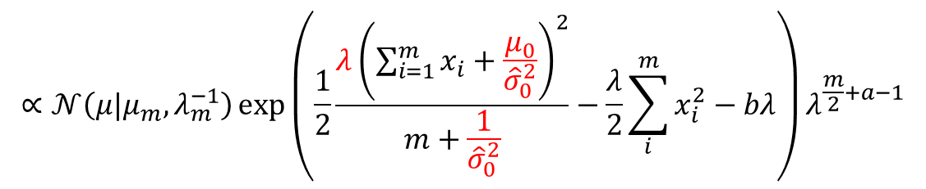

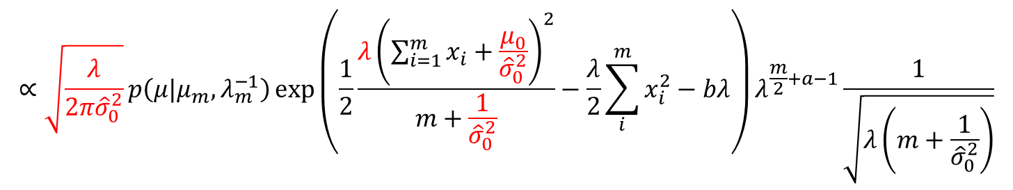


期中6：
6.(10分)假设数据集$D=\left\{x_{1},x_{2},…,x_{m}\right\}$, 任意$x_{i}$是从均值为$μ$、方差为$\frac{1}{λ}$的正态分布$𝒩\left(μ,λ^{−1}\right)$中独立采样而得到。
试通过极大似然估计法求解$μ$和$β$.（4分）
假设$μ$和$λ$也是随机变量，在未知数据集$D$时分别满足正态分布和伽玛分布，即$μ\sim 𝒩\left(μ_{0},σ_{0}^{2}\right)$，而$λ\sim Gam\left(a,b\right)=\frac{1}{Γ\left(a\right)}b^{a}λ^{a−1}\exp\left(−bλ\right)$，其中$Γ\left(a\right)$为伽玛函数，请用贝叶斯定理求解$μ$和$λ$的后验分布$p\left(μ | D\right)$和$p\left(λ|D\right)$.（6分）
解：2、$P\left(D,λ,μ\right)=P\left(D | μ,λ\right)p\left(λ\right)p\left(μ\right)=p\left(λ\right)p\left(μ\right)\prod_{i=1}^{m}{p\left(x_{i} | μ,λ\right)}$
需要限定$σ_{0}^{2}=\frac{{\hat{σ}}_{0}^{2}}{λ}$，$λ$才能满足Gamma分布
记$λ_{m}=λ\left(m+\frac{1}{{\hat{σ}}_{0}^{2}}\right)$
$$∝\sqrt{\frac{λ}{2π{\hat{σ}}_{0}^{2}}}p\left(μ|μ_{m},λ_{m}^{−1}\right)\exp\left(\frac{1}{2}\frac{{λ\left(\sum_{i=1}^{m}{x_{i}}+\frac{μ_{0}}{{\hat{σ}}_{0}^{2}}\right)}^{2}}{m+\frac{1}{{\hat{σ}}_{0}^{2}}}−\frac{λ}{2}\sum_{i}^{m}{x_{i}^{2}}−bλ\right)λ^{\frac{m}{2}+a−1}\frac{1}{\sqrt{λ\left(m+\frac{1}{{\hat{σ}}_{0}^{2}}\right)}}$$
$$μ_{m}=\frac{\sum_{i=1}^{m}{x_{i}}+\frac{μ_{0}}{{\hat{σ}}_{0}^{2}}}{m+\frac{1}{{\hat{σ}}_{0}^{2}}}$$
$$∝𝒩\left(μ|μ_{m},λ_{m}^{−1}\right)\exp\left(\frac{1}{2}\frac{{λ\left(\sum_{i=1}^{m}{x_{i}}+\frac{μ_{0}}{{\hat{σ}}_{0}^{2}}\right)}^{2}}{m+\frac{1}{{\hat{σ}}_{0}^{2}}}−\frac{λ}{2}\sum_{i}^{m}{x_{i}^{2}}−bλ\right)λ^{\frac{m}{2}+a−1}$$
$$∝𝒩\left(μ|μ_{m},λ_{m}^{−1}\right)\exp\left(−\left(b+\frac{λ}{2}\sum_{i}^{m}{x_{i}^{2}}−\frac{1}{2}\frac{{λ\left(\sum_{i=1}^{m}{x_{i}}+\frac{μ_{0}}{{\hat{σ}}_{0}^{2}}\right)}^{2}}{m+\frac{1}{{\hat{σ}}_{0}^{2}}}\right)λ\right)λ^{\frac{m}{2}+a−1}$$
$$𝒩\left(μ|μ_{m},λ_{m}^{−1}\right)Gam\left(a_{m},b_{m}\right)$$

