Slide 1
Bloomfilter result demo for cs564
Haijin He

Slide 2
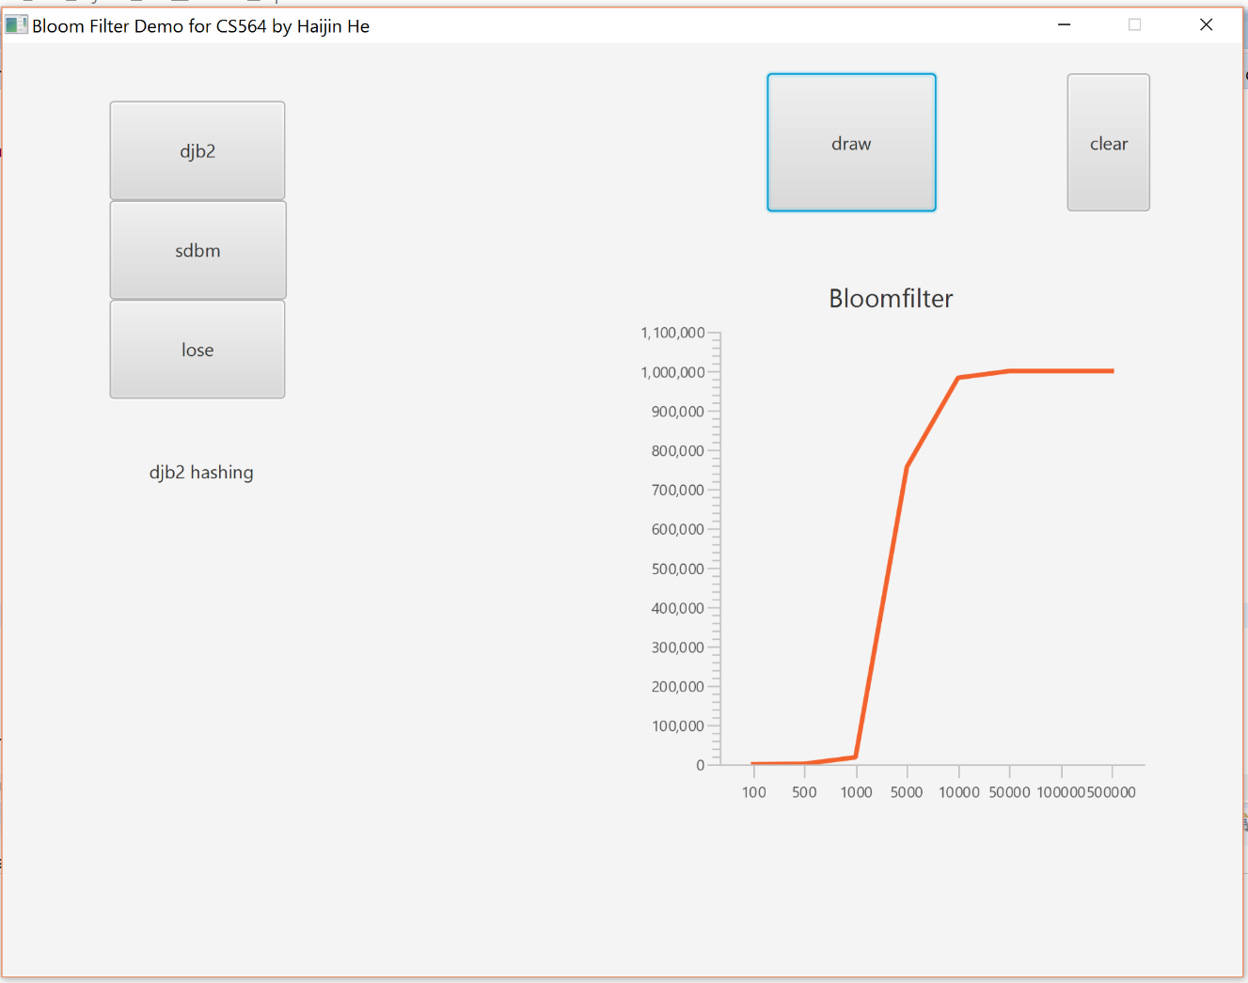
djb2

Slide 3
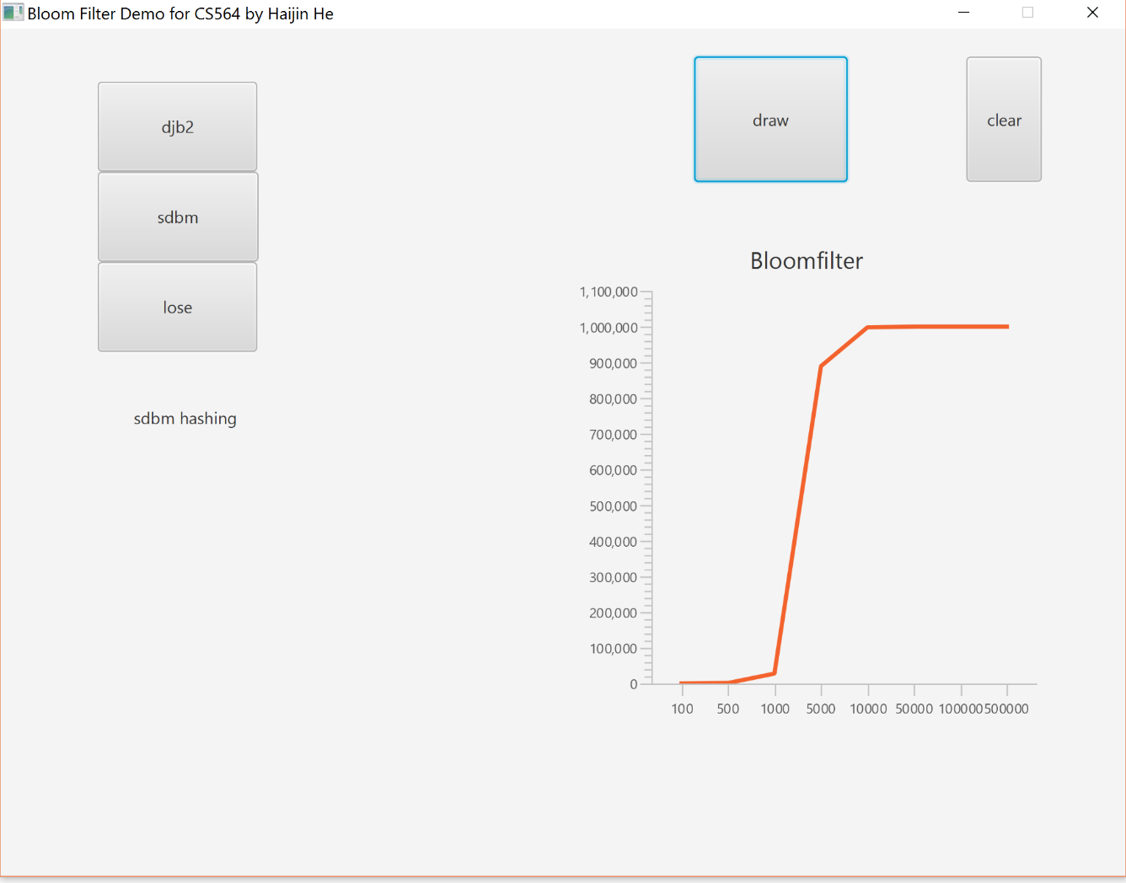
sdbm

Slide 4
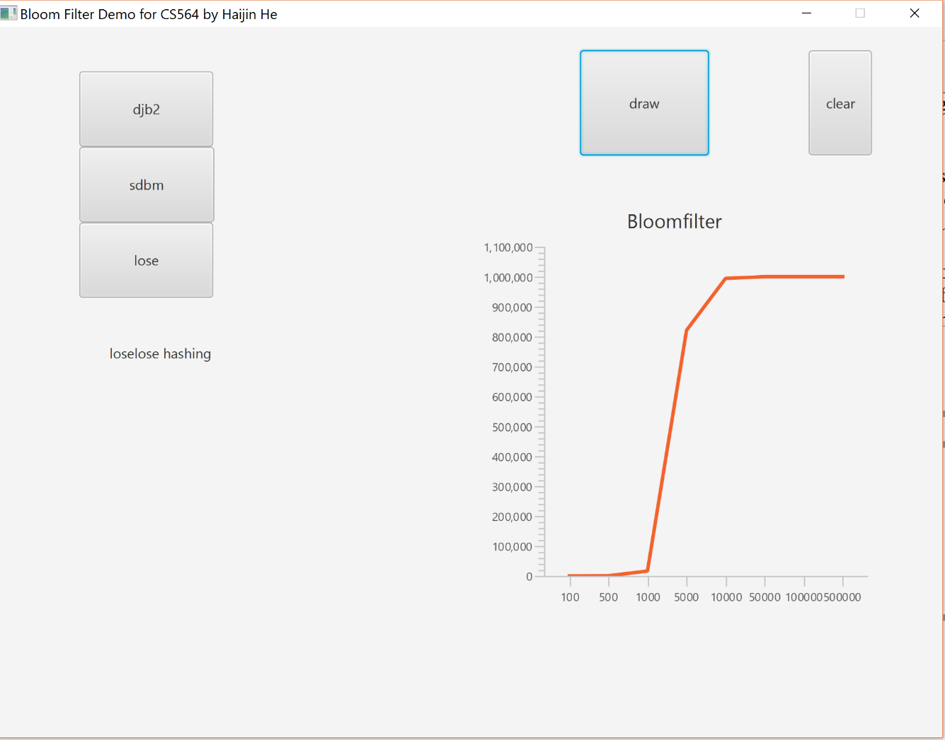
loselose

