Slide 1
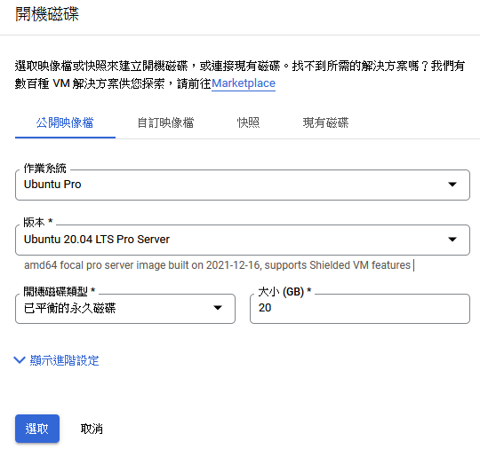
Creat VM

Slide 2
~/CTFd/prepare.sh

Slide 3
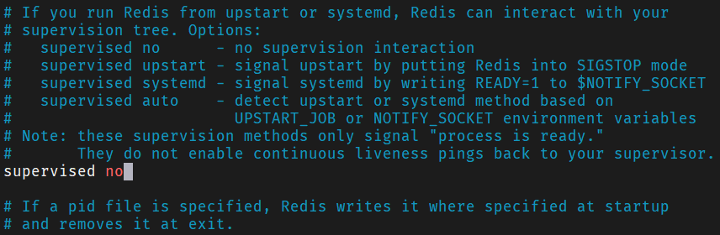
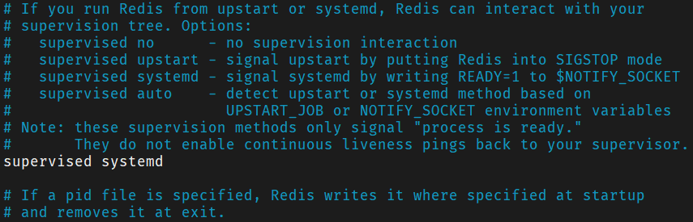
/etc/redis/redis.conf

Slide 4
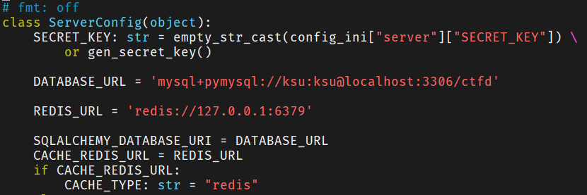
~/CTFd/CTFd/config.py

Slide 5
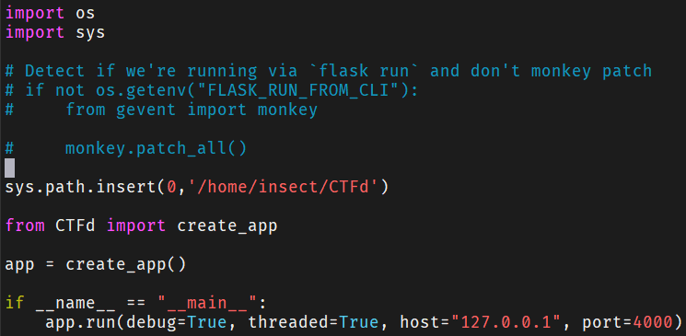
/home/ksu/CTFd

Slide 6
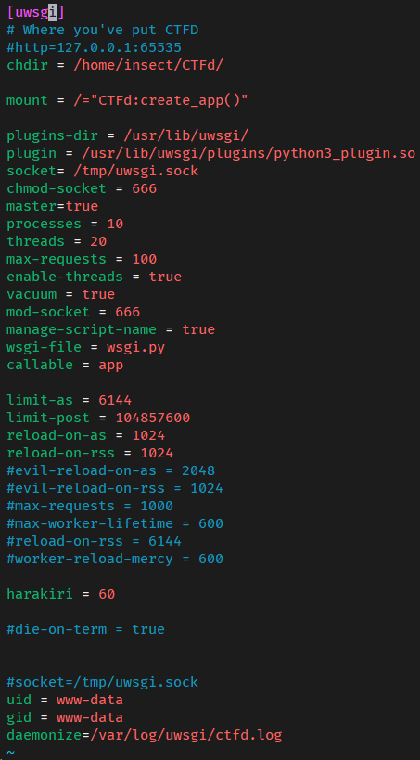
/etc/uwsgi/apps-available/uwsgi.ini

Slide 7
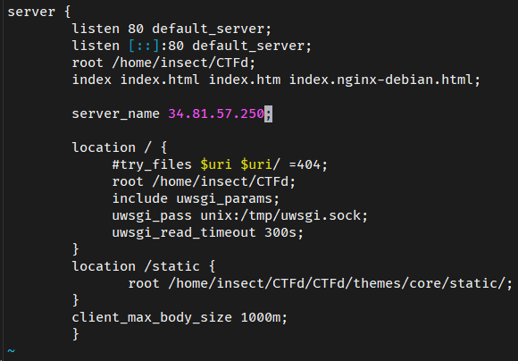
/etc/nginx/sites-available/default

Slide 8
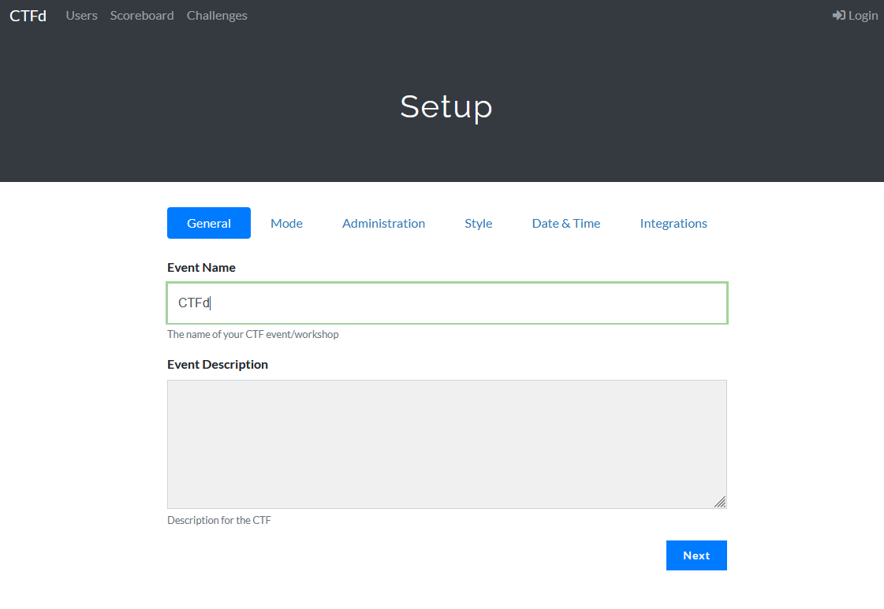
CTFd Setting
1.
2.

Slide 9
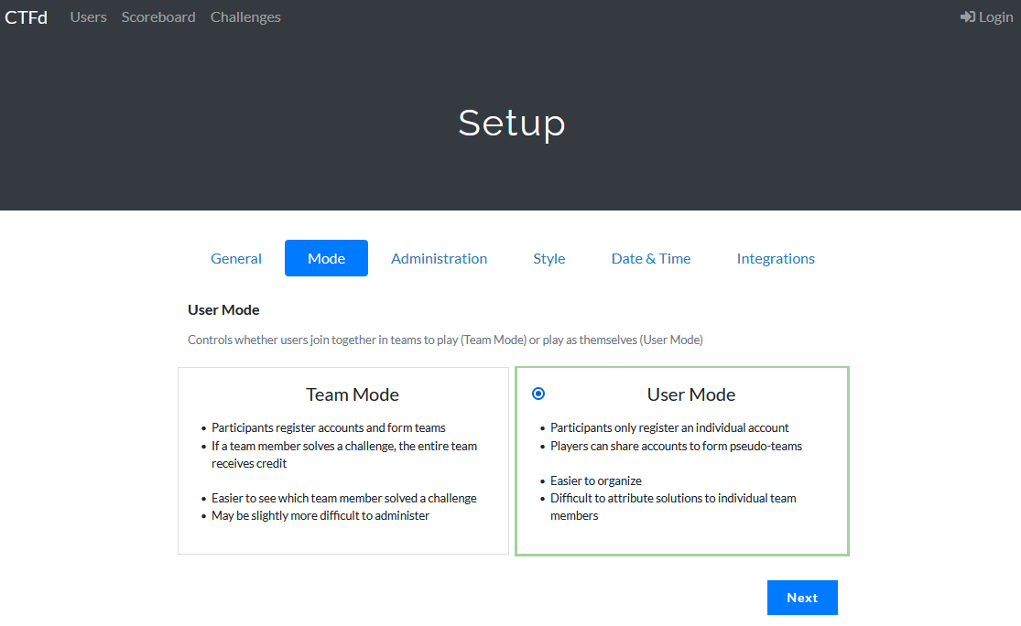
CTFd Setting
1.
2.

Slide 10
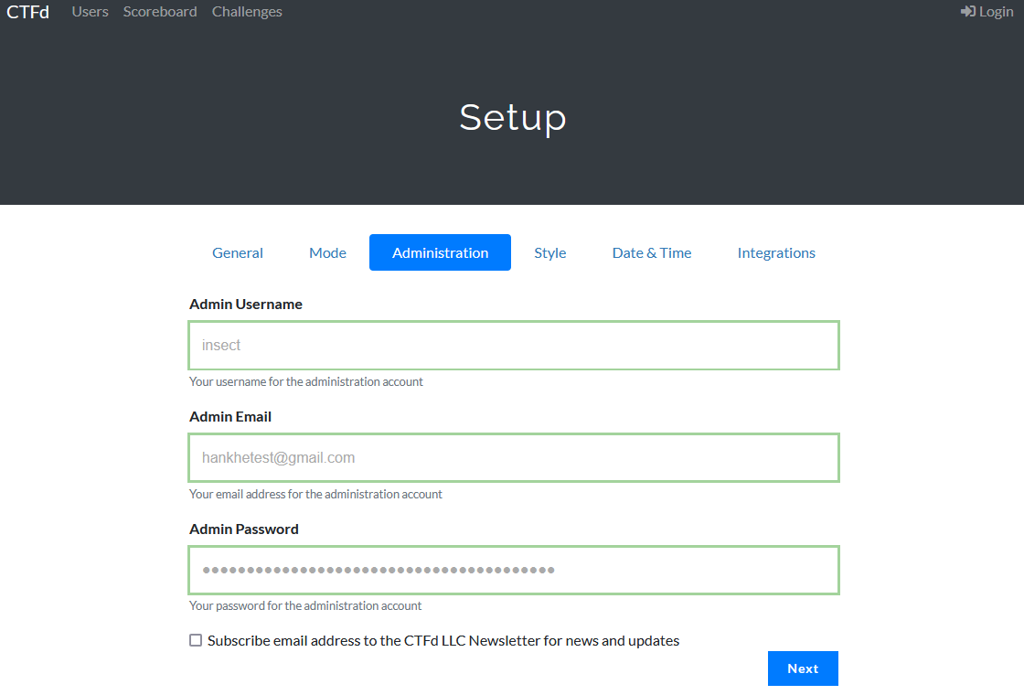
CTFd Setting
1.
2.

Slide 11
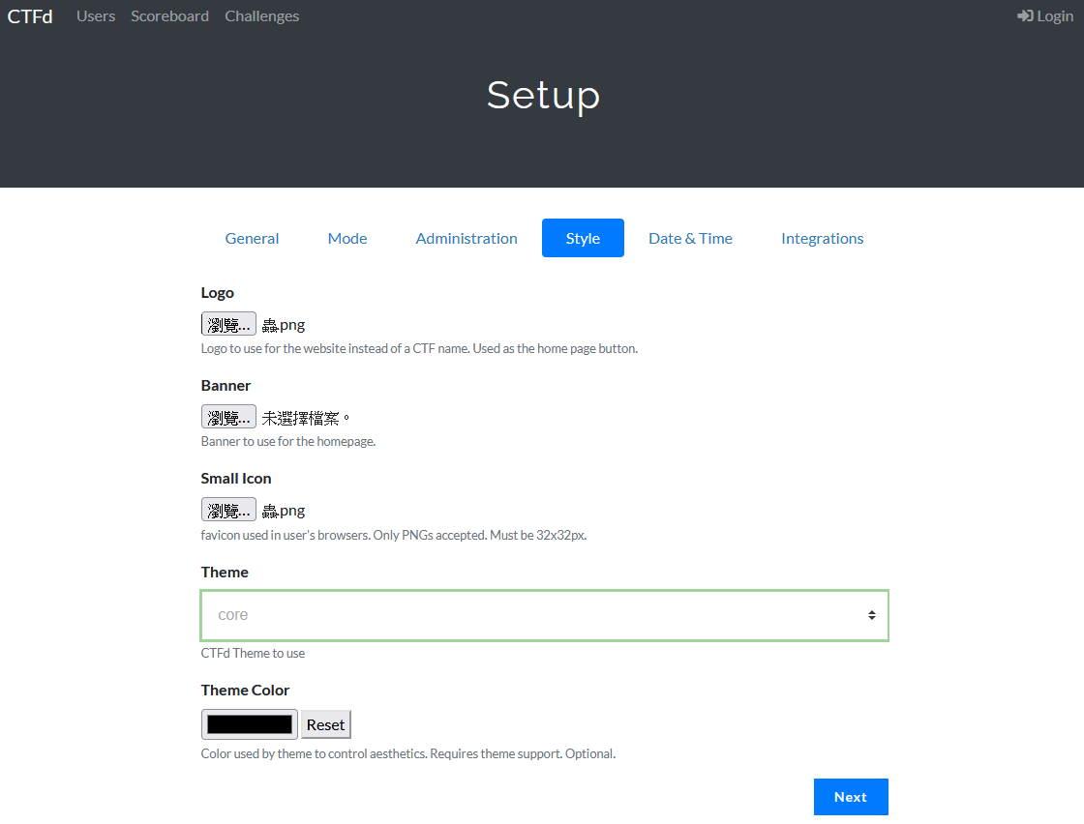
CTFd Setting

Slide 12
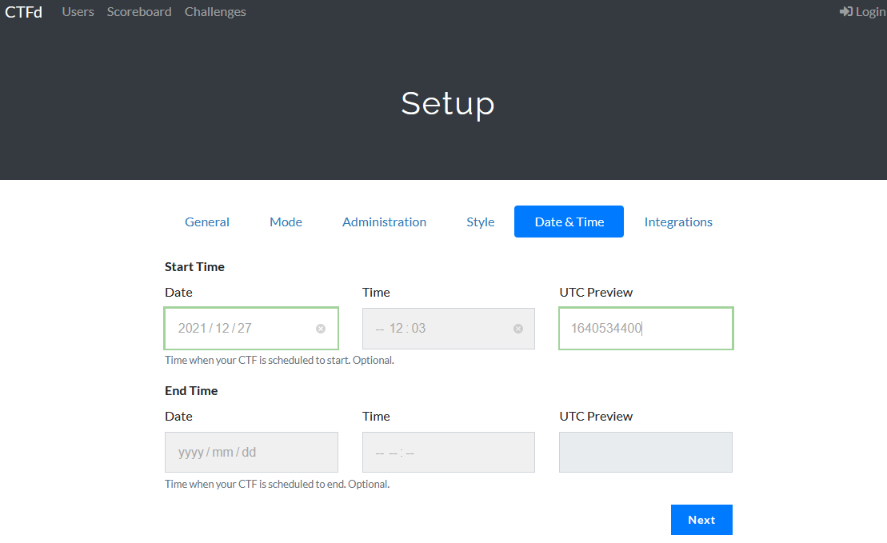
CTFd Setting

Slide 13
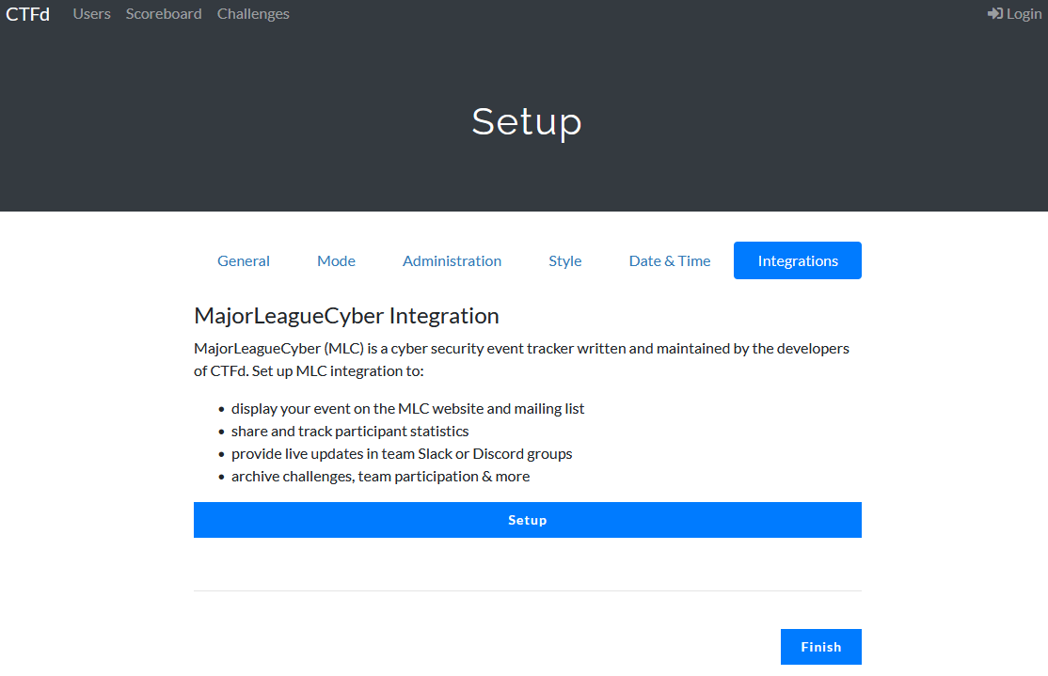
CTFd Setting

Slide 14
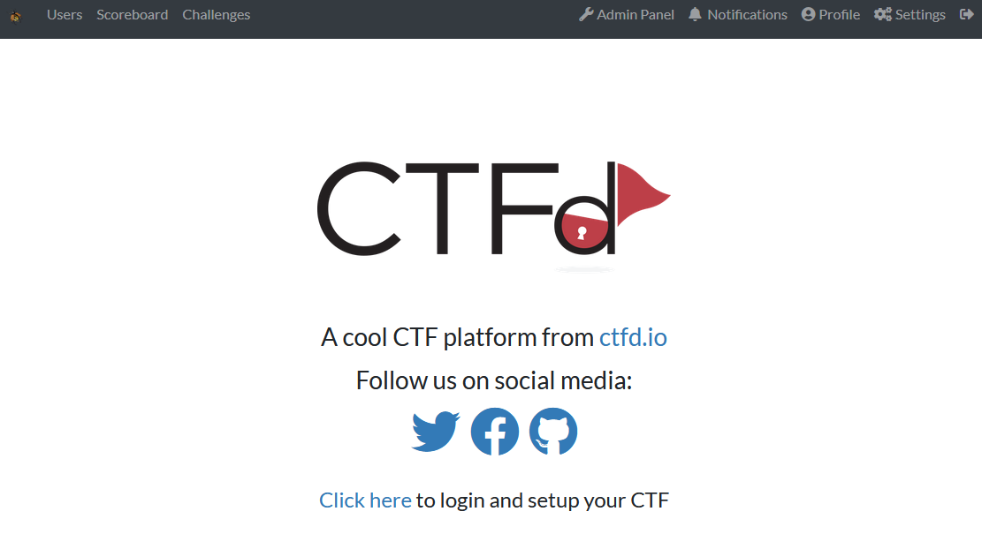
CTFd Setting – add config

Slide 15
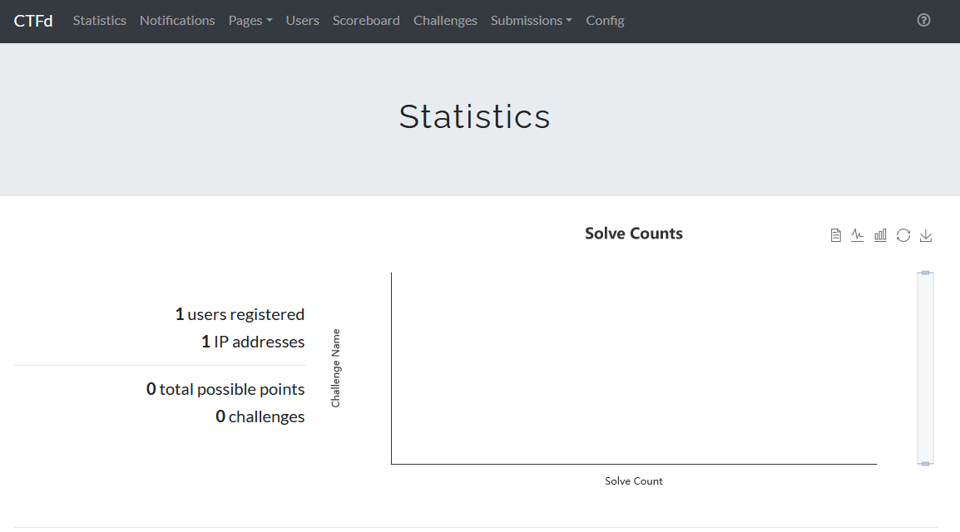
CTFd Setting – add config

Slide 16
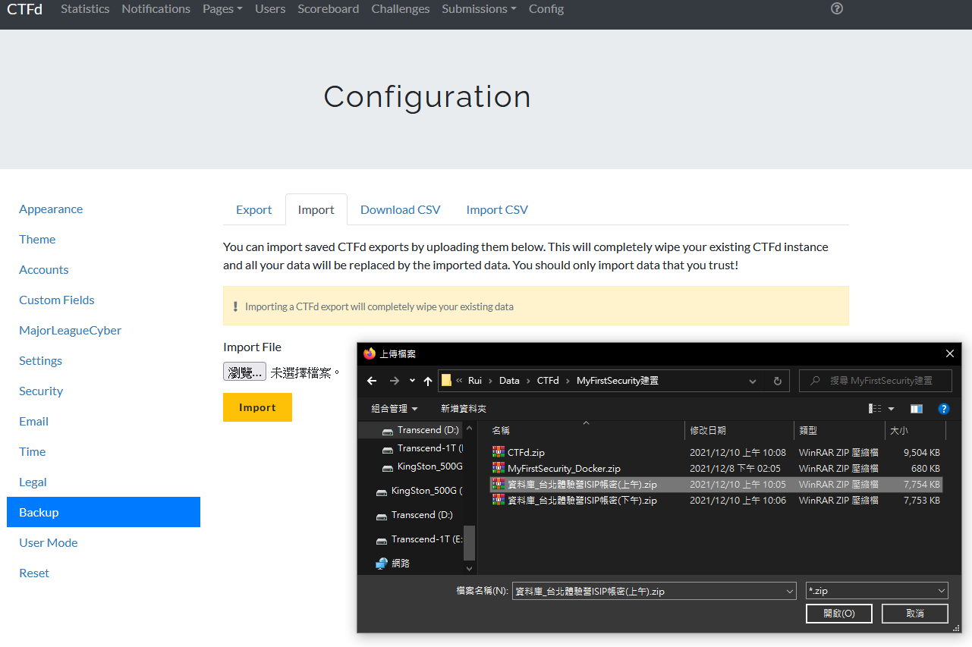
CTFd Setting – add config
2.
3.
6.
4.
1.
5.

Slide 17
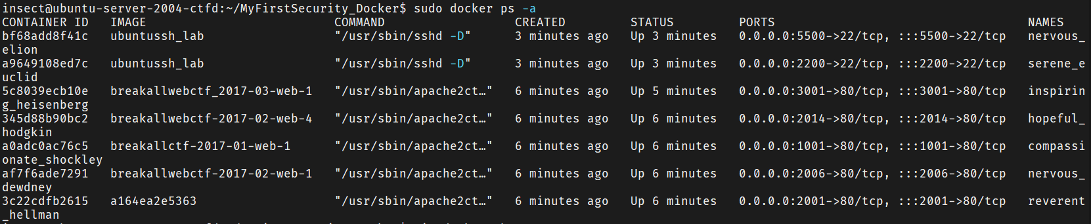
CTFd Setting – docker questions

Slide 18
CTFd Setting – docker questions

Slide 19
CTFd Setting – questions IP

Slide 20
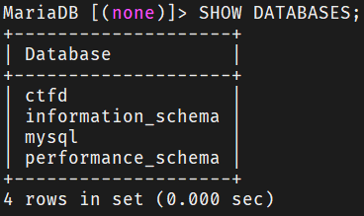
CTFd Setting – List your database

