Slide 1

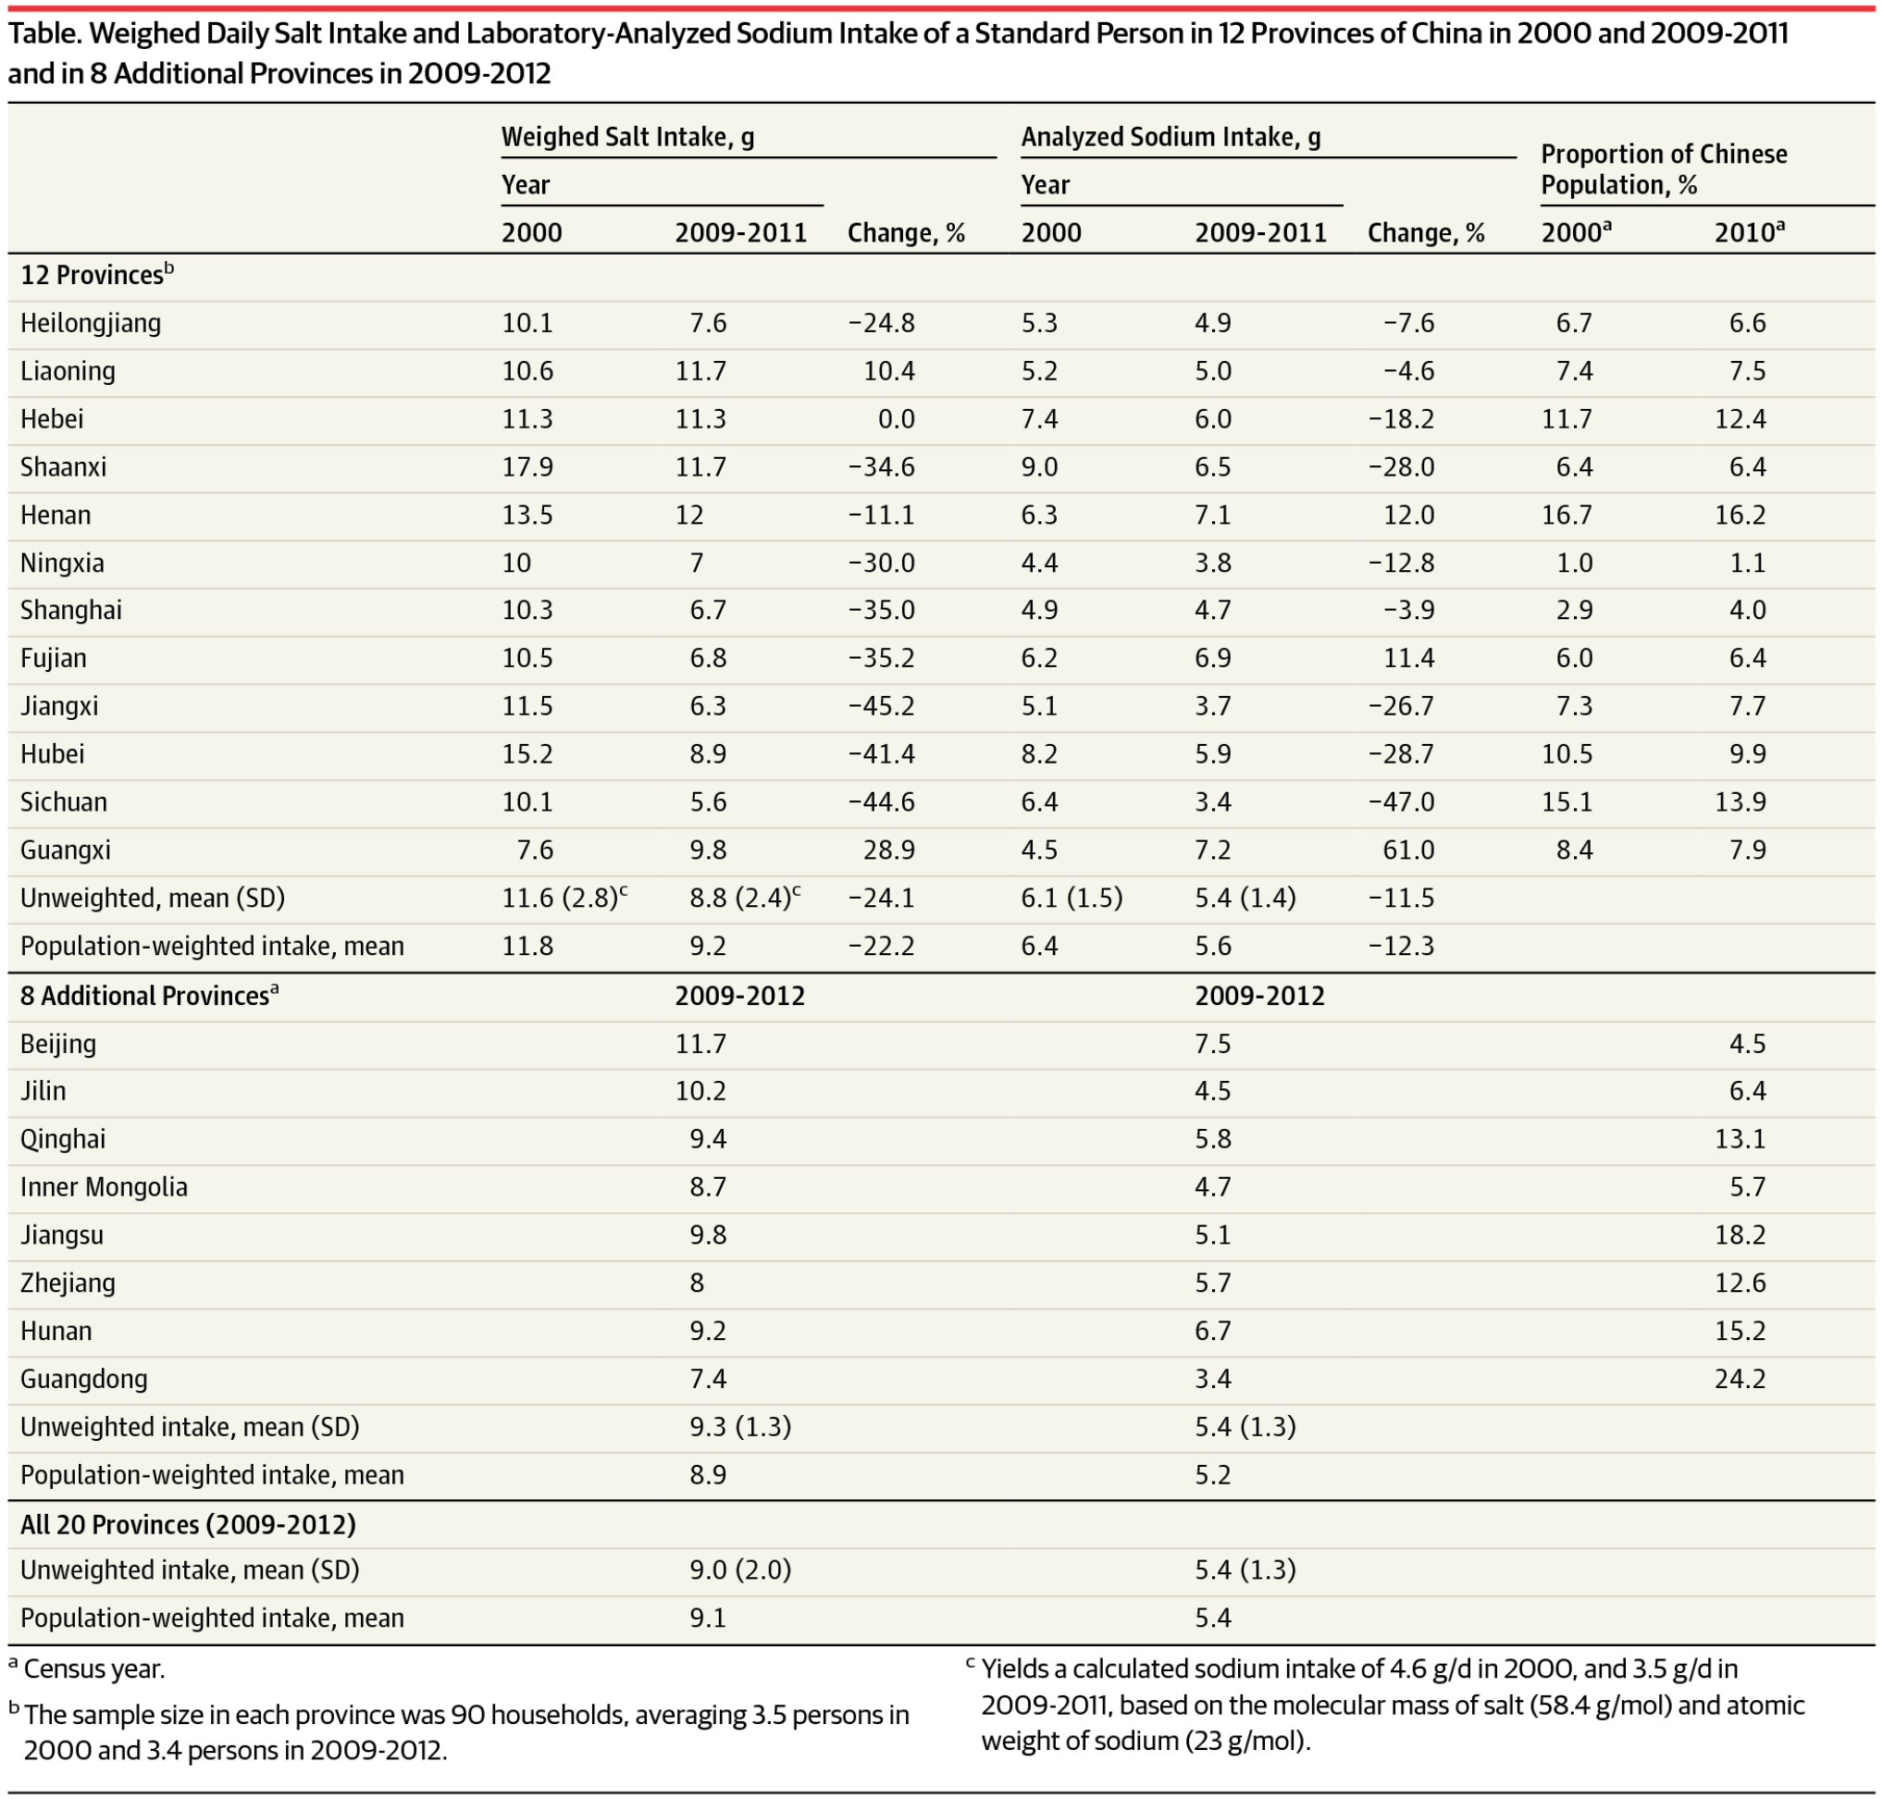
From: Salt and Sodium Intake in China
JAMA. 2016;315(7):703-705. doi:10.1001/jama.2015.15816
Table Title:
Weighed Daily Salt Intake and Laboratory-Analyzed Sodium Intake of a Standard Person in 12 Provinces of China in 2000 and 2009-2011 and in 8 Additional Provinces in 2009-2012
Date of download: 11/25/2018
Copyright © 2016 American Medical Association. All rights reserved.

