Slide 1





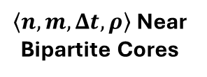
Low Activity Signature
(Suspected) Fake Stars
User | Repo | StarredAt
Foo | Bar | 20240830
… | … | …
Lockstep Signature
Stargazer Bipartite Graph
User
Repo
1
1
Postprocessing
GHArchive
CopyCatch
2
2
…
…
Repositories with Fake Star Campaigns
N
M
Stargazer Bipartite Graph
$\left\langle n,m,Δt, ρ\right\rangle$ Near Bipartite Cores
Accounts in Fake Star Campaigns

