Slide 1


Faculty of Computer Science
Data Science and Business Analytics
Research seminar «Data analysis in finance»
Price Impact or Trading Volume:
Why Is the Amihud (2002) Measure Priced?
X. Lou, T. Shu, Review of Financial Studies, 2017 · replication on Binance
Group 12: Andrey Tsember, Sofia Shapovalova, Ksenia Stepanova, Marat Bineman, Alexia Fox
Moscow 2026
Notes:
Good afternoon. We are Team 12, and we present Lou and Shu, 2017, "Price Impact or Trading Volume: Why Is the Amihud Measure Priced?" We replicated it on Binance crypto data.

Slide 2

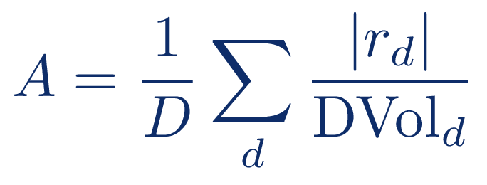
Price Impact or Trading Volume
(Lou, Shu, 2017)
2
Problem
Standard reading
Lou & Shu
Illiquid stocks earn a premium.
Is it for price impact, or just for low volume?
Amihud A
Amihud A
price impact
trading volume
illiquidity
premium
low-volume
premium
Notes:
The Amihud measure is the average absolute return per dollar traded. Stocks that look illiquid by this measure earn a premium. The standard reading, on the left, is that investors are paid for price impact. Lou and Shu propose the reading on the right: the measure mostly reflects trading volume, so the premium may simply be a low-volume premium.

Slide 3
Price Impact or Trading Volume
(Lou, Shu, 2017)
3
Amihud is almost only volume
0.899
0.956
corr(A, A_{C}) · US stocks, paper
corr(A, A_{C}) · Binance, us
A_{C} keeps only 1/DVol, and it explains almost all of A.
Notes:
Why is this plausible? Across assets, dollar volume varies enormously, while absolute returns vary little. So Amihud is almost the same as A_C, a version that keeps only one over volume. The correlation is 0.899 in the paper and 0.956 on Binance. Ksenia will now show how the authors test this.

Slide 4
Price Impact or Trading Volume
(Lou, Shu, 2017)
4
Method: split Amihud in two
ln A
ln A_{C}
volume
Res.ln A
price impact
If only the volume part is priced, the premium is about volume.
priced?
“volume”
priced?
“price impact”
Notes:
The authors split log Amihud into two parts: the volume part, log A_C, and a residual, estimated each month in a cross-sectional regression. If only the volume part is priced, the premium is about volume. If the residual is priced, it is about price impact.

Slide 5
Price Impact or Trading Volume
(Lou, Shu, 2017)
5
Test design
month t − 2
MEASURE
month t − 1
SKIP
month t
RETURN
Quintile sorts and Fama–MacBeth, as in the paper.
Notes:
They measure the signal in month t minus 2, skip a month, and look at the return in month t. They use two standard tools: quintile sorts and Fama–MacBeth regressions, with Newey–West standard errors.

Slide 6
Price Impact or Trading Volume
(Lou, Shu, 2017)
6
The paper's result
H-L on A
H-L on A_{C}
H-L on Res.A
0.56 (t 2.36)
0.61 (t 2.95)
−0.17 (t −1.05)
% per month
% per month
% per month
Volume is priced, the rest is not: the premium is not for price impact.
Notes:
On US stocks from 1964 to 2012, sorting on Amihud gives 0.56 percent per month, and sorting on A_C gives 0.61, both significant. Sorting on the residual gives a negative, insignificant spread. So volume is priced and the rest is not, and the authors conclude that the premium is not for price impact. Marat will now show what we got.

Slide 7
Price Impact or Trading Volume
(Lou, Shu, 2017)
7
First, simulations
World V
volume is priced
World P
price impact is priced
World 0
nothing is priced
100%
100%
9.5%
runs find A_{C} priced
runs find Res.ln A priced
false positives (target 5%)
The pipeline tells the hypotheses apart before we touch real data.
Notes:
We wrote our own code, and before touching real data, we checked it on simulated worlds. In world V, where only volume is priced, we find A_C priced in 100 percent of runs. In world P, where price impact is priced, we find the residual in 100 percent of runs. In world 0, where nothing is priced, false positives are 9.5 percent, a bit above the 5 percent target. So the pipeline can tell the hypotheses apart.

Slide 8
Price Impact or Trading Volume
(Lou, Shu, 2017)
8
Dataset overview
March 2021
5-min λ window, 36 months
2019-01 – 2022-10
FIRST HALF
2022-11 – 2026-09
SECOND HALF
Binance spot · USDT pairs
626
93
24 628
3
coins
months
coin-months
signals: A, A_{C}, Res.A
Notes:
Our data are Binance spot USDT pairs from January 2019 to September 2026: 626 coins, 93 months, about 25 thousand coin-months, and three signals: A, A_C and the residual. On the timeline: two halves for the subperiod test, March 2021, and the last 36 months, where we have 5-minute data.

Slide 9
Price Impact or Trading Volume
(Lou, Shu, 2017)
9
Data analysis: what differs from the paper
 | paper | Binance
spread of A_{C}, Q75/Q25 | 116.60 | 9.40
corr(A, |Ret|) | 0.489 | −0.133
s.d. of monthly return | — | 43.9%
Coins differ less in liquidity, move much more, and trade more when volatile.
Notes:
Coins differ from stocks in three ways. Liquidity varies much less: the interquartile ratio of A_C is 9 against 117. Coins move much more: the monthly return has a standard deviation of 44 percent. And coins trade more when they are volatile.

Slide 10
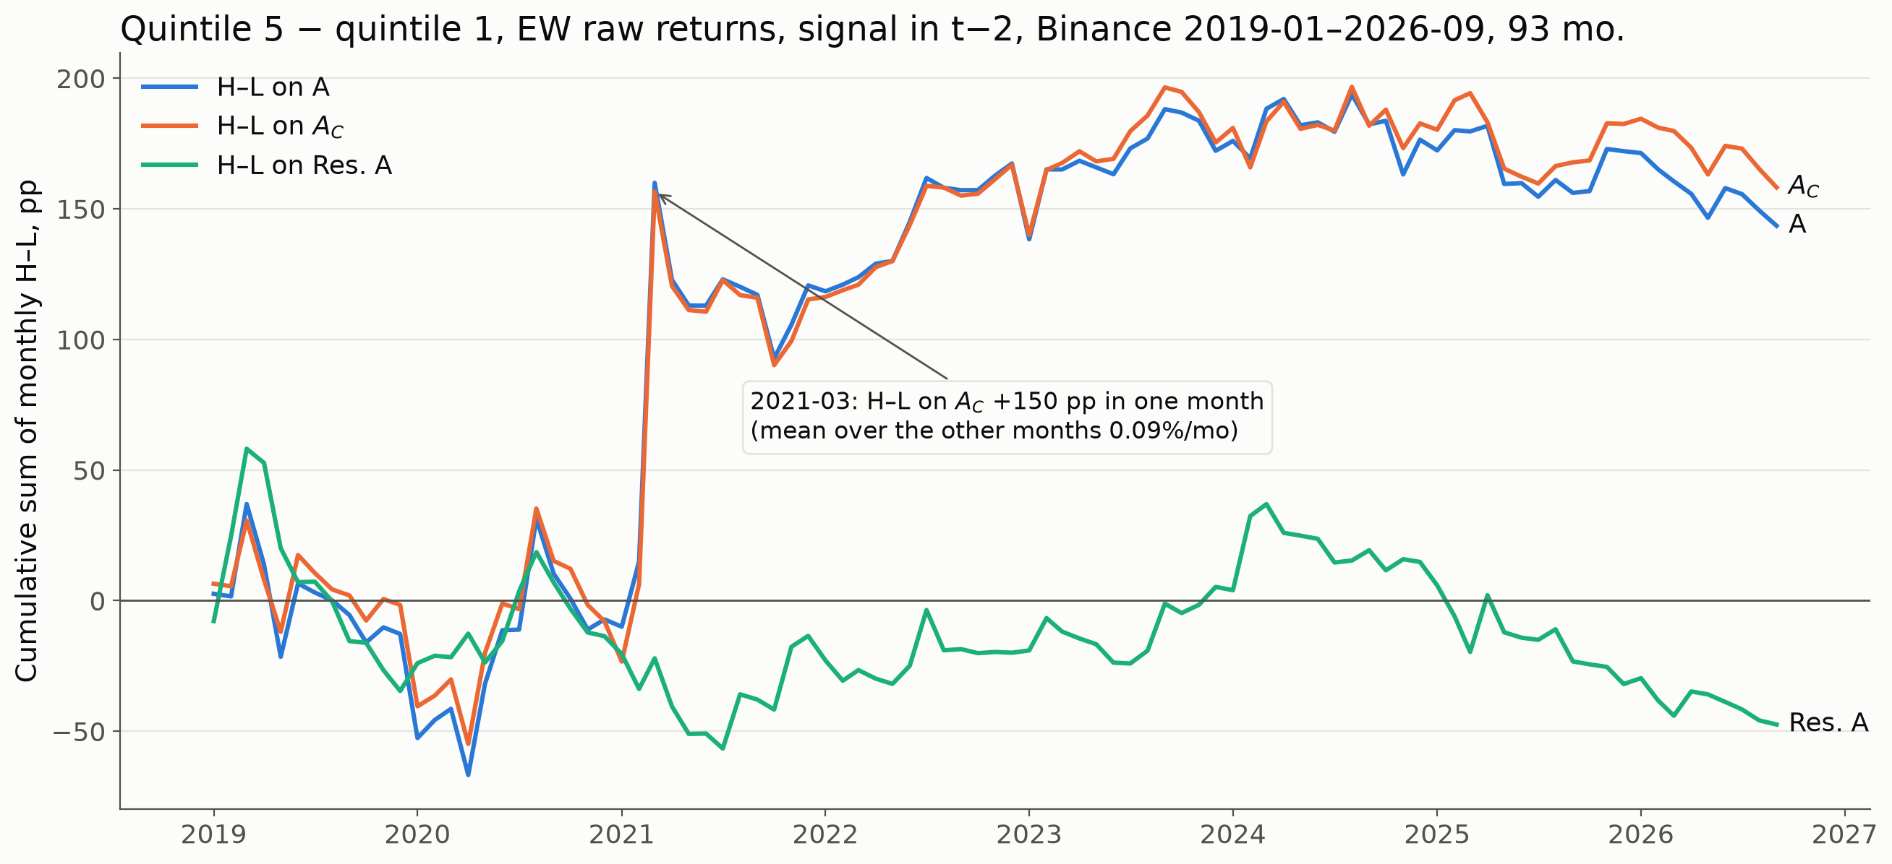
Price Impact or Trading Volume
(Lou, Shu, 2017)
10
One outlier month: March 2021
The altcoin season makes the volume spread. Without it: 0.09% per month.
Notes:
This chart is the cumulative high-minus-low return. One month stands out: March 2021, the altcoin season, when the volume spread jumped by 150 percentage points. Without that month, the average spread on A_C is only 0.09 percent per month.

Slide 11
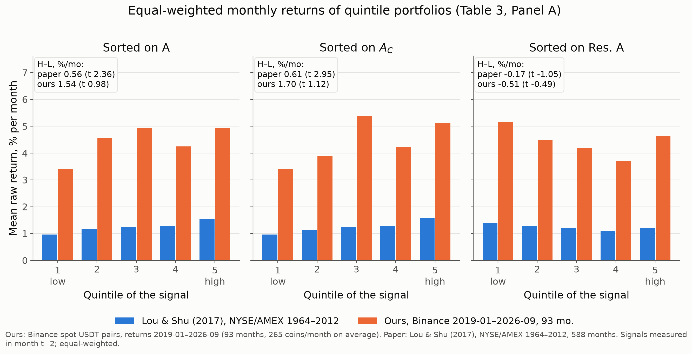
Price Impact or Trading Volume
(Lou, Shu, 2017)
11
Our replication next to the paper
Same signs, but noisy: H-L on A_{C} 1.70 (t 1.12).
Notes:
This is our result next to the paper's, on the same axes. The signs match: the top quintile beats the bottom for A and A_C, and the residual spread is negative. But our spreads are noisy: 1.70 percent per month for A_C with t of 1.1, so they are not significant.

Slide 12
Price Impact or Trading Volume
(Lou, Shu, 2017)
12
Upgrades
0.615
98.8%
2.57 (t 1.84)
0.308 (t 2.87)
corr with 5-min λ
(paper 0.737)
months with COV < 0
(Amihud & Noh premise)
sentiment long-short
ln A_{C} on MOEX
Amihud tracks true price impact, but no upgrade settles the debate.
Notes:
We added four upgrades. A price-impact benchmark from 5-minute data correlates with Amihud at 0.615, close to the paper's 0.737. Amihud and Noh's missing covariance term is negative in 99 percent of coin-months, but it does not predict returns significantly. Sentiment does not explain the spread. And on the Moscow Exchange, the volume slope is positive and significant. Alexia will now talk about the limits of all this.

Slide 13
Price Impact or Trading Volume
(Lou, Shu, 2017)
13
The paper versus us
25/28
8/21
7.0×
signs agree
significant results repeat
smallest premium we could
detect, vs the paper's
The direction replicates. With 93 months instead of 588, significance does not.
Notes:
In total, signs agree in 25 of 28 comparisons, and 8 of the paper's 21 significant results repeat, mostly the negative residual. The main problem is power: with 93 months instead of 588, the smallest premium we could detect is seven times the paper's premium. So the direction replicates, the significance does not.

Slide 14
Price Impact or Trading Volume
(Lou, Shu, 2017)
14
Overfitting
16/73
0
2/11
tests pass 1.96
(3.65–5.7 expected by chance)
survive Bonferroni
stable in the bootstrap
Every test logged: our evidence is weak, and we say so.
Notes:
Could this be overfitted? We fixed the specification before the first run and logged every test. 16 of 73 base tests pass 1.96, while about 4 to 6 would pass by chance; none survive a Bonferroni correction; and only 2 of 11 statistics are stable in a block bootstrap. So we treat our evidence as weak, and we say so openly.

Slide 15
Price Impact or Trading Volume
(Lou, Shu, 2017)
15
Takeaways
Amihud is mostly volume.
The paper's signs replicate on crypto.
Its significance needs more than 93 months.
Notes:
To conclude: Amihud is mostly volume, in stocks and in crypto. The paper's signs replicate on crypto. But to confirm its significance, we need far more than 93 months.

Slide 16

Price Impact or Trading Volume (Lou, Shu, 2017)
Notes:
Thank you for your attention, we are happy to take questions.

