Slide 1
Huazhong University of Science and Technology
International Economics
Fall 2016
Lecture: 3-4(T, Th) D9-D317
1-<number>

Slide 2
About Me
Instructor: Jing FANG（方晶）
Office: School of Economics 419
Email: jing_fang@hust.edu.cn
1-<number>

Slide 3
About Me
Wuhan University, BA & BS in Econ & Math
Wuhan University, MA in Econ
University of Minnesota, PhD in Econ
Research interests: Industrial Organization, Econometrics and International Trade
1-<number>

Slide 4
What about you?
Name?
Where are you from?
Which economic course are you most interested in?
Any hobby?
What’s your plan after graduate?
1-<number>

Slide 5
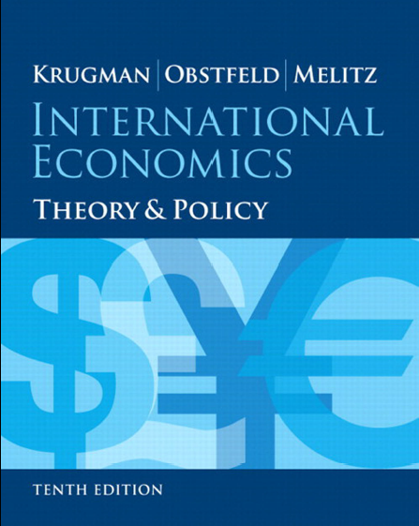
Textbook
2-<number>

Slide 6
Course Description
This will be a full English course.
We will use English everywhere except the conversation.
Homework and exam which is written in Chinese will not be accepted and get no score!
2-<number>

Slide 7
Course Description
You could find the necessary materials in the course website: bayeswhu.github.io
You need to prepare to learn it by yourself and help each other.
2-<number>

Slide 8
Course Requirements
Homework
  2 Problem Sets
  All homework should be typed (and stapled)
  Work that is not typed (or stapled) gets an automatic discount of 30%
  Assignments not turned in by the due date will be penalized 10 points for each day it is late
  Students are strongly encouraged to work in groups. However, each student is responsible of writing up his or her own problem set.
2-<number>

Slide 9
Course Requirements
Project
  1 Project
  You need to collect the data and do some analysis in group.
  You will be asked to comment on others work.
2-<number>

Slide 10
Course Requirements
Presentation
  At least 1 turn
  You need to introduce the examples in textbook to other classmates
  You will need to answer any question from classmates.
2-<number>

Slide 11
Course Requirements
Exams
  1 final exam
  Final date: Nov 24 2016
2-<number>

Slide 12
Grading Policy
The weights for the final score will be as follows:
  Problem sets: 30%
  Projects: 20%
  Presentation: 5%
  Final exam: 50%
I reserve the right to raise the final score, but I will not lower them.
2-<number>

Slide 13
Course Schedule
The material of the textbook is summarized below.
  Part1: International Trade Theory
  Part2: International Trade Policy
  Part3: Exchange Rates and Open-Economy macroeconomics
  Part4: International Macroeconomic Policy
We will definitely cover parts I and part II.
2-<number>

Slide 14
Question?
2-<number>

