Slide 1
Case Study in Chapter 3

Slide 2
Comparative Advantage in Practice
The Case of Babe Ruth

Slide 3
Baseball
Baseball is a bat-and-ball game played between two teams of nine players each, who take turns batting and fielding.
The batting team attempts to score runs by hitting a ball that is thrown by the pitcher with a bat swung by the batter, then running counter-clockwise around a series of four bases: first, second, third, and home plate.
A run is scored when a player advances around the bases and returns to home plate.

Slide 4
Baseball
Players on the batting team take turns hitting against the pitcher of the fielding team, which tries to prevent runs by getting hitters out in any of several ways.
A player on the batting team who reaches a base safely can later attempt to advance to subsequent bases during teammates' turns batting, such as on a hit or by other means.
The teams switch between batting and fielding whenever the fielding team records three outs.

Slide 5
Baseball
One turn batting for both teams, beginning with the visiting team, constitutes an inning.
A game is composed of nine innings, and the team with the greater number of runs at the end of the game wins.
Baseball has no game clock, although almost all games end in the ninth inning.

Slide 6
Baseball
The team in the field attempts both to prevent runs from scoring and to record outs, which remove opposing players from offensive action until their turn in their team's batting order comes up again.
When three outs are recorded, the teams switch roles for the next half-inning.
If the score of the game is tied after nine innings, extra innings are played to resolve the contest.

Slide 7
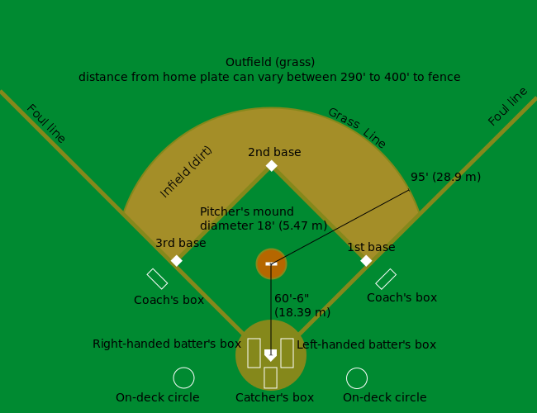
Baseball

Slide 8
Baseball
There are three basic tools of baseball: the ball, the bat, and the glove or mitt:
Protective helmets are also standard equipment for all batters.
At the beginning of each half-inning, the nine players on the fielding team arrange themselves around the field.

Slide 9
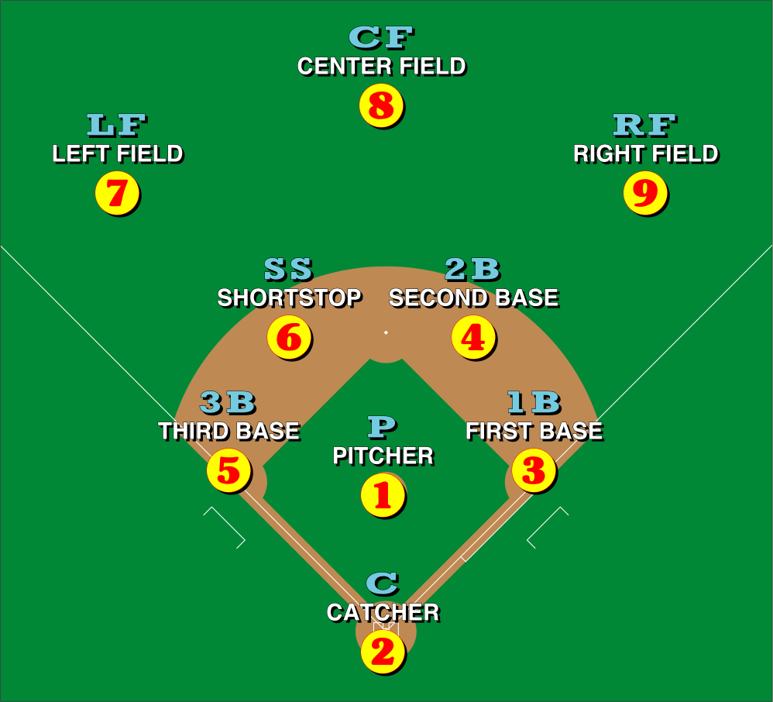
Baseball

Slide 10
Baseball
A neutral umpire sets up behind the catcher.
Other umpires will be distributed around the field as well, though the number will vary depending on the level of play, amateur or children's games may only have an umpire behind the plate, while as many as six umpires can be used for important Major League Baseball games.

Slide 11
Baseball
Play starts with a batter standing at home plate, holding a bat.
The batter waits for the pitcher to throw a pitch (the ball) toward home plate, and attempts to hit the ball with the bat.
The catcher catches pitches that the batter does not hit—as a result of either electing not to swing or failing to connect—and returns them to the pitcher.
A batter who hits the ball into the field of play must drop the bat and begin running toward first base, at which point the player is referred to as a runner (or, until the play is over, a batter-runner).

Slide 12
Baseball
A batter-runner who reaches first base without being put out (see below) is said to be safe and is now on base.
A batter-runner may choose to remain at first base or attempt to advance to second base or even beyond—however far the player believes can be reached safely.
A player who reaches base despite proper play by the fielders has recorded a hit.
If the ball is hit in the air within the foul lines over the entire outfield (and outfield fence, if there is one), it is a home run: the batter and any runners on base may all freely circle the bases, each scoring a run.
This is the most desirable result for the batter.

Slide 13
Baseball
Any runners already on base may attempt to advance on batted balls that land, or contact the ground, in fair territory, before or after the ball lands. A runner on first base must attempt to advance if a ball lands in play.
If a ball hit into play rolls foul before passing through the infield, it becomes dead and any runners must return to the base they were at when the play began.
If the ball is hit in the air and caught before it lands, the batter has flied out.
Runners may also attempt to advance to the next base while the pitcher is in the process of delivering the ball to home plate—a successful effort is a stolen base.

Slide 14
Baseball
A pitch that is not hit into the field of play is called either a strike or a ball.
A batter against whom three strikes are recorded strikes out.
A batter against whom four balls are recorded is awarded a base on balls or walk, a free advance to first base.
Crucial to determining balls and strikes is the umpire's judgment as to whether a pitch has passed through the strike zone.

Slide 15
Baseball
A strike is called when one of the following happens:
The batter lets a well-pitched ball (one within the strike zone) go through to the catcher.
The batter swings at any ball (even one outside the strike zone) and misses, or foul tips it directly into the catcher's hands.
The batter hits a foul ball—one that either initially lands in foul territory or initially lands within the diamond but moves into foul territory before passing first or third base.
A ball is called when the pitcher throws a pitch that is outside the strike zone, provided the batter has not swung at it.

Slide 16
Baseball
While the team at bat is trying to score runs, the team in the field is attempting to record outs. Among the various ways a member of the batting team may be put out, five are most common:
The strikeout: recorded against a batter who makes three strikes before putting the ball into play or being awarded a free advance to first base
The flyout: recorded against a batter who hits a ball in the air that is caught by a fielder, whether in fair territory or foul territory, before it lands, whether or not the batter has run.

Slide 17
Baseball
While the team at bat is trying to score runs, the team in the field is attempting to record outs. Among the various ways a member of the batting team may be put out, five are most common:
The ground out: recorded against a who hits a ball that lands in fair territory which, before the batter-runner can reach first base, is retrieved by a fielder who touches first base while holding the ball or relays it to another fielder who touches first base while holding the ball.
The force out: recorded against a runner who is required to attempt to advance but fails to reach the next base before a fielder touches the base while holding the ball. The ground out is technically a special case of the force out.
The tag out: recorded against a runner who is touched by a fielder with the ball or a glove holding the ball, while the runner is not touching a base.

Slide 18
Baseball
It is possible to record two outs in the course of the same play—a double play. Even three—a triple play—is possible, though this is very rare.
Players put out or retired must leave the field, returning to their team's dugout or bench.
A runner may be stranded on base when a third out is recorded against another player on the team.
Stranded runners do not benefit the team in its next turn at bat—every half-inning begins with the bases empty of runners.

Slide 19
Baseball
Once a player has completed a plate appearance, that player may not bat again until the eight other members of the player's team have all taken their turn at bat.
The batting order is set before the game begins, and may not be altered except for substitutions.
Once a player has been removed for a substitute, that player may not reenter the game.

Slide 20
Babe Ruth
George Herman Ruth Jr. (February 6, 1895 – August 16, 1948), better known as Babe Ruth, was an American professional baseball player whose career in Major League Baseball (MLB) spanned 22 seasons, from 1914 through 1935.
Nicknamed "The Bambino" and "The Sultan of Swat", he began his MLB career as a stellar left-handed pitcher for the Boston Red Sox, but achieved his greatest fame as a slugging outfielder for the New York Yankees.
Ruth established many MLB batting (and some pitching) records.
Ruth is regarded as one of the greatest sports heroes in American culture and is considered by many to be the greatest baseball player of all time.
In 1936, Ruth was elected into the Baseball Hall of Fame as one of its "first five" inaugural members.

Slide 21
The Losses from Nontrade

Slide 22
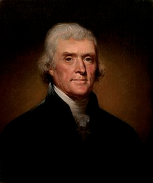
President Thomas Jefferson

Slide 23
President Thomas Jefferson
Thomas Jefferson (April 13, 1743 – July 4, 1826) was an American Founding Father who was the principal author of the Declaration of Independence and later served as the third President of the United States from 1801 to 1809.
As President, Jefferson organized the Louisiana Purchase, almost doubling the country's territory.
American foreign trade was diminished when Jefferson implemented the Embargo Act of 1807, responding to British threats to U.S. shipping.

Slide 24
President Thomas Jefferson
Jefferson mastered many disciplines, which ranged from surveying and mathematics to horticulture and mechanics.
He founded the University of Virginia after retiring from public office.
Jefferson is an icon of individual liberty, democracy, and republicanism, hailed as the author of the Declaration of Independence, an architect of the American Revolution, and a renaissance man who promoted science and scholarship.

Slide 25
President Thomas Jefferson
Jefferson has been memorialized with buildings, sculptures, postage, and currency.
In the 1920s, Jefferson, together with George Washington, Theodore Roosevelt, and Abraham Lincoln, was chosen to be depicted in stone at the Mount Rushmore Memorial.

Slide 26
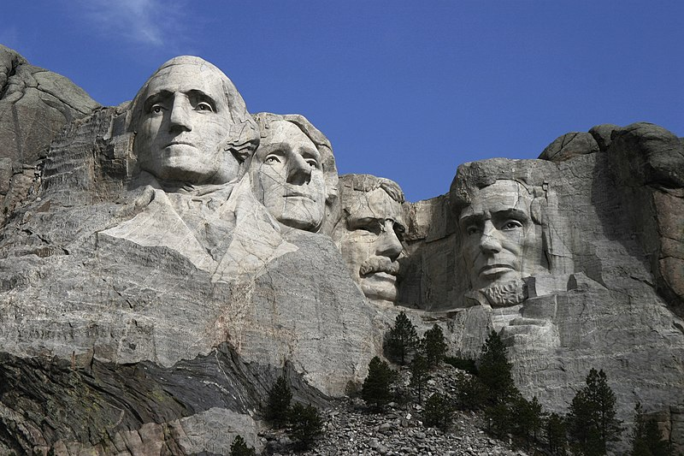
President Thomas Jefferson

Slide 27
President Thomas Jefferson
The Jefferson Memorial was dedicated in Washington, D.C. in 1943, on the 200th anniversary of Jefferson's birth. The interior of the memorial includes a 19-foot (6 m) statue of Jefferson and engravings of passages from his writings.
Most prominent are the words inscribed around the monument near the roof: "I have sworn upon the altar of God eternal hostility against every form of tyranny over the mind of man."

Slide 28
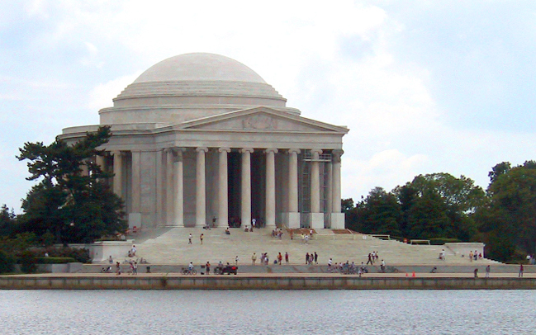
President Thomas Jefferson

Slide 29
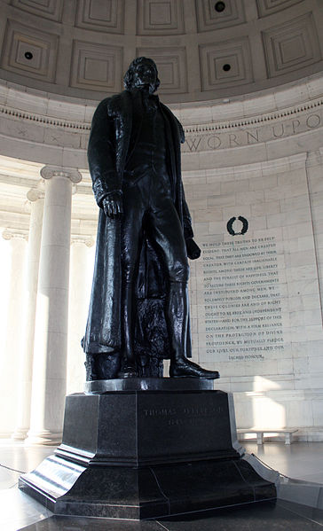
President Thomas Jefferson

Slide 30
Do Wages Reflect Productivity?

Slide 31
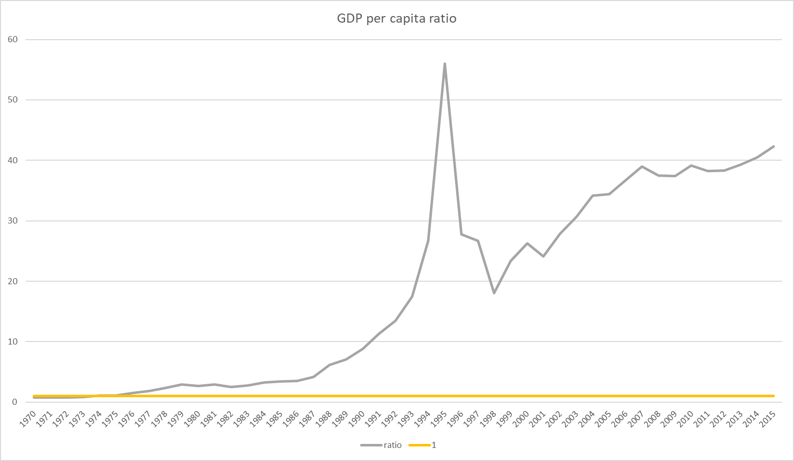
South/North Korea

