Slide 2
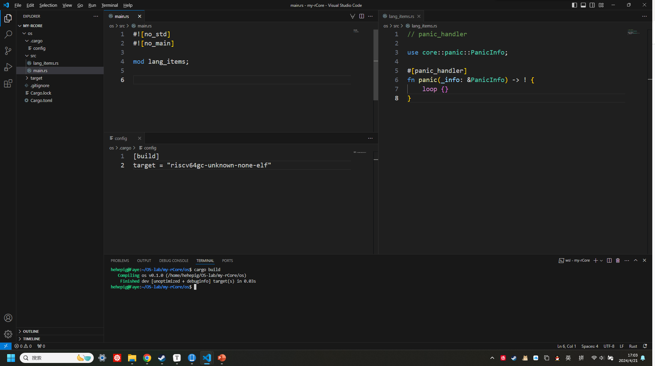

Slide 3
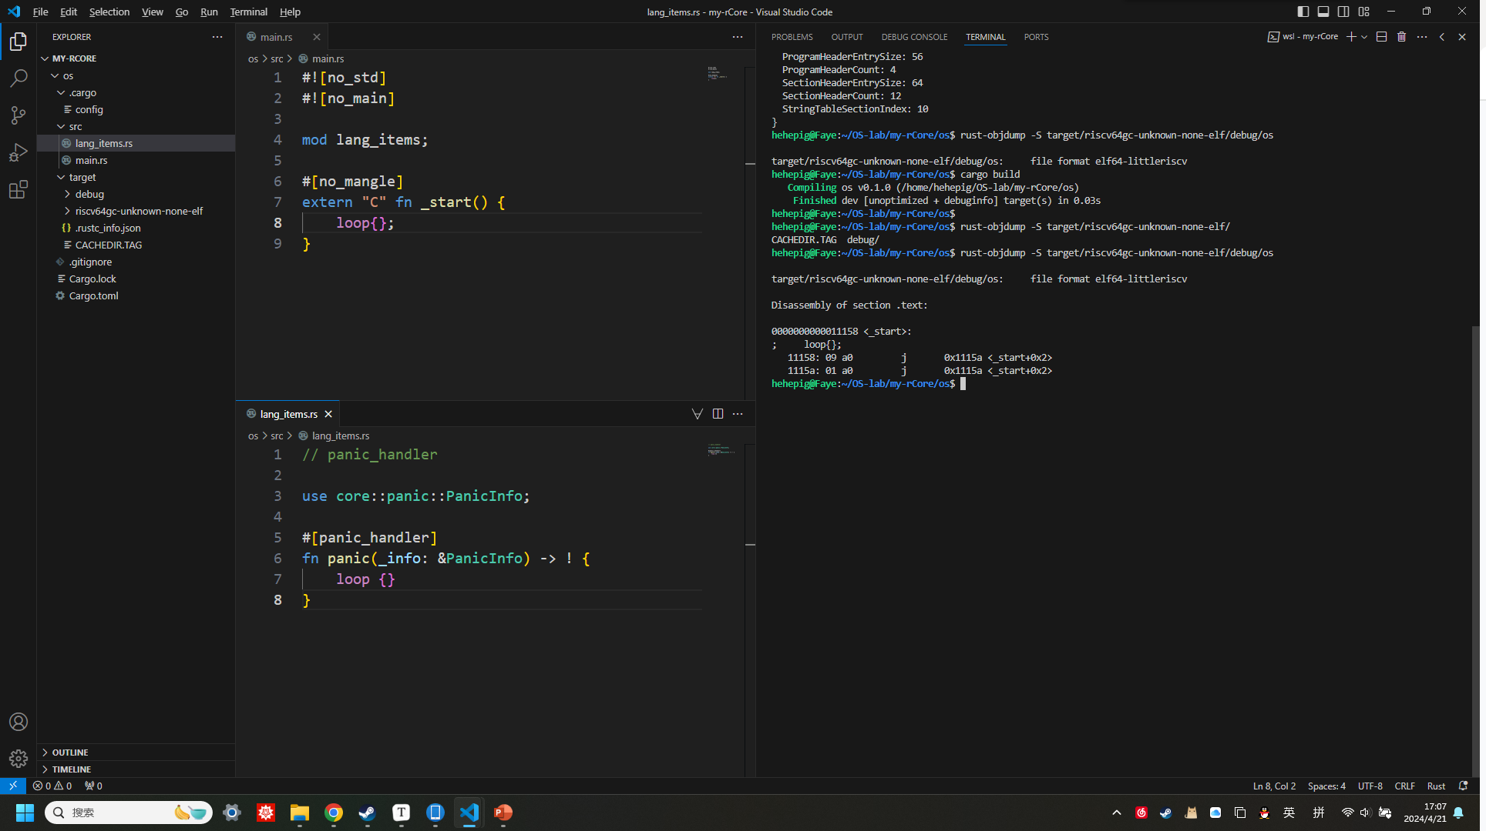
入口函数

Slide 4
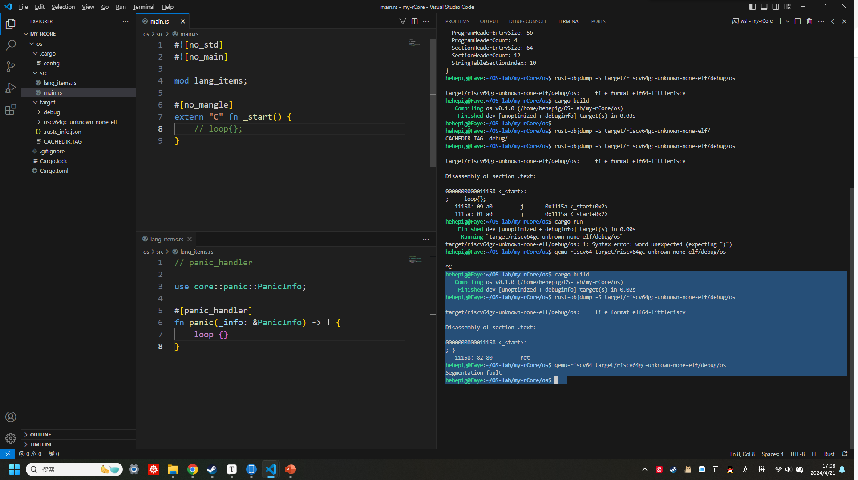
入口函数
缺少退出机制，如调用 exit 系统调用

Slide 5
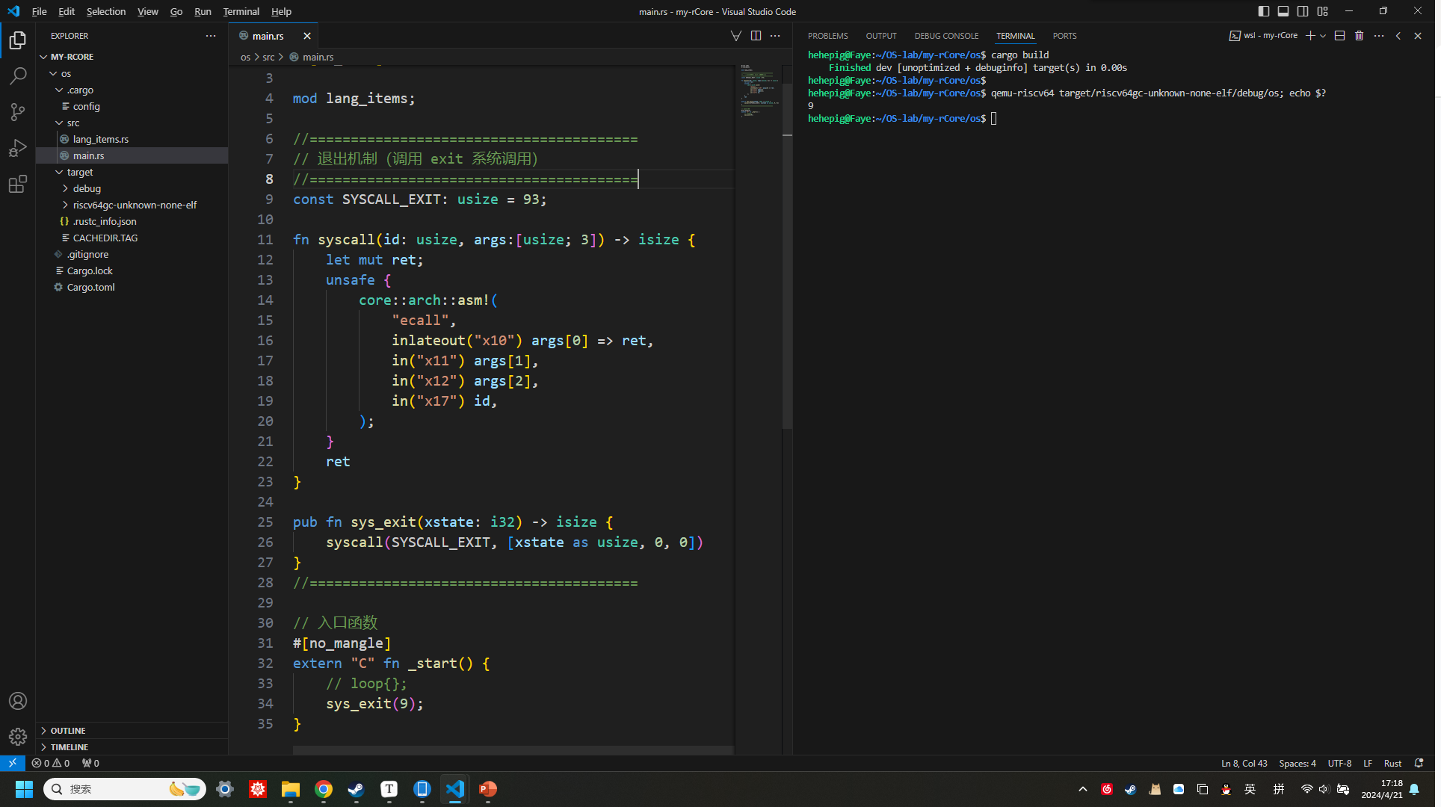
用户态最小化执行环境

Slide 6
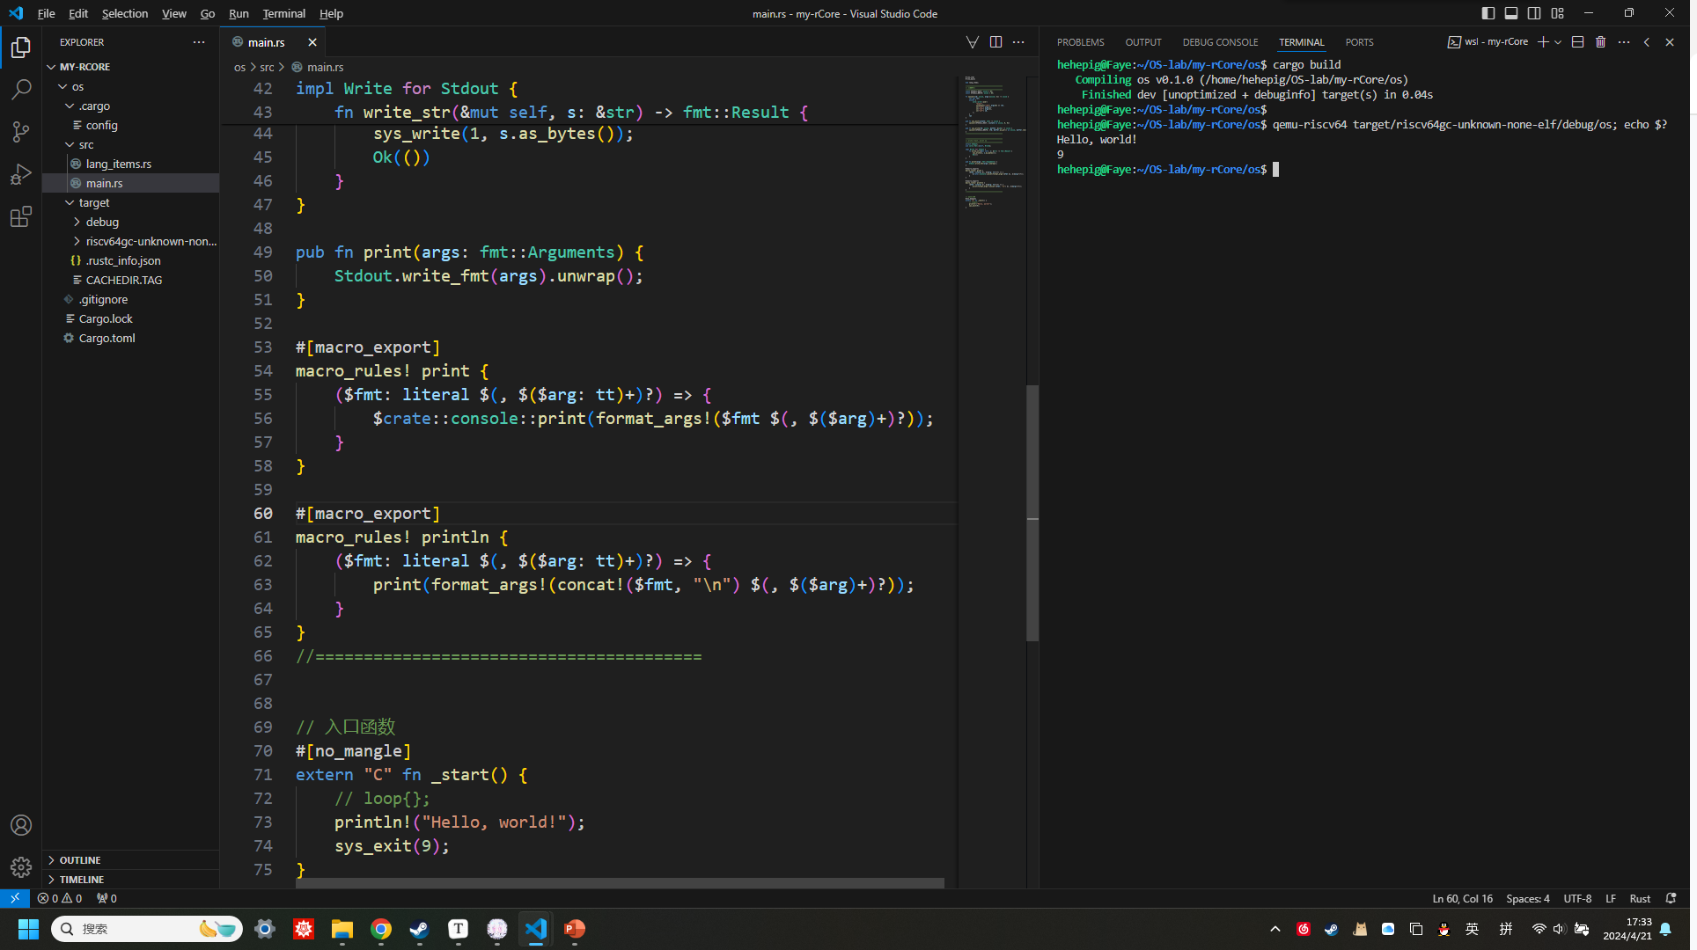
可输出字符串的用户态执行环境
// main.rs
#![no_std]
#![no_main]
mod lang_items;
//========================================
// 系统调用
//========================================
const SYSCALL_EXIT: usize = 93;
const SYSCALL_WRITE: usize = 64;
fn syscall(id: usize, args:[usize; 3]) -> isize {
let mut ret;
unsafe {
core::arch::asm!(
"ecall",
inlateout("x10") args[0] => ret,
in("x11") args[1],
in("x12") args[2],
in("x17") id,
);
}
ret
}
pub fn sys_exit(xstate: i32) -> isize {
syscall(SYSCALL_EXIT, [xstate as usize, 0, 0])
}
pub fn sys_write(fd: usize, buffer: &[u8]) -> isize {
syscall(SYSCALL_WRITE, [fd, buffer.as_ptr() as usize, buffer.len()])
}
//========================================
//========================================
// write trait, print 宏
//========================================
struct Stdout;
use core::fmt::{self, Write};
impl Write for Stdout {
fn write_str(&mut self, s: &str) -> fmt::Result {
sys_write(1, s.as_bytes());
Ok(())
}
}
pub fn print(args: fmt::Arguments) {
Stdout.write_fmt(args).unwrap();
}
#[macro_export]
macro_rules! print {
($fmt: literal $(, $($arg: tt)+)?) => {
$crate::console::print(format_args!($fmt $(, $($arg)+)?));
}
}
#[macro_export]
macro_rules! println {
($fmt: literal $(, $($arg: tt)+)?) => {
print(format_args!(concat!($fmt, "\n") $(, $($arg)+)?));
}
}
//========================================
// 入口函数
#[no_mangle]
extern "C" fn _start() {
// loop{};
println!("Hello, world!");
sys_exit(9);
}
// lang_items.rs
// panic_handler
use core::panic::PanicInfo;
#[panic_handler]
fn panic(_info: &PanicInfo) -> ! {
loop {}
}

Slide 7
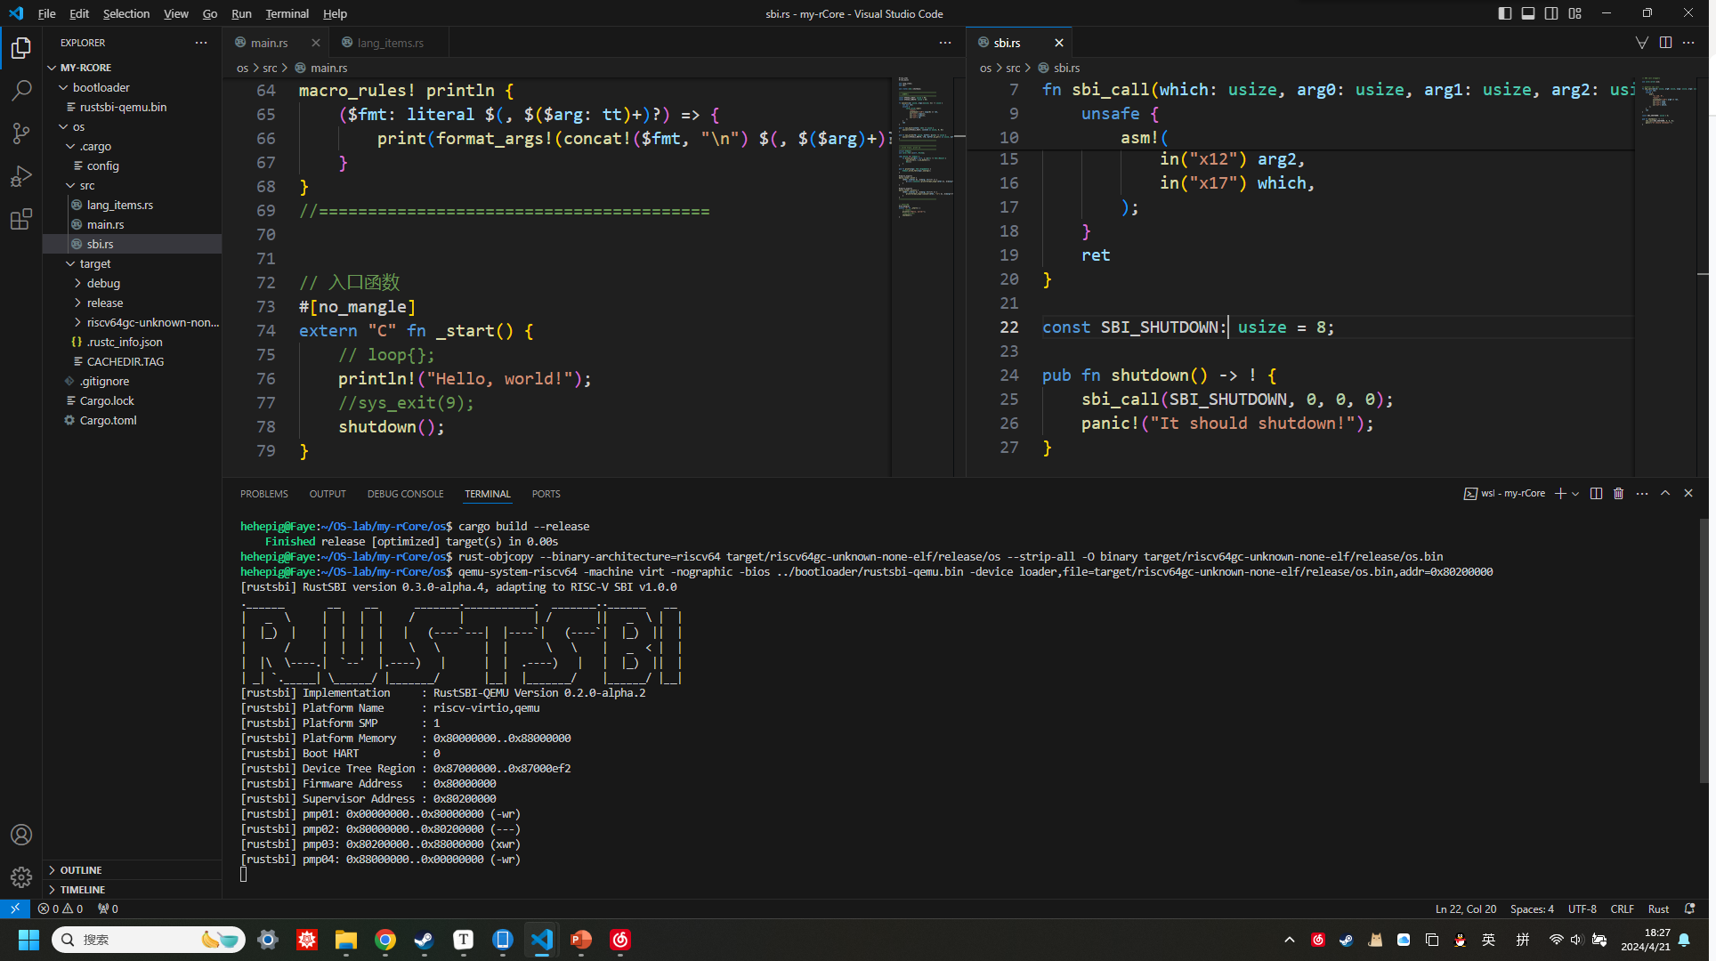
#![no_std]
#![no_main]
mod lang_items;
mod sbi;
use crate::sbi::shutdown;
//========================================
// 系统调用
//========================================
const SYSCALL_EXIT: usize = 93;
const SYSCALL_WRITE: usize = 64;
fn syscall(id: usize, args:[usize; 3]) -> isize {
let mut ret;
unsafe {
core::arch::asm!(
"ecall",
inlateout("x10") args[0] => ret,
in("x11") args[1],
in("x12") args[2],
in("x17") id,
);
}
ret
}
pub fn sys_exit(xstate: i32) -> isize {
syscall(SYSCALL_EXIT, [xstate as usize, 0, 0])
}
pub fn sys_write(fd: usize, buffer: &[u8]) -> isize {
syscall(SYSCALL_WRITE, [fd, buffer.as_ptr() as usize, buffer.len()])
}
//========================================
//========================================
// write trait, print 宏
//========================================
struct Stdout;
use core::fmt::{self, Write};
impl Write for Stdout {
fn write_str(&mut self, s: &str) -> fmt::Result {
sys_write(1, s.as_bytes());
Ok(())
}
}
pub fn print(args: fmt::Arguments) {
Stdout.write_fmt(args).unwrap();
}
#[macro_export]
macro_rules! print {
($fmt: literal $(, $($arg: tt)+)?) => {
$crate::console::print(format_args!($fmt $(, $($arg)+)?));
}
}
#[macro_export]
macro_rules! println {
($fmt: literal $(, $($arg: tt)+)?) => {
print(format_args!(concat!($fmt, "\n") $(, $($arg)+)?));
}
}
//========================================
// 入口函数
#[no_mangle]
extern "C" fn _start() {
// loop{};
println!("Hello, world!");
//sys_exit(9);
shutdown();
}
// panic_handler
use core::panic::PanicInfo;
#[panic_handler]
fn panic(_info: &PanicInfo) -> ! {
loop {}
}
// SBI call wrappers
use core::arch::asm;
// general sbi call
fn sbi_call(which: usize, arg0: usize, arg1: usize, arg2: usize) -> usize {
let mut ret;
unsafe {
asm!(
"li x16, 0",
"ecall",
inlateout("x10") arg0 => ret,
in("x11") arg1,
in("x12") arg2,
in("x17") which,
);
}
ret
}
const SBI_SHUTDOWN: usize = 8;
pub fn shutdown() -> ! {
sbi_call(SBI_SHUTDOWN, 0, 0, 0);
panic!("It should shutdown!");
}
qemu 一直卡着，电脑风扇狂转。

Slide 8
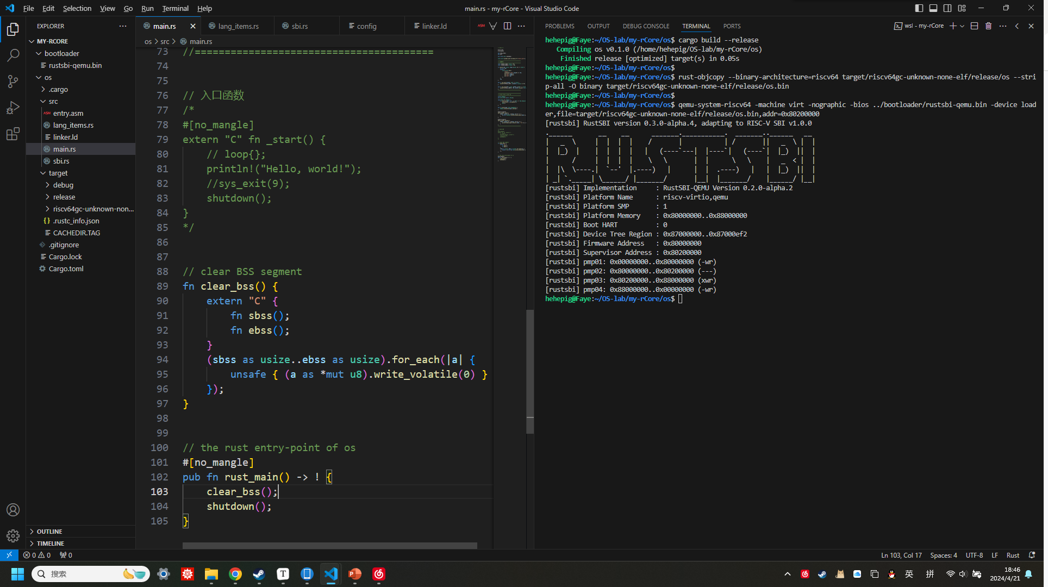
链接脚本 linker.ld 设置正确的内存布局，
再用嵌入一段汇编 entry.asm 初始化栈空间，
得到正常进入然后退出 qemu 模拟的 RISC-V 64 计算机的程序。
# os/src/entry.asm
.section .text.entry
.globl _start
_start:
la sp, boot_stack_top
call rust_main
.section .bss.stack
.globl boot_stack_lower_bound
boot_stack_lower_bound:
.space 4096 * 16
.globl boot_stack_top
boot_stack_top:
OUTPUT_ARCH(riscv)
ENTRY(_start)
BASE_ADDRESS = 0x80200000;
SECTIONS
{
. = BASE_ADDRESS;
skernel = .;
stext = .;
.text : {
*(.text.entry)
*(.text .text.*)
}
. = ALIGN(4K);
etext = .;
srodata = .;
.rodata : {
*(.rodata .rodata.*)
}
. = ALIGN(4K);
erodata = .;
sdata = .;
.data : {
*(.data .data.*)
}
. = ALIGN(4K);
edata = .;
.bss : {
*(.bss.stack)
sbss = .;
*(.bss .bss.*)
}
. = ALIGN(4K);
ebss = .;
ekernel = .;
/DISCARD/ : {
*(.eh_frame)
}
}
// main.rs
#![no_std]
#![no_main]
mod lang_items;
mod sbi;
use crate::sbi::shutdown;
core::arch::global_asm!(include_str!("entry.asm"));
//========================================
// 系统调用
//========================================
const SYSCALL_EXIT: usize = 93;
const SYSCALL_WRITE: usize = 64;
fn syscall(id: usize, args:[usize; 3]) -> isize {
let mut ret;
unsafe {
core::arch::asm!(
"ecall",
inlateout("x10") args[0] => ret,
in("x11") args[1],
in("x12") args[2],
in("x17") id,
);
}
ret
}
pub fn sys_exit(xstate: i32) -> isize {
syscall(SYSCALL_EXIT, [xstate as usize, 0, 0])
}
pub fn sys_write(fd: usize, buffer: &[u8]) -> isize {
syscall(SYSCALL_WRITE, [fd, buffer.as_ptr() as usize, buffer.len()])
}
//========================================
//========================================
// write trait, print 宏
//========================================
struct Stdout;
use core::fmt::{self, Write};
impl Write for Stdout {
fn write_str(&mut self, s: &str) -> fmt::Result {
sys_write(1, s.as_bytes());
Ok(())
}
}
pub fn print(args: fmt::Arguments) {
Stdout.write_fmt(args).unwrap();
}
#[macro_export]
macro_rules! print {
($fmt: literal $(, $($arg: tt)+)?) => {
$crate::console::print(format_args!($fmt $(, $($arg)+)?));
}
}
#[macro_export]
macro_rules! println {
($fmt: literal $(, $($arg: tt)+)?) => {
print(format_args!(concat!($fmt, "\n") $(, $($arg)+)?));
}
}
//========================================
// 入口函数
/*
#[no_mangle]
extern "C" fn _start() {
// loop{};
println!("Hello, world!");
//sys_exit(9);
shutdown();
}
*/
// clear BSS segment
fn clear_bss() {
extern "C" {
fn sbss();
fn ebss();
}
(sbss as usize..ebss as usize).for_each(|a| {
unsafe { (a as *mut u8).write_volatile(0) }
});
}
// the rust entry-point of os
#[no_mangle]
pub fn rust_main() -> ! {
clear_bss();
shutdown();
}
// sbi.rs
// SBI call wrappers
use core::arch::asm;
// general sbi call
fn sbi_call(which: usize, arg0: usize, arg1: usize, arg2: usize) -> usize {
let mut ret;
unsafe {
asm!(
"li x16, 0",
"ecall",
inlateout("x10") arg0 => ret,
in("x11") arg1,
in("x12") arg2,
in("x17") which,
);
}
ret
}
const SBI_SHUTDOWN: usize = 8;
pub fn shutdown() -> ! {
sbi_call(SBI_SHUTDOWN, 0, 0, 0);
panic!("It should shutdown!");
}
// lang_items.rs
// panic_handler
use core::panic::PanicInfo;
#[panic_handler]
fn panic(_info: &PanicInfo) -> ! {
loop {}
}

Slide 9
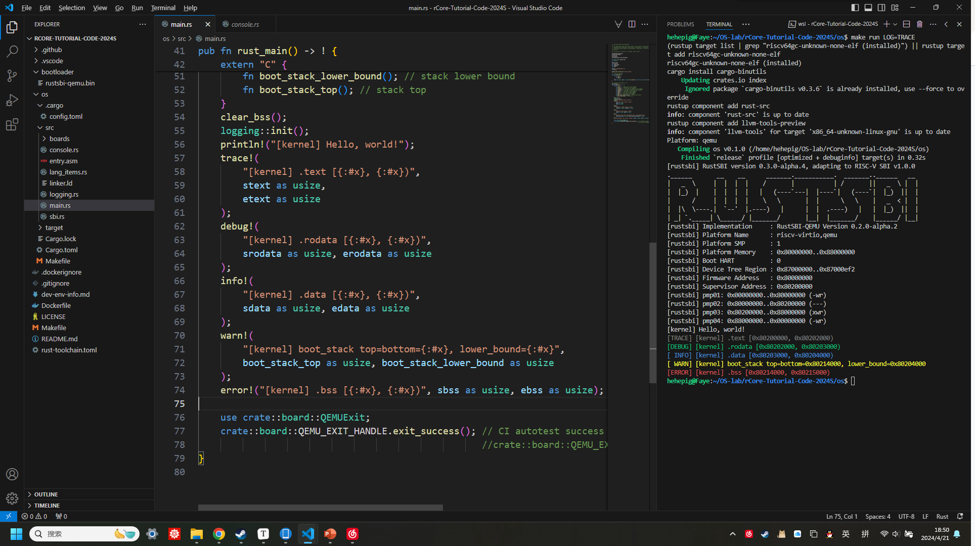
最后再运行一次仓库里的第一章代码。
仓库里的代码加了 console.rs 模块，就是前面的 println! 宏稍作修改，并重写了异常处理函数 panic 使得可以进行打印。

