Slide 1
Mental Illness And Unemployment In The United States
Hannah Hill - Retrieved Data, Summarized Findings
Nicholas Noark – Cleaned data, Made Heatmaps
Cecilia Zhang – Visualized Data, performed regressions

Slide 2
Outline
1. Background and Research Questions
2. Individual data analysis
Mental illness and unemployment
Covariates (education, income, age, gender)
3. State-wide data analysis
Self-reported poor mental health and unemployment
4. Geographic analysis
Poor mental health
Unemployment
Access to mental health care
5. Findings Summary

Slide 3
Previous studies suggest a cyclic relationship between poor mental health and unemployment
Several studies in the 1990’s uncovered a significant bi-directional relationship between employment and mental health (IWH August 2009 Report)
Unemployment has a negative effect on mental health
Those suffering from poor mental health are more likely to become unemployed
Unemployment affects many areas of life which are tied to mental health
Standard of living
Security of income
Self-esteem
Social life
Access to healthcare
Mental Distress
Unemployment
Loss of Benefits & Health Coverage
Loss of Access to Treatment
Return to Work
NAMI, Road to Recovery: Employment and Mental Illness, July 2014

Slide 4
Research Questions
Is there evidence for a relationship between unemployment and mental health in more recent data?
Do factors like age, income, education correlate with mental illness and/or unemployment status?
What regions of the US are most affected by mental illness and unemployment?
What is the status of access to mental health care in the regions most affected?

Slide 5
Methodology and Data Collection
We used two datasets on mental health and employment status:
1. Unemployment and mental illness survey from kaggle.com
paid research survey sponsored by NAMI of 334 individuals
2. BRFSS 2019 data from cdc.gov
aggregated state-level data on various behavioral and demographic factors
NOTE: New Jersey is excluded for not meeting minimum data requirements
Additionally, we found data on access to mental health care at a state level:
1. Mental Health America 2020 Report from mhnational.org
Notes:
NAMI = National Alliance on Mental Illness
BRFSS = Behavior Risk Factor Surveillance System
Mental Health America compiled state-level data about mental illness and access to care at from multiple nationwide surveys (including NSDUH and BRFSS

Slide 6
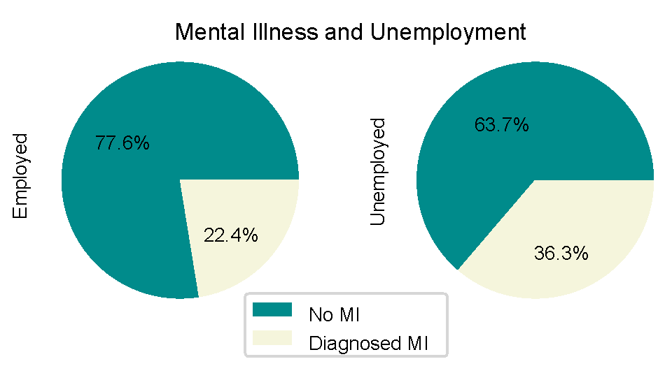
Individuals with diagnosed mental illness (MI) more likely to be unemployed
 | No MI | Diagnosed MI
Employed | 197 | 51
Unemployed | 57 | 29
Fisher’s exact p-value = 0.019

Slide 7
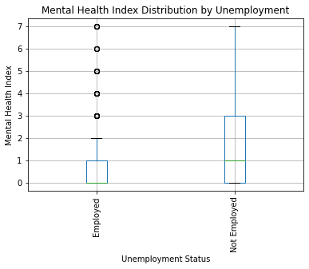
Unemployed individuals more likely to suffer from one or more mental health Symptoms
Mental Health Symptoms:
Lack of concentration
Anxiety
Depression
Obsessive thinking
Mood swings
Panic attacks
Compulsive behavior

Slide 8
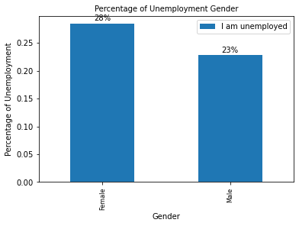
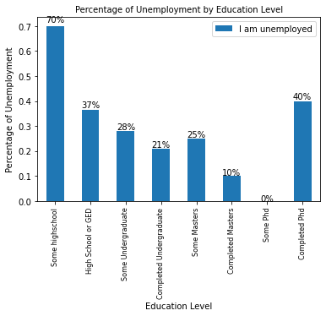
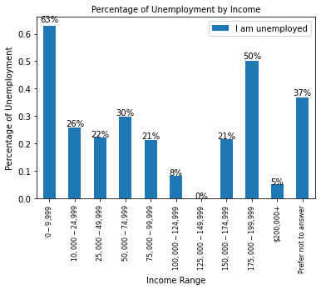
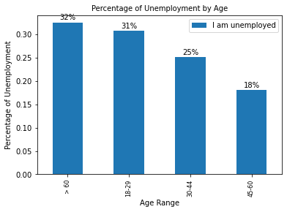
Individual Education level is correlated with unemployment risk
only 2 people are in this category

Slide 9
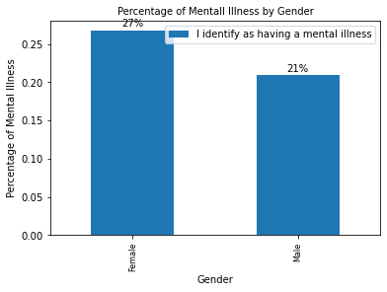
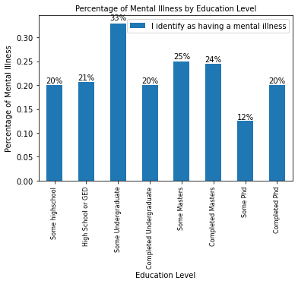
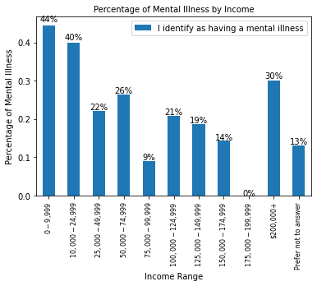
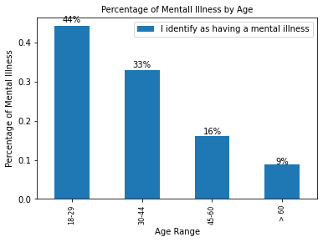
More young individuals identify as having a mental illness

Slide 10
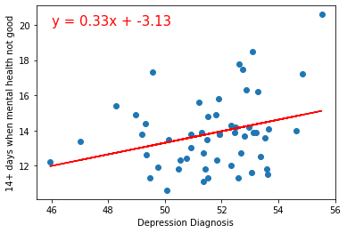
States: discrepancy between percent reporting poor mental health and those with a diagnosis of depression
R²= 0.088

Slide 11
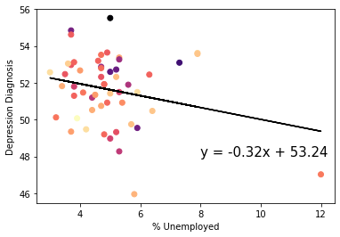
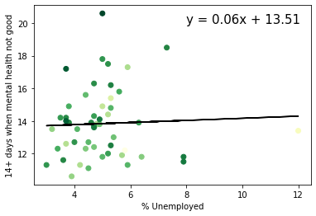
No correlation between Mental Illness and Unemployment at the state level
R²= 0.061
R²= 0.002
Notes:
Likely explanation: Too hard to parse other important contributors to unemployment using aggregated state level data.

Slide 12
States with the highest unemployment rate
State | % Unemployed | % Reporting Poor MH | % Diagnosed Depressed
Guam | 12.0 | 13.4 | 47.0
Puerto Rico | 7.9 | 11.8 | 53.6
District of Columbia | 7.9 | 11.5 | 53.6
Louisiana | 7.3 | 18.5 | 53.1
New York | 6.4 | 11.8 | 50.5
Rhode Island | 6.3 | 13.9 | 52.5
Mississippi | 5.9 | 17.3 | 50.0
Connecticut | 5.9 | 11.3 | 51.5
Texas | 5.8 | 12.2 | 46.0
California | 5.7 | 11.9 | 49.8

Slide 13
States with the highest rates of poor mental health
State | % Unemployed | % Reporting Poor MH | % Diagnosed Depressed
West Virginia | 5.0 | 20.6 | 55.5
Louisiana | 7.3 | 18.5 | 53.1
Arkansas | 5.0 | 17.8 | 52.6
Alabama | 5.2 | 17.5 | 52.7
Mississippi | 5.9 | 17.3 | 49.6
Kentucky | 3.7 | 17.2 | 54.9
Ohio | 4.7 | 16.3 | 52.9
Michigan | 5.3 | 16.2 | 53.3
Tennessee | 5.6 | 15.8 | 51.9
Oklahoma | 4.4 | 15.6 | 51.2

Slide 14
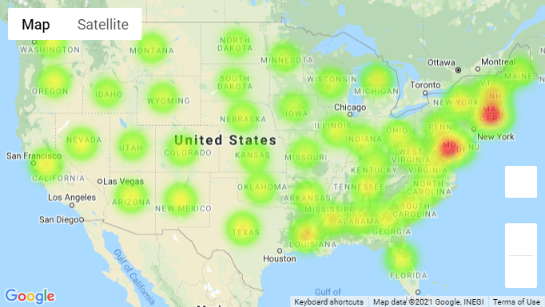
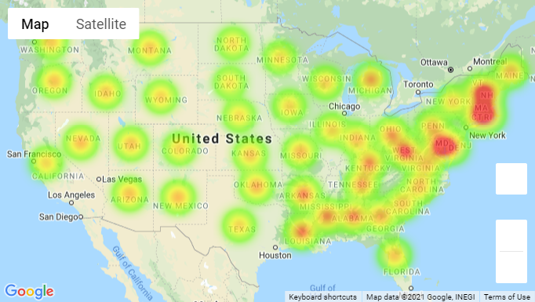
Geographically, high rates of unemployment correlate with clustered areas of poor mental health
Percent Unemployed by State
Percent Report Poor Mental Health by State

Slide 15
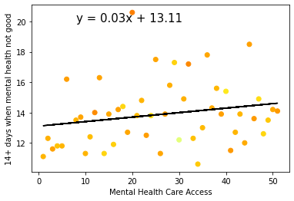
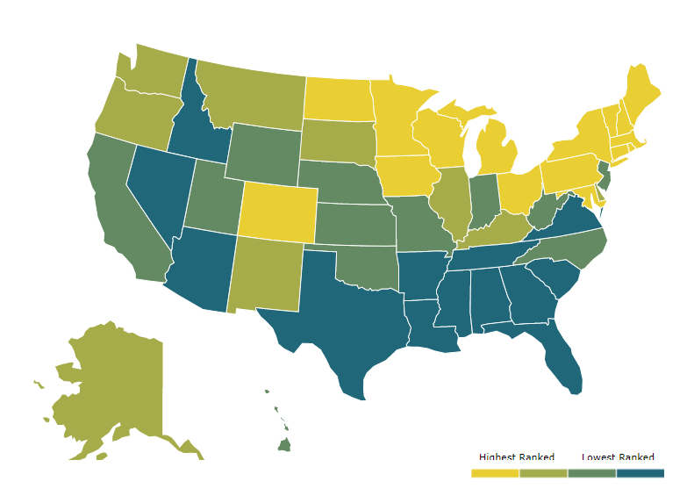
At the state level, not a strong correlation between poor mental health and access to mental health care
Access to Care Ranking MHA 2020
R²= 0.042
https://mhanational.org/issues/2020/mental-health-america-access-care-data#one

Slide 16
Findings Summary
Individuals with diagnosed mental illness (MI) more likely to be unemployed
Unemployed individuals more likely to suffer from one or more mental health symptoms
More young individuals (18-29) identify as having a mental illness than older individuals (60+).
However, these groups have similar rates of unemployment
Appears to be no correlation between Mental Illness and Unemployment at the state level.
However, geographically, high rates of unemployment correlate with clustered areas of poor mental health
At the state level, not a strong correlation between poor mental health and access to mental health care

