Slide 1
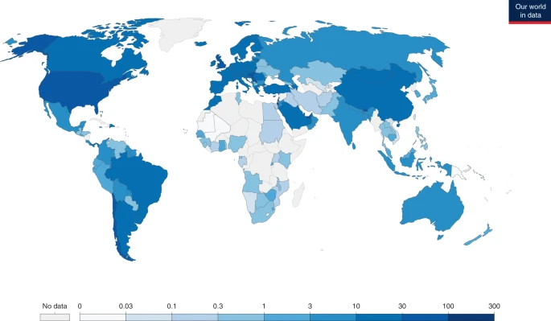
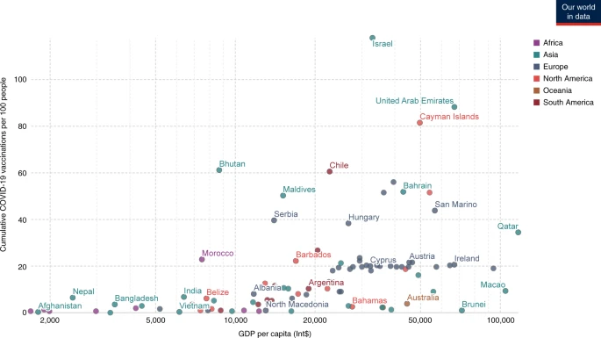

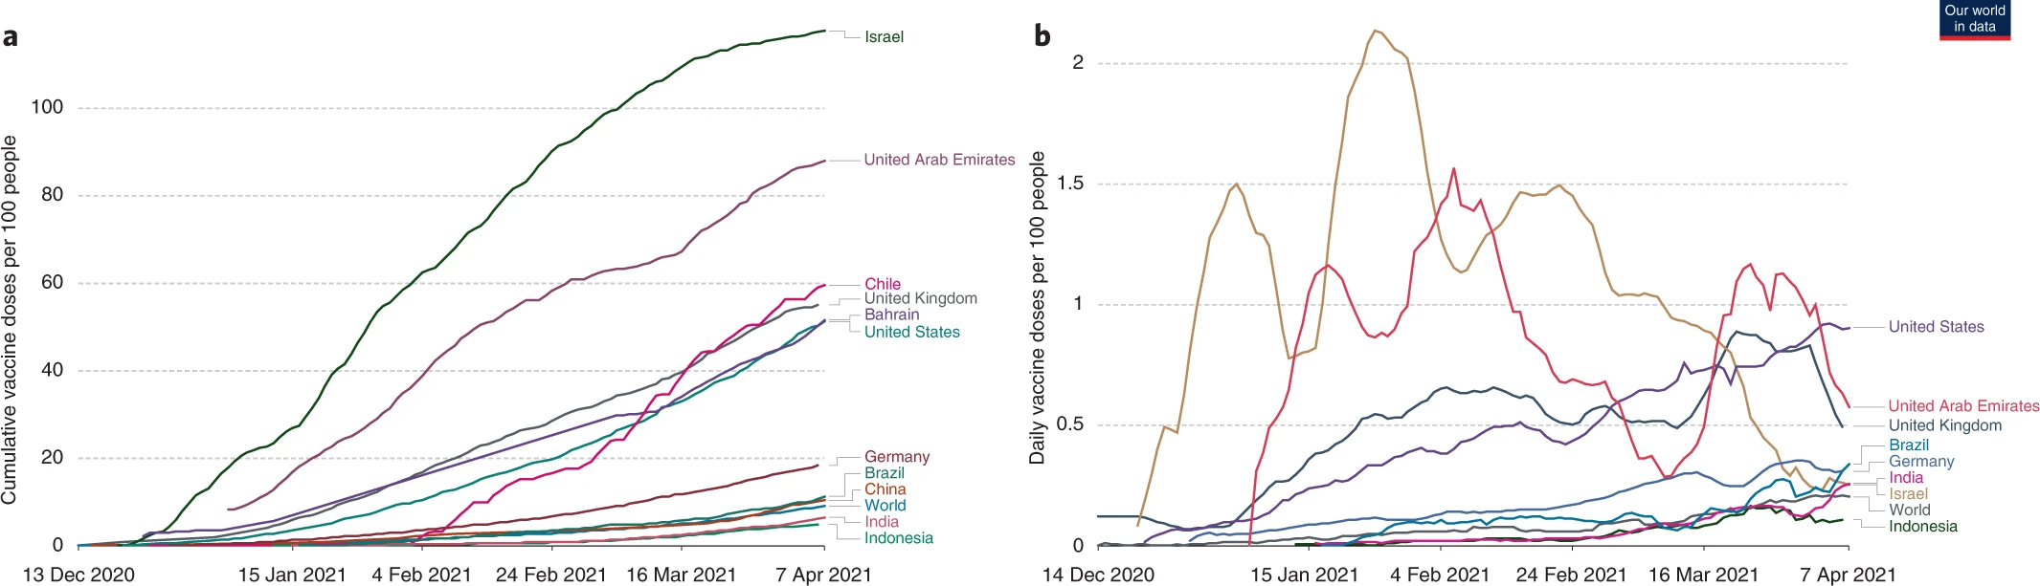
Worldwide COVID-19 Data Dashboard
ꙨCumulative cases per pop ꙨCumulative doses per pop ꙨCumulative deaths per pop ꙨGDP per pop
y-axis options:
cumulative cases
cumulative doses
cumulative deaths
excess mortality
on hover/click:
country metadata
population
life expectancy
hospital beds
handwashing facilities
cumulative cases/doses
daily cases/doses
country checkboxes
x-axis slide
x-axis slide

