Slide 1
ECE498 IMU3D
Paul Pok Hym Ng (ppng2)
Honglu He (hhe12)

Slide 2
Intro
Calculate and plot the movement based upon only sensor information
Accelerometer, gyroscope, magnetometer
Be able to do this with cheap sensors
Like the ones found on the phone

Slide 3
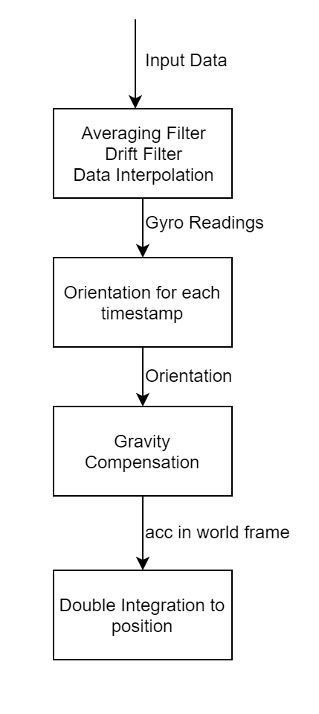
Algorithm
Dealing with gravity
Gravity compensation (subtraction)
Applying rotations
Quaternion multiplication
Calculating position
Integration, varying time slices
Drift
Scaling acceleration and angular velocity

Slide 4
Quaternion
Why use quaternion?
Gimbal lock: Pitch/Yaw same at 90 degrees
Less computations
Dead reckoning + Madgwick
Scaling + Normalization
Calculation of quaternions
Take in gyro readings and timestamp, integrate to get orientation based on previous orientation
Madgwick reformats quaternion calculation as a minimum optimization problem
Uses gradient descent to calculate the best next quaternion

Slide 5
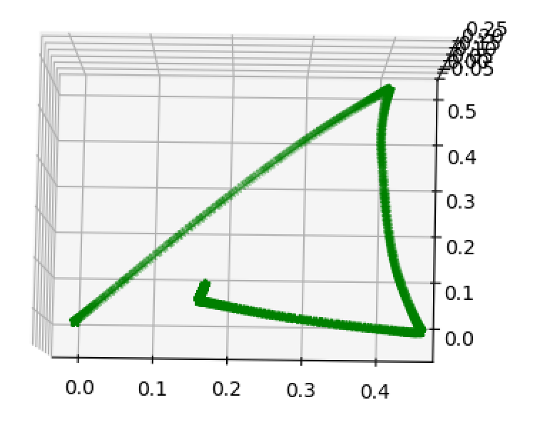
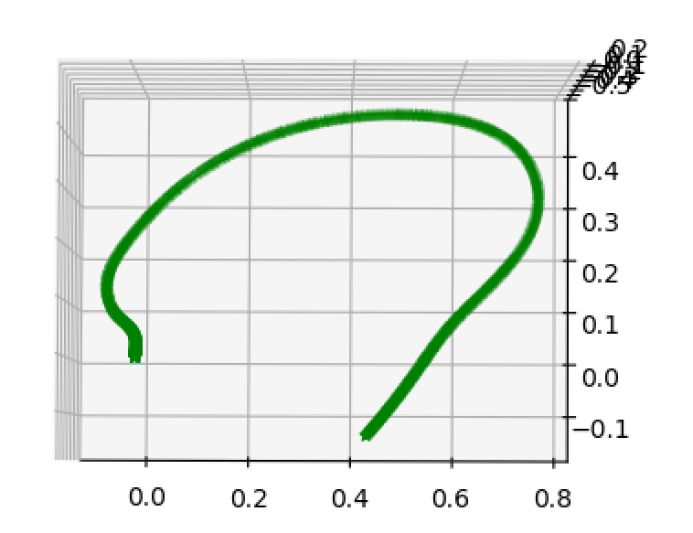
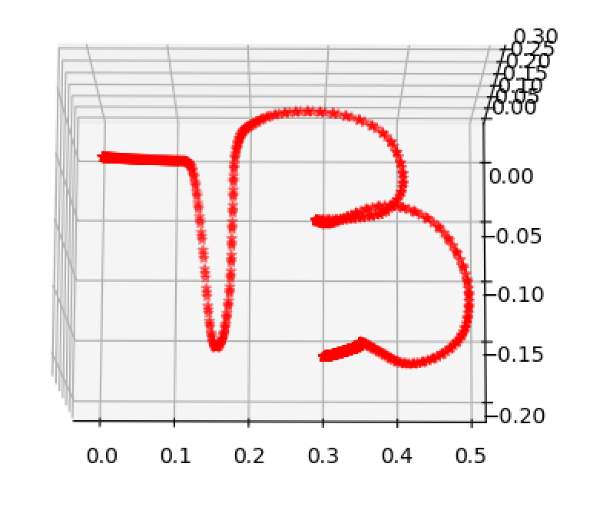
Result
3D Result is not ideal/incorrect
Possible Reason: Gravity compensation incorrect
2D Result is acceptable
However still some blow-up (0-30cm) in the Z-axis
2D Triangle
B (self collected data)
3D Circle

