Slide 1
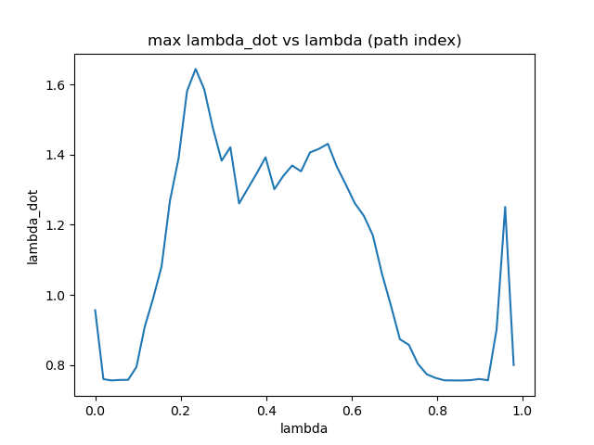
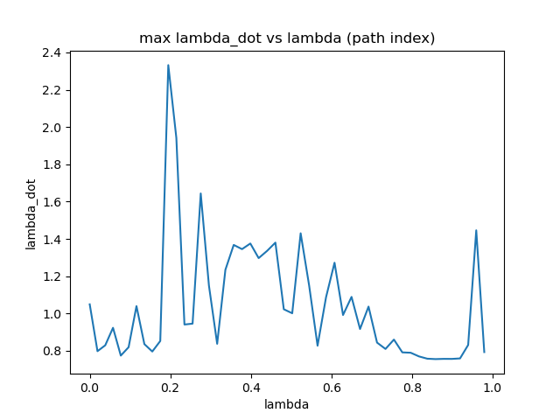

Single Arm $\dot{λ}$ Optimization, with eef orientation redundancy (Global)
$\min_{θ_{all}}{−min⁡({\dot{λ}}_{max})}$
$λ$: relative path length, steps$×$1 vector
$θ_{all}$: stepsx1 rotation angle redundancy of eef
$q_{all}$: steps$×$6 flattened vector, calculated from $θ_{all}$
${\dot{λ}}_{max}$: steps$×$1 vector, calculated given $q_{all}$
No constraints

Slide 2
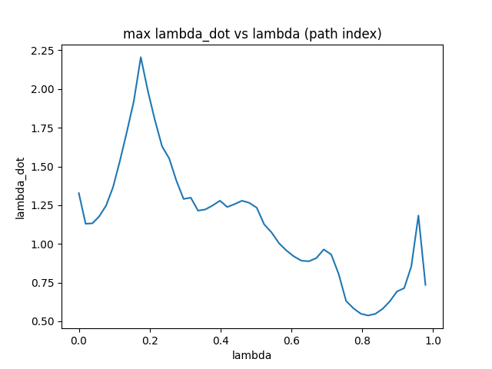

Stepwise local optimization
$\min_{\dot{q}}{{\left|\left|J_{p}(q)∙\dot{q}−v_{d}\right|\right|}^{2}+{w\left|\left|J_{R}(q)∙\dot{q}−ω_{d}\right|\right|}^{2}+K_{q}{\left|\left|\dot{q}\right|\right|}^{2}}$
Accumulate to get full trajectory $q_{all}$: $q+=q+\dot{q}$
$e_{p}$: position error between $p_{cur}$ and next waypoint
$e_{R}:$ orientation error between current tool z-axis and next waypoint curve normal

Slide 3
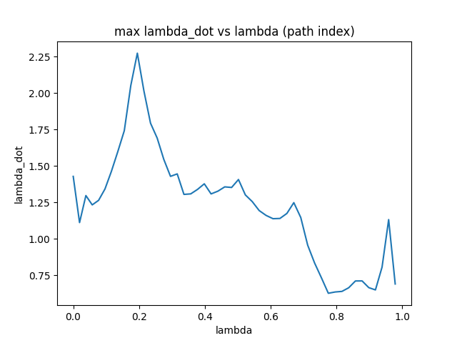

Optimization on initial config, then stepwise
$\min_{θ_{init}}{−min⁡({\dot{λ}}_{max})}$
$q_init$: initial joint config from $θ_{init}$
$q_all$: calculated trajectories from stepwise qp with $q_init$
${\dot{λ}}_{max}$: steps$×$1 vector, calculated given $q_{all}$

Slide 4
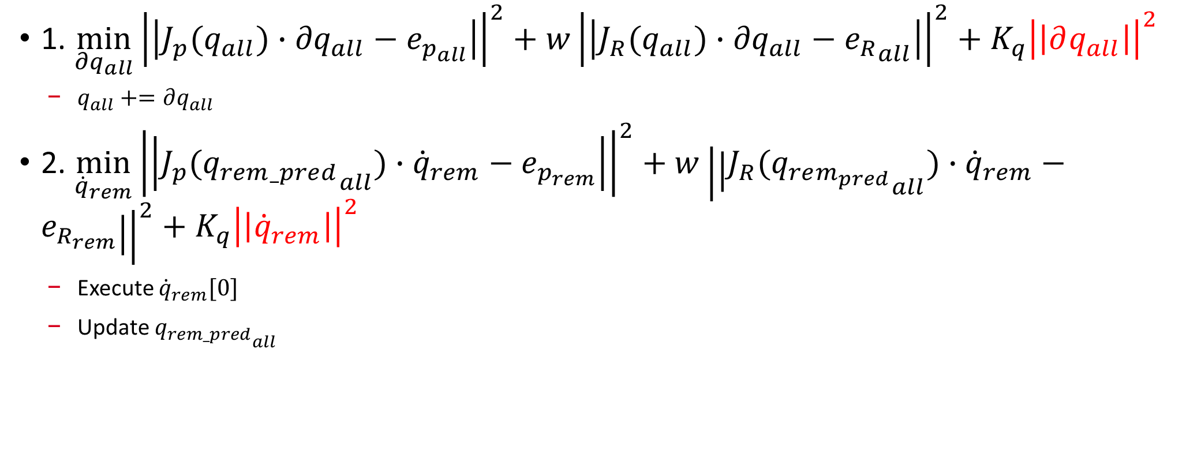
Global QP
1. $\min_{{∂q}_{all}}{{\left|\left|J_{p}(q_{all})∙{∂q}_{all}−e_{p_{all}}\right|\right|}^{2}+{w\left|\left|J_{R}(q_{all})∙{∂q}_{all}−{e_{R}}_{all}\right|\right|}^{2}+K_{q}{\left|\left|∂q_{all}\right|\right|}^{2}}$
$q_{all}+=∂q_{all}$
2. $\min_{{\dot{q}}_{rem}}{{\left|\left|J_{p}({q_{rem_pred}}_{all})∙{\dot{q}}_{rem}−e_{p_{rem}}\right|\right|}^{2}+{w\left|\left|J_{R}({q_{rem_{pred}}}_{all})∙{\dot{q}}_{rem}−e_{R_{rem}}\right|\right|}^{2}+K_{q}{\left|\left|{\dot{q}}_{rem}\right|\right|}^{2}}$
Execute ${\dot{q}}_{rem}[0]$
Update ${q_{rem_pred}}_{all}$

