Slide 1
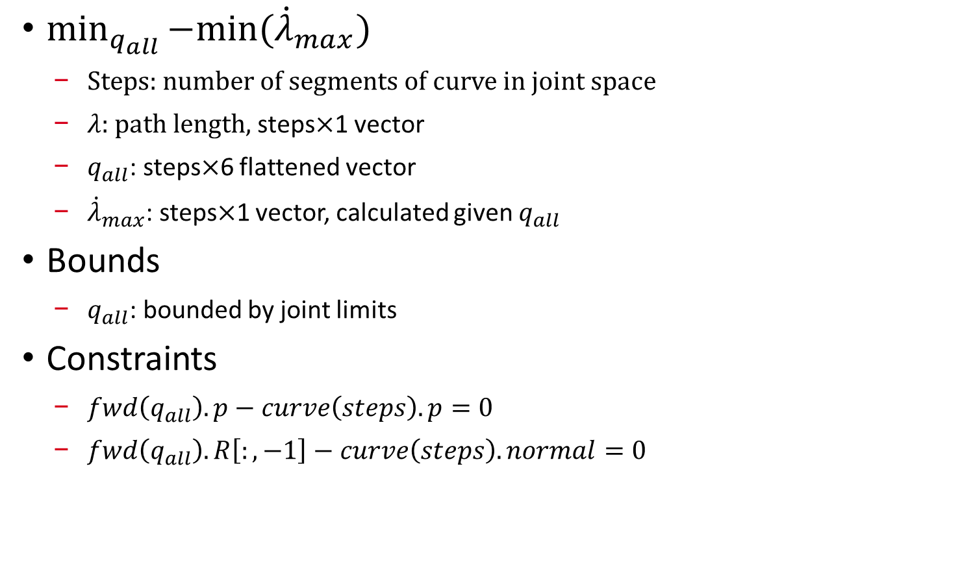
Single Arm $\dot{λ}$ Optimization, with eef orientation redundancy
$\min_{q_{all}}{−min⁡({\dot{λ}}_{max})}$
Steps: number of segments of curve in joint space
$λ$: path length, steps$×$1 vector
$q_{all}$: steps$×$6 flattened vector
${\dot{λ}}_{max}$: steps$×$1 vector, calculated given $q_{all}$
Bounds
$q_{all}$: bounded by joint limits
Constraints
$fwd\left(q_{all}\right).p−curve\left(steps\right).p=0$
$fwd\left(q_{all}\right).R\left[:,−1\right]−curve\left(steps\right).normal=0$

Slide 2
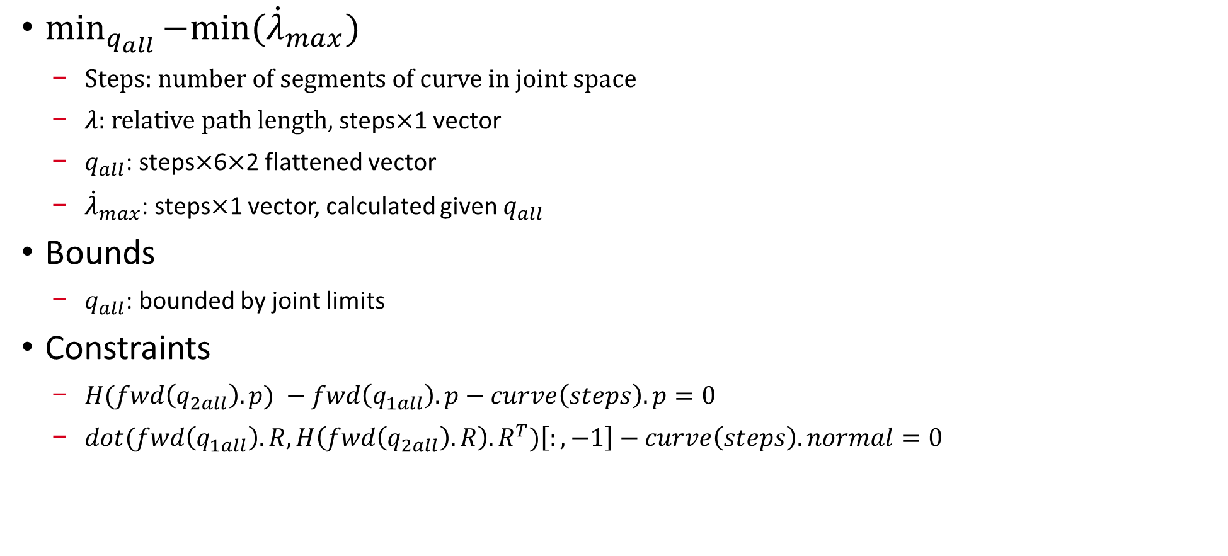
Dual Arm $\dot{λ}$ Optimization
$\min_{q_{all}}{−min⁡({\dot{λ}}_{max})}$
Steps: number of segments of curve in joint space
$λ$: relative path length, steps$×$1 vector
$q_{all}$: steps$×$6$×$2 flattened vector
${\dot{λ}}_{max}$: steps$×$1 vector, calculated given $q_{all}$
Bounds
$q_{all}$: bounded by joint limits
Constraints
$H(fwd\left(q_{2all}\right).p) −fwd\left(q_{1all}\right).p−curve\left(steps\right).p=0$
$dot(fwd\left(q_{1all}\right).R,H\left(fwd\left(q_{2all}\right).R\right).R^{T})\left[:,−1\right]−curve\left(steps\right).normal=0$

