Slide 1
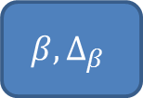


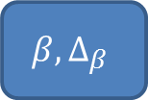

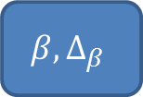

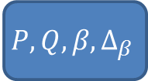
genotype, direct LDL-C
genotype, indirect LDL-C
genotype, indirect LDL-C
genotype, indirect LDL-C
genotype, indirect LDL-C
linear regression
genotype, indirect LDL-C
$$β,∆_{β}$$
$$β,∆_{β}$$
$$β,∆_{β}$$
$$β,∆_{β}$$
$$β,∆_{β}$$
first meta-analysis
linear regression
$$β,∆_{β}$$
$$β,∆_{β}$$
second meta-analysis
$$P, Q, β,∆_{β}$$

