Slide 1
Analysis of quantitative traits: , WBV, LVV, P300A, P300L
Cathryn Lewis
20th December, 2011

Slide 2
Summary
Analysis of quantitative traits, showing distribution by centre and by group (control, case, relative
Removing outliers
3 for WBV, 1 for LVV, none for P300A and P300L
Linear model correcting trait value for centre, group, age and sex.
Producing trait values corrected for these factors (i.e. Model residuals)
Original model residuals (on scale of original value
Standardised residuals (necessary for any meta-analysis)
Rank transformed residuals
Graphics of model fit and normality

Slide 3
Comments
I suggest we use the standardised residuals
Since these are corrected for age and sex, individuals missing these values will be omitted
Is this a problem? How many?
Only trait values for QC-passed individuals (n=4881) are included in output, but modelling based on all individuals (numbers given for each trait)
All output traits have been corrected for group to ensure association analysis is testing for SNPs that influence the trait, not those that distinguish between (e.g.) cases and controls.

Slide 4
For each trait: WBV, LVV, P300A, P300L
Histograms for trait distribution by centre, and by group (case, relative control)
Model parameters – sex, age, centre, group
Model fit for including group (i.e. How much of an effect does this have?)
Model fit graphics
QQ plot for residuals, standardised residuals, rank normalised residuals

Slide 5
Output file Quant_traits_resid.csv
Output contains
All input file
Residuals for WBV, LVV, P300A, P300L
Adjusted trait values given in final columns, with 3 columns per trait
WPV_resid
WPV_stand
WPV_rank
I suggest we use either ‘resid’ or ‘stand’
Both should give the same statistical results
‘resid’ will give beta values for the same scale as the origial measures
Standardised values should be used for any meta-analysis

Slide 6
Sample size
 | Total | Total, outliers removed | Adjusted trait values | Individuals passing QC
Total | 8797 | - | - | 4881
WBV | 1766 | 1762 | 1353 | 826
LVV | 1758 | 1757 | 1345 | 826
P300A | 1089 | 1089 | 1041 | 515
P300L | 1102 | 1102 | 1053 | 520
NB : all modelling and trait value standardisation was performed on all individuals, regardless of DNA QC metrics.
Data output includes all individuals (numbers given in ‘Adjusted trait values’ column).
Final column gives the effective sample size, after DNA QC is included

Slide 7
WBV : whole brain volume

Slide 8
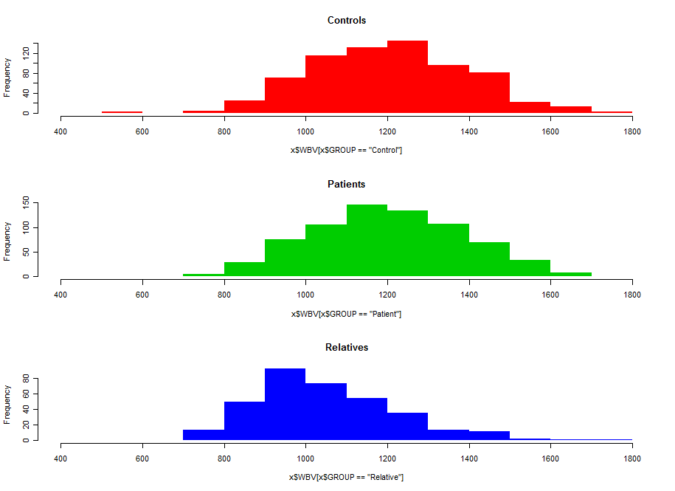

Slide 9
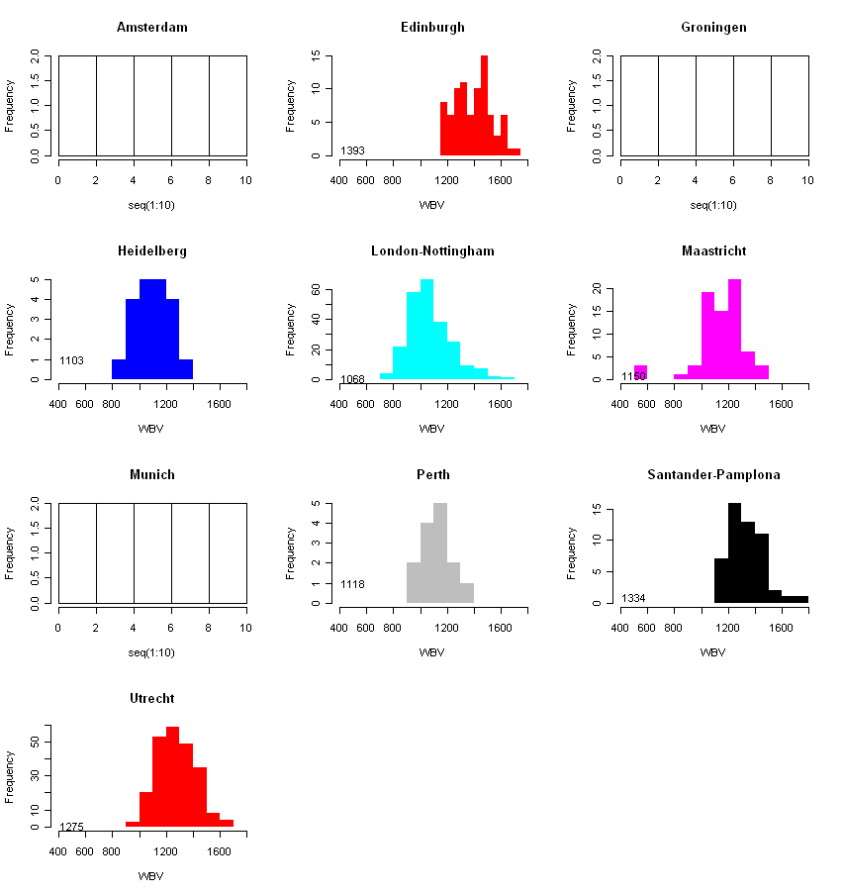
4 outliers removed

Slide 10
WBV model coefficients
 | Estimate | Std.Error | t-value | Pr(>|t|)
(Intercept) | 1430.465 | 16.87 | 84.795 | <2e-16 | ***
x$SEX_SUMM_NAMale | 120.403 | 6.394 | 18.831 | <2e-16 | ***
x$AGE | -2.763 | 0.271 | -10.198 | <2e-16 | ***
x$CENTRES4CathrynHeidelberg | -325.559 | 18.891 | -17.234 | <2e-16 | ***
x$CENTRES4CathrynLondon-Nottingham | -348.592 | 13.257 | -26.295 | <2e-16 | ***
x$CENTRES4CathrynMaastricht | -248.961 | 15.465 | -16.099 | <2e-16 | ***
x$CENTRES4CathrynPerth | -252.028 | 22.552 | -11.176 | <2e-16 | ***
x$CENTRES4CathrynSantander-Pamplona | -128.88 | 16.241 | -7.935 | 4.39E-15 | ***
x$CENTRES4CathrynUtrecht | -77.635 | 14.773 | -5.255 | 1.72E-07 | ***
x$GROUPPatient | -14.813 | 7.519 | -1.97 | 0.049 | *
x$GROUPRelative | -5.381 | 8.805 | -0.611 | 0.541

Slide 11
WBV – non-significant effect of adding group to model
anova(modelWBV,modelWBVgp,test="Chi")
Analysis of Deviance Table
Model 1: x$WBV ~ x$SEX_SUMM_NA + x$AGE + x$CENTRES4Cathryn
Model 2: x$WBV ~ x$SEX_SUMM_NA + x$AGE + x$CENTRES4Cathryn + x$GROUP
Resid. Df Resid. Dev Df Deviance P(>|Chi|)
1 1344 17825949
2 1342 17773719 2 52231 0.1392

Slide 12
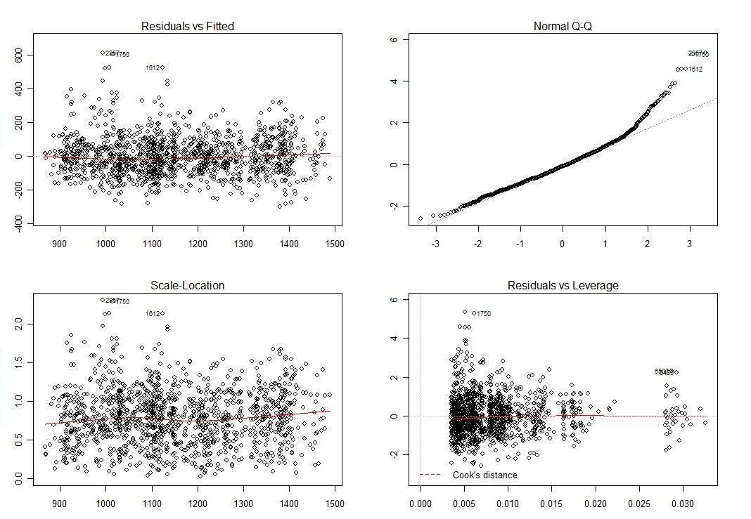
WPG, by group, model fit graphics

Slide 13
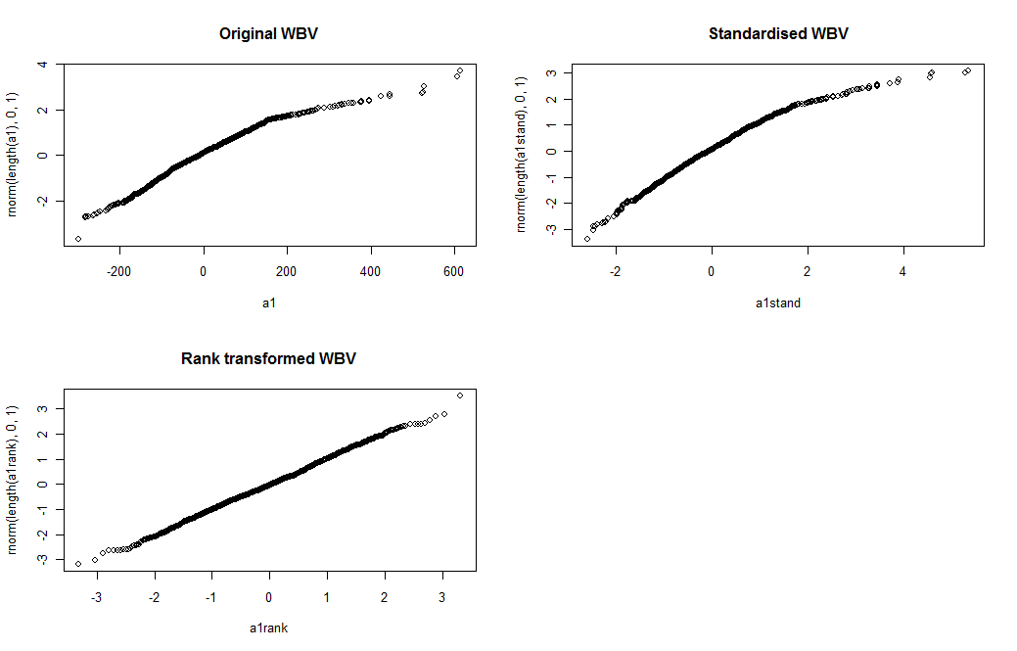

Slide 14
LVV : Lateral ventricle volume

Slide 15
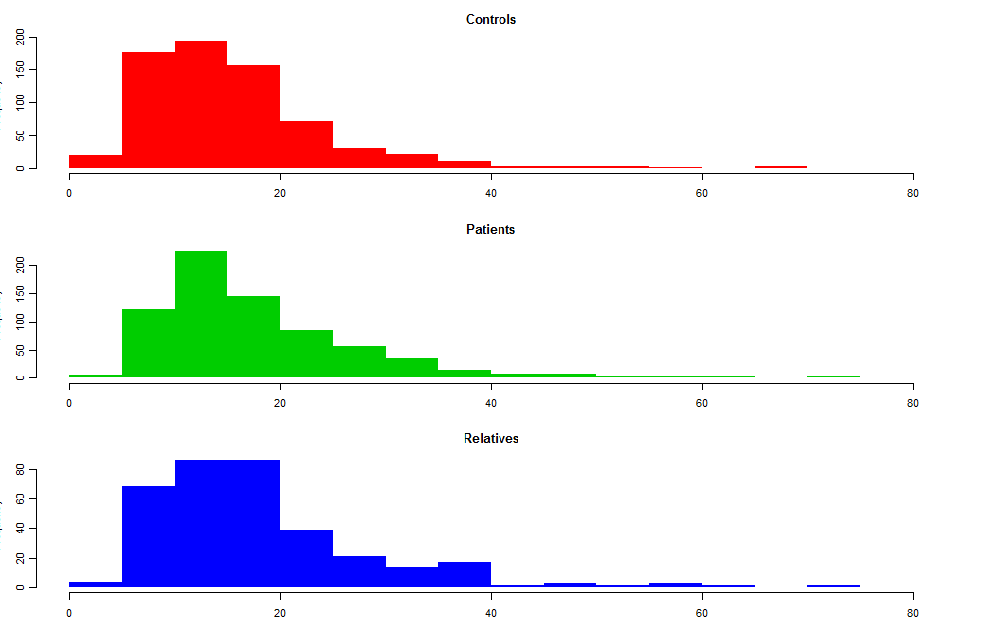
LVV

Slide 16
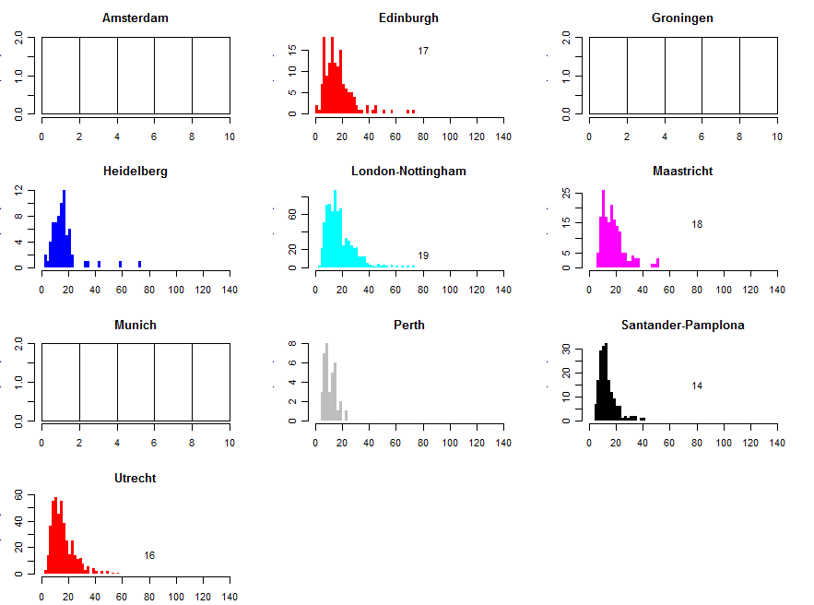
1 outlier removed

Slide 17
LVV model coefficients
 | Estimate | Std.Error | tvalue | Pr(>|t|)
(Intercept) | 8.44987 | 1.47431 | 5.731 | 1.23E-08 | ***
x$SEX_SUMM_NAMale | 2.86093 | 0.55797 | 5.127 | 3.37E-07 | ***
x$AGE | 0.16491 | 0.02384 | 6.919 | 7.06E-12 | ***
x$CENTRES4CathrynHeidelberg | 0.94314 | 1.64581 | 0.573 | 0.56671
x$CENTRES4CathrynLondon-Nottingham | 1.76705 | 1.15646 | 1.528 | 0.12675
x$CENTRES4CathrynMaastricht | 2.47506 | 1.34213 | 1.844 | 0.06538 | .
x$CENTRES4CathrynPerth | -5.37174 | 2.00424 | -2.68 | 0.00745 | **
x$CENTRES4CathrynSantander-Pamplona | -2.57109 | 1.41507 | -1.817 | 0.06945 | .
x$CENTRES4CathrynUtrecht | -0.72528 | 1.28716 | -0.563 | 0.57321
x$GROUPPatient | 1.54133 | 0.65824 | 2.342 | 0.01935 | *
x$GROUPRelative | 0.37692 | 0.7702 | 0.489 | 0.62466

Slide 18
LVV – significant effect of adding group to model
anova(modelLVV,modelLVVgp,test="Chisq")
Model 1: x$LVV ~ x$SEX_SUMM_NA + x$AGE + x$CENTRES4Cathryn
Model 2: x$LVV ~ x$SEX_SUMM_NA + x$AGE + x$CENTRES4Cathryn + x$GROUP
Resid. Df Resid. Dev Df Deviance P(>|Chi|)
1 1336 121304
2 1334 120573 2 730.84 0.01755 *

Slide 19
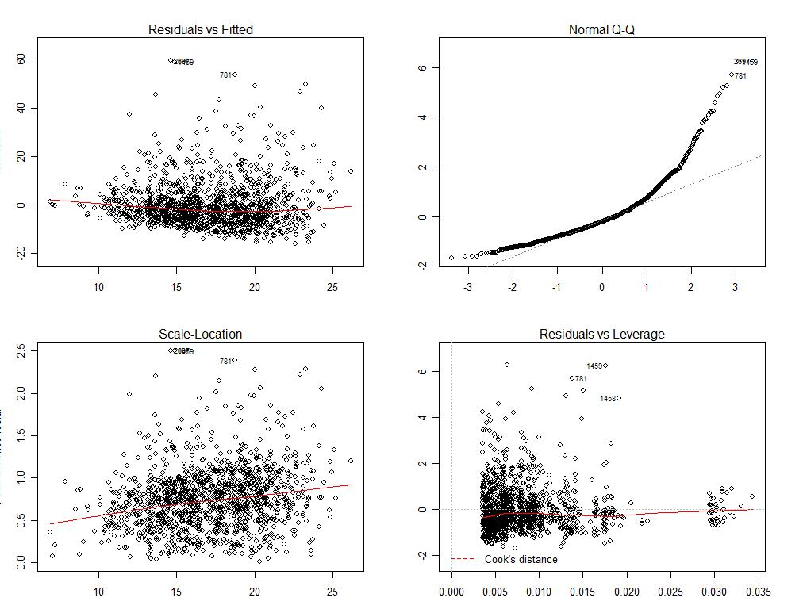
LVV model fit

Slide 20
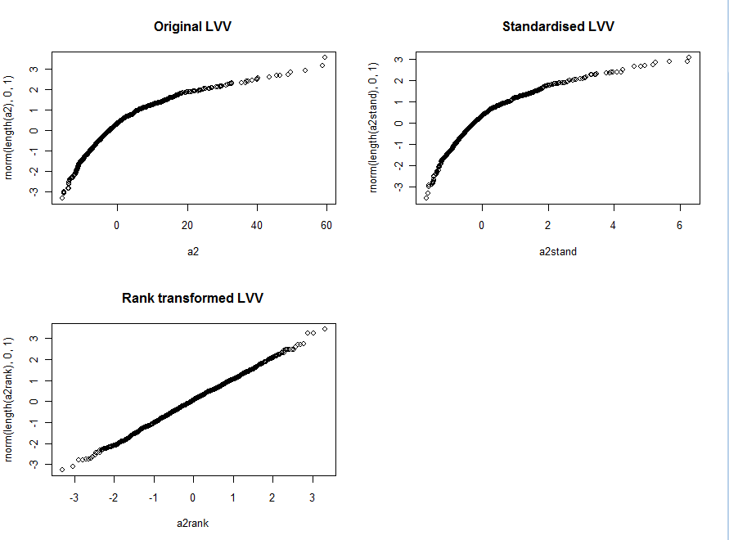

Slide 21
P300A Amplitude

Slide 22
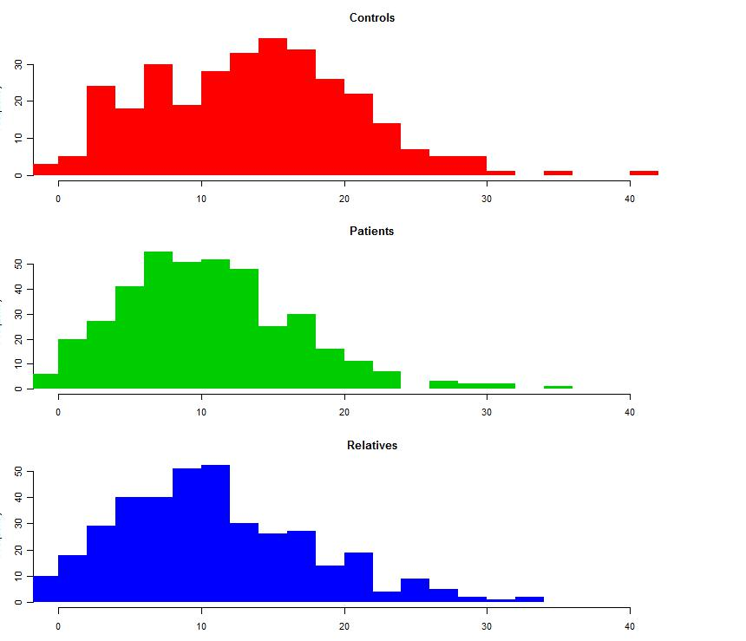

Slide 23
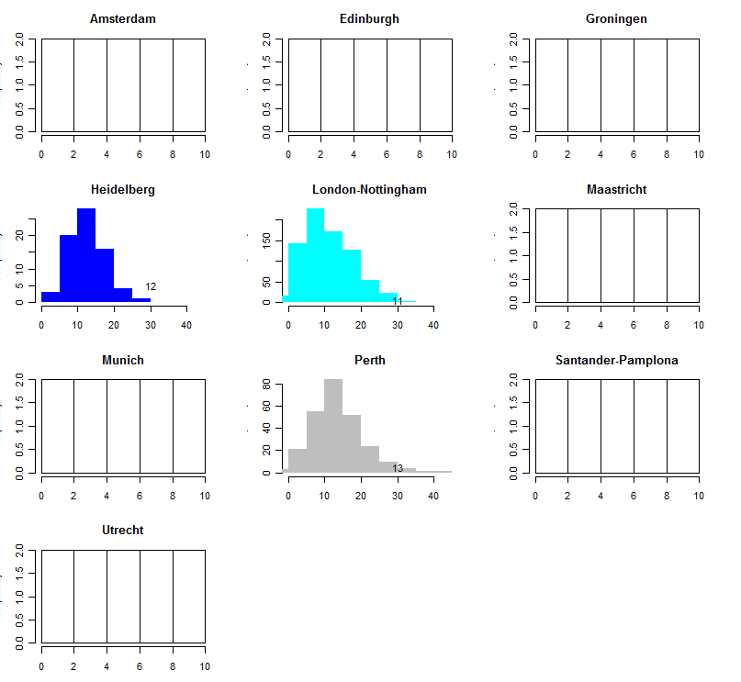

Slide 24
P300A model coefficients
 | Estimate | Std.Error | tvalue | Pr(>|t|)
(Intercept) | 17.48315 | 0.96213 | 18.171 | <2e-16 | ***
x$SEX_SUMM_NAMale | -2.03878 | 0.41235 | -4.944 | 8.91E-07 | ***
x$AGE | -0.07381 | 0.01558 | -4.738 | 2.46E-06 | ***
x$CENTRES4CathrynLondon-Nottingham | -1.2854 | 0.81007 | -1.587 | 0.11287
x$CENTRES4CathrynPerth | 2.15924 | 0.86226 | 2.504 | 0.01243 | *
x$GROUPPatient | -2.85917 | 0.51007 | -5.605 | 2.66E-08 | ***
x$GROUPRelative | -1.64799 | 0.51743 | -3.185 | 0.00149 | **

Slide 25
P300A: significant contribution of group to model
anova(P300Amodel,P300Amodelgp,test="Chisq")
Analysis of Deviance Table
Model 1: x$P300A ~ x$SEX_SUMM_NA + x$AGE + x$CENTRES4Cathryn
Model 2: x$P300A ~ x$SEX_SUMM_NA + x$AGE + x$CENTRES4Cathryn + x$GROUP
Resid. Df Resid. Dev Df Deviance P(>|Chi|)
1 1036 42516
2 1034 41261 2 1254.7 1.487e-07 ***

Slide 26
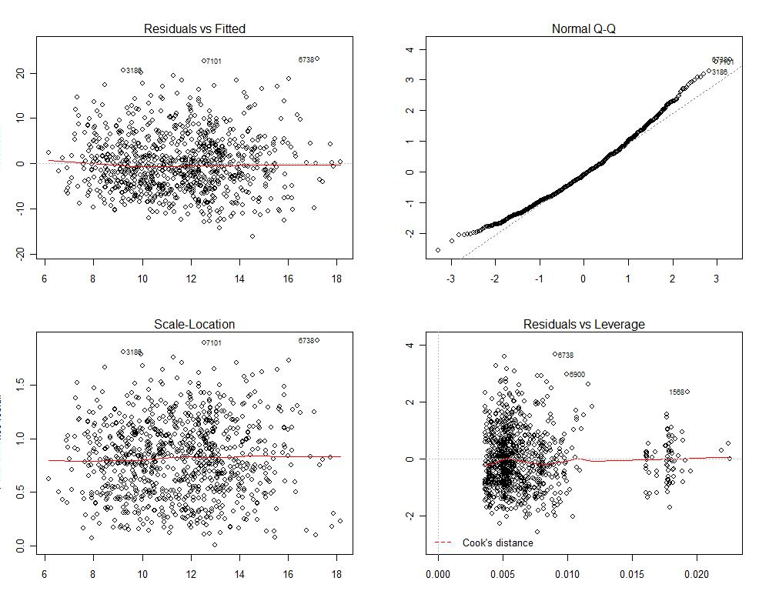

Slide 27
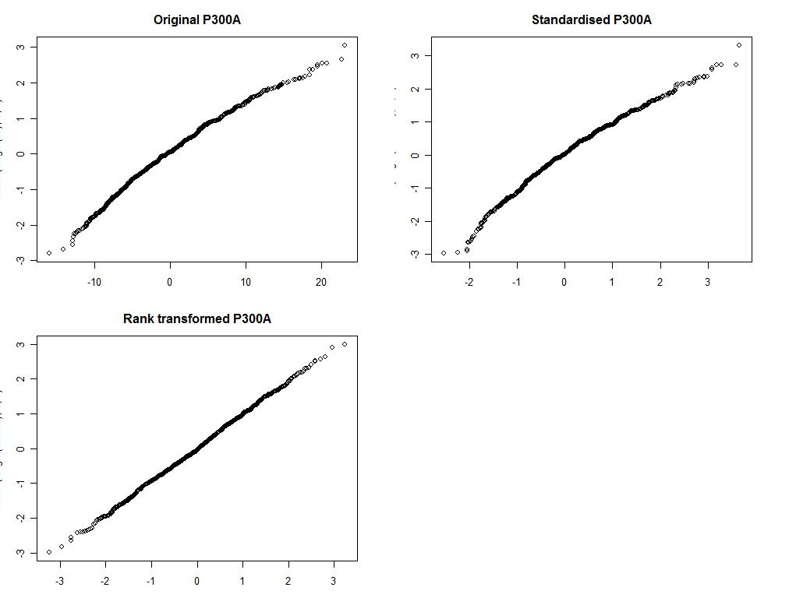

Slide 28
P300L AMPLitude

Slide 29
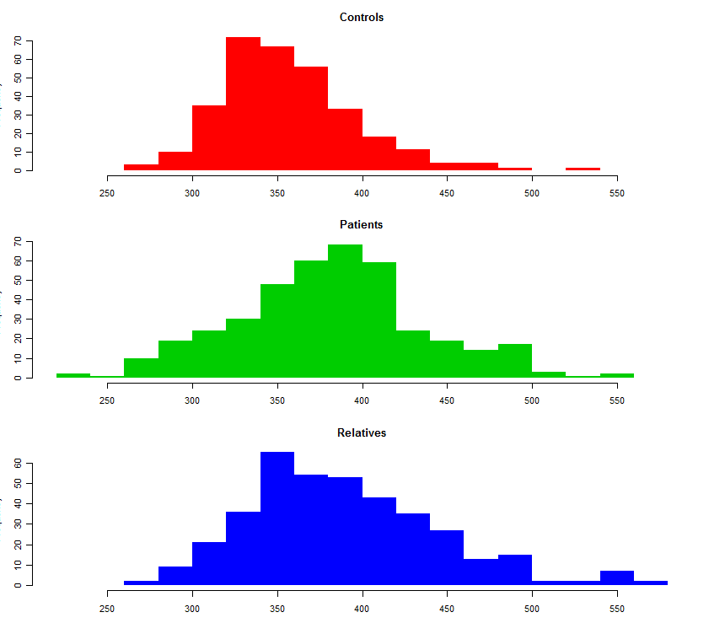

Slide 30
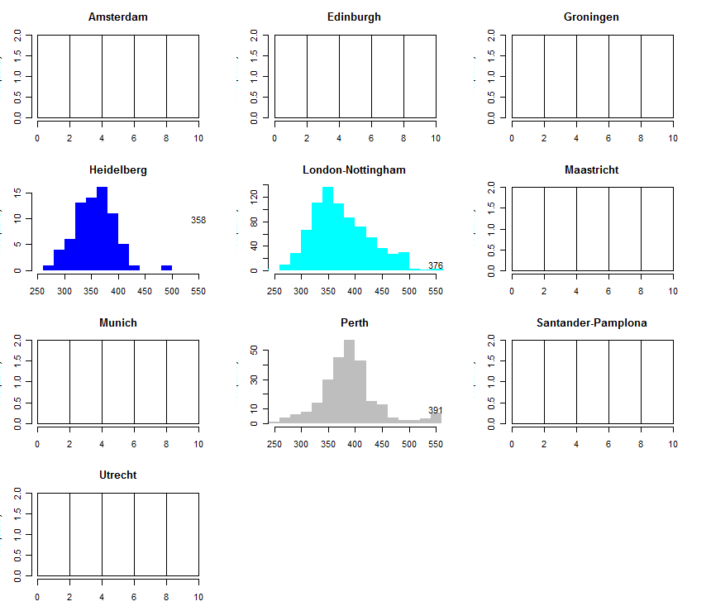

Slide 31
P300L model coefficients
 | Estimate | Std.Error | tvalue | Pr(>|t|)
(Intercept) | 310.019 | 7.5146 | 41.255 | <2e-16 | ***
x$SEX_SUMM_NAMale | -4.2383 | 3.2095 | -1.321 | 0.18695
x$AGE | 1.1336 | 0.1211 | 9.359 | <2e-16 | ***
x$CENTRES4CathrynLondon-Nottingham | 5.6104 | 6.3274 | 0.887 | 0.375449
x$CENTRES4CathrynPerth | 23.2117 | 6.7425 | 3.443 | 0.000599 | ***
x$GROUPPatient | 23.5902 | 3.9711 | 5.94 | 3.87E-09 | ***
x$GROUPRelative | 21.4517 | 4.0252 | 5.329 | 1.21E-07 | ***

Slide 32
P300L – significant effect of group on model
anova(P300Lmodel,P300Lmodelgp,test="Chisq")
Analysis of Deviance Table
Model 1: x$P300L ~ x$SEX_SUMM_NA + x$AGE + x$CENTRES4Cathryn
Model 2: x$P300L ~ x$SEX_SUMM_NA + x$AGE + x$CENTRES4Cathryn + x$GROUP
Resid. Df Resid. Dev Df Deviance P(>|Chi|)
1 1048 2652544
2 1046 2551371 2 101172 9.843e-10 ***

Slide 33
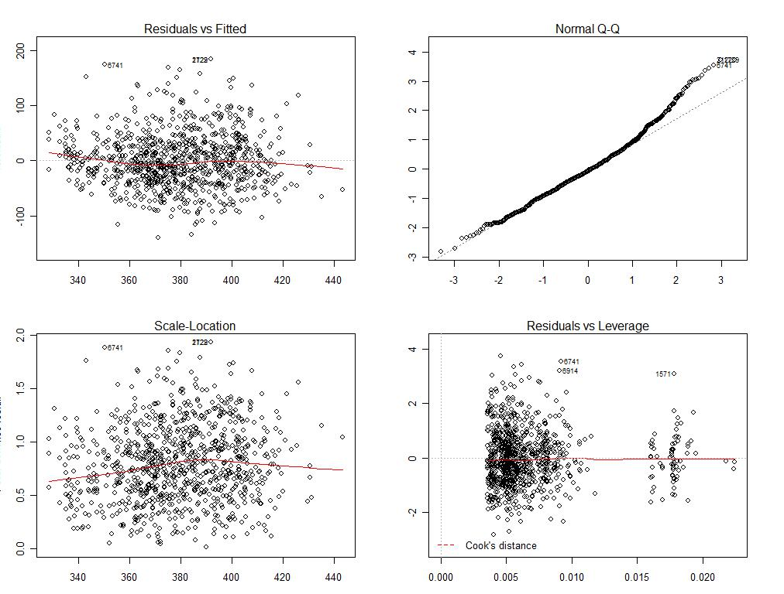
P300L Model fit

Slide 34
