Slide 1
CAO: contact accepted mutation
More alignments this time
Side-chain to side-chain contact definition
… that's it

Slide 2
Data
CATH v3.5.0
2429 H family representatives
320225 residues

Slide 3
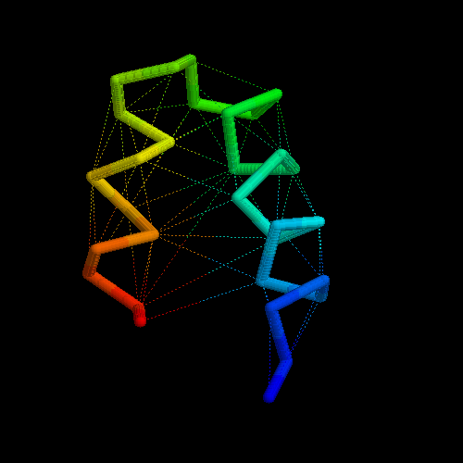
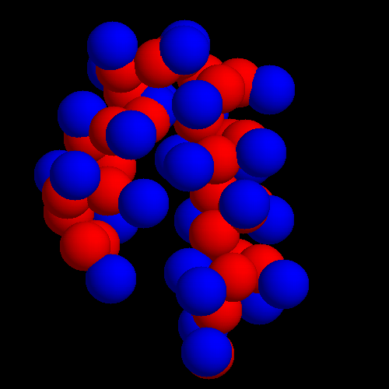
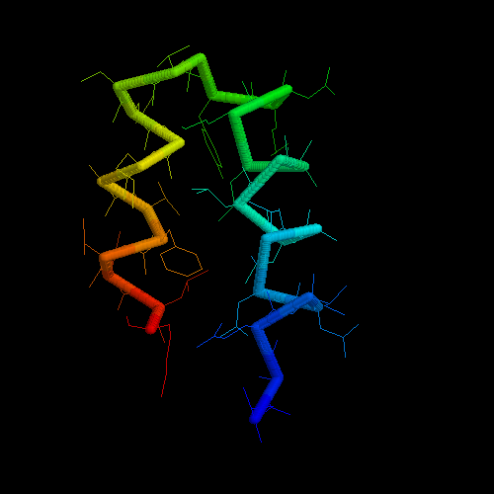
Contact definition
Residue side-chain and main-chain centres
Delaunay tetrahedralization
S-M, M-M contacts are ignored
S-S are used

Slide 4
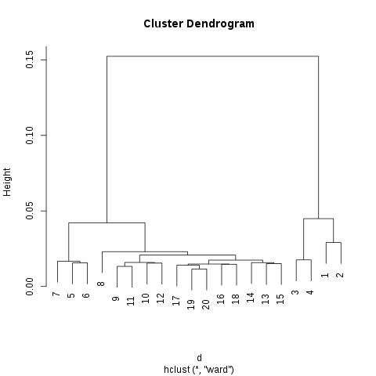
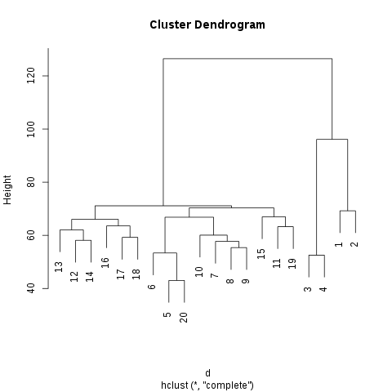
Contact definition
Global vs local contacts?
Local: sequence distance 1-4
Global: sequence distance >=5
Based on contact residue composition clustering

Slide 5
Alignments
241686 sequence alignments (PSIBlast, Kalign2)
15512 structure alignments (SAP)
More structure alignments can be helpful
Need to avoid over-presenting of big structure families?

Slide 6
VTML
T Muller and M Vingron 2000
PAM like scoring matrices
Seems to be good enough for amino acids
But problematic for contact
Standard ML estimation can be done
Very time consuming
Unstable...

Slide 7
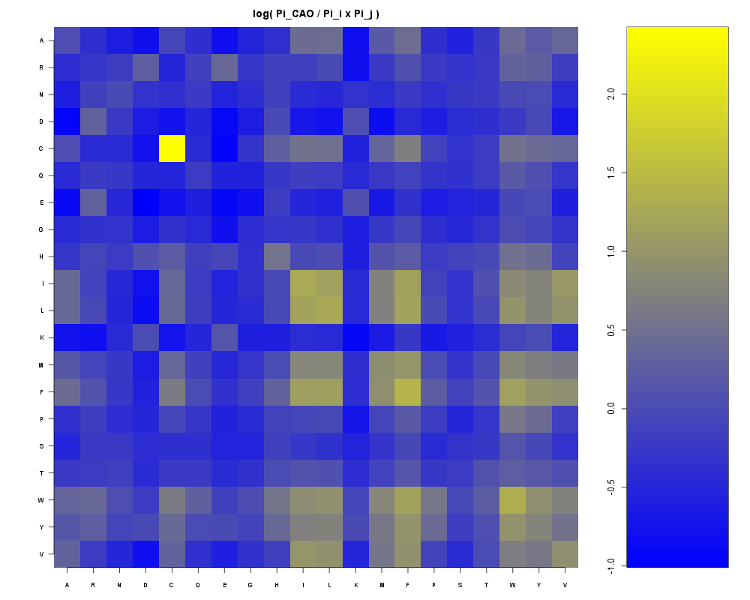
Contact Pi π
C-C
big and hydrophobic
Negative and positive
Not symmetric
K-M to M-K

Slide 8
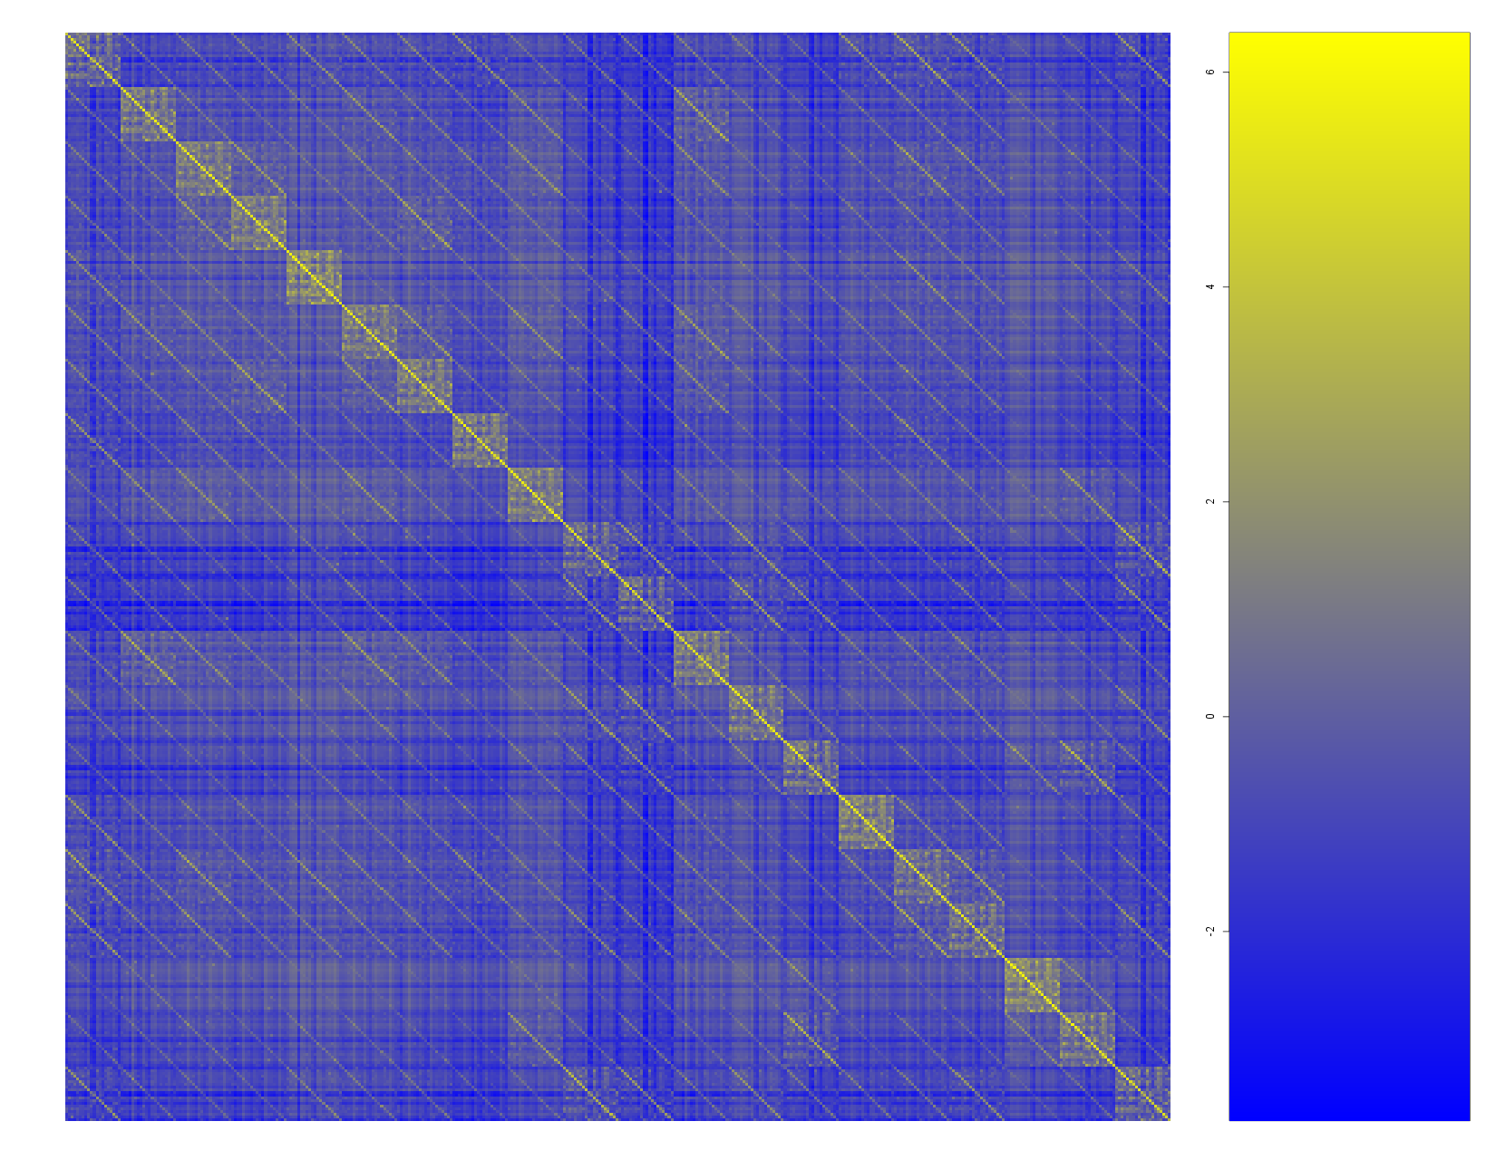
CAO_100

Slide 9
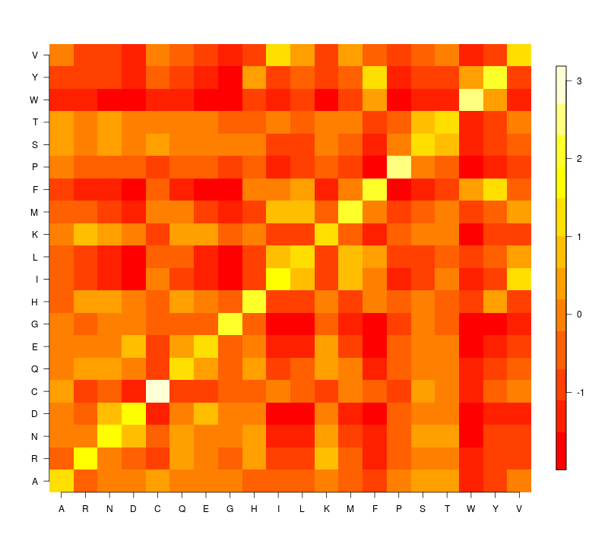
VTML 150

Slide 10
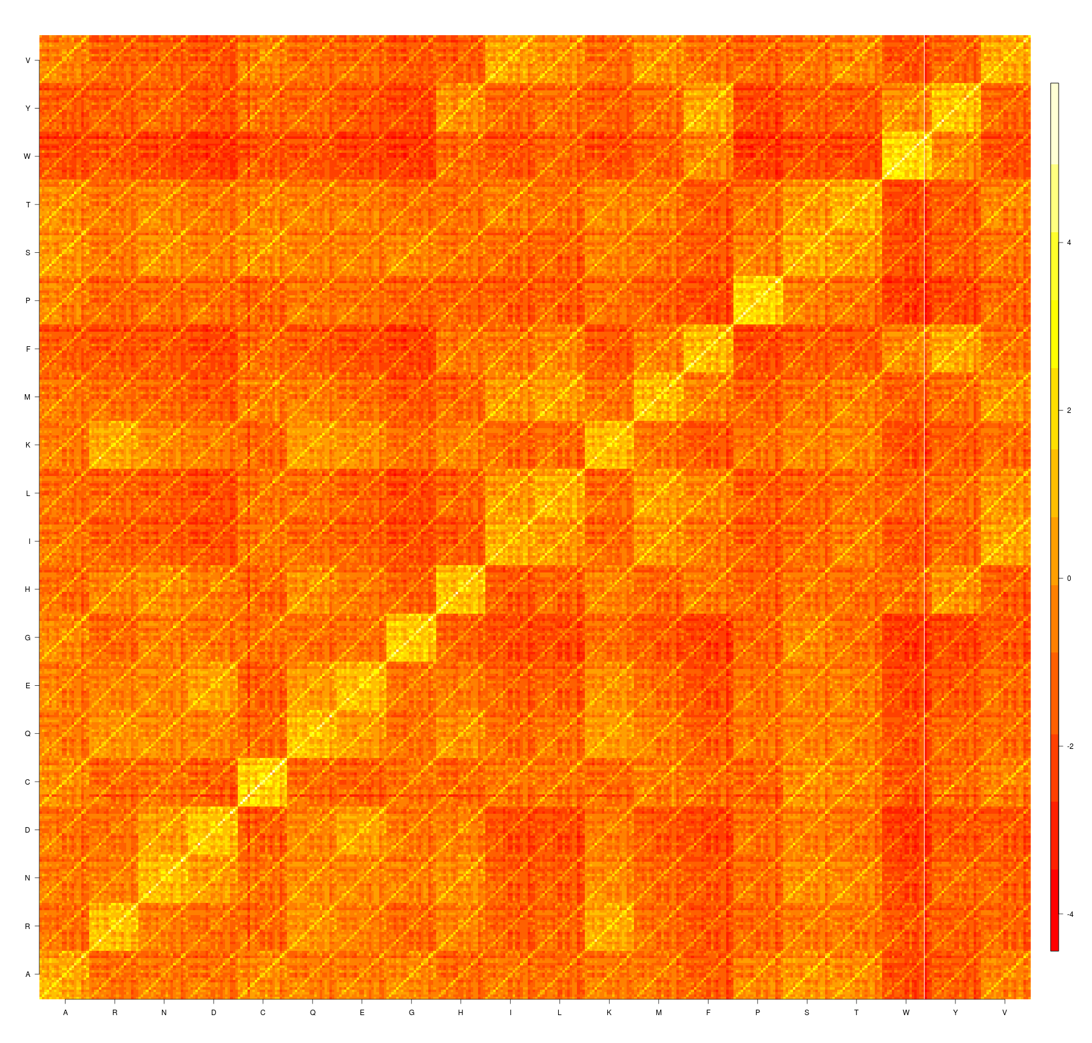
CAO250

Slide 11
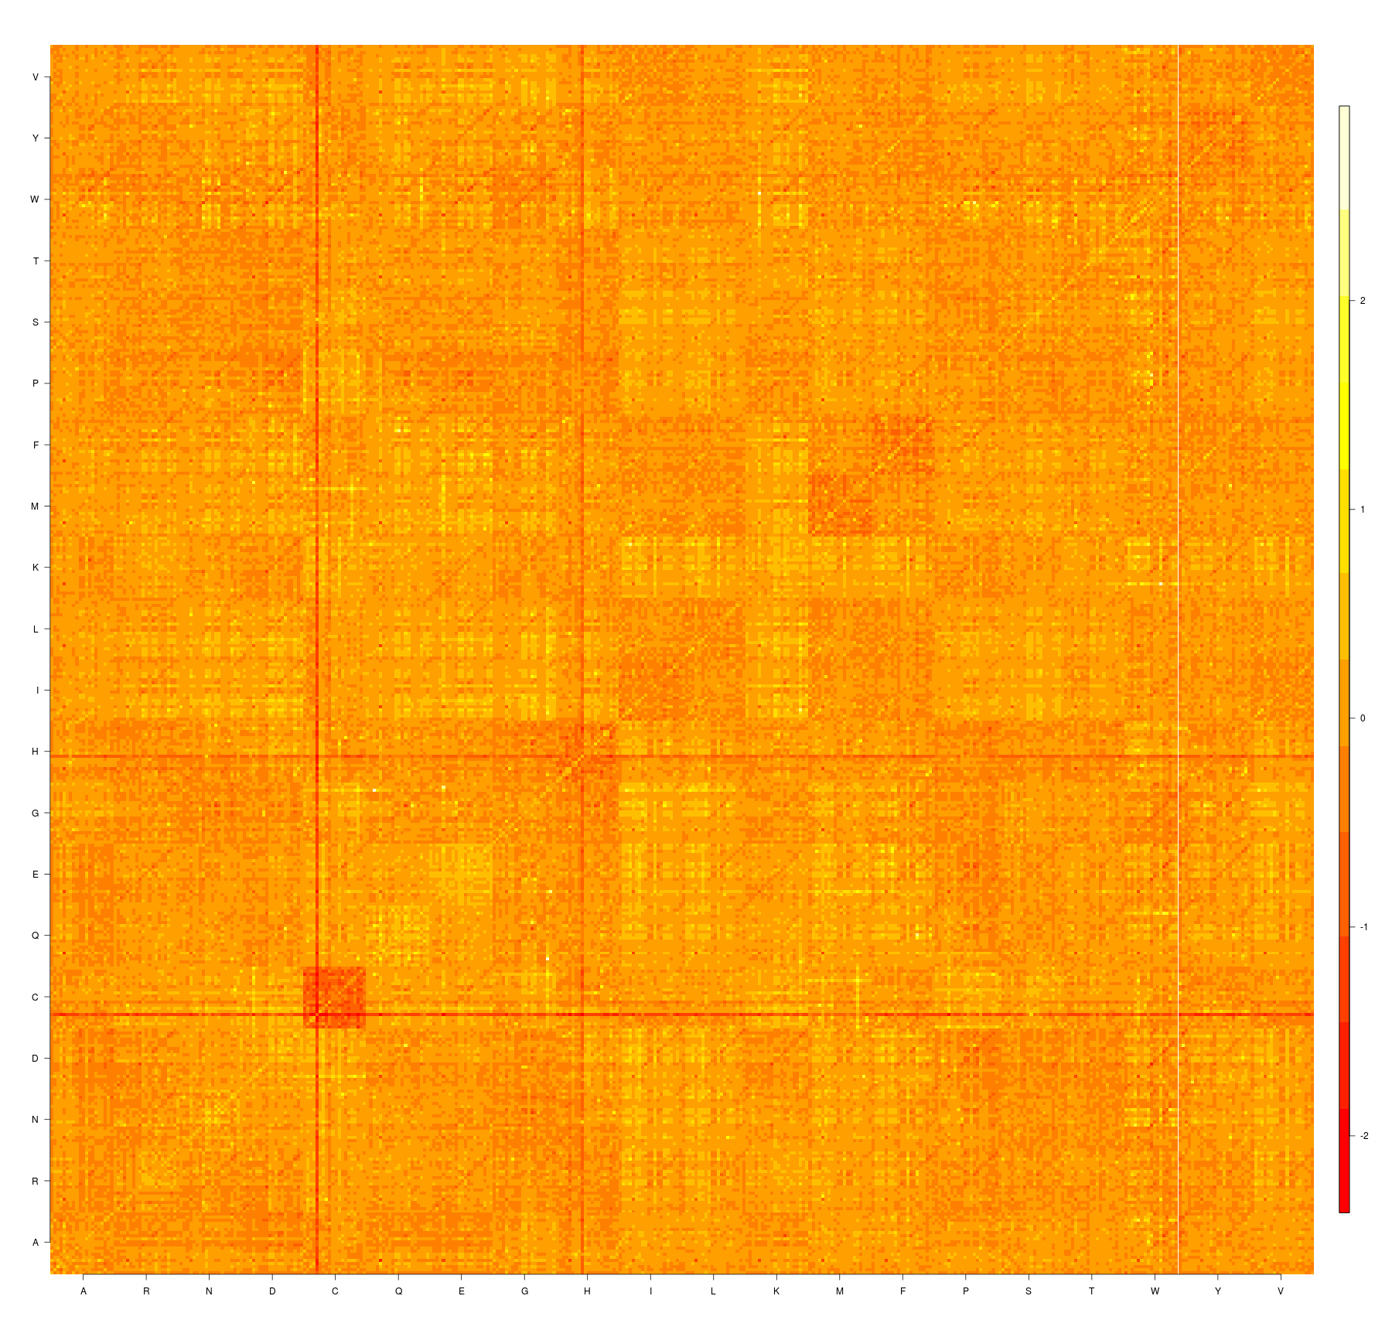
CAO250-VTML150

