Slide 1


Resequencing of the complement gene pathway to identify rare variants that affect risk of Alzheimer’s disease.
Michelle Lupton
Department of Neuroscience
Institute of Psychiatry
Kings College London

Slide 2
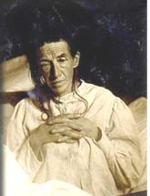
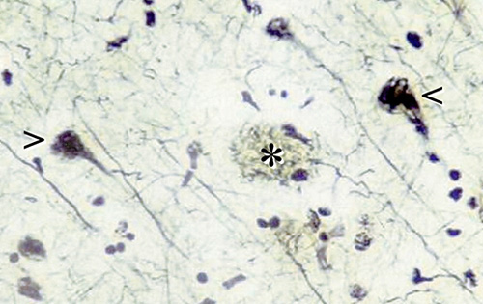
Involvement of Complement in Alzheimer’s Disease
Alzheimer’s Disease (AD) and Inflammation
AD accounts for 50-60% of dementia cases.
Prevalent (20-30 million worldwide)
Costly (£20 billion/year in UK)
The number is set to double every 20 years.
Characteristic histological lesions of amyloid plaques and hyperphosphorylated tau tangles.
Inflammation has been shown to be an important disease process in AD occurring early in the pathologically vulnerable regions of the AD brain.
Non-steroidal anti-inflammatory drugs (NSAIDs) down regulate pro-inflammatory signals, and there is epidemiological evidence that NSAID use reduces AD risk.
Notes:
Ad most common form of dementia with 700,000 living with the disease on the UK today and the number forecast to double within a generation.
Auguste Deter was the first person to be diagnosed by Dr Alois Alzheimer in 1901, characteristic hallmarks amyloid plaques and hyperphosphorylated tau tangles.
A hundred years on and a great deal has been elucidated about the pathways that contribute to AD, but this is still yet to lead to the development of a treatment with anything more than modest benefit.
Genetics has taught us about the condition though the identification of autosomal dominant mutations in three genes that cause the early onset familial form
The common late onset form is sporadic but is known to be ~70% heritable.
Until recently the only genetic risk factor that has been unequivocally indentified APOE where possession of the e4 variant increases risk and conveys and earlier AAO. But at least a third of AD patients do not carry this variant and some e4 homozygotes do not develop AD.
Recent new genetic evidence.

Slide 3
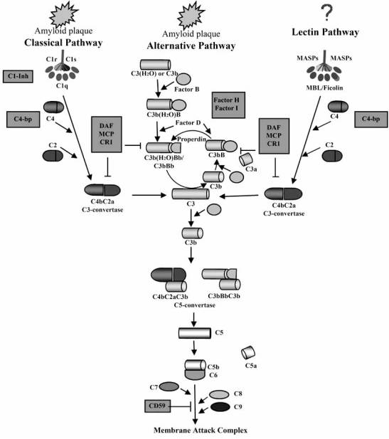
Involvement of Complement in Alzheimer’s Disease
Inflammation occurs early in pathologically vulnerable regions of the brain, stimulated by degenerating tissue and the deposition of Aβ peptide and tau tangles.
A local up-regulation of inflammatory mediators is seen; including complement components, cytokines and acute phase reactants.
Complement is suggested to have both protective and destructive roles. It may promote, though opsonisation and phagocytosis, plaque clearance, or through chronic inflammatory processes, tissue damage.
Fig from Kolev MV et al (2009) Current Neuropharmacology, 1, 1-8
Notes:
Inflammation occurs early in pathologically vulnerable regions of the brain, stimulated by degenerating tissue and the deposition of highly insoluble abnormal materials, Aβ peptide and tau tangles.
The complement pathway is part of the innate immune system with basic functions of;
enhancing phagocytosis of antigens, attracting macrophages and neutrophils, rupturing membranes of foreign cells, and Clumping of antigen-bearing agents.
At the heart of the complement pathway is a proteolytic cascade leading to the activation of complement component C3. leads to opsonisation of targets for phagocytosis, the promotion of inflammation and formation of the membrane attack complex (MAC) which can lyse the target membrane. In total, over 30 plasma proteins and membrane bound proteins participate in the complement cascade.
There is now compelling evidence that complement is produced locally in AD, mainly microglia although at least some components of the complement system are expressed in all the cell types of the nervous system.
Complement proteins of the activated classical pathway are found associated with senile plaques and neurofibrilliary tangles. Aggregated Aβ binds to the collagen tail of C1q initiates the classical cascade, working to clear AB therefore having a protective mechanism at the early stage.
In contrast, once stimulated the microglia release a wide variety of pro-inflammatory mediators, which can potentially contribute to further neuronal dysfunction and eventually cell death. This activation becomes a chronic feedback loop that may be an essential mechanism in the disease progression
Complement is suggested to have both protective and destructive roles. Complement may promote, though opsonisation and phagocytosis, plaque clearance, or through chronic inflammatory processes, tissue damage.

Slide 4
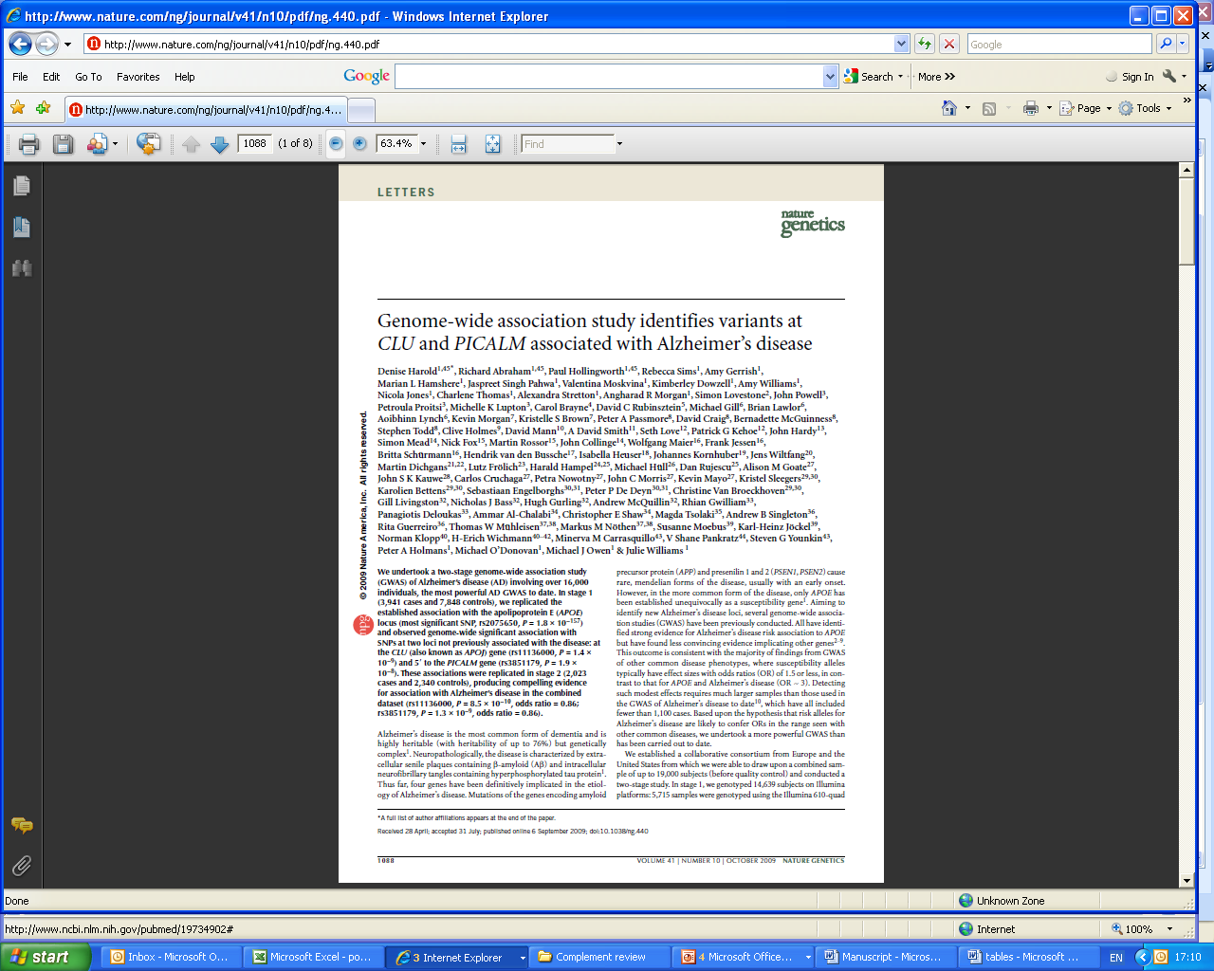
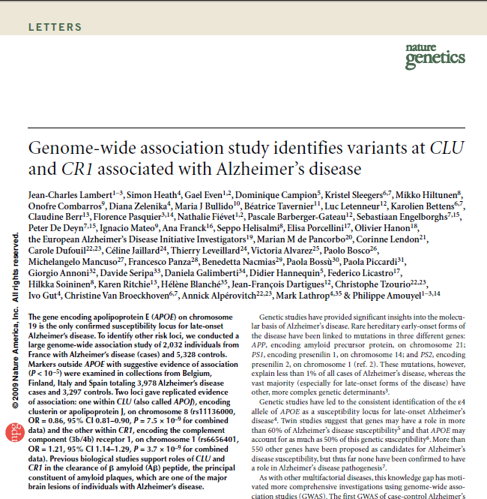
Complement genetic studies
Notes:
Recent GWAS CR1, CLU. a two-stage study involving over 16,000 individuals. A second GWAS study of over 2000 AD and 5000 control individuals replicated the CLU finding and also identified an association with the CR1 SNP .The association of these genes has since been robustly replicated.
CLU is an important inhibitor of complement activation though modulation of the membrane attack complex
CR1 acts in the clearance of immune complexes, as well as playing an important role in the regulation of the complement cascade regulation.
There is evidence that a LCR (low copy number repeat) in high LD with both risk variants is likely to be responsible for the identified association. LCR1 is located in the coding region where copy number variations produce the two protein isoforms CR1-F and CR1-S. A significant association with AD risk was identified with carriers of the CR1-S isoform and the finding was replicated in a second cohort (Brouwers et al., 2011). This longer isoform has an increased number of C3b/C4b and cofactor activity sites and may have an effect on Aβ clearance or enhance the proteins inhibitory potential towards complement activation.

Slide 5
Rare variants
These risk variants have a small effect size and cumulatively explain only a small proportion of the genetic heritability.
Only common variants (MAF > 0.1) are captured by whole genome association platforms.
Rare variation may explain some of the missing heritability.
The genes of the complement pathway are strong candidates for harbouring rare variation.
Due to recent advances in next generation sequencing, it is now possible to carry out tens of thousands of reactions in parallel, making it possible to sequence all the coding regions of the genes in the complement pathway in many individuals.
Aim; To sequence all the coding and promoter regions of the genes in the complement pathway using next generation sequencing to identify if both common and rare variation in the complement pathway contributes to risk for AD.
Notes:
Rare variation may explain some of the missing heritability, where several rare variants accumulate in a population and single individual, this ‘genetic load’ will contribute to increased risk.

Slide 6
“Complementome” sequencing
1000 individuals including AD cases, controls and individuals with Mild Cognitive impairment will be sequenced from the Addneuromed study (a multicentre European collaboration, including AD, MCI and control subjects)
Target enrichment is carried out using custom designed Sure select in-solution capture (Agilent) covering all exons, UTRs and promoter regions (1.5kb upstream) of 55 genes in the complement pathway.
Use multiplexed pooling with DNA bar-coding allowing multiple individuals to be included in a single lane of sequencing.
The final libraries run on the Illumina HiSeq.

Slide 7
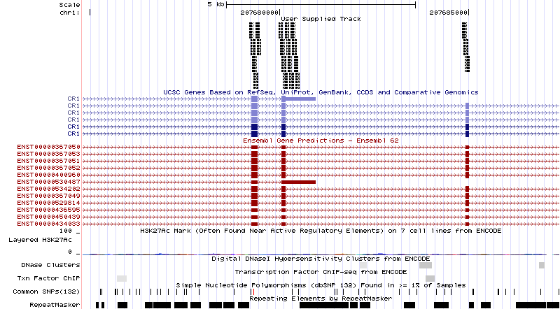
Library preparation
Sure select in solution capture design
Notes:
Sure select in solution capture works by designing baits of 120 bp that selectively bind to the region of interest-using there e array software.
Baits are tiled with an over lap of 20bp, then each bait repeated as many times as will fit, I did 6x covering all exons, UTRs and 1.5 kb upstream to cover promoter regions cover both predicted gene exons by both UCSC and Refseq.
Cannot cover repetitive regions.

Slide 8
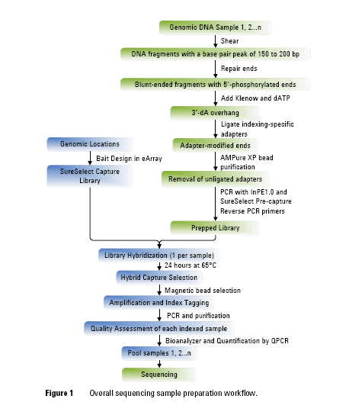
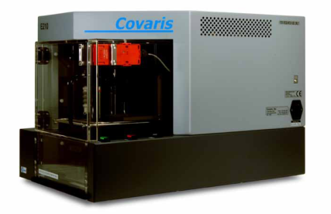
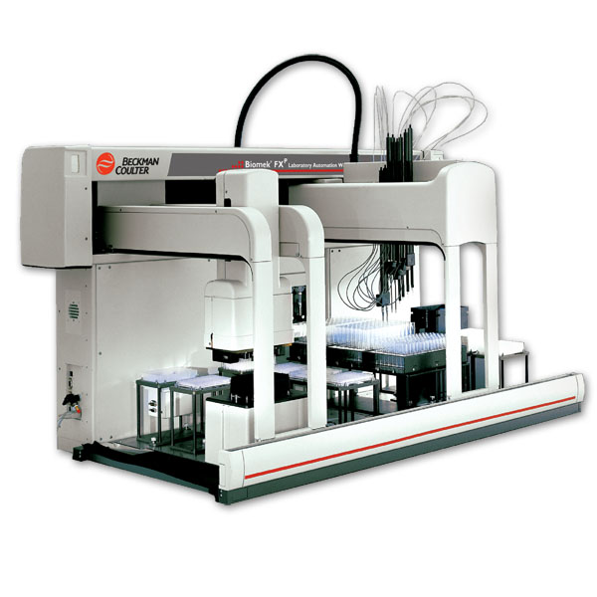
Library preparation
Pico green
Quantification
libraries to be prepared in parallel.
Covaris E series
Robotic automation

Slide 9
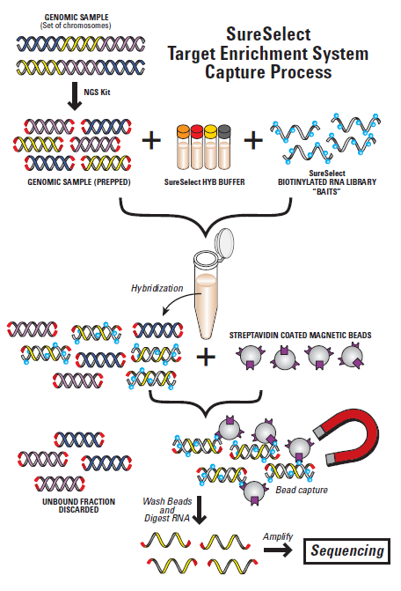
Notes:
The library is hybridized to sequence specific biotinylated capture sequences in solution.
The capture sequences are then extracted using streptavidin coated beads.

Slide 10
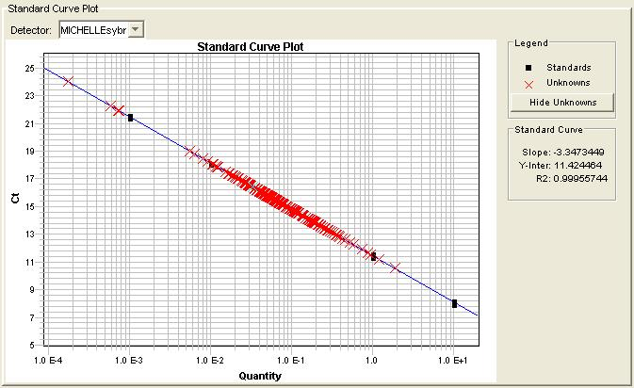
Library preparation
96 index barcode tags
libraries to be prepared in parallel.
QPCR quantification

Slide 11
Data Analysis
CASAVA
coverts image files to fastq by barcode
Quality control results for raw sequence data
Data checking
FASTQC
Alignment to reference
Novoalign
Metrics for PCR duplicates, depth of coverage, Quality and GC content
Filter and collect quality metrics
GATK, PICARD Tools
SNP and indel calling
GATK
Annotation
ANNOVAR
Genotype calls in VCF format
Notes:
Data analysis pipeline carried out using a high performance linux cluster-IOP BRC
Fastqc checks the raw sequence data for any problems in the sequencing run. Eg. Sequence quality scores, GC content, sequence length distribution, sequence duplication, over represented samples ect.
Novoalign for alignment-a commercial for multiphed options to improve speed. but affordable tool, works similarly well as BWA- but slight improvement (triming before alignment?)Novoalign finds global optimum alignments using full Needleman-Wunsch algorithm with affine gap penalties. No limit of 2 mismatches per read, aligns with up to 16 on paired end reads.
Annovar annotates called variants with publically available data bases, e.g, gene based annotation-where in gene, and whether the SNP or CNV causes protein changes and the amino acids that are affected. Can also identify variants that are reported in DBsnp etc.

Slide 12
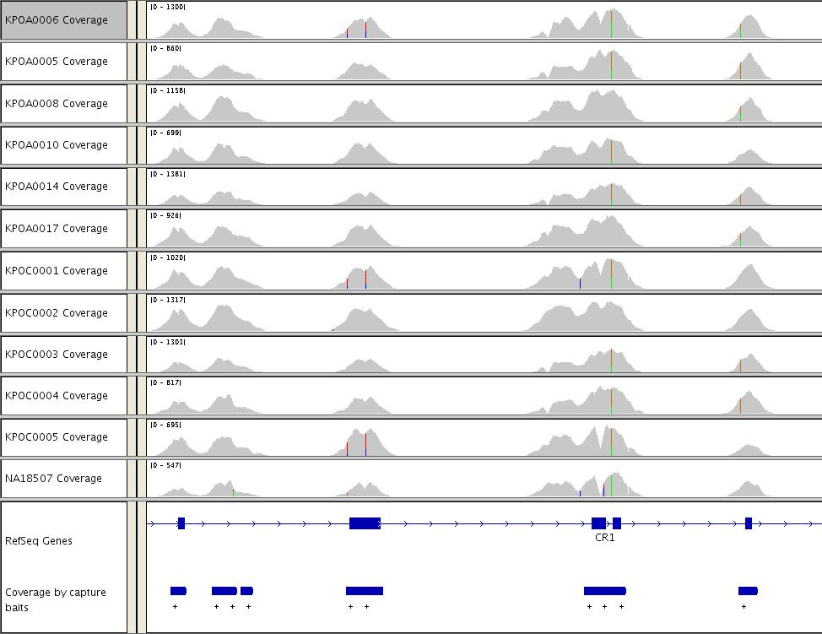
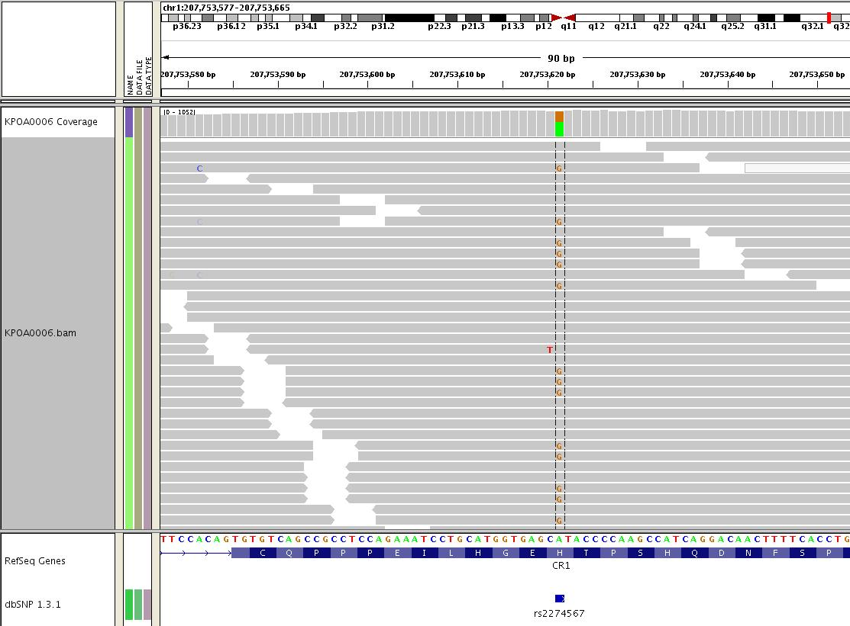
Results
Notes:
An example of the depth of coverage obtained for each sample, for a section of the CR1 gene. The lower panel shows the locations covered by capture probes. (screen shot from the Integrative Genomics Viewer, IGV visualisation tool)
A called heterozygous SNP in a single individual in the CR1 gene.

Slide 13
Results-validation
First run was twelve individuals in one lane of sequencing on GAII
To validate the method an individual of Yoruba ethnicity previously characterised by the HapMap and 1000 Genomes project was included.
Genotypes were compared from the different studies (in regions included in both reference sequences with coverage >40x).
In the HapMap genotype data 190 common SNPs were genotyped in these regions. Of these 189 (99%) had matching genotype calls.
In the 1000 genome low coverage data (depth of 2-4X) of the 450 SNPs identified 431 of our calls were in agreement (96%). An additional 175 SNPs were called in our high coverage data.
Notes:
It is also worth noting that the one common SNP called in the Hapmap project that was not called in our data, was also not called in the 1000 genomes data.

Slide 14
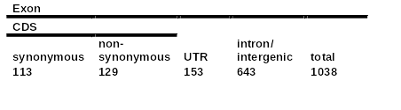
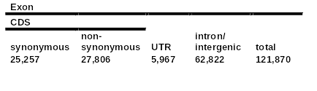
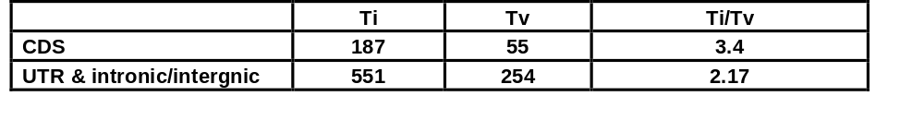
Results-validation
Properties of the SNPs called in the European individuals were investigated and compared to expectations from other large scale studies.
Of 1038 SNPs 935 are present in dbSNPv132, of the remaining 45 are present in publically available sequencing data, and 58 are novel.
CDS ratio of synonymous to non- synonymous =0.88
In Li Y et al 2010 “Resequencing of 200 human exomes identifies an excess of low-frequency non-synonymous coding variants” Nat Genet. 2010 Nov;42(11):969-72
CDS ratio of synonymous to non-synonymous =0.9
Transition to Transversion ratio is expected to be ~2 across the genome and just above 3 in protein coding regions.
Notes:
The transition to transversion ratio: due to there nature transitions are expected to occur twice as frequently as transversions. In protein coding regions a higher ratio occurs because, especially when they occur in the third base of a codon, transitions are more likely to change the encoded amino acid.

Slide 15
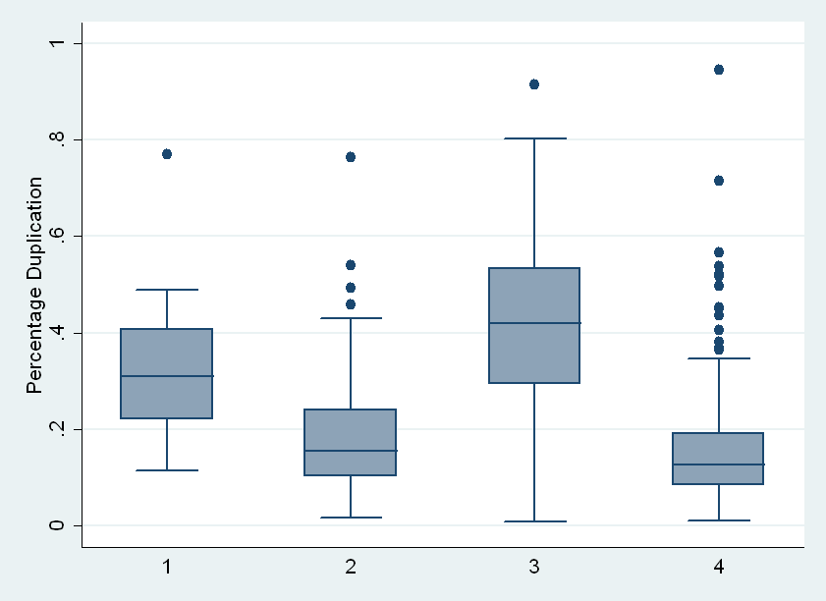
Metrics –so far
12 indexed samples one lane GA II
96 indexed samples one lane Hiseq
Same library as 2. run on 7 lanes of Hiscan (test at the IOP)
96 indexed samples one lane Hiseq X 2

Slide 16
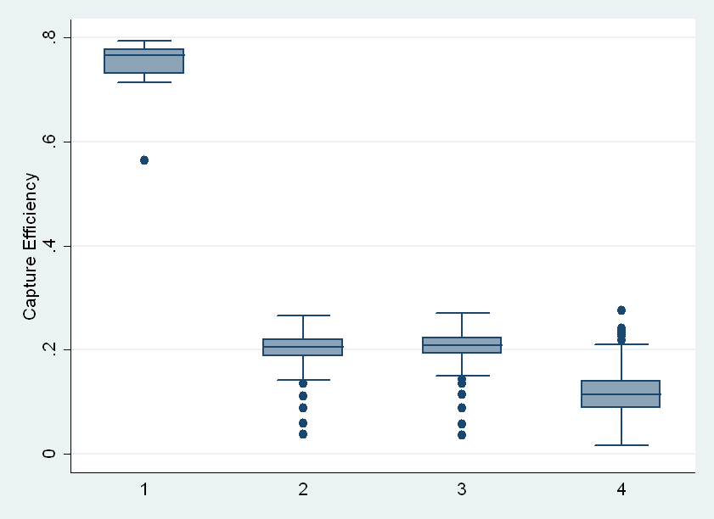
Metrics –so far
12 indexed samples one lane GA II
96 indexed samples one lane Hiseq
Same library as 2. run on 7 lanes of Hiscan (test at the IOP)
96 indexed samples one lane Hiseq X 2

Slide 17
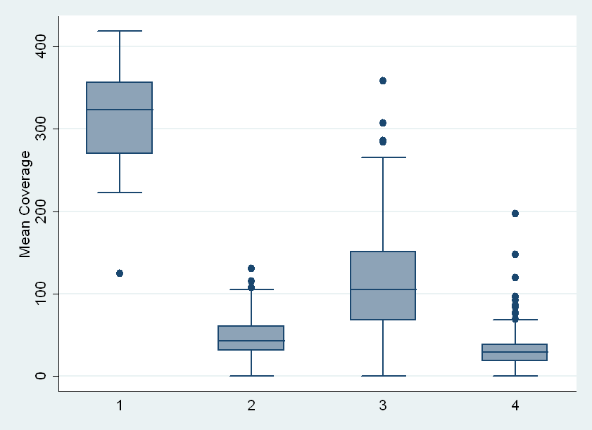
Metrics –so far
12 indexed samples one lane GA II
96 indexed samples one lane Hiseq
Same library as 2. run on 7 lanes of Hiscan (test at the IOP)
96 indexed samples one lane Hiseq X 2

Slide 18
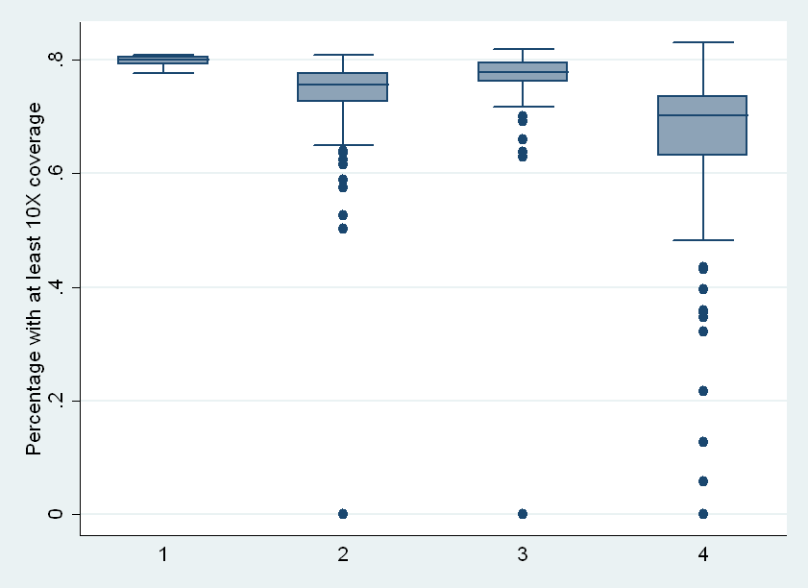
Metrics –so far
12 indexed samples one lane GA II
96 indexed samples one lane Hiseq
Same library as 2. run on 7 lanes of Hi scan (test at the IOP)
96 indexed samples one lane Hiseq X 2

Slide 19
SNP calling
SNPs using all results together.
Following SNPS are filtered out:
SNPs in a clusters of 3 within 10 bp
QUAL < 20 (Phred scaled probability, 20 is 1 in 20 chance of error)
Strand Bias > -0.10
Contiguous homopolymer run > 5.0
Quality by depth < 5.0 (variant confidence)
Mapping Quality Zero (MQ0 total count of all samples with mapping quality zero). If MQO is >=4 and MQO/Depth>0.1
The following are marked in the VCF file at each genotype
Depth at SNP <=4
Depth at SNP <8 >4

Slide 20
Results
So far have genotyping results for 291 individuals with :
2616 SNPs after filtering
365 are non-synonymous SNPs
15 create a stop codon in the protein
Very Preliminary results!
From 121 AD, 103 control, 66 MCI (code AD and MCI as cases)
Association of common SNPs (MAF>0.05)
Grouped analysis of rare SNPs (MAF<0.05)
Superlocus/collasping method: test for combined effect of rare SNPs in one gene (using CCRaVAT)

Slide 21
Common SNPs association
CHR | SNP | BP | A1 | F_A | F_U | A2 | CHISQ | P | OR
1 | rs72670315 | 57320444 | A | 0.0163 | 0.06373 | G | 9.191 | 0.002433 | 0.2435 | C8A promoter region, splicing
9 | rs2070622 | 137804830 | G | 0.3156 | 0.4444 | C | 9.163 | 0.002469 | 0.5765 | FCN1 intronic
19 | rs11569565 | 6678474 | A | 0.02989 | 0.08333 | G | 8.052 | 0.004546 | 0.3389 | C3 intronic
1 | rs41285940 | 57395294 | A | 0.01902 | 0.06373 | G | 7.773 | 0.005303 | 0.2849
9 | rs17514136 | 137772664 | G | 0.347 | 0.2353 | A | 7.682 | 0.005578 | 1.727
5 | rs476569 | 39342308 | T | 0.5326 | 0.4118 | C | 7.67 | 0.005615 | 1.628
9 | rs17613 | 139840560 | A | 0.1038 | 0.1845 | C | 7.44 | 0.00638 | 0.5122
9 | rs20574 | 139840580 | T | 0.1016 | 0.1814 | C | 7.333 | 0.006769 | 0.5107
9 | rs7875913 | 139839447 | T | 0.1033 | 0.1832 | A | 7.288 | 0.006943 | 0.5135
2 | rs76516995 | 127864921 | G | 0.1518 | 0.07216 | C | 7.246 | 0.007106 | 2.301
9 | rs41307442 | 139840521 | C | 0.1087 | 0.1881 | T | 6.965 | 0.008313 | 0.5263
19 | rs2230201 | 6713291 | T | 0.2065 | 0.1188 | C | 6.935 | 0.008451 | 1.93
9 | rs1071583 | 137801800 | T | 0.3125 | 0.4216 | C | 6.85 | 0.008863 | 0.6237
19 | rs2230205 | 6709704 | T | 0.1848 | 0.1029 | C | 6.691 | 0.009691 | 1.975
1 | rs3093059 | 159685136 | G | 0.1196 | 0.05392 | A | 6.507 | 0.01074 | 2.383
2 | rs78710909 | 127864922 | C | 0.1471 | 0.07292 | G | 6.374 | 0.01158 | 2.192
9 | rs11103564 | 137779875 | C | 0.3784 | 0.2745 | T | 6.309 | 0.01201 | 1.609
9 | rs2274845 | 137804360 | A | 0.337 | 0.4412 | G | 6.088 | 0.01361 | 0.6437
19 | rs7412 | 45412079 | T | 0.01923 | 0.06667 | C | 6.073 | 0.01373 | 0.2745
Notes:
All together 850 common SNPs with MAF >0.05 in either cases or controls.
F_A frequency in cases
Nor corrected for multiple testing.

Slide 22
Rare SNP association
Gene | Chr | Start | Stop | (SNPs/MAF<0.05) | Case+RV | Case-RV | Cont+RV | Cont-RV | Chisq | PearsonPval | FishExPval
ABCA1 | 9 | 1.07E+08 | 1.07E+08 | (128/93) | 117 | 66 | 78 | 24 | 4.76 | 0.029 | No<20 | ABCA1
APOE | 19 | 50050879 | 50154490 | (13/10) | 16 | 110 | 18 | 57 | 4.27 | 0.039 | 0.051 | APOE
CD59 | 11 | 33631132 | 33764600 | (74/57) | 56 | 127 | 44 | 60 | 4 | 0.045 | No<20 | CD59
CFD | 19 | 760665 | 864624 | (15/11) | 18 | 108 | 18 | 57 | 3.02 | 0.082 | 0.09 | CFD
C4A | 6 | 32040550 | 32161173 | (50/27) | 57 | 14 | 31 | 14 | 1.95 | 0.162 | 0.186 | C4A
BIN1 | 2 | 1.27E+08 | 1.28E+08 | (116/73) | 136 | 29 | 67 | 22 | 1.84 | 0.175 | No<20 | BIN1
C4B | 6 | 32007813 | 32128435 | (109/73) | 110 | 10 | 67 | 11 | 1.66 | 0.198 | 0.24 | C4B
CFI | 4 | 1.11E+08 | 1.11E+08 | (36/32) | 38 | 146 | 28 | 76 | 1.48 | 0.224 | No<20 | CFI
CD55 | 1 | 2.06E+08 | 2.06E+08 | (48/31) | 75 | 109 | 35 | 69 | 1.42 | 0.233 | No<20 | CD55
C6 | 5 | 41128093 | 41299369 | (69/57) | 77 | 107 | 50 | 54 | 1.05 | 0.306 | No<20 | C6
C5AR1 | 19 | 52454971 | 52567173 | (18/16) | 21 | 151 | 16 | 83 | 0.833 | 0.362 | 0.365 | C5AR1
AGER | 6 | 32206724 | 32310001 | (31/23) | 59 | 122 | 39 | 65 | 0.704 | 0.401 | No<20 | AGER
CFHR3 | 1 | 1.95E+08 | 1.95E+08 | (110/57) | 84 | 66 | 36 | 36 | 0.705 | 0.401 | No<20 | CFHR3
C8G | 9 | 1.39E+08 | 1.39E+08 | (30/19) | 40 | 132 | 27 | 70 | 0.695 | 0.404 | No<20 | C8G
C4BPA | 1 | 2.05E+08 | 2.05E+08 | (64/52) | 74 | 110 | 47 | 57 | 0.675 | 0.411 | No<20 | C4BPA
C4BPB | 1 | 2.05E+08 | 2.05E+08 | (64/52) | 74 | 110 | 47 | 57 | 0.675 | 0.411 | No<20 | C4BPB
C7 | 5 | 40895356 | 41068798 | (83/47) | 63 | 120 | 31 | 73 | 0.642 | 0.423 | No<20 | C7
CFB | 6 | 31971752 | 32077839 | (102/77) | 124 | 4 | 70 | 4 | 0.641 | 0.423 | 0.468 | CFB
CFHR4 | 1 | 1.95E+08 | 1.95E+08 | (161/96) | 114 | 48 | 62 | 21 | 0.508 | 0.476 | No<20 | CFHR4
Notes:
Using the program CCRaVAT tests the hypothesis that there are a significantly different proportions of rare minor alleles each gene in cases compared to controls.
Shows the total number of SNPs in the region and the number with MAF<0.05.
Case+RV=number of cases with a rare variant.
CCRaVAT analyzes case-control data and constructs a 2x2 contingency table of the presence or absence of rare variant minor alleles in cases and controls for each region. Differences in the proportion of cases and controls carrying rare minor alleles are tested using a Pearson's chi-squared test or a Fisher's exact test when cell counts are small.
Future analysis-should only look at non-synonymous SNPs, or ones predicted to have an effect on the protein.
Also test for an effect of a total pathway or components of the pathway, for example the alternative complement pathway.

Slide 23
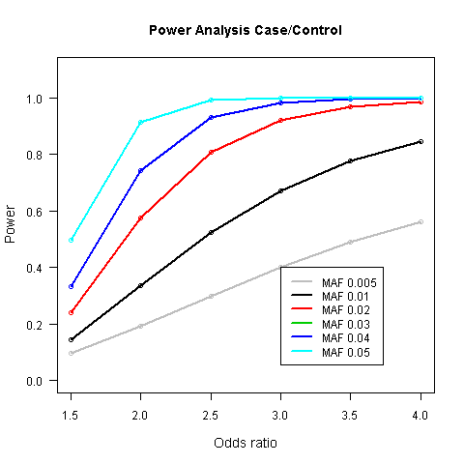
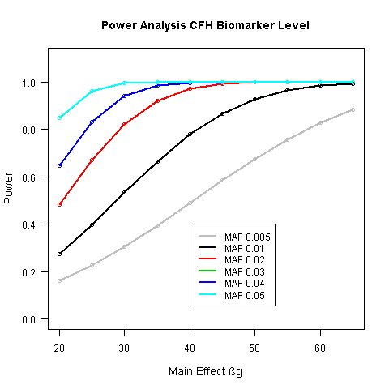
Sequencing of 1000 individuals
With the data for 1000 individuals we will test for association of identified variants with disease both individually and cumulatively based on functional predictions.
This large cohort has whole genome SNP data, MRI scan data and plasma biased biomarkers. We will test for association of identified variants with quantitative traits related to disease progression and levels of plasma based complement biomarkers.
Notes:
Power analysis assuming an additive model for our sample size, with 375 AD and 250 MCI classified as cases, 375 controls. Alpha significance level of 0.05
Quantitative trait- example of the level of CFH biomarker, and the power to identify an effect of genotype. –unit ug/ml
Very low frequency alleles will not have power in a single marker association test.
Alternatively will use multi marker tests and collapsing methods, either within a gene or pathway all rare variants that are genotyped may be included in the analysis. To avoid loss in power from inclusion of non-functional variants can predict function using bioinformatic programs using predicted changes to protein structure , or evolutionary analysis (polyphen or SIFT)
GWA snp data can increase the accuracy of allele calling and will allow the imputation of novel variants in to a larger sample size.

Slide 24
Conclusions
We will examine the importance of both common and rare variation in the complement pathway in Alzheimer’s disease pathogenesis and complement biomarker expression.
The use of in-solution capture and sample indexing allows candidate regions of interest to be investigated in many samples in parallel in a single sequencing lane.
The identification of rare variation in this pathway that has a functional consequence may go some way in explaining the missing heritability in AD.
Potential to be able to identify those with a ‘high risk profile’ and identify new therapeutic targets.

Slide 25

Acknowledgements
Resequencing of the complement gene pathway to identify rare variants that affect risk of Alzheimer’s disease.
Michelle K Lupton₁, Steven Newhouse₁, Mike Weale₂, Simon Lovestone₁, John F Powell₁.
Kings College London, Institute of Psychiatry, MRC Centre for Neurodegeneration Research, London, UK.,
Division of Genetics and Molecular Medicine, King's College London, London, UK
This study is funded by Guy’s and st Thomas’ charitable trust, FP7 EU grant, and the MRC.
We acknowledge the use of; the BRC Core Facilities provided by financial support from the Department of Health via the NIHR comprehensive Biomedical Research Centre award to Guy's & St Thomas' NHS Foundation Trust in partnership with King's College London and King’s College Hospital NHS Foundation Trust.
The BRC-MH Linux Cluster used is provided by the NIHR Biomedical Research Centre for Mental Health at the South London and Maudsley NHS Foundation Trust and Institute of Psychiatry. Kings College London.
Many Thanks to:
Agilent Technologies for early access to 96 barcoding
BRC Core Facility team: Efterpi Papouli, Muddassar Mirza
Those working on the Addneuromed cohort at Kings: Petroula Proitsi, Katie Lunnon, Angela Hodges, Rufina Leung, Megan Pritchard, Belinda M Martin
Addneuromed international collaborators: Magda Tsolaki, Iwona Kloszewska, Hilkka Soininen, Patrizia Mecocci, Bruno Vellas.
Linux Cluster administrators: David To, Caroline Johnston

