Slide 1


Whole-genome sequencing in schizophrenia patients with low sequencing coverage
Kuang Lin
Department of Neuroscience
Institute of Psychiatry
Kings College London

Slide 2
A large cohort of schizophrenic patients
Extensive genetic, clinical and endophenotypic information
Employ low coverage whole genome sequencing to detect structural variants

Slide 3
Why low coverage?
~1000€ per sample
~500€ in two years.
Small files

Slide 4
Easy to deal with
100G fastq / sample, ~45G zipped
~35G bam / sample
50 x 5 hrs novoalign / sample

Slide 5
Low coverage
~400 million 100bp reads
FASTQC
Average depth ~13

Slide 6
FASTQC
Novoalign
samtools, PICARD tools
qualimap
GATK

Slide 7
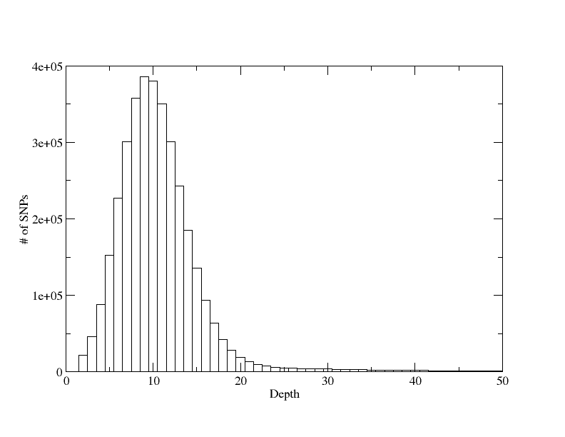
3.5 million SNPs
~0.5 million indels

Slide 8

Acknowledgements
John Powell
Michelle Lupton
Stephen Newhouse

