Slide 1
L2 Korean Vowel Productions of L1 English learners: A Pilot Study
Heidi, Shi (Eastern Asian Languages & Literatures)
Jung-ah, Lee (Eastern Asian Languages & Literatures)
Jeongim, Jin (Quantitative Research Methods)

Slide 2
Project Overview
Purpose:
Compare the convergence and divergence of L1 Korean and L2 Korean Vowel Production
Discover the potential “challenging” and “easy” vowels for L1 English learners of L2 Korean.
The results can be applied in Korean language pedagogy or phonetic studies in Korean linguistics.
Research Questions:
For each vowel: are there any differences between the NS and NNS?
Fore each difference: is it reflected by F1 or F2?

Slide 3
Project Overview
Data Collection:
Participants :3 native Korean Speakers (NS) + 3 non-native Korean Speakers (NNS) with shared L1 English
Audio recorded the 6 participants’ 3 repetitions of 8 stimuli (144 observations in total)
Data analysis:
-Focused on two acoustic measurements :
F1(vowel height) and F2(vowel backness)

Slide 4
Data Tidying Process
Tidy data
Remove outliners
Summary tables
The correlations between two groups, NS and NNS
NNS patterns
Make data visualized in multiple aspects:
Compute mean, median, max, and min values of F1 &F2 for each speaker group
-(a) general vowel space of each group
-(b) vowel-based comparison by speakers
-(c) speaker-based comparison by vowel

Slide 5
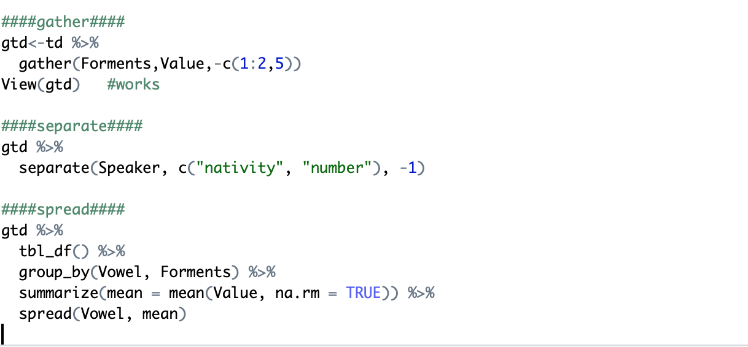
Tidy Messy Data

Slide 6
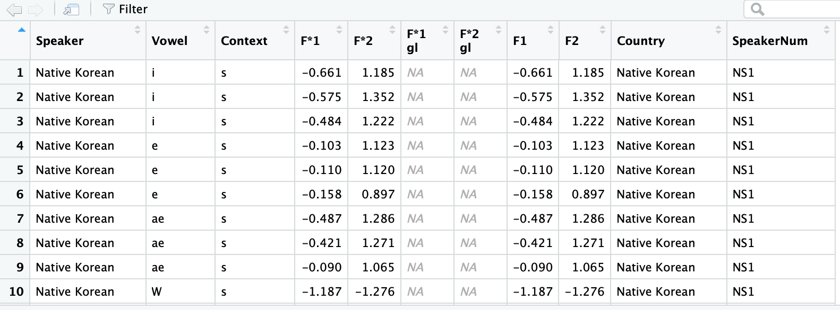
Tidy Messy Data-Before

Slide 7
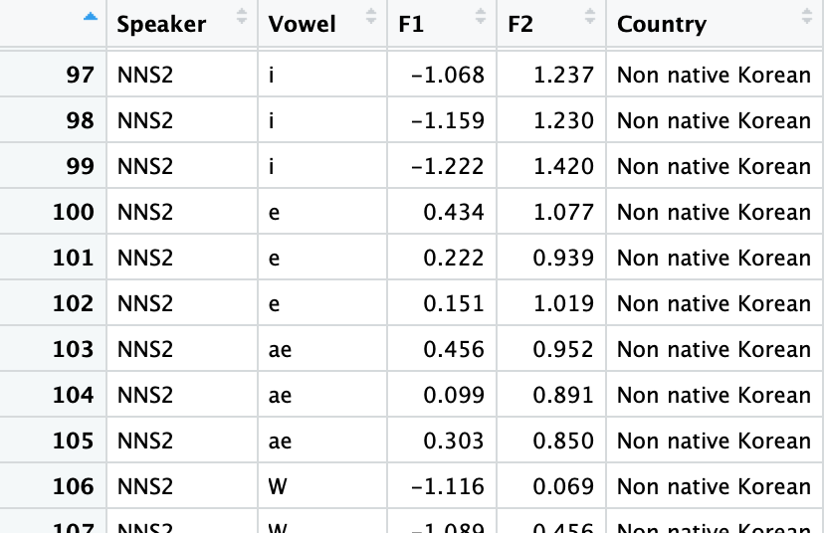
Tidy Messy Data-After

Slide 8
Challenges faced along the way
To understand the taught functions is relatively easier
To comprehensively apply them is challenging
Although the plots we learned in this class are very useful, phonetic research requires more relevant visualization of the data (eg. vowel chart)

Slide 9
Victories and things to celebrate
Successfully tidyversed the data
Created 14 plots from various aspects
Generated vowel charts which better facilitate phonetic studies

Slide 10
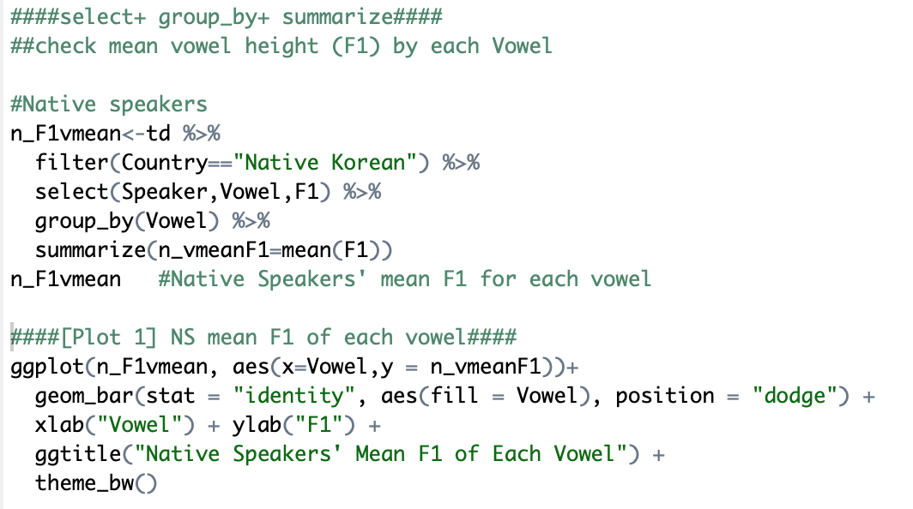

Slide 11
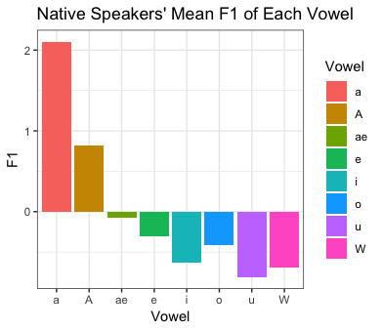
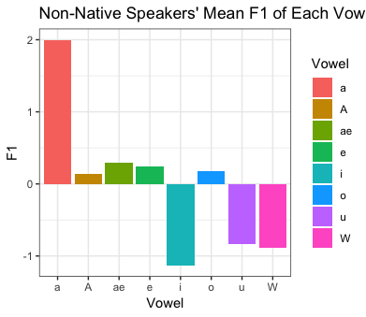

Slide 12
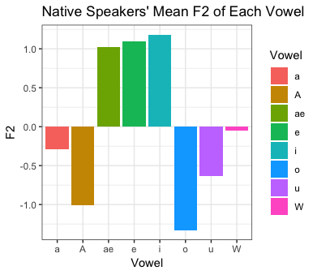
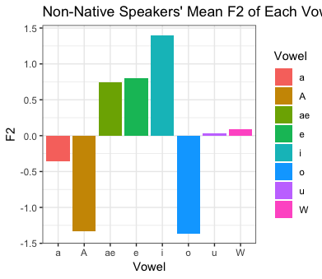

Slide 13
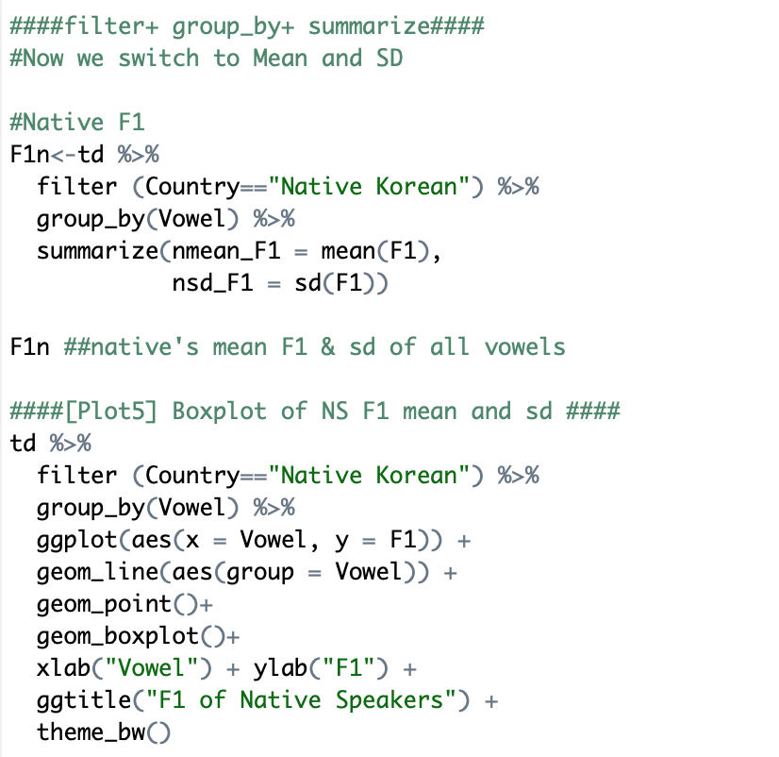

Slide 14
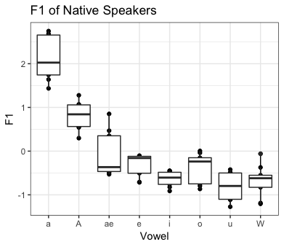
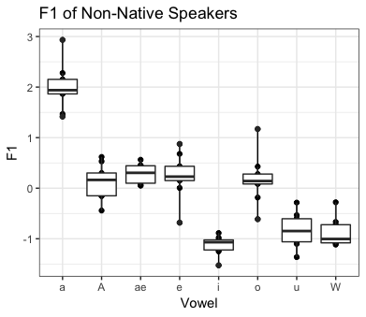

Slide 15
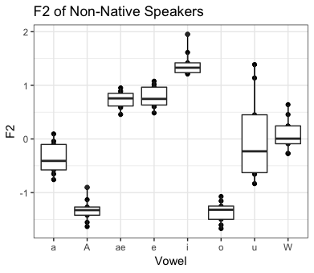


Slide 16
Substantive findings/interpretations
Compared to NS, NNS’ vowel production have the following features:
w/u confusion
o/a confusion
Lower and backer e/ae ← L1 Transfer

Slide 17
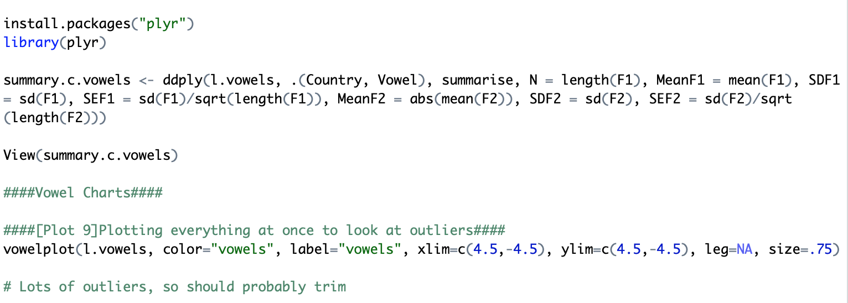

Slide 18
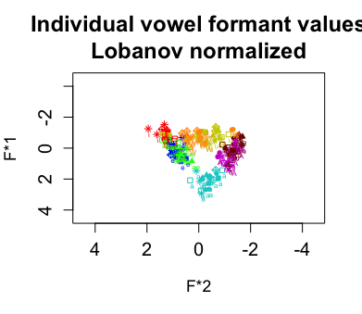
Outlier Check

Slide 19
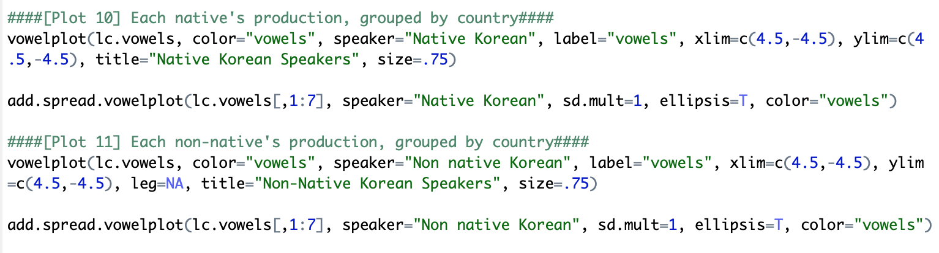

Slide 20
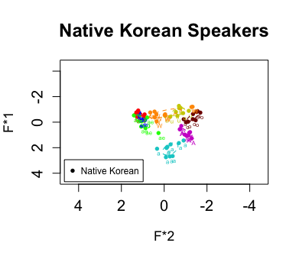
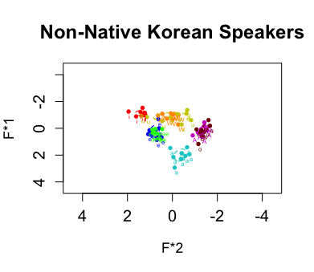

Slide 21
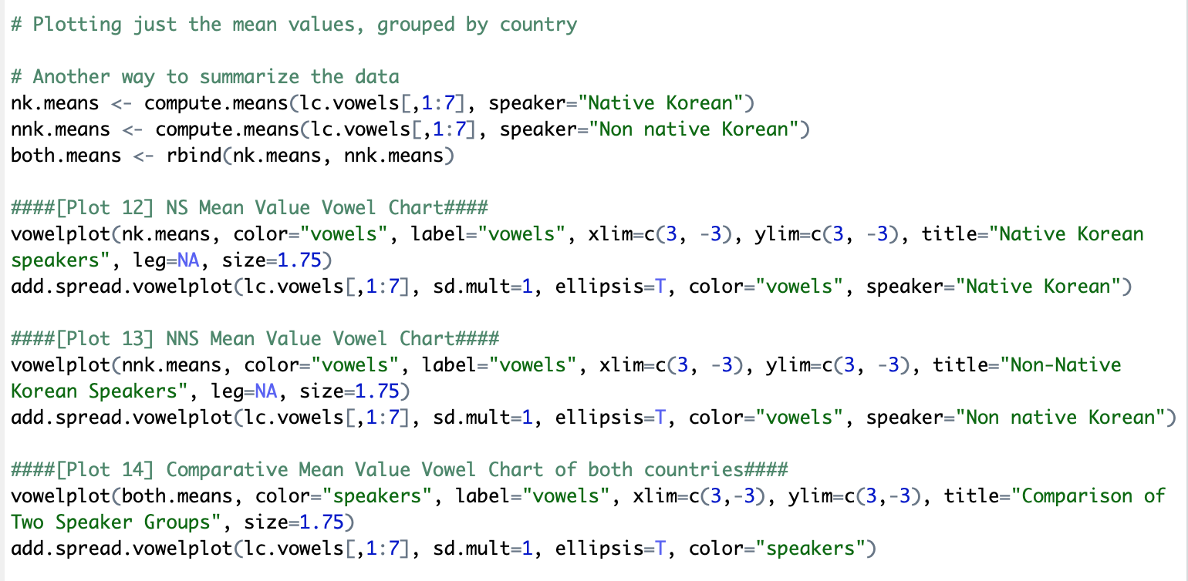

Slide 22
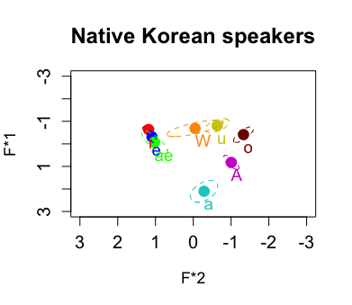
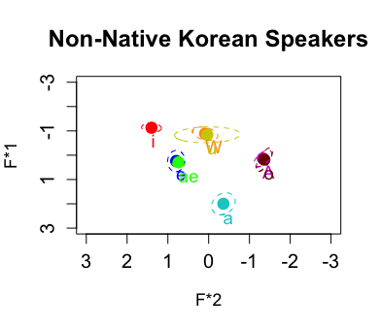

Slide 23
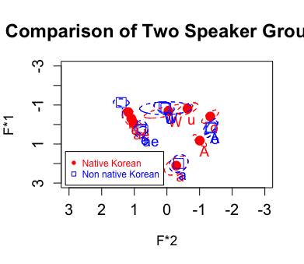

Slide 24
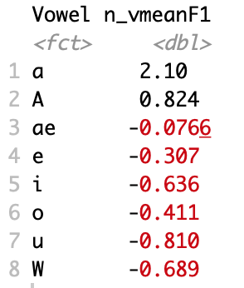
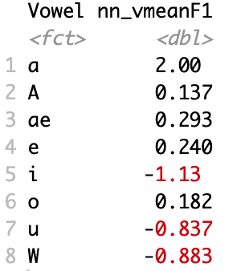
Challenges we are still facing
Run statistics to find any significant F1 differences between NS and NNS and visualize the results

Slide 25
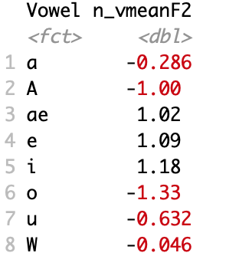
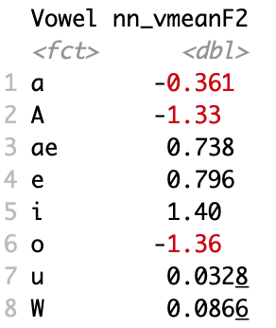
Challenges we are still facing
Run statistics to find any significant F2 differences between NS and NNS and visualize the results

Slide 26
Next R hurdle to tackle
In the current stage, we employ R to analyze data collected by ourselves. The data frames have relatively smaller size and more familiar layouts.
In the next stage, we wish to better integrate R with corpus data. For instance, corpus annotation, KWIC, and collocation.

