Slide 1
Understanding CMDB
By
Nandini Krishnan
Business Analyst

Slide 2
Agenda
Need of an IT Asset Manager
What is CMDB?
Plan your CMDB
Get started!
The next steps
The CMDB Strategies
The Business value

Slide 3
Nitesh Dalvi – IT Asset Manager
Responsibility: Monitoring & Managing Complete Asset Lifecycle [from procuring to disposal and recording all the information]
The Boss – CIO/CTO
Scenario
Boss plans to deploy an application and wants to know few things like No of servers, their relationships with certain application – Basically the big picture…
Will Nitesh be able to provide this info to his boss?

Slide 4
Needs of an IT Asset Manager
How many servers do I have?
What versions and editions are they?
What applications are they hosting?
Who has the permissions to access them?
What isn’t configured rightly?
What are the “Best Practices” of IT Management today?
What has changed recently?
How does this relate to my business?
This is how life is for a IT Administrator like Nitesh…

Slide 5

Now for the big question!!
WHAT IS CMDB?? Some kinda Genie?

Slide 6

What is CMDB? – The ITIL Way!
“A Configuration management database (CMDB) is a repository of information related to all the components of an information system. Although repositories similar to CMDBs have been used by IT departments for many years, the term CMDB…..
Blah Blah Blah..

Slide 7
What is CMDB? – my way!
Configuration Management Database (CMDB) creates one repository of information of all your “IT” components
Note: IT Components in CMDB are called CIs – Configuration Items
CMDB
Servers
Databases
Applications
Users & Contacts
Configurations
History

Slide 8
Plan your CMDB
Identify existing information repository
Hardware/Software – model/versions – record
Record of Office system configurations
Asset purchase register
The shelf holding user manuals
The wardrobe holding spare hardware

Slide 9
Plan your CMDB
Beware CMDB isn’t a huge thing you have to purchase or develop
Start small and grow as you mature
Don’t try to do everything in one shot
Design for the future
Make it flexible and scalable

Slide 10
Get Started!
Everything starts with ITIL which provides great details on implementing CMDB…below are the highlights…
Select and identify CIs and their relationships
Ensure no change to any CI without controlling documentation
Define how will you accurately update CMDB records
Include methods to track CIs from ordering to depreciation
Verification and Audits
Plan list of audits and procedures to be used
List of authorizations required
Report descriptions and expected contents

Slide 11
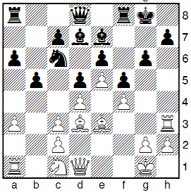
The Next Steps
The Business objective of CM and CMDB is to “Control CIs”
Identify CIs that underpin key systems
Combine CI information into services
Follow rest of the CM process from ITIL to maintain integrity of CMDB as you expand it

Slide 12



The CMDB Strategies
CMDB – PEOPLE
- Project Team
- Data providers
- Users

Slide 13
The CMDB Strategies
CMDB – Data
Initially choose and consider three “Business Services” (ex: e-mail client, telecom infrastructure, related hardware) to build CMDB and later expand…
Identify requirements of CI state
Build CI Relationship Layout
Build CI and their Attributes

Slide 14
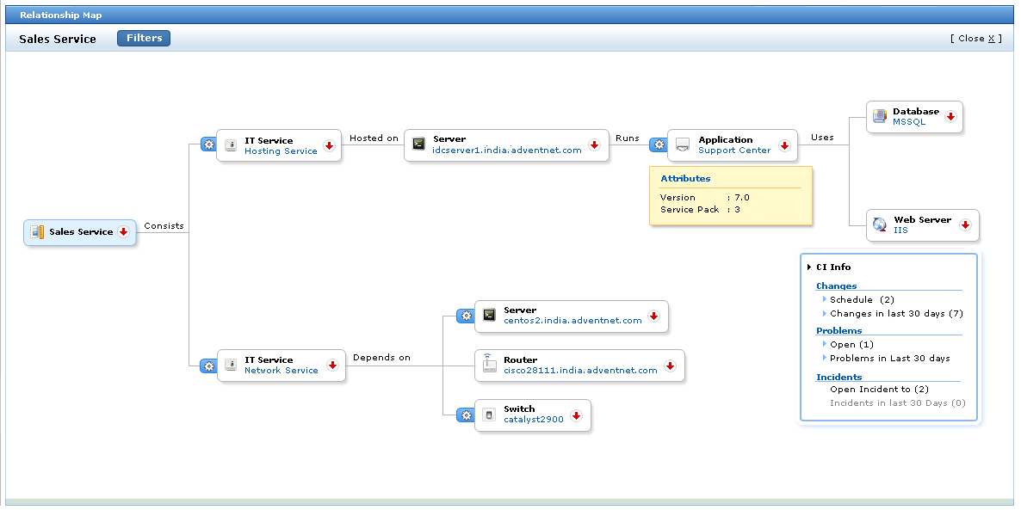
The CMDB Strategies
CMDB Data continued…CI Relationship Layout

Slide 15
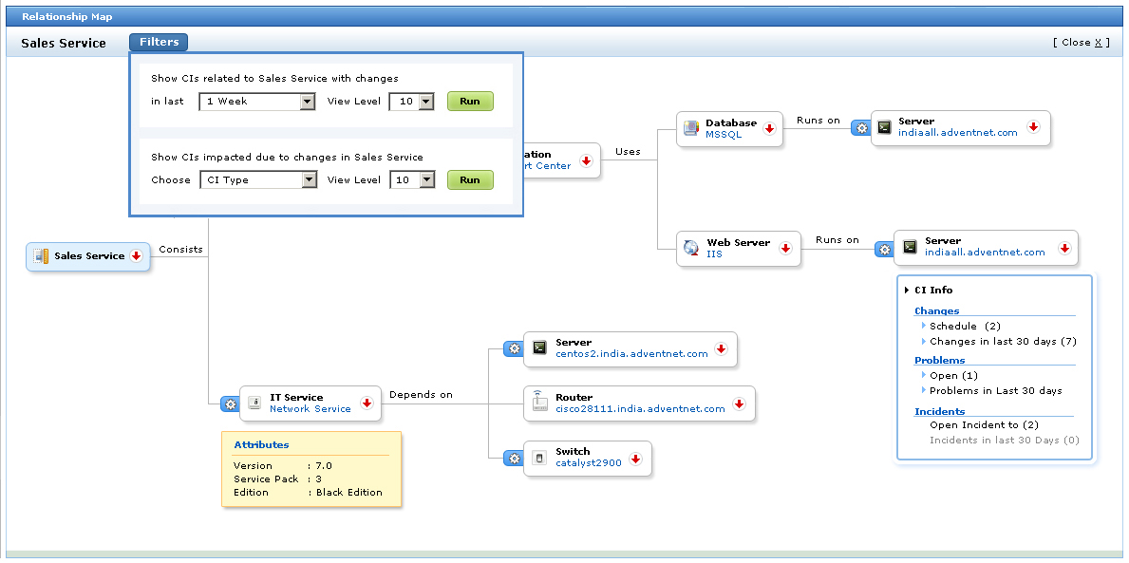
The CMDB Strategies
CMDB Data Continued…CI map for one of the attributes..
About planned changes..

Slide 16
The CMDB Strategies
CMDB – Process
CMDB Services
SUPPORT
Incident Mgmt
Problems Mgmt
Change Mgmt
Release Mgmt
Configuration Mgmt
DELIVERY
Availability
Service-Level Mgmt
Capacity Mgmt
Continuity Mgmt
Financial Mgmt

Slide 17
The CMDB Strategies
CMDB – Implementation
Think from a casual CMDB user perspective
Let everyone to give inputs
Identify experts in each community of CMDB
Carefully examine culture, risk, operational issues
Record the experience and share with the community

Slide 18
Some pitfalls!
Its common to attempt more than once
Unclear objectives
Too big a plan
Poorly defined roles and responsibilities
Poor data
Only set of people knowing how to access it
Not staying current

Slide 19
The Business Value
Strategy and Planning
Operational Efficiency
Continuous Improvement
Specify Requirements
Business Effectiveness
Ongoing Value
Select Technologies
Construct and Deploy
Users and Services

Slide 20

Q & A
Nandini Krishnan
nandini@managengine.com

Slide 21


