Slide 1

The Enterprise-class Monitoring Solution
for Everyone
System Overview

Slide 2

CONTENT
About Company
About Product
Zabbix Services
Use Cases & Solutions

Slide 3

ABOUT COMPANY
NAME
FOUNDER, OWNER & CEO
ESTABLISHED
STRUCTURE
SUBSIDARIES
MISSION
ZABBIX SIA
Alexei Vladishev
In 2005
Zabbix SIA is a limited liability company registered in the Republic of Latvia
Zabbix Japan LLC – registered in Japan, 100% of belongs to Zabbix SIA
To create top-quality open source monitoring platform of choice for solving real needs of users backed by the excellent level of commercial services
www.zabbix.com/about.php

Slide 4
About company | STRATEGY
Stay Open Source
Concentrate on enterprise-level companies, while continue to be the best solution for small and medium companies
Deliver improvements regularly
Listen to customers’ needs, while defining strategy ourselves

Slide 5
ABOUT PRODUCT
ABOUT PRODUCT
What problems Zabbix solves?
Cost of downtime is high
Hard to manage nontransparent environment
Impossible to make wise planning and purchasing
ZABBIX
SOLVES ALL THESE ISSUES
www.zabbix.com/product.php

Slide 6

About Product | LICENSE
GPLv2
Open Source
No hidden (Corporate, Enterprise) versions
www.zabbix.com/license.php

Slide 7
About Product | MAIN FUNCTIONALITIES
Collect data | Automated Device Management| Web monitoring
Store data
Manage data
Alert | via E-mail, SMS, & Jabber, Chat message, Command Execution
Visualize | Dashboard, Graphs, Maps, Screens
www.zabbix.com/functionality.php

Slide 8
About Product | COMPETITIVE BENEFITS
All-in-one solution
True Open Source
Enterprise friendly support pricing
Monitor anything
Distributed monitoring
Commercially Backed

Slide 9
About Product | PERFORMANCE
SINGLE ZABBIX NODE
25 000 hosts
100 metrics per host checked every minute

Slide 10
About Product | ZABBIX IN NUMBERS
500 000
times software was downloaded during 2013
BEST OF BREED
Zabbix was nominated for the 2nd time among world’s best monitoring solutions according to Gartner
25
languages Zabbix interface is translated to

Slide 11


About Product | HISTORY
2009
V.1.8
2012
V.2.0
API
Configuration Cache
Passive Zabbix Proxy
IBM DB2 Support
Calculated Items
Zabbix Japan LLC
2008
V.1.6
LLD
Multinamed Host
Java Gateway
JMX Monitoring
Automatic Inventory
SNMP Trap Monitoring
Escalations
Zabbix Proxy
LDAP Auth
Dashboard
Maintenance
2007
V.1.4
New Interface
SQLite
Network Discovery
Web Monitoring
UTF8, IPv6
2013
V.2.2
Improved Performance
VMware monitoring
Loadable modules
Templates for web monitoring
Plain text monitoring with regex
Self-monitoring
2006
V.1.1
XML Protocol
Active Checks
Logfile Monitoring
Event log Monitoring
GSM Modern
SNMPv3
1998
PRODUCT IDEA
2005
Zabbix SIA Company est.
2004
V.1.0
Fist Stable Version Release
2001
V.0.1
Fist GPL release

Slide 12
ZABBIX SERVICES
Designed to:
Save customer’s time & money
Simplify adoption by corporate sector
Ensure smooth operation
Safeguard future extension
www.zabbix.com/services.php

Slide 13

Zabbix services | VARIETY
  Build around customers to fit their unique business needs, requirements and complexities
CONSULTING
Talk to expert
TEMPLATE BUILDING
PROFESSIONAL TRAINING
Add unique device
Obtain knowledge
TURN-KEY SOLUTION
UPGRADE
Outsource set-up
Get new version
TECHNICAL SUPPORT
DEVELOPMENT
Technical advice
Optimize
REMOTE TROUBLESHOOTING
Get assistance

Slide 14
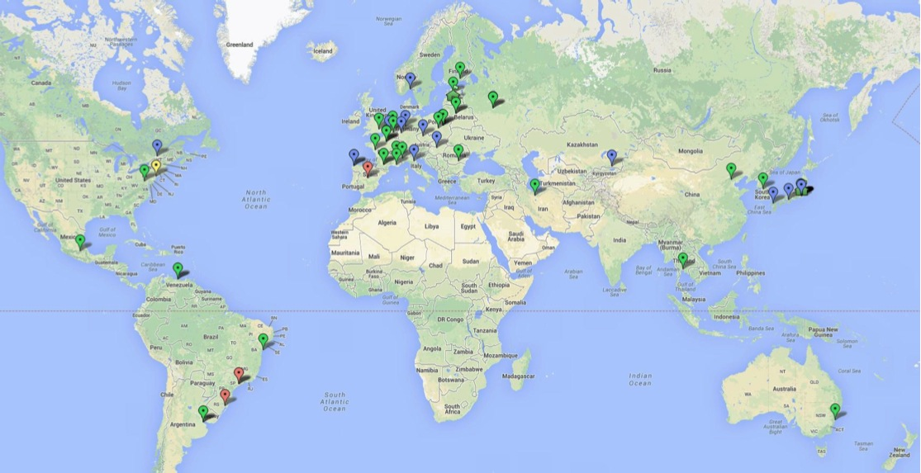
Zabbix services | HOW TO PURCHASE
  70
partners
are actively involved in Zabbix promotion all over the world
www.zabbix.com/partners.php

Slide 15
USE CASES & SOLUTIONS
Zabbix is a popular monitoring solution that is:
applied across different industries
used to perform variety of functions
www.zabbix.com/solutions.php

Slide 16
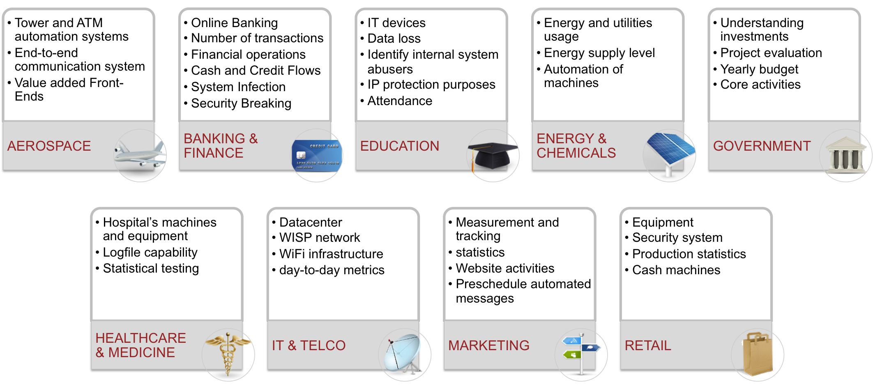
Use cases & Solutions | SOLUTIONS BY INDUSTRY
www.zabbix.com/solutions_by_industry.php

Slide 17
Use cases & Solutions | SOLUTIONS BY AREA
Access Control
Application Development
Business Analytics
Capacity
Configuration
Inventory
Security
Zabbix can be adapted in 99.9% of cases within any area of your IT infrastructure
www.zabbix.com/solutions_by_application_area.php

Slide 18
DOWNLOAD
3 options:
Use virtual appliance to test
Install from a package | RHEL, CentOS, Debian, Ubuntu
Install from a source
www.zabbix.com/download.php

Slide 19


CONTACTS
SALES
Worldwide: +371 6 778 4742
USA Toll-free: 1-877-4-Zabbix (1-877-4-922249)
Japan Toll-free: 0053 1130 907
Fax: +371 6 778 4741
Email: sales@zabbix.com
PARTNERSHIP INQUIRIES
Worldwide: +371 6778 4702
Zabbix SIA
117 Dzelzavas Street
Riga, LV-1021
Latvia
twitter.com/zabbix
facebook.com/zabbix
linkedin.com/company/zabbix
google.com/+Zabbix

