Slide 1

Zabbix Performance
Tuning
Getting most out of your hardware

Slide 2
What is all about
Overview of Zabbix Performance
Step 1. Identify & fix common problems
Step 2. Tuning of Zabbix Parameters
Step 3. Do extra work

Slide 3
Overview
What's Zabbix performance?

Slide 4
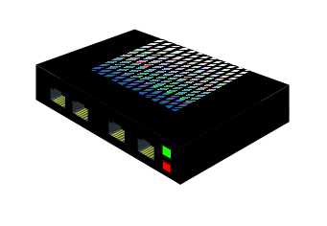
Basic data flow
DATA
GUI
Alerter
Poller
Escalator
Poller
History
syncer
DATA
Database
DATA
History
syncer
Trapper
DATA
Conf syncer
Conf
syncer
OTHER
Trapper
No proxies, not a distributed setup
Zabbix Server

Slide 5
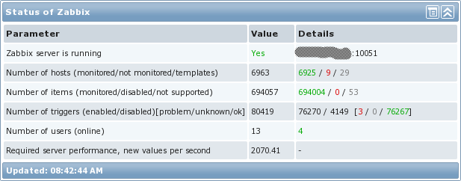
Metrics of Zabbix performance
Number of values processed per second (NVPS)
A rough estimate of NVPS is visible in Zabbix Dashboard
NVPS
....:..........................

Slide 6

Performance delivered by Zabbix
Hardware: Quad Core CPU, 6GB, RAID10 BBWC
Budget: around 2K EUR
Zabbix is able to deliver 1 million of values per minute or around 15.000 of values per second
In real life performance would be worse. Why?!
.....:.........................

Slide 7
Factors making performance lower
Type of items, value types, SNMPv3, number of triggers and what the triggers are
Housekeeper settings and thus size of the database
Number of front-end users
Complexity of triggers

Slide 8
Performance VS number of hosts
60 items per host, update frequency once per minute
Number of hosts | Performance (values per second)
100 | 100
1000 | 1000
10000 | 10000
600 items per host, update frequency once per minute
Number of hosts | Performance (values per second)
100 | 1000
1000 | 10000
10000 | 100000

Slide 9
Slow v.s. Fast
What | Slow | Fast
Database size | Large | Fits into memory
Trigger expressions | min(),max(),avg() | last(), nodata()
Data collection | Polling (SNMP, Agent-less, Passive agent) | Trapping (active agents)
Data types | Text, string | Numeric

Slide 10
Visible symptoms of bad performance
Zabbix Queue has too many delayed items
  Administration->Queue
Frequent gaps in graphs, no data for some of the items
False positives for triggers having nodata() function
Unresponsive front-end

Slide 11
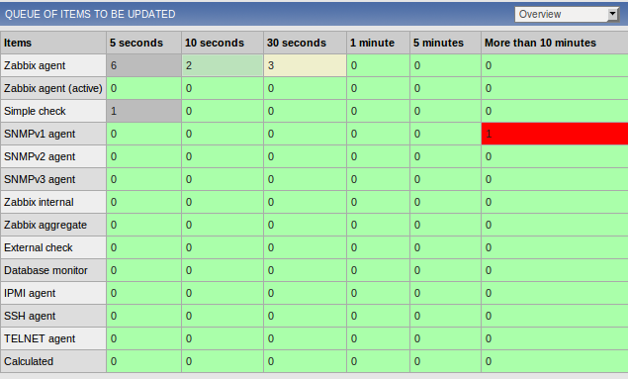
Nice looking Queue

Slide 12
Identify & fix common problems
STEP 1

Slide 13
Different views on performance
“I just added 5 hosts and Zabbix died” :-(
“Zabbix is so slooooow, I have only 48 hosts” :-(
    however:
“Zabbix Milestone achieved - 1000 hosts and growing” :-)
“Our status update: 8500 hosts, 950400 items, 670340 triggers, 9550 vps” :-)
:-) - Happy! :-( - Unhappy!

Slide 14
Common problems of initial setup
Use of default templates
  Make your own smarter templates
Default database settings
  Tune database for the best performance
Not optimal configuration of Zabbix Server
  Tune Zabbix Server configuration
Housekeeper
Use of older releases
  Always use the latest one!

Slide 15
How do I know database performance is bad?
Zabbix Server configuration file, zabbix_server.conf:
LogSlowQueries=1000

Slide 16
Tune Zabbix Configuration
STEP 2

Slide 17
Get internal stats
Real number of VPS
  zabbix[wcache, values, all]
  zabbix[queue,1m] number of items delayed for more than 1 minute
Zabbix Server components
  Alerter, Configuration syncer, DB watchdog, discoverer, escalator, history syncer, http poller, housekeeper, icmp pinger, ipmi poller, poller, trapper

Slide 18
Get internal stats
Before Zabbix 1.8.5 no way to see clearly how well Zabbix components work!

Slide 19
Get internal stats
Now we have a very nice way of monitoring internal performance
Percentage of time a component is in BUSY state
  zabbix[process,<type>,<mode>,<state>]
  <type> - trapper, discoverer, escalator, alerter, etc
  <mode> - avg, count, min, max
  <state> - busy, idle

Slide 20
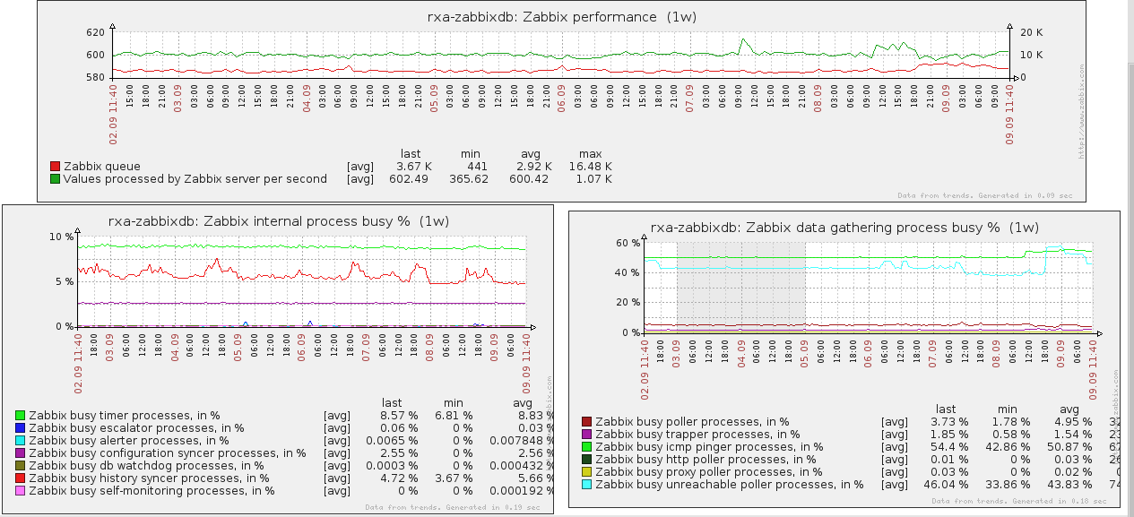
How it looks like
A graph indicating a problem

Slide 21
Tune number of processes
Zabbix Server configuration file, zabbix_server.conf:
StartPollers=80
StartPingers=10
StartPollersUnreachable=80
StartIPMIPollers=10
StartTrappers=20
StartDBSyncers=8

Slide 22
Do extra work
STEP 3

Slide 23
Use Proxies
DATA
Alerter
Trapper
Proxy
DATA
Escalator
Pollers
Trapper
History
syncer
DATA
History
syncer
Trapper
Proxy
DATA
Pollers
DATA
Conf syncer
Conf
syncer
OTHER
Trapper
Proxies do data collection
Zabbix Server

Slide 24
Table partitioning
It is a way to split large tables into smaller partitions.
Make sense for historical tables:
  history_*, trends*, events
Benefits
  Easy to remove older data
  Much better performance

Slide 25
No table partitioning
History
Zabbix
Server
& GUI

Slide 26
With table partitioning
Partition 2013_09
Zabbix
Server
& GUI
Partition 2013_08
Partition 2013_07
Partition 2013_06

Slide 27
Hey, I tried everything! Performance is still not good.
Run all Zabbix components on separate hardware!
Zabbix Server
8 core CPU
4GB of RAM
Database
24 core CPU
64GB of RAM
Fast storage
Zabbix GUI
Fast CPU
4GB of RAM

Slide 28
Summary
Make sure you did everything

Slide 29
Check list
Zabbix internal statistics is monitored!
  Otherwise you don't know anything about Zabbix health
Zabbix configuration is tuned
Database performance is tuned
Housekeeper is not used, you use table partitions
  DisableHousekeeper=1

Slide 30
Additional reading
MySQL & PostgreSQL Performance Tuning Guides
Table partitioning for Zabbix
  MySQL: zabbixzone.com
  PostgreSQL: https://www.zabbix.org/wiki/Docs/howto/zabbix2_postgresql_partitioning
Zabbix Internal Checks
  http://blog.zabbix.com/monitoring-how-busy-zabbix-processes-are
  http://www.zabbix.com/documentation/1.8/manual/config/items#internal_checks

Slide 31
WWW.ZABBIX.COM
Any questions?

