Slide 1
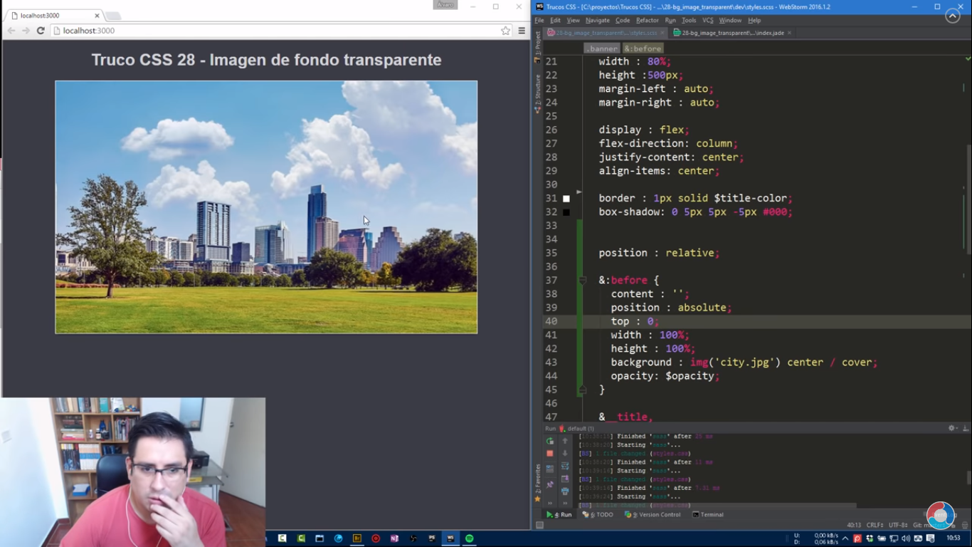

Slide 2
https://www.youtube.com/watch?v=Vf8hoR-EqMQ

