Slide 1
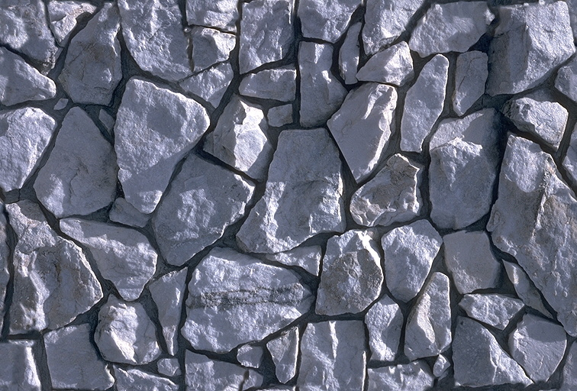
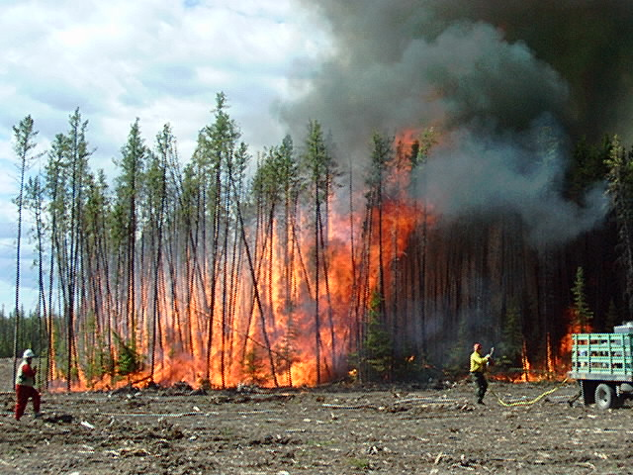
ECE 492 - Computer Engineering Design Project
<Project Title>
You may use any graphic
design software to create
your poster – but replicate
this template if you do!
<Insert team member names here> | 2017
Please note that Powerpoint may have difficulty printing colour gradations like the one in this balloon.
Check with AICT before putting a whole whack of colour transitions on the poster.
Adobe Illustrator & Photoshop do not have this limitation.
Poster Essentials
Keep the poster title to two lines in length. Below the main poster title is the information table where you supply the names of your group members, the client (if applicable) and the year. The column widths may be changed by dragging the vertical column separators.
Three or four column text box formats are recommended as a wide single column of text is difficult to read.
Poster Size
Please print the poster so its final dimensions are: W: 31 x H: 24 inches. Landscape posters are required.
Background & Colour
You may change the colour of the section titles to something other than black, but use a solid colour make the colour consistent for all titles. Paragraph text should be kept black.
The background colour of this interior poster region must be white.
Experiment with colour and gradients. Use colours that enhance visual appeal while maintaining readability. Images can make very effective backgrounds, or can be very distracting, experiment with transparency to achieve the desired effect.
Experiment with layout, form and colour to achieve a visually appealing and informative technical poster. Something that you would read!
Printing Instructions
See course web page
Deviation from any of these specifications will require that your group pay for the full production costs. Also, if you need to re-print the poster for whatever reason, the cost of re-printing is to be looked after by you or your group. Rigorous quality-control according to AICT's protocol is encouraged to avoid this situation.
See the course website and AICT’s website for details and suggestions regarding printing: http://helpdesk.ualberta.ca/printing/
More Information
Check out these online poster resources:
http://www.swarthmore.edu/NatSci/cpurrin1/posteradvice.htm
http://abacus.bates.edu/~bpfohl/posters/
Remember
Remove comment bubbles from template before printing! Acknowledge your client if you have one.
delete these annoying comment bubbles
Fig. 2 Line art (or another vector format) is very effective for figures.
Figure numbers are not mandatory
and depend very much on how
you wish to convey graphical
and tabular information
Image Resolution
Pictures and images should be created at high resolution (600 – 1200 dpi). Remember that graphics will be printed larger than normal due to the poster size. Low resolution images will result in aliasing and low quality results.
Fig. 1 A Bunch of Rocks
Fig. 4 Don’t Play With Fire
Font Sizes and Types
For paragraph text 24-28 pt text works well. Section titles should be sized appropriately, 40 pt is a good start. Be consistent with your font sizes.
A good test for font size is to print the poster scaled to fit on 8.5x11 paper; if you can read it easily at arm’s length then it should be ok.
If using formulas or variable symbols, be sure to italicize them so they are recognized as such… e.g. y + g(x).
Remember to acknowledge your project sponsor
Fig. 3 Damped sinusoidal response
Department of Electrical & Computer Engineering
Notes:
For colour ideas, University Visual Identity Guidelines can be found here: http://www.toolkit.ualberta.ca/VisualIdentityGuidelines.aspx

