Slide 1
Web performance
Optimization
网站性能优化

Slide 2


Slide 3
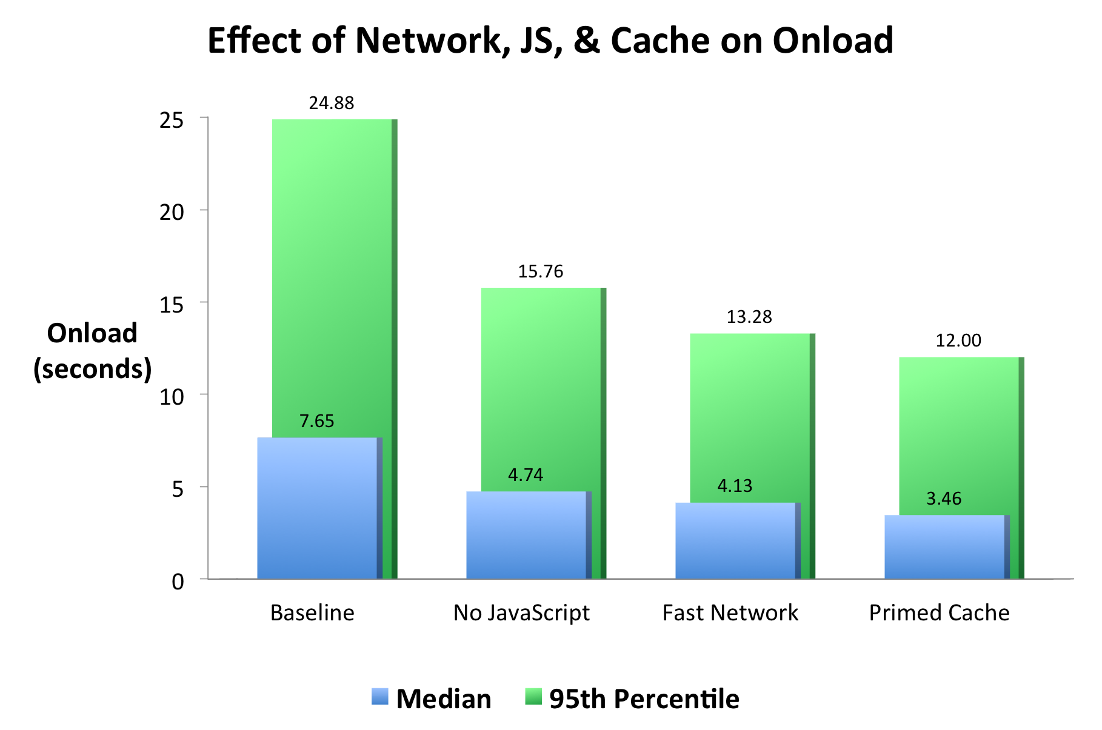

Slide 4
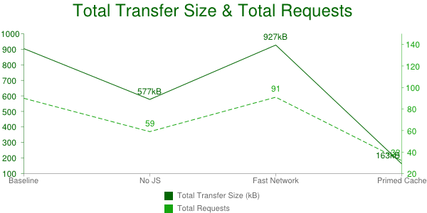

Slide 5
Question？

Slide 6
Thankyou!

