Slide 1
Introduction to UML
Credits: Slides burrowed heavily from http://sunset.usc.edu/classes/cs590_s2002/CPT-Readings.html

Slide 2
About this lecture…
Will attempt to introduce you to UML and Rational Rose
Not possible to teach everything
Requires that you study on you own after
Goal is to get you familiar
Make use of on-line tutorials, books, etc.

Slide 3
Introduction to UML
What is UML?
Motivations for UML
Types of UML diagrams
UML syntax
Descriptions of the various diagram types
  Rational Rose and UML
UML pitfalls

Slide 4
What is UML?
A standardized, graphical “modeling language” for communicating software design.
Allows implementation-independent specification of:
  user/system interactions (required behaviors)
  partitioning of responsibility (OO)
  integration with larger or existing systems
  data flow and dependency
  operation orderings (algorithms)
  concurrent operations
Pretty pictures.
UML is not “process”. (That is, it doesn’t tell you how to do things, only what you should do.)

Slide 5
Motivations for UML
UML is a fusion of ideas from several precursor modeling languages.
We need a modeling language to:
  help develop efficient, effective and correct designs, particularly Object Oriented designs.
  communicate clearly with project stakeholders (concerned parties: developers, customer, etc).
  give us the “big picture” view of the project.

Slide 6
Types of UML diagrams
There are different types of UML diagram, each with slightly different syntax rules:
  use cases.
  class diagrams.
  sequence diagrams.
  package diagrams.
  state diagrams
  activity diagrams
  deployment diagrams.

Slide 7
UML syntax, 1
Actors: a UML actor indicates an interface (point of interaction) with the system.
  We use actors to group and name sets of system interactions.
  Actors may be people, or other systems.
  An actor is NOT part of the system you are modeling. An actor is something external that your system has to deal with.
Boxes: boxes are used variously throughout UML to indicate discrete elements, groupings and containment.

Slide 8
UML syntax, 2
Arrows: arrows indicate all manner of things, depending on which particular type of UML diagram they’re in. Usually, arrows indicate flow, dependency, association or generalization.
Cardinality: applied to arrows, cardinalities show relative numerical relationships between elements in a model: 1 to 1, 1 to many, etc.

Slide 9
UML syntax, 3
Constraints: allow notation of arbitrary constraints on model elements. Used, for example, to constrain the value of a class attribute (a piece of data).
Stereotypes: allow us to extend the semantics of UML with English. A stereotype is usually a word or short phrase that describes what a diagram element does. That is, we mark an element with a word that will remind us of a common (stereotypical) role for that sort of thing. Stereotypes should always be applied consistently (with the same intended meaning in all instances).

Slide 10
UML diagrams: use cases
A use case encodes a typical user interaction with the system. In particular, it:
  captures some user-visible function.
  achieves some concrete goal for the user.
A complete set of use cases largely defines the requirements for your system: everything the user can see, and would like to do.
The granularity of your use cases determines the number of them (for you system). A clear design depends on showing the right level of detail.
A use case maps actors to functions. The actors need not be people.

Slide 11

Use case examples, 1
(High-level use case for powerpoint.)

Slide 12
About the last example...
Although this is a valid use case for powerpoint, and it completely captures user interaction with powerpoint, it’s too vague to be useful.

Slide 13
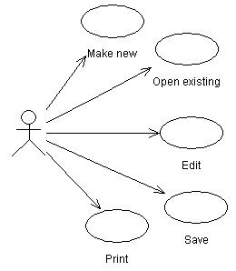
Use case examples, 2
(Finer-grained use cases for powerpoint.)

Slide 14
About the last example...
The last example gives a more useful view of powerpoint (or any similar application).
The cases are vague, but they focus your attention the key features, and would help in developing a more detailed requirements specification.
It still doesn’t give enough information to characterize powerpoint, which could be specified with tens or hundreds of use cases (though doing so might not be very useful either).

Slide 15
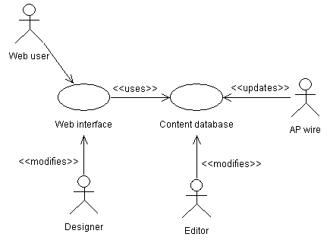
Use case examples, 3
(Relationships in a news web site.)

Slide 16
About the last example...
The last is more complicated and realistic use case diagram. It captures several key use cases for the system.
Note the multiple actors. In particular, ‘AP wire’ is an actor, with an important interaction with the system, but is not a person (or even a computer system, necessarily).
The notes between << >> marks are stereotypes: identifiers added to make the diagram more informative. Here they differentiate between different roles (ie, different meanings of an arrow in this diagram).

Slide 17
More UML later,
now on to…

Slide 18
Using Rational Software

Slide 19
IBM Rational resources
Getting the program:
  http://www-01.ibm.com/software/rational/
  http://en.wikipedia.org/wiki/Rational_Software
Installed in A32

Slide 20
What is Rational Rose?
An expensive CASE (Computer-Aided Software Engineering) tool for object-oriented modeling.
Based on UML (more or less).
Provides semantics (a ‘compiler’) for UML.
Has a reasonably intuitive GUI similar to standard drawing programs, like Illustrator. Is available for Windows and other platforms.
Makes creating and maintaining your UML diagrams easier (or at least more consistent).
Has many bizarre features, including generation of C++ (and other) code from your diagrams.

Slide 21

What is a Rose Model?
A Rose “model” is a representation of the problem domain and system software
  Each model contains views, diagrams, and specifications to visualize and manipulate the elements in the model
  There are many views of each underlying element
  Every “object” in the design is represented once in the Rose “model”
  Rose maintains a consistent semantic representation in the “model”

Slide 22
About the next 2 slides…
The next slides introduce the Rose UI.
Main points are the:
  “Browser”, a drop-down list of things in your model.
  “Documentation window”, where you can add notes to a thing in your model.
  “Diagram windows”, where you draw your pictures.

Slide 23
The Rose User Interface
Rose consists of:
  Standard toolbar
  Diagram toolbar
  Browser
  Documentation window
  Diagram windows
  Specifications
  Status bar

Slide 24
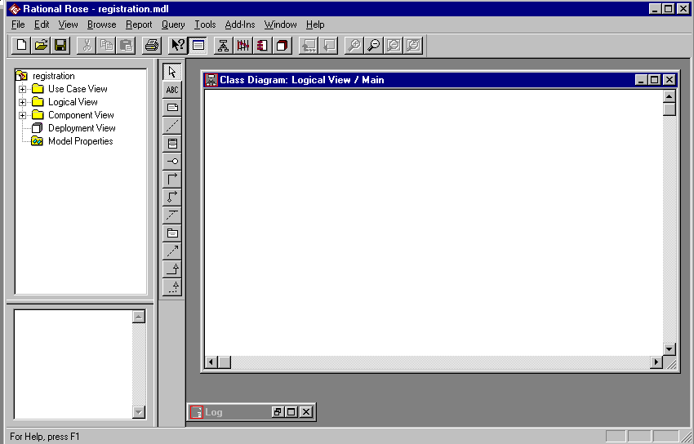
Rational Rose
Standard
Toolbar
Browser
Documentation
Window
Status
Bar
Diagram Toolbar
Diagram Window

Slide 25
About the next slide…
Most things in your model (classes, use cases, actors, etc) have all manner of attributes and parameters. You edit these via the “Specification” dialogue associated with each.
To get the specifications, right-click a thing in the browser or a diagram and choose “Specification”.

Slide 26
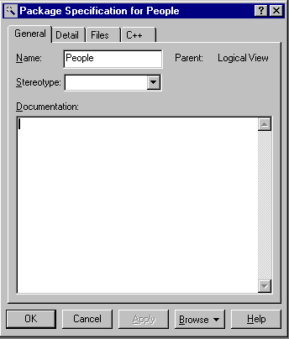
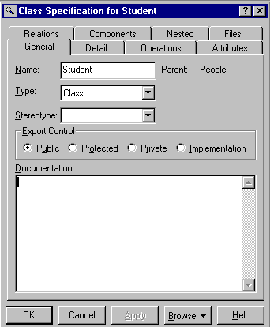
Specifications
Most modeling elements have a Specification that contains additional information about the modeling element

Slide 27
About the next slide…
The next several slides refer to use cases, a particular type of diagram
The next slide shows the “Use Case View” section of the browser. Any actors, use cases and use case diagrams each get an entry. “Associations”, ie arrows, are grouped together.
Use the browser to add elements to your model, then draw a picture to show how they go together.

Slide 28
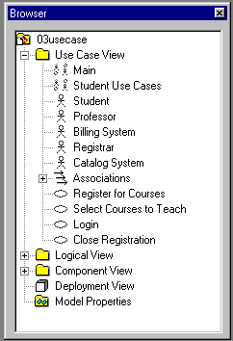
Use Case Diagrams

Slide 29
About the next slide…
The next slide shows a full use case diagram.
The stick figures denote actors, and the ovals are use cases (a function or behavior or interface your software provides).
The arrows indicate ‘use’ or dependency. For example, the “Student” uses the function “Register for Courses”, which in turn uses the external “Catalog System”.
The <<uses>> tokens attached to some of the associations (arrows) are stereotypes, an indication of what the association means. In this diagram, <<uses>> indicates that the association means a direct software link, ie, that the function “Register for Courses” will directly use the function “Login”. This is different than the unmarked arrows, which indicate “use” in the vague sense of manipulating or interacting.

Slide 30
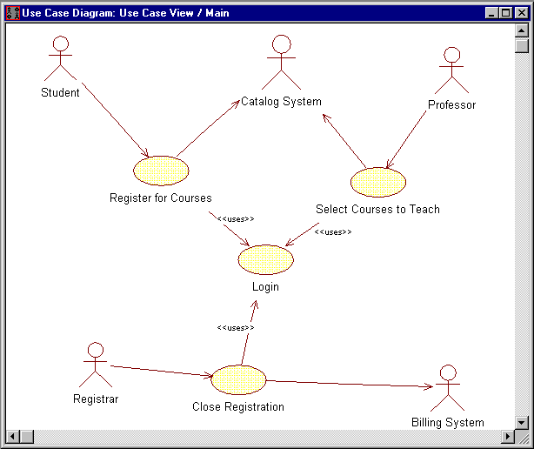
Use Case Relationships

Slide 31
About the next slide…
The next slide shows how documentation (notes, etc) can be added to a particular element.
Here, they’re adding the documentation via the Specification dialogue.

Slide 32
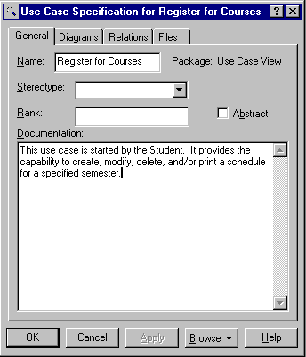
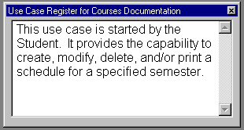
Brief Description -- Register for Courses

Slide 33
UML in your documents
UML is intended to ease the task of communicating software designs.
Typical uses of UML in G64HLL:
  conceptual component diagrams in the concept document.
  use cases and class diagrams in the requirements document.
  class, sequence, state, package and deployment diagrams in the architecture document.

Slide 34
UML pitfalls, 1
UML is a language, with a (reasonably) rigorous syntax and accepted semantics; that is, the diagrams have a meaning. Thus you have to be careful that the meaning of your diagram is what you intended.
However, the semantics of UML are less well-defined than a programming language (where the semantics are defined by the compiler). Thus there is some leeway to use UML your own way: but you must be consistent in what you mean by the things you draw.

Slide 35
UML pitfalls, 2
Arrow happiness: people tend to draw arrows (associations) everywhere in their diagrams, inconsistently without much regard for the UML meaning of a given arrow.
Diagram fever: it’s easy to do too many diagrams. The trick is to get the correct granularity. Eg, the requirements document should leave implementation detail to the architecture.
General loopiness: be careful about slapping together UML diagrams, or doing a diagram without thoroughly understanding your system. You should always be able to give a clear and concise explanation of your diagram, and why you did it that way.

Slide 36
Exporting Rational diagrams?
You can use screen captures
Find out other ways to do this …

Slide 37
Learning Rational …
Lots of practice
Read online tutorial

Slide 38
Citation
These slides borrow heavily:
Martin Fowler, UML Distilled
Addison-Wesley, 1997
You can also get the material from:
Sinan Si Alhir, UML In A Nutshell
O’Reilly, 1998

Slide 39
Back to UML
Class Diagrams

Slide 40
UML diagrams: class diagram
Motivated by Object-Oriented design and programming (OOD, OOP).
A class diagram partitions the system into areas of responsibility (classes), and shows “associations” (dependencies) between them.
Attributes (data), operations (methods), constraints, part-of (navigability) and type-of (inheritance) relationships, access, and cardinality (1 to many) may all be noted.

Slide 41
Class diagram “perspective”
Class diagrams can make sense at three distinct levels, or perspectives:
  Conceptual: the diagram represents the concepts in the project domain. That is, it is a partitioning of the relevant roles and responsibilities in the domain.
  Specification: shows interfaces between components in the software. Interfaces are independent of implementation.
  Implementation: shows classes that correspond directly to computer code (often Java or C++ classes). Serves as a blueprint for an actual realization of the software in code.

Slide 42
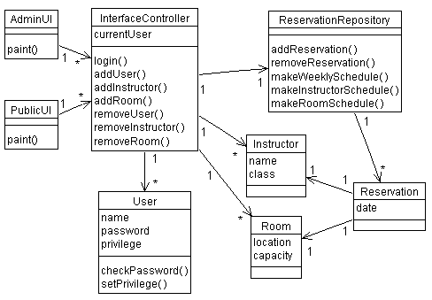
Class diagram examples
(A classroom scheduling system: specification perspective.)

Slide 43
About the last example...
Each box is a class, with necessary attributes and operations specified.
Navigability arrows show which classes can reference which others.
Cardinality marked in bi-directional manner on arrows.
The classes together represent the complete system; thus the the classes are a partitioning of the system.

Slide 44
Rational Software
Class Diagrams

Slide 45
About the next 4 slides…
The next several slides deal with classes and class diagrams.
The next two slides show classes and packages in the browser. A package contains some classes.
The following two slides show adding attributes (a class’s data; “operations” are a classes methods) to a class from the Specification dialogue, and from the browser directly.
As you’d expect, the menus pop up when click the right mouse button.

Slide 46
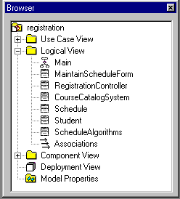
Classes in the Browser

Slide 47
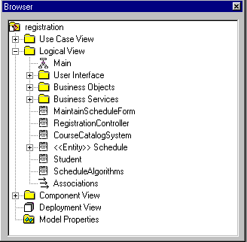
Packages in the Browser

Slide 48
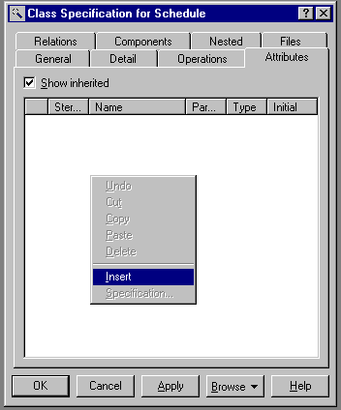
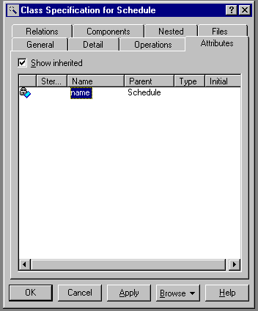
Using the Class Specification - Attributes

Slide 49
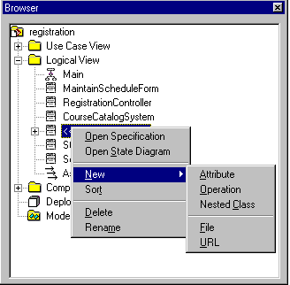
Attributes and Operations and the Browser

Slide 50
About the next slide…
The next slide shows how to specify the visibility of class attributes in the model.
The visibilities correspond to the notions of visibility in Java (public, private, protected, etc).

Slide 51
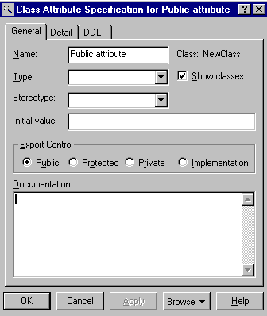
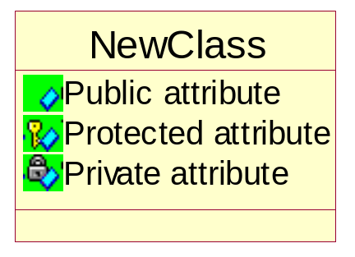
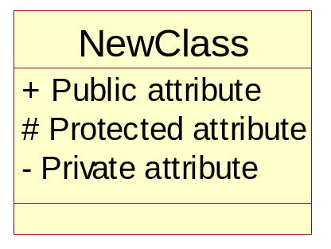
Attribute Visibility Options

Slide 52
About the next 2 slides…
The next slide shows the icons for packages and classes in a class diagram.
The third icon is a class, marked with a stereotype. Here the stereotype indicates a type of class, ie that it is an “interface”. This doesn’t necessarily mean that the class is a Java-type interface (but that’s probably what they mean).
The following slide shows the types of associations (arrows) Rose allows in a class diagram. They correspond to constructs in OO design and programming.

Slide 53
What is a Class Diagram?
A class diagram is a view of the static structure of a system
  Models contain many class diagrams
Class diagrams contain:
  Packages, classes, interfaces, and relationships
Notation:
Package
Class Name
<<Interface>>
Name
Interface Name

Slide 54
Relationships
Class diagrams may contain the following relationships:
  Association, aggregation, dependency, realize, and inheritance
Notation:
Association
Aggregation
Dependency
Inheritance
Realize

Slide 55
About the next 2 slides…
The next slide shows a package diagram, with dependencies.
The following slide shows a class diagram, with various associations between the classes.

Slide 56
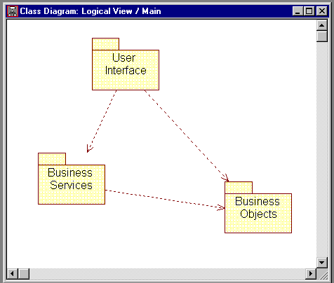
Package Relationships

Slide 57
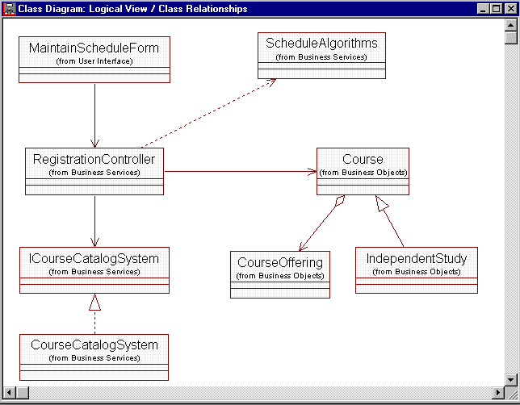
Class Relationships

Slide 58
About the next 2 slides…
The next slide shows how cardinalities are denoted in Rose.
The following slide is the class diagram example from before, but this time with cardinalities marked on the associations.

Slide 59
Multiplicity Indicators
Each end of an association or aggregation contains a multiplicity indicator
  Indicates the number of objects participating in the relationship
Exactly one
1
0..*
Zero or more
1..*
One or more
0..1
Zero or one
2..7
Specified range

Slide 60
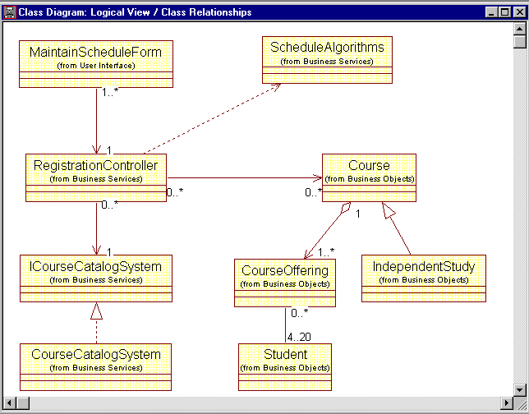
Multiplicity Indicators

Slide 61
Sequence Diagrams

Slide 62
UML diagrams: sequence diagram
Sequence diagram describe algorithms, though usually at a high level: the operations in a useful sequence diagram specify the “message passing” (method invocation) between objects (classes, roles) in the system.
The notation is based on each object’s life span, with message passing marked in time-order between the objects. Iteration and conditional operations may be specified.
May in principle be used at the same three levels as class diagrams, though the specification level will usually be most useful. (At the implementation level, you might better use pseudocode.)

Slide 63
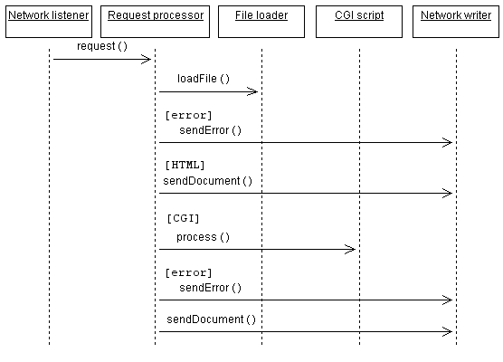
Sequence diagram example

Slide 64
About the last example...
Each box with connected line represents a distinct thing, where all the things aren’t necessarily in the same piece of software, or software at all.
Arrows indicate message passing. That is, an arrow indicates that one thing tells another thing to do something.
Reverse arrows are implied. If arrow goes from A to B, and then immediately afterward an arrow goes from A to something else, it is understood that B completed it’s operation and returned control (and a result, probably) to A.
Time runs down the page. An comes before an arrow that is below it.
Bracketed expressions indicate conditions. In the diagram, an error document is returned if the fileLoad() operation returns and error.

Slide 65
About the next 3 slides…
The next several slides are about sequence diagrams (for algorithms, processes).
The next slide shows how to create a sequence diagram in browser, by associating it with a use case.
The following slide shows some “objects” in a sequence diagram, and the slide after shows how to associated an object with a class. Objects are a bit more general than classes, but you’ll get the best results if you create a one-to-one association between the objects in your sequence diagrams and the classes you’ve defined (define your classes first, if you can!).

Slide 66
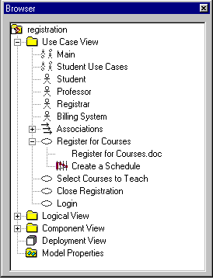
Creating a Sequence Diagram

Slide 67
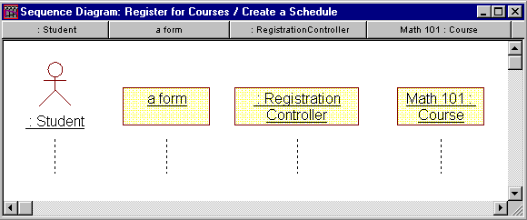
Representing Objects
Object
only
Class
only
Object and
Class
Actor

Slide 68
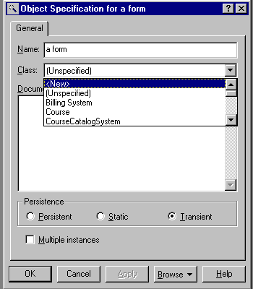
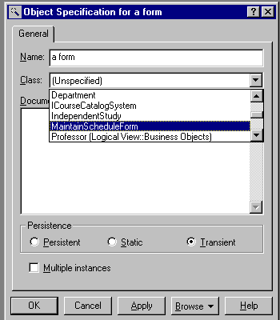
Assigning Objects to Classes
A new class can be created for the object
An object can be assigned to a class already defined

Slide 69
About the next 3 slides…
The next slide shows how to denote message passing in a sequence diagram. To pass a message is usually to call a method on an object.
The following slide shows a notation for “focus of control”. This means that an object in control when there is a box around its lifeline. The example indicates that “Student” maintains control throughout “drop a course”, even while “Maintain schedule form” does its thing. Among other things, this can be used to imply that called methods terminate and return.
The third slide shows a full sequence diagram example.

Slide 70
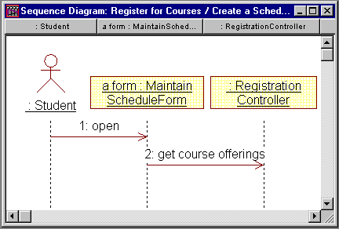
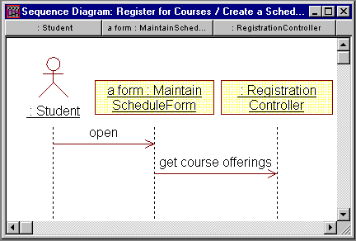
Messages

Slide 71
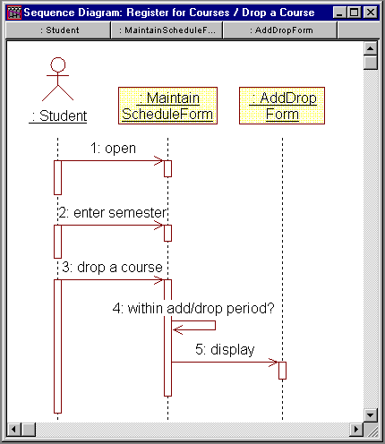
Focus of Control

Slide 72
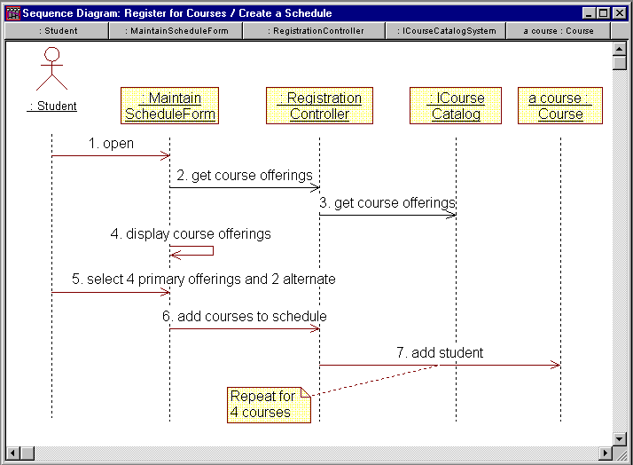
Exercise: Sequence Diagram

Slide 73
Other Diagrams

Slide 74
UML diagrams: Package diagram
A type of class diagram, package diagrams show dependencies between high-level system component.
A “package” is usually a collection of related classes, and will usually be specified by it’s own class diagram.
The software in two distinct packages is separate; packages only interact through well-defined interfaces, there is no direct sharing of data or code.
Not all packages in a system’s package diagram are new software; many packages (components) in a complex system are often already available as existing or off-the-shelf software.

Slide 75
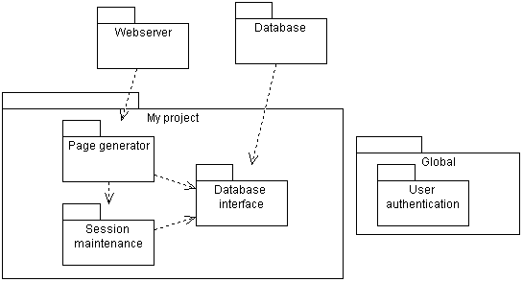
Package diagram example

Slide 76
About the last example...
This package diagram indicates that:
  there are three dependent but decoupled software components that will be developed in “My Project”, which is itself a package or component.
  Parts of my software depend on some existing software packages, which I won’t be developing, but just using (“Webserver” and “Database”).
  There is a globally available package “User authentication” which all the other packages depend on.

Slide 77
About the next slide…
The next slide shows a complete deployment diagram.
A deployment diagram is useful for showing how your software will be deployed on hardware. It may show how your system will integrate with existing systems in the domain.

Slide 78
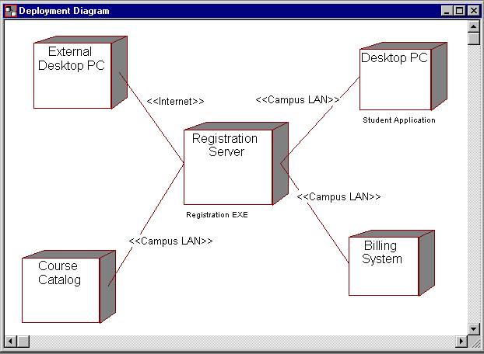
Exercise: Deployment Diagram

Slide 79
UML diagrams: other diagrams
State diagrams: similar in function to sequence diagrams, but with focus on the prerequisites for an operation, rather than the exact sequence of actions.
Deployment diagrams: shows the installation of software on hardware platforms.
Others: activity diagrams, collaboration diagrams.
Look in UML Distilled for examples.

Slide 80
UML diagrams: other diagrams
UML Distilled: A Brief Guide to the Standard Object Modeling Language
Martin Fowler, Kendall Scott
IBM Rational
http://www-306.ibm.com/software/rational/uml/

