Slide 1


Pedestrian Detection By
Light Detection And Ranging Sensor(LiDAR)
in Autonomous Driving System
Juncheng Hu
Chemnitz University of Technology
Course of Automotive Software Engineering(ASE)
3. Semester
Seminar Automotive Sensors
Univ.-Prof. Dr.-Ing. O. Kanoun
Chair for Measurement and Sensor Technology
Notes:
1，拿个小本子记教授提的意见

Slide 2
Outline
Motivation
State of the Art
Principle
Application in Autonomous driving
Limitation of LiDAR
Conclusion
Seminar Automotive Sensors
Univ.-Prof. Dr.-Ing. O. Kanoun
Chair for Measurement and Sensor Technology

Slide 3
Outline
Motivation
State of the Art
Principle
Application in Autonomous driving
Limitation of LiDAR
Conclusion
Seminar Automotive Sensors
Univ.-Prof. Dr.-Ing. O. Kanoun
Chair for Measurement and Sensor Technology

Slide 4
Motivation
Seminar Automotive Sensors
Univ.-Prof. Dr.-Ing. O. Kanoun
Chair for Measurement and Sensor Technology

Slide 5
Outline
Motivation
State of the Art
Principle
Application in Autonomous driving
Limitation of LiDAR
Conclusion
Seminar Automotive Sensors
Univ.-Prof. Dr.-Ing. O. Kanoun
Chair for Measurement and Sensor Technology

Slide 6
State of the Art
  Classification Methods
    Nearest Neighbor Classifier
    Approximate Nearest Neighbor (KNN)
    Spatial Pyramid Matching
    Histogram of Gradients (HoG)
    Nowadays
      Convolutional Neural Network (CNN)
Seminar Automotive Sensors
Univ.-Prof. Dr.-Ing. O. Kanoun
Chair for Measurement and Sensor Technology
Notes:
MCI-NN (Minimization of interclass interference Neural Networks)

Slide 7
Outline
Motivation
State of the Art
Principle
Application in Autonomous driving
Limitation of LiDAR
Conclusion
Seminar Automotive Sensors
Univ.-Prof. Dr.-Ing. O. Kanoun
Chair for Measurement and Sensor Technology

Slide 8
Principle
  Linear Classification
  Loss Function
  Optimization
  Backpropagation
Seminar Automotive Sensors
Univ.-Prof. Dr.-Ing. O. Kanoun
Chair for Measurement and Sensor Technology

Slide 9




Principle
  Linear Classification:
  Input:
  Xi: the image, in the form of an array
  W: the parameter for each pixel in the image, in matrix
  b: the bias to correct the classification result
  Output:
  f: array of labels, which are the scores of each class
Seminar Automotive Sensors
Univ.-Prof. Dr.-Ing. O. Kanoun
Chair for Measurement and Sensor Technology

Slide 10
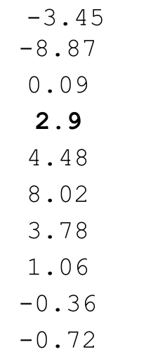
Principle
  Input Output
Seminar Automotive Sensors
Univ.-Prof. Dr.-Ing. O. Kanoun
Chair for Measurement and Sensor Technology

Slide 11
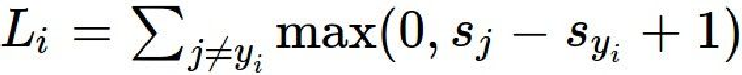



Principle
  Loss Function
  Multiclass SVM loss function:
  : the score for the correct label
  : score for other labels
  Loss : 2.9
Seminar Automotive Sensors
Univ.-Prof. Dr.-Ing. O. Kanoun
Chair for Measurement and Sensor Technology

Slide 12
Principle
  Drawback with Multiclass SVM loss function:
Seminar Automotive Sensors
Univ.-Prof. Dr.-Ing. O. Kanoun
Chair for Measurement and Sensor Technology

Slide 13
Principle
Seminar Automotive Sensors
Univ.-Prof. Dr.-Ing. O. Kanoun
Chair for Measurement and Sensor Technology

Slide 14
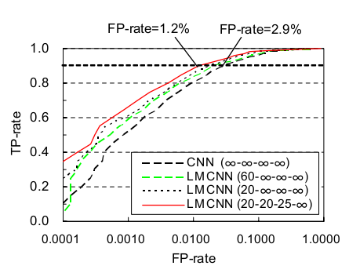
Principle
Seminar Automotive Sensors
Univ.-Prof. Dr.-Ing. O. Kanoun
Chair for Measurement and Sensor Technology

Slide 15
Outline
Motivation
State of the Art
Working Principle of LiDAR
Application in Autonomous driving
Limitation of LiDAR
Conclusion
Seminar Automotive Sensors
Univ.-Prof. Dr.-Ing. O. Kanoun
Chair for Measurement and Sensor Technology

Slide 16
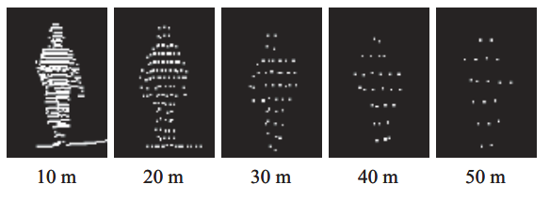
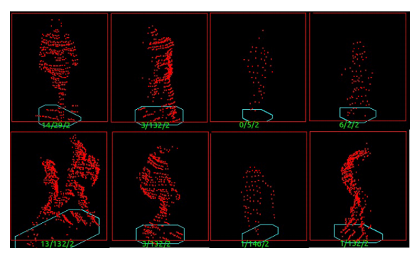
Application in Autonomous driving
Figure 9: Pedestrian at different distance[3]
Figure 10: Pedestrian cluster [4]
Train the model at different distance and different postures by SVM (Support Vector Machine)
Seminar Automotive Sensors
Univ.-Prof. Dr.-Ing. O. Kanoun
Chair for Measurement and Sensor Technology

Slide 17
Application in Autonomous driving
Problems:
The recognition rate is 85% according to this paper,[4] which is not as good as the result by using computer vison on cameras.
Solutions:
Calibration with the help of cameras. [5]
By calibration, the result is improved and also can be used as a redundancy system for the autonomous driving vehicles.
Seminar Automotive Sensors
Univ.-Prof. Dr.-Ing. O. Kanoun
Chair for Measurement and Sensor Technology

Slide 18
Outline
Motivation
State of the Art
Working Principle of LiDAR
Application in Autonomous driving
Limitation of LiDAR
Conclusion
Seminar Automotive Sensors
Univ.-Prof. Dr.-Ing. O. Kanoun
Chair for Measurement and Sensor Technology

Slide 19
Limitation of LiDAR
1, Affected by environment
Can be blocked by flog, snow, and dust
light maybe reflect from the rain rather than the object
2, can not detect transparent object
Light will go though the window, and detect the wrong target
3, Extremely high cost
7500$ for 1 64-line LiDAR
Seminar Automotive Sensors
Univ.-Prof. Dr.-Ing. O. Kanoun
Chair for Measurement and Sensor Technology

Slide 20
Outline
Motivation
State of the Art
Working Principle of LiDAR
Application in Autonomous driving
Limitation of LiDAR
Conclusion
Seminar Automotive Sensors
Univ.-Prof. Dr.-Ing. O. Kanoun
Chair for Measurement and Sensor Technology

Slide 21
Conclusion
Advantage:
Higher resolution
Farther detecting distance
Disadvantage:
Sensible to environment
Too expensive
Can cooperate well with other sensors, like cameras to ensure the redundancy and reliability
Seminar Automotive Sensors
Univ.-Prof. Dr.-Ing. O. Kanoun
Chair for Measurement and Sensor Technology

Slide 22
Reference
Chris Urmson: How a driverless car sees the road
J. K. Kim, J. W. Kim, J. H. Kim, T. H. Jung, Y. J. Park, Y. H. Ko, and S. Jung, "Study on Extracting Curb Using a LiDAR Sensor", JCROS DaeJeon-Chungchung Regional Conference, pp.161-162,2014.
Clément Mallet ∗ , Frédéric Bretar, Full-waveform topographic lidar: State-of-the-art , ISPRS Journal of Photogrammetry and Remote Sensing 64 (2009) 1–16
Heng Wang, Bin Wang, Pedestrian recognition and tracking using 3D LiDAR for autonomous vehicle, Robotics and Autonomous Systems 88(2017) 71-78
K. Kidono, T. Miyasaka, A.W.T. Naito, J. Miura, Pedestrian recognition using high-definition lidar, in: IEEE Intelligent Vehicles Symposium (IV), 2011.
Lipu Zhou, Zhidong Deng, Extrinsic Calibration of a Camera and a Lidar Based on Decoupling the Rotation from the Translation, 2012 Intelligent Vehicles Symposium Alcalá de Henares, Spain, June 3-7, 2012
Seminar Automotive Sensors
Univ.-Prof. Dr.-Ing. O. Kanoun
Chair for Measurement and Sensor Technology

Slide 23
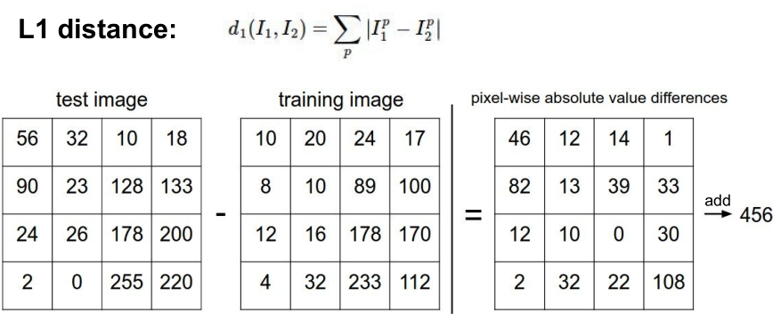
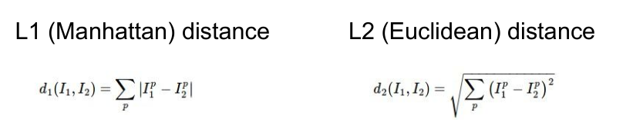

Slide 24
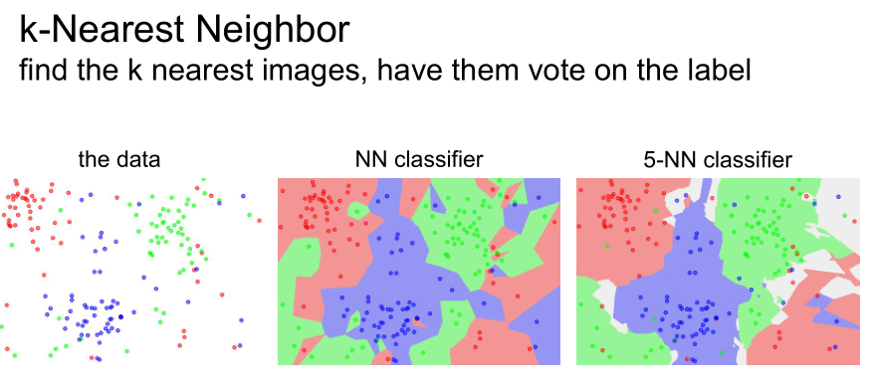

Slide 25
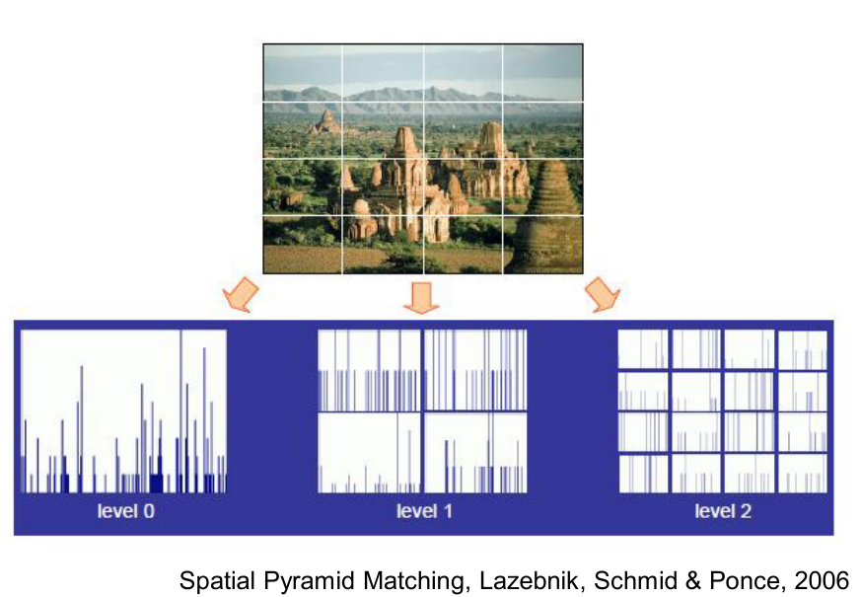

Slide 26
