Slide 1

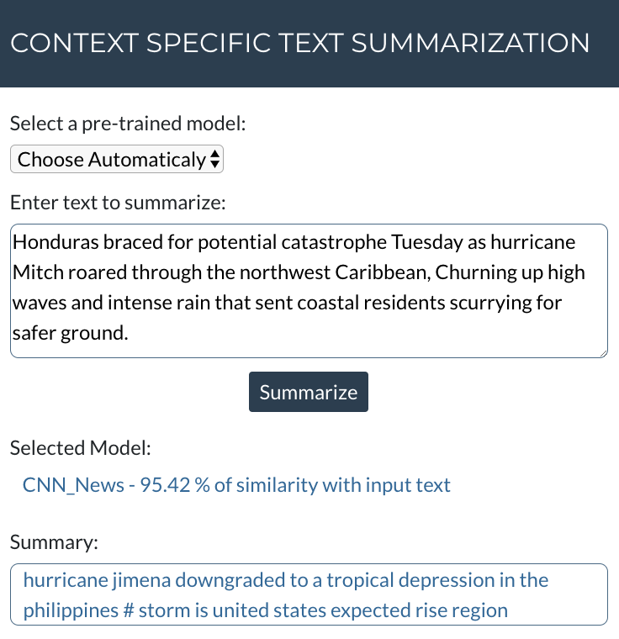
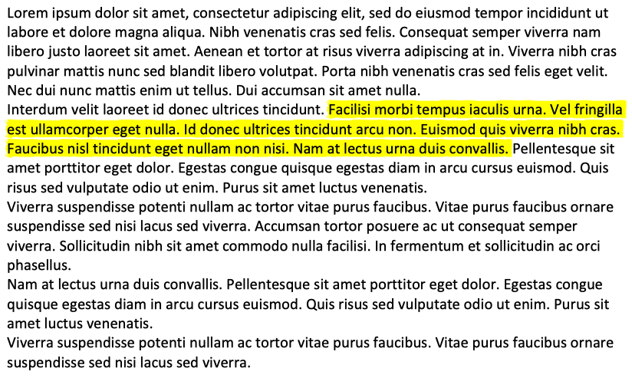
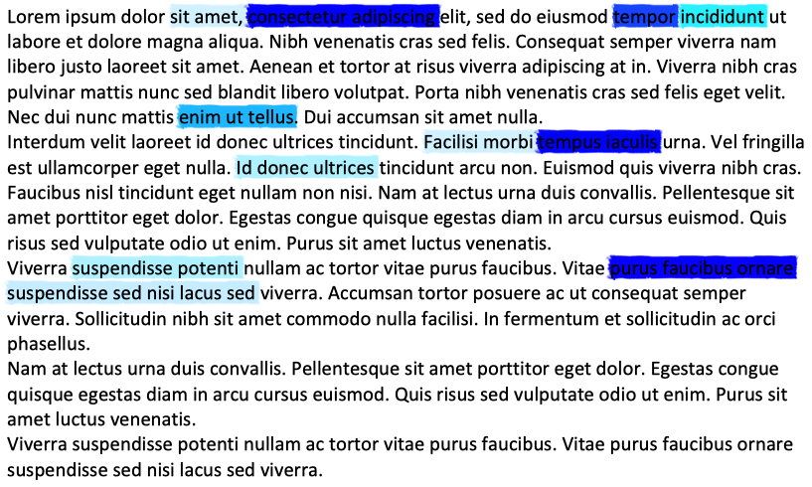

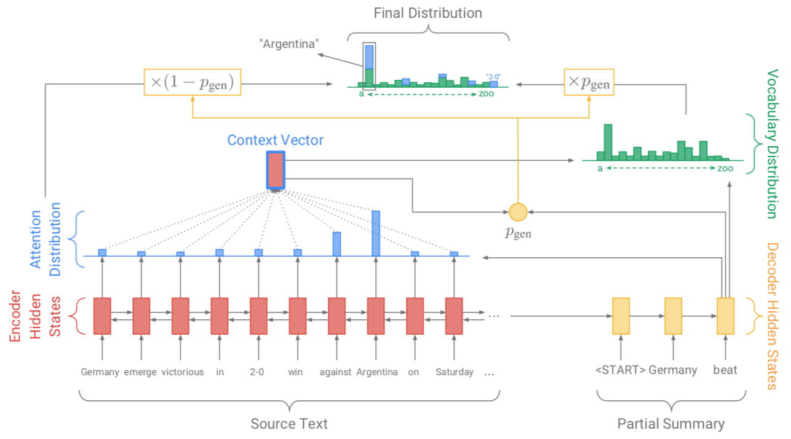



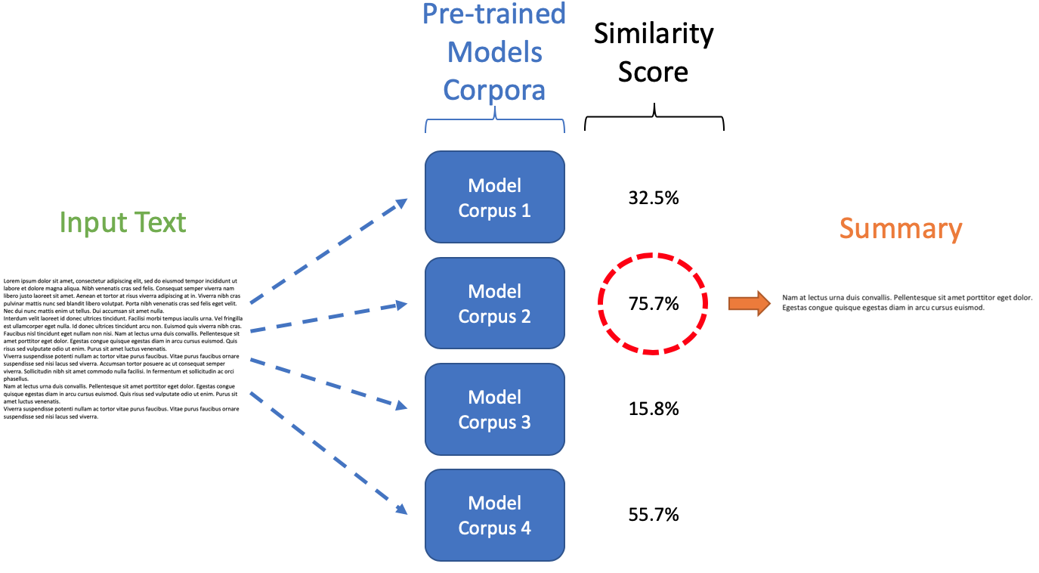

Context Specific Text Summarization Using seq2seq Model
Simon Fraser University, 8888 University Dr., Burnaby, BC, Canada
Chithra Bhat, Gustavo Felhberg, Heikal Badrulhisham; {cbhat, gustavo_felhberg, heikal_badrulhisham}@sfu.ca
Overview
• Text summarization models may be specific to their training data. • Different text domains may require different models [1]. • Proposal: a system that combines multiple context-specific models. The model used varies according to input text. • There are different genres of summaries (e.g.: abstracts, synopses, TL;DRs)
Web App demonstration
Text Summarization
Extraction-Based | Abstraction-based
Model Architecture
Word Embedding: GloVe Encoder and Decoder using LSTM Attention Mechanism: BahdanauAttention with weight normalization [2]
Results
Article | Model | Summary | ROUGE-1 | ROUGE-2 | ROUGE-L
Honduras braced for potential catastrophe Tuesday as hurricane Mitch roared through the northwest Caribbean, Churning up high waves and intense rain that sent coastal residents scurrying for safer ground. Summary: Honduras, Belize, Mexico brace for category 5 Hurricane Mitch | Gigaword | Honduras braces for potential catastrophe | Prec: 0,11 Recall: 0,20 F1: 0,14 | Prec: 0 Recall: 0 F1: 0 | Prec: 0,12 Recall: 0,11 F1: 0,20
 | CNN News | Hurricane Jimena downgraded to a tropical depression in the Philippines # storm is United States expected rise region | Prec: 0,11 Recall: 0,05 F1: 0,07 | Prec: 0 Recall: 0 F1: 0 | Prec: 0,11 Recall: 0,05 F1: 0,06
 | Daily Mail News | Als travel to washington dulles # pm kick off | Prec: 0 Recall: 0 F1: 0 | Prec: 0 Recall: 0 F1: 0 | Prec: 0 Recall: 0 F1: 0
Zlatan Ibrahimovic scored his third goal in as many games to continue his return to form and lift Barcelona to the top of Spains La Liga on Saturday night. The Sweden striker was criticized after his scoring streak dried up in the first two months of this year. Summary: Barcelona move three points clear of Real Madrid with victory at Mallorca. Sweden striker Zlatan Ibrahimovic nets winner for his third goal in a week. | Gigaword | Barca striker <unk> 's third goal | Prec: 0,12 Recall: 0,50 F1: 0,19 | Prec: 0,04 Recall: 0,20 F1: 0,07 | Prec: 0,12 Recall: 0,50 F1: 0,13
 | CNN News | Real Madrid coach Jose Mourinho scores twice as Barcelona beat # Arsenal at the Nou Camp and Gonzalo Higuain are top of table | Prec: 0,20 Recall: 0,22 F1: 0,21 | Prec: 0,04 Recall: 0,05 F1: 0,04 | Prec: 0,12 Recall: 0,13 F1: 0,12
 | Daily Mail News | Atan Ibrahimovic scored twice as PSG beat Getafe at the world cup # Zlatan winner for first time since | Prec: 0,20 Recall: 0,26 F1: 0,23 | Prec: 0,04 Recall: 0,06 F1: 0,05 | Prec: 0,16 Recall: 0,21 F1: 0,17
Encoder-Decoder model for text summarization [3]
Context-based Model Selection
• Model selection based on the input’s text similarity to the model’s training data.
Future Work
Build models with specific formats of summary (paper titles, news headlines, legal contracts summary, etc.) Deploy models as a REST API to improve performance of predictions Compare predictions of multiple models and select summary with highest quality
References
[1] Ferreira, Rafael, Fred Freitas, Luciano Cabral, Rafael Lins, Rinaldo Lima, Gabriel Franca, Steven Simske and Luciano Favaro. 2014. A Context Based Text Summarization System. Proceedings - 11th IAPR International Workshop on Document Analysis Systems, [2] Dongjun Lee. Tensorflow seq2seq Implementation of Text Summarization. https://github.com/dongjun-Lee/text-summarization-tensorflow [3] Abigail See, Peter J. Liu, Christopher D. Manning. 2017. Get To The Point: Summarization with Pointer-Generator Networks. Proceedings of the 55th Annual Meeting of the Association for Computational Linguistics. P17-1099

