Slide 1
5 - It’s moving!
R workshop
- Advanced Graphics -

Slide 2
Outline
Maps
ggmap package
the animation package

Slide 3
US Flights Data
Part of ASA Data Expo`09
http://stat-computing.org/dataexpo/2009/
Details on US Flights from 1987 - 2008
Carrier information from BTS / RITA
RITA - Research and Innovative Technology Administration
BTS - Bureau of Transportation Statistics

Slide 4
US Flights
approx. 15.000 flights a day
120 Mio Flights April 1987 - Dec 2008
(only carriers with $20 Mio annual revenue)
Storage size: 18GB
SQL database (accessed in R via RMySQL)
we will only look at different excerpts

Slide 5
US Flights
Primary Question: on-time performance
more details:
http://stat-computing.org/dataexpo/2009/

Slide 6
US Flights - Variables
 | Name | Description
1 | Year | 1987-2008
2 | Month | Jan 12, 2009
3 | DayofMonth | Jan 31, 2009
4 | DayOfWeek | 1 (Monday) - 7 (Sunday)
5 | DepTime | actual departure time (local, hhmm)
6 | CRSDepTime | scheduled departure time (local, hhmm)
7 | ArrTime | actual arrival time (local, hhmm)
8 | CRSArrTime | scheduled arrival time (local, hhmm)
9 | UniqueCarrier | unique carrier code
10 | FlightNum | flight number
11 | TailNum | plane tail number
12 | ActualElapsedTime | in minutes
13 | CRSElapsedTime | in minutes
14 | AirTime | in minutes

Slide 7
US Flights - Variables
 | Name | Description
15 | ArrDelay | arrival delay, in minutes
16 | DepDelay | departure delay, in minutes
17 | Origin | origin IATA airport code
18 | Dest | destination IATA airport code
19 | Distance | in miles
20 | TaxiIn | taxi in time, in minutes
21 | TaxiOut | taxi out time in minutes
22 | Cancelled | was the flight cancelled?
23 | CancellationCode | reason for cancellation (A = carrier, B = weather, C = NAS, D = security)
24 | Diverted | 1 = yes, 0 = no
25 | CarrierDelay | in minutes
26 | WeatherDelay | in minutes
27 | NASDelay | in minutes
28 | SecurityDelay | in minutes
29 | LateAircraftDelay | in minutes

Slide 8
U.S. Flights
Five Sample Records
Year Month DayofMonth DayOfWeek DepTime CRSDepTime ArrTime CRSArrTime UniqueCarrier FlightNum TailNum
41217 2006 1 20 5 1215 1215 1421 1415 WN 2875 N671SW
34575 2006 1 19 4 557 600 924 933 AA 1711 N5DCAA
7693 2006 1 18 3 1913 1915 2014 2019 XE 2174 N13969
22758 2006 1 19 4 NA 1830 2345 10 WN 828 N768
31566 2006 1 19 4 1244 1250 1523 1539 MQ 4067 N802AE
ActualElapsedTime CRSElapsedTime AirTime ArrDelay DepDelay Origin Dest Distance TaxiIn TaxiOut
41217 186 180 164 6 0 MCI PHX 1044 4 18
34575 147 153 130 -9 -3 DFW MIA 1121 7 10
7693 121 124 99 -5 -2 IAH ELP 667 3 19
22758 200 220 185 -25 -5 SAN MDW 1728 5 10
31566 159 169 149 -16 -6 MIA DAY 999 3 7
Cancelled CancellationCode Diverted CarrierDelay WeatherDelay NASDelay SecurityDelay LateAircraftDelay
41217 0 0 0 0 0 0 0
34575 0 0 0 0 0 0 0
7693 0 0 0 0 0 0 0
22758 0 0 0 0 0 0 0
31566 0 0 0 0 0 0 0

Slide 9
“Normal” Days
Flights January 19-20, 2008
each dot = 1 plane,
size corresponds to amount of delays
data used:
Departure & Origin Airports
Departure & Arrival times
movie built from sequence of 2 min snapshots

Slide 10
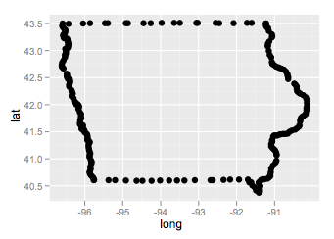
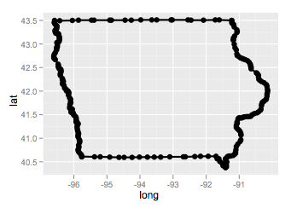
What is a map?
Set of points specifying latitude and longitude
Polygon: connect dots in correct order

Slide 11
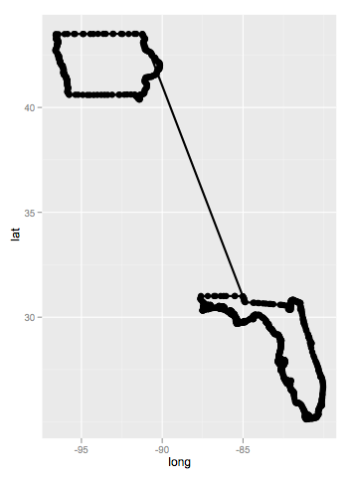
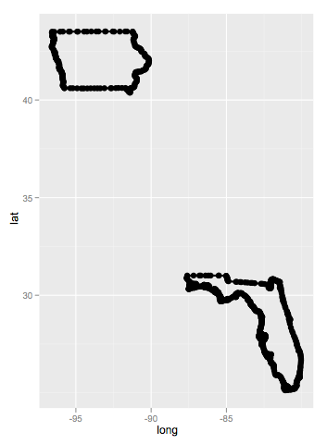
What is a map?
Polygon: connect only the correct dots
This is called grouping

Slide 12
Map of the U.S.
Load datafile with geographic data for the U.S.
> summary(states)
x y id
Min. :-124.68 Min. :25.13 Min. : 1.00
1st Qu.: -96.22 1st Qu.:33.91 1st Qu.:15.00
Median : -87.61 Median :38.18 Median :26.00
Mean : -89.67 Mean :38.18 Mean :30.16
3rd Qu.: -79.13 3rd Qu.:42.80 3rd Qu.:47.00
Max. : -67.01 Max. :49.38 Max. :63.00
NA's : 62.00 NA's :62.00
state abbr
texas : 1089 tx : 1089
florida : 873 fl : 873
michigan : 832 mi : 832
north carolina: 785 nc : 785
virginia : 737 va : 737
louisiana : 651 la : 651
(Other) :10632 (Other):10632
x and y are geographic latitude and longitude (GPS coordinates)

Slide 13
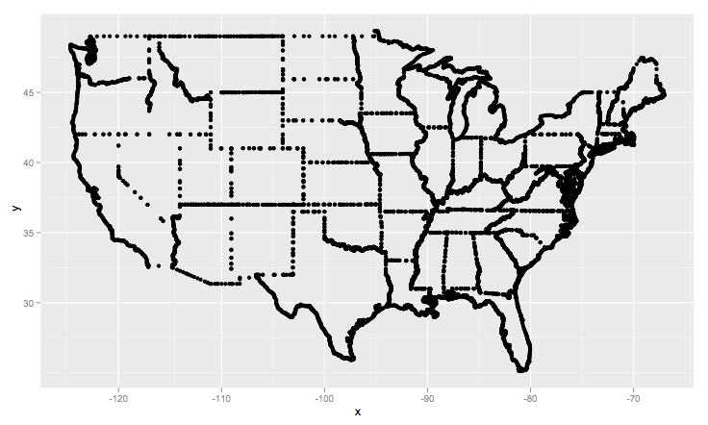
Map of the U.S.
Plot x vs y
qplot(x,y, data=states)

Slide 14
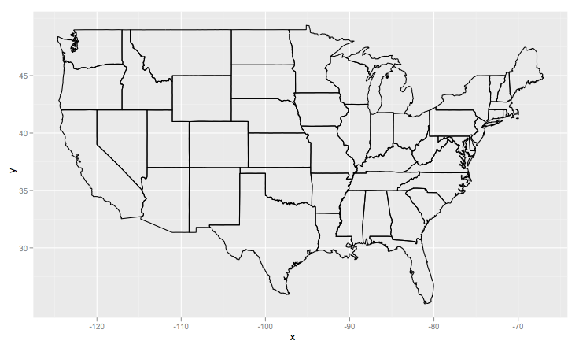
Map of the U.S.
Paths
qplot(x,y, data=states, geom="path")
Connect dots by line (in the correct order)
Paths are line objects

Slide 15
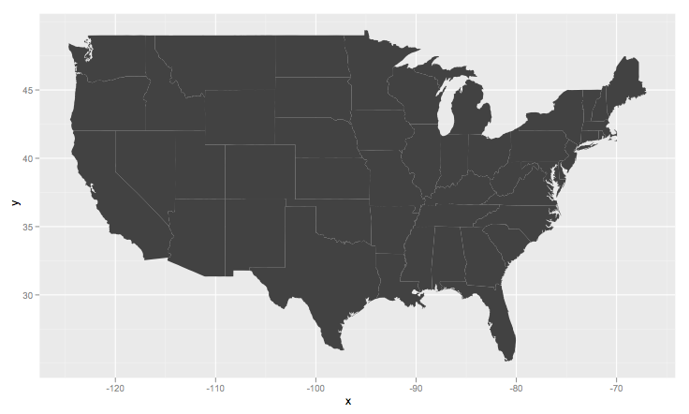
Map of the U.S.
Polygon
qplot(x,y, data=states, geom="polygon")
Connect dots and fill area
Polygons are 2-dimensional shapes

Slide 16
Your Turn
Plot a map of the United States using geom_polygon() and explicitly save this layer
Download file airports.csv and plot airport locations on top of the US map … you might need to filter some locations (use subset)

Slide 17
Making Maps look like Maps
theme_nothing <- opts(axis.title.x=theme_blank(), # remove x and y label
axis.title.y=theme_blank(),
axis.line=theme_blank(), # no axis at the bottom and the left
axis.ticks=theme_blank(), # don’t show ticks
axis.text.y = theme_blank(), # no tick marks
axis.text.x = theme_blank(),
panel.grid.minor=theme_blank(), # don’t show any gridlines
panel.grid.major=theme_blank(),
panel.background=theme_blank(), # invisible background
panel.border = theme_blank(), # no border around plot space
panel.margin = unit(0, "lines")
)
read up on this on the ggplot2 website

Slide 18
Next step
Map with the airport locations is our structural framework … now we want to add some data:
  write a function to extract flights that are in the air
  write a function that finds location (by interpolation)
  visualize!

Slide 19
Your Turn
Load a day worth of flights, e.g.
flights <- read.csv("http://www.public.iastate.edu/~hofmann/looking-at-data/data/mar13.csv")
Write a function that gives you Departure time, arrival time, origin, and destination for all the flights in the air between a specified timepoint tp and tp + x minutes.
Use the following function definition:
inFlight(dataset, tp, x)
Check your function by calling
inFlight(flights, 800, 2)
Advanced: get the location of a plane at timepoint tp by interpolating its starting and landing coordinates.

Slide 20
Printing & Saving Graphics
ggsave() allows to print a graphic to a file
formats: pdf, png, jpeg, tiff, ....

Slide 21
Your Turn
Plot a map of the U.S.
Add airport locations as points
Add flights for a particular time point 1
Save the file as “tp-01.pdf”
Repeat the above steps for several time points (continuous time points will have the best effect).
Open the files in a pdf viewer ...
More details, explanations & code:
https://github.com/hadley/ggplot2/wiki/Flying-over-the-usa
airport-extra.R and airport-movie.R

Slide 22
Satellite Images

Slide 23
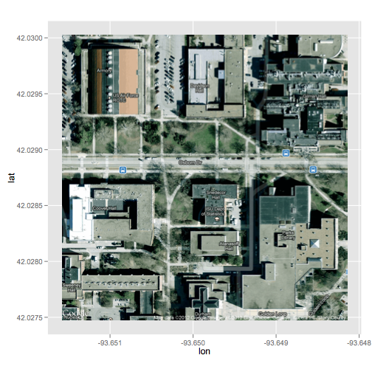
Satellite Images
What is a map?
Satellite images are bitmap images, i.e. for each (pixel) location we have a specific colour:
> str(ames_map)
chr [1:1280, 1:1280] "#D6DCBA" "#D8DDBD" "#D9E1BE" ...
- attr(*, "class")= chr [1:2] "ggmap" "raster"
- attr(*, "bb")='data.frame': 1 obs. of 4 variables:
..$ ll.lat: num 36.6
..$ ll.lon: num -101
..$ ur.lat: num 47
..$ ur.lon: num -86.6
> ames_map[1:5,1:5]
[,1] [,2] [,3] [,4] [,5]
[1,] "#D6DCBA" "#DCE2C0" "#D6DCBA" "#D8DDBD" "#D9E1BE"
[2,] "#D8DDBD" "#DCE2C0" "#D6DCBA" "#D6DDBC" "#D9E1BE"
[3,] "#D9E1BE" "#DCE2C0" "#D6DCBA" "#D6DDBC" "#D9E1BE"
[4,] "#DCE2C0" "#DCE2C0" "#D9E1BE" "#D9E1BE" "#DCE2C0"
[5,] "#DCE2C0" "#DCE2C0" "#DCE2C0" "#DCE2C0" "#DCE2C0"

Slide 24
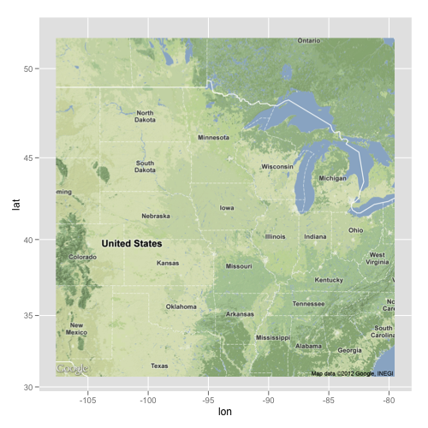
package ggmap
ggmap is based on Google maps to get satellite images, it relies on RGooglemaps:
install.packages("ggmap")
library(ggmap)
# location of Ames, IA
ames <- c(-93.62, 42.034722)
ames_map <- get_map(ames, zoom=5)
ggmap(ames_map, extent = 'normal')

Slide 25
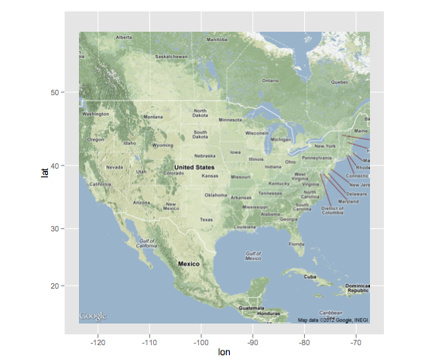
USA
Load a satellite image:
library(ggmap)
# get satellite image for the US
# if this doesn't work, load data usa.RData
map_center <- c(lon=-95.6, lat=38.2)
sat_map <- get_map(map_center, zoom=4)
usa <- ggmap(sat_map, extent = 'normal')

Slide 26
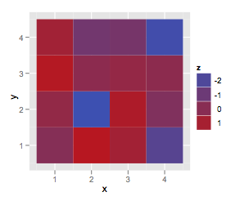
Images in ggplot2
The tile geom renders data on a grid:
x <- rep(1:4, each=4)
y <- rep(1:4, 4)
z <- rnorm(16)
qplot(x,y, fill=z, geom="tile")
small part of the map:
qplot(lon, lat, data = subset(sat_map, (lat <= 22) & (lon <= -92)),
geom = 'tile', fill = fill) +
scale_fill_identity(legend=F) +
scale_x_continuous('Longitude') +
scale_y_continuous('Latitude') +
coord_equal() + theme_nothing()

Slide 27
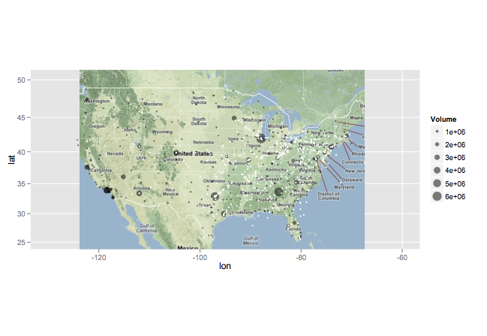
Adding to satellite images
usa + geom_point(aes(longitude, latitude, size=Volume), colour="black", alpha=0.5, data=mainland)
usa +
geom_point(aes(longitude, latitude, size=Volume), colour="black", alpha=0.5, data=mainland) +
geom_point(aes(longitude, latitude), data=flightXY(inFlight(flights, 800, 2), 800),
colour="white", size=1) +
xlim(c(-130,-60)) + ylim(c(25, 50))
ggsave(filename="tp-800.pdf")

Slide 28
The animation package
package by Yihui Xie, available from CRAN
different output options: HTML, Latex, …
saveHTML({
for (i in seq(800, 858, by=2)) {
print(usa + geom_point(aes(longitude, latitude, size=Volume),
colour="black", alpha=0.5, data=mainland) +
geom_point(aes(longitude, latitude),
data=flightXY(inFlight(flights, i, 2), i), size=1) +
xlim(c(-130,-60)) + ylim(c(25, 50)))
ani.pause()
}
}, ani.height = 600, ani.width = 1200,
img.name = "unif_plot", outdir = getwd(),
imgdir = "unif_dir", htmlfile = "random.html",
autobrowse = FALSE,
title = "Demo of 1h of flight data on Mar 13 1993",
description = c("You can describe it in more detail.",
"For example, bla bla..."))

