Slide 1
2 - Perception
What do we see?
R workshop
- Advanced Graphics -

Slide 2
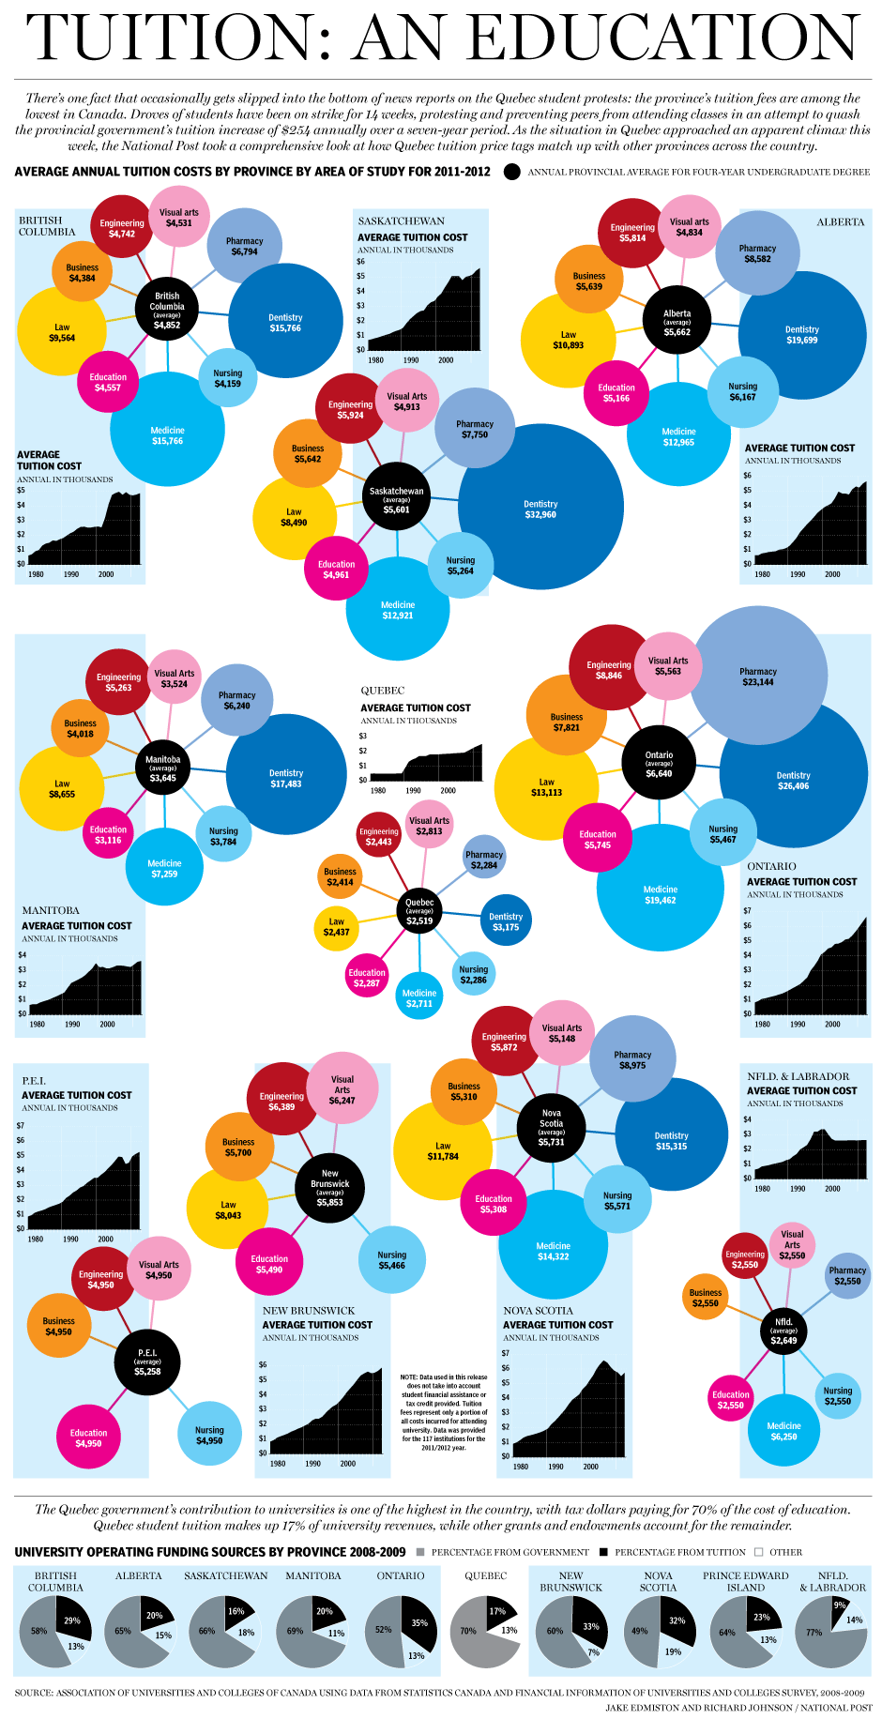
Cost of an Education

Slide 3
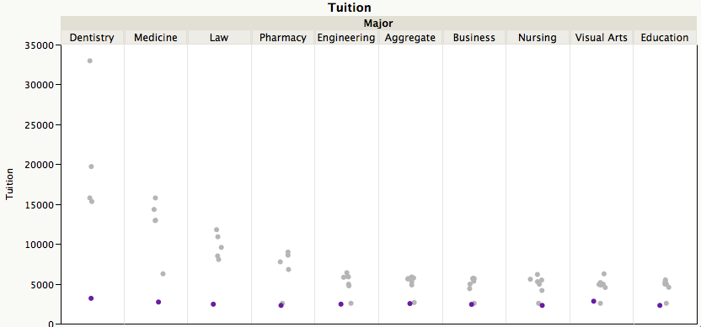
Motivation
Why are some plots harder to read?
http://junkcharts.typepad.com/junk_charts/2012/05/spring-flowers-and-striking-hours.html

Slide 4
‘Good Graphics’
Structure
Mapping of additional information on aesthetics, such as color, shape, size, ...
Graphics consist of
Both needs to be ‘right’ - in the sense that it helps - or at least not hinders - viewers in interpreting the information

Slide 5
Outline
Pre-attentive Features & Aesthetics
Visual Ordering Mechanisms
Gestalt Principles in Statistical Graphics

Slide 6
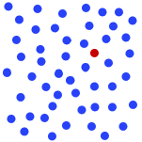
Pre-attentive Features
http://www.infovis.net/printMag.php?num=179&lang=2
Things that ‘pop-out’ at a glance
(≤ 200-250 milliseconds)
Pre-attentive Features can be grouped into
color, form, movement and spatial localization
Typical question: is target
present in a set of ‘distractors’ ?
?
Ready, set, go ...

Slide 7
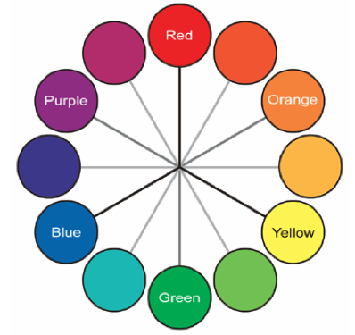

Color
Color is determined by hue and intensity
Hue is typically associated with a color wheel
Intensity is amount of color
Note: color is context sensitive

Slide 8
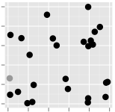
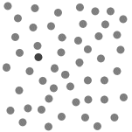
Color
Both hue and intensity are pre-attentive
Bigger contrast - i.e. larger angle on the wheel, or larger intensity difference - makes for faster detection

Slide 9
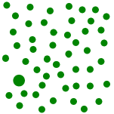
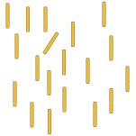
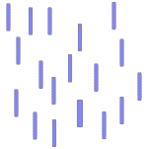
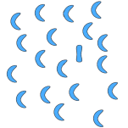
Pre-attentive features
Size
Width
Angle
Curvature

Slide 10
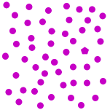
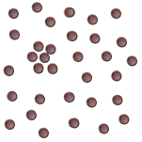
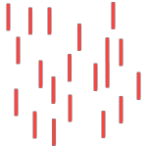
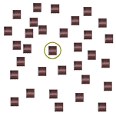
Pre-attentive features
Shape
Length
Grouping
Added Marks

Slide 11
Pre-attentive features
Motion
Flicker

Slide 12
Pre-attentive Features have a hierarchy
e.g. color > shape
Movement/Flickering are one of the strongest pre-attentive features
(used in highly sensitive situations - e.g. flight control)
Cleveland & McGill (1989):
- Length, Size, Direction, Angle
- Curvature
- Shading, Color Intensity
Strength varies with task

Slide 13
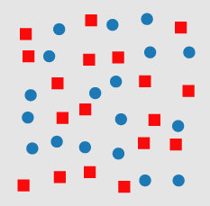
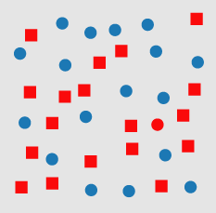
Hierarchy of features
Color gives a stronger signal than shape
where is the odd one?

Slide 14
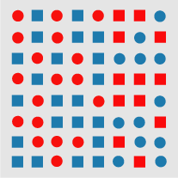
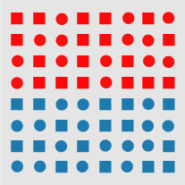
Combinations of Pre-attentive features
Interactions of pre-attentive features are usually not pre-attentive - quite the opposite!
this is called interference
where is the boundary?

Slide 15
Summary so far
Exploit pre-attentive features to map additional information (in form of aesthetics)
need to avoid interference
Some pre-attentive features also suggest visual ordering

Slide 16
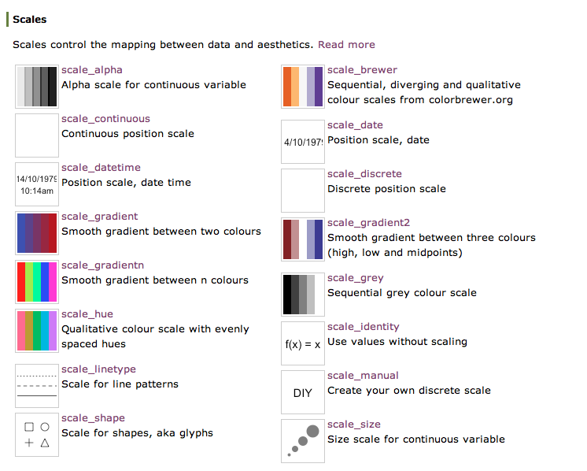
Aesthetics in ggplot2

Slide 17
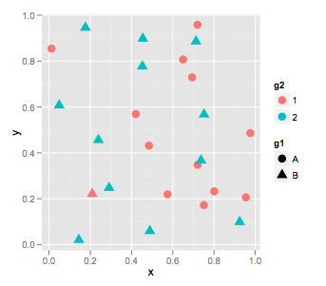
Your Turn
Find ways to improve the following graphic:
Make sure the `oddball’
stands out, while keeping
the information on the
groups
setwd(20120605)
frame <- data.frame(x=runif(25), y=runif(25),
g1=rep(c("A","B"), c(12,13)),
g2=rep(c("1", "2"), c(13,12)))
qplot(x,y, shape=g1, colour=g2, data=frame, size=I(4))

Slide 18
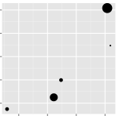
What is bigger?
Position:
origin is at the bottom left
(if not explicitly placed somewhere else)
higher is bigger (y-axis)
more to the right is bigger (x-axis)
Bigger size is bigger

Slide 19
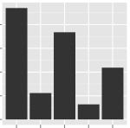
What is bigger?
Larger area is bigger

Slide 20
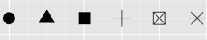
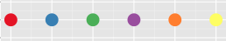
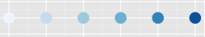
What is bigger?
Some aesthetics do not lend themselves to ordering
Shape is unordered
Color depends on the color scheme:
unordered
ordered
more contrast
from background is bigger

Slide 21


Using Colour
“...avoiding catastrophe becomes the first principle in bringing color to information: Above all, do no harm.”
Envisioning Information, Edward Tufte, Graphics Press, 1990
mapping of data to color scheme needs to match the variable type:
- qualitative schemes for nominal variables (upper cognitive limit is about 8 colors)
- quantitative schemes:
positive values only: color gradient
positive & negative values: double gradient

Slide 22
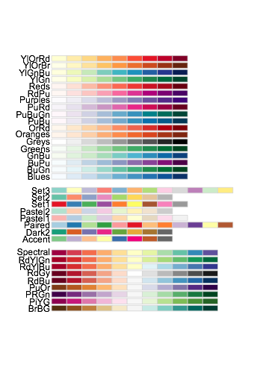
RColorBrewer
R package
based on Cynthia Brewer’s ColorBrewer
install.packages("RColorBrewer")
library(RColorBrewer)
help(package=RColorBrewer)
display.brewer.all()

Slide 23
Colour in ggplot2
factor variable:
scale_colour_discrete
scale_colour_brewer(palette = ...)
continuous variable:
scale_colour_gradient
scale_colour_gradient2
equivalent for parameter fill

Slide 24
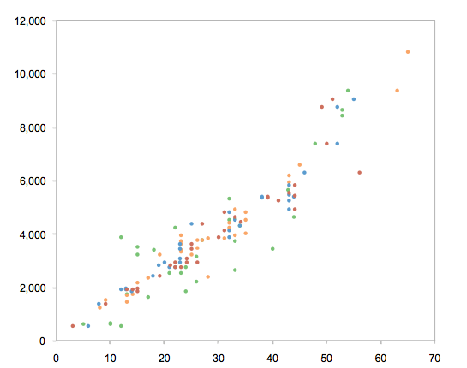
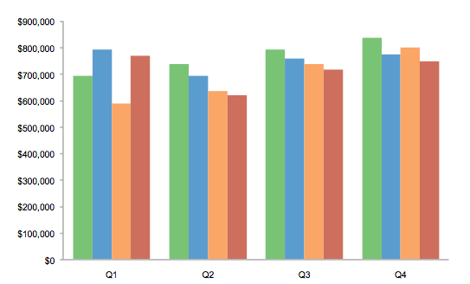
Small vs Large
Small objects or thin lines need more contrast than larger areas

Slide 25
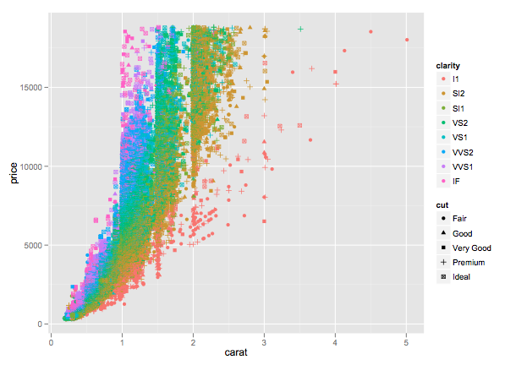
Your Turn
In the diamonds data, clarity and cut are ordinal variables, while price and carat are both numeric (continuous) variables.
Find a graphic that gives an overview of these four variables while respecting their types.
You could start with the following chart:
data(diamonds)
qplot(carat, price, shape=cut, colour=clarity, data=diamonds)

Slide 26
Gestalt Principles
Similarity
what an items looks like and how that effects gestalt
Proximity
where items are in relationship to each other and how that effects gestalt

Slide 27
Proximity
How many items do you see - try to describe in words
Maybe:
16 dots in a square

Slide 28
Proximity
How many items do you see now?
Now:
4 blocks of 4 dots in squares

Slide 29
Similarity
How many items do you see?
Color groups items
Now:
two groups of points
forming a square

Slide 30
Similarity
How many items do you see?
Now:
two groups of different size

Slide 31
Similarity
How many items do you see?
Both size and shape group, but it’s conflicting information
Now:
???

Slide 32
Which circle is the largest?
Comparisons of near-by objects are easier

Slide 33
Facetting
facetting is a way to extract subsets of data and place them side-by-side in graphics
(lattice graphics, trellis displays)
Facetting has the form:
facets = row ~ col
use . if there is no variable for either row or column
qplot(price, carat, data=diamonds, facets = . ~ color)
qplot(price, carat, data=diamonds, facets = color ~ clarity)

Slide 34
Your Turn
File errors.csv contains data for comparing errors from four different estimators in a total of six different situations: two different sample sizes and three different distributions
You are asked to give a visual comparison of the estimators in different simulation situations - of primary interest are the different estimators, the impact of different distributions is secondary.
hint: use facetting!

