Slide 1
Layers of Graphics
R workshop: looking at data
June 5 2012

Slide 2
Outline
Data Sources
Layers
ggplot versus qplot

Slide 3
BP Oil Spill

Slide 4
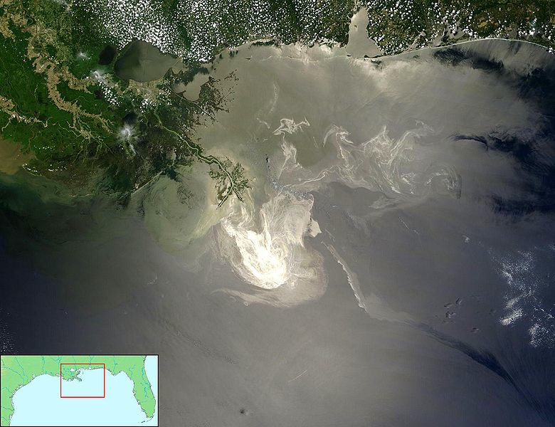
Deepwater Horizon Oil Spill

Slide 5
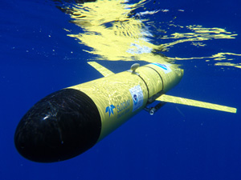
Datasets
NOAA
(National Oceanic and Atmospheric Administration)
glider records, boats, floats
data from fisheries
EPA
(Environmental Protection Agency)
petrochemical measurements along the coast
US Fish and Wildlife
animal sightings: birds, turtles, mammals

Slide 6
Loading Data
NOAA
Working Directory
> load("noaa.rdata")
> ls()
[1] "boats" "floats" "gliders" "rig"
> getwd()
[1] "~/R workshop/data/"
> setwd("..") # path
# or use CMD-d (on a Mac)

Slide 7
Gliders
> summary(gliders)
callSign Date_Time JulianDay Time_QC Latitude
48901 :134830 2010-05-29: 18107 Min. :2455345 Min. :1 Min. :24.74
48905 : 46747 2010-05-28: 17237 1st Qu.:2455351 1st Qu.:1 1st Qu.:26.48
48904 : 38391 2010-05-30: 15362 Median :2455371 Median :1 Median :27.55
48900 : 36061 2010-05-31: 13126 Mean :2455374 Mean :1 Mean :27.18
48903 : 35436 2010-06-01: 12063 3rd Qu.:2455395 3rd Qu.:1 3rd Qu.:28.04
48902 : 26861 2010-06-03: 11866 Max. :2455418 Max. :1 Max. :28.80
(Other): 51058 (Other) :281623
Longitude Position_QC Depth Depth_QC Temperature Temperature_QC
Min. :-90.64 Min. :1 Min. : 0.00 Min. :1 Min. : 4.41 Min. :1.000
1st Qu.:-84.63 1st Qu.:1 1st Qu.: 7.00 1st Qu.:1 1st Qu.:19.60 1st Qu.:1.000
Median :-84.03 Median :1 Median : 20.00 Median :1 Median :25.67 Median :1.000
Mean :-84.41 Mean :1 Mean : 71.36 Mean :1 Mean :23.99 Mean :1.000
3rd Qu.:-83.36 3rd Qu.:1 3rd Qu.: 59.00 3rd Qu.:1 3rd Qu.:29.24 3rd Qu.:1.000
Max. :-81.95 Max. :1 Max. :997.00 Max. :1 Max. :32.64 Max. :3.000
Salinity Salinity_QC
Min. :-99.00 Min. : 1.000
1st Qu.: 35.48 1st Qu.: 1.000
Median : 36.00 Median : 1.000
Mean : 35.68 Mean : 1.013
3rd Qu.: 36.34 3rd Qu.: 1.000
Max. : 38.44 Max. : 9.000
NA's :369.00 NA's :369.000
Temperature & Salinity at different depths

Slide 8
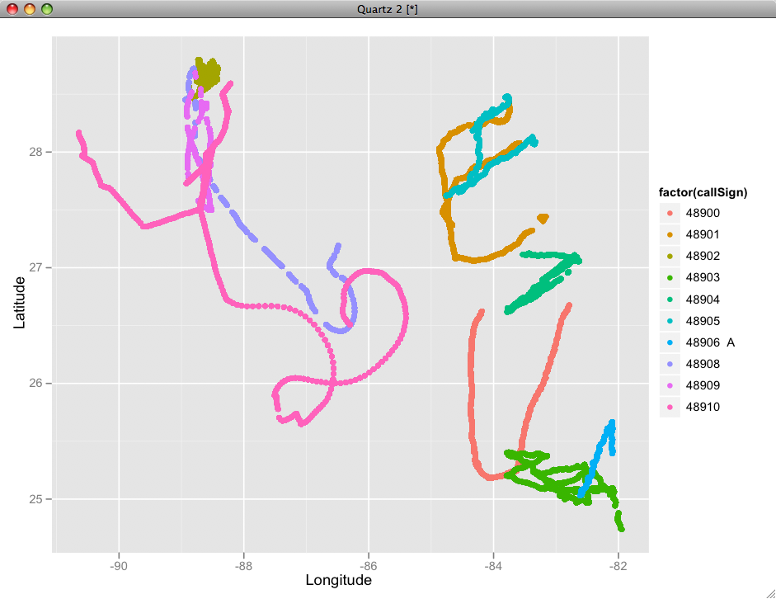
rig <- data.frame(x= -88.365997, y = 28.736628)

Slide 9
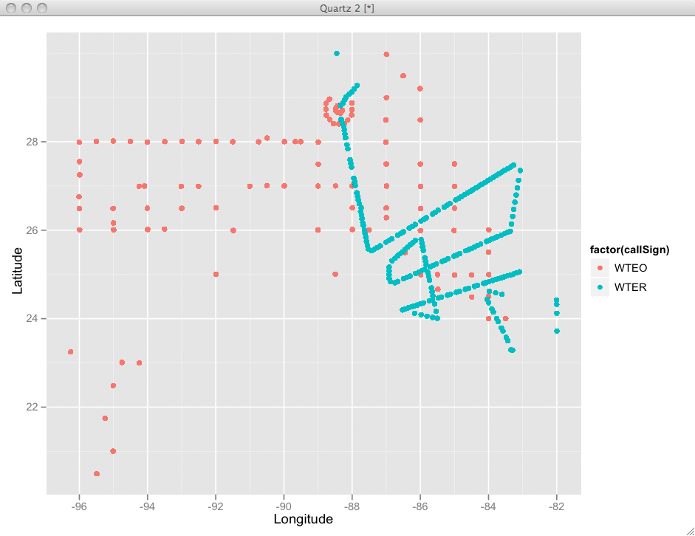
Boats

Slide 10
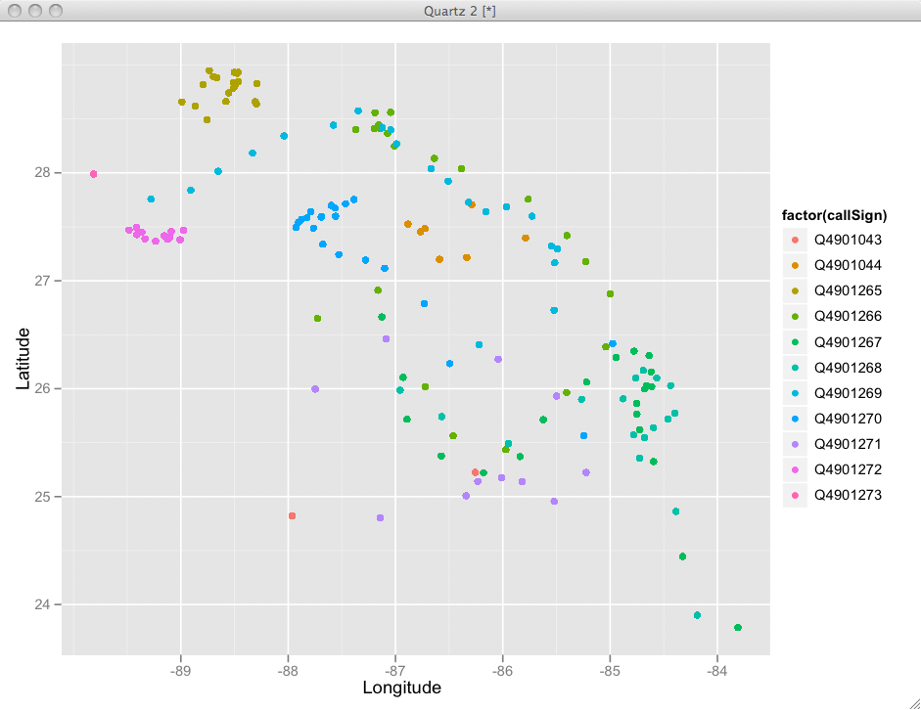
Floats

Slide 11
Petrochemicals
> summary(epa)
DATE MATRIX SAMPLE.NAME LOCATION
2010-06-07: 1329 Surface Water:29919 D001-TAR-20100715 : 183 V02 : 1243
2010-06-06: 1302 Air :12646 D001-WO-20100718 : 179 WAMS : 1228
2010-05-30: 1275 Sediment : 7342 D001-WO-20100612 : 173 C04 : 1197
2010-06-08: 1176 Weathered Oil: 5620 D007-W-20100608 : 170 V03 : 747
2010-05-31: 1115 Solid Waste : 1413 D001-WO-20100619 : 156 GPMS : 733
2010-06-29: 1111 Liquid Waste : 1003 T003-0001-100515-OD-1: 153 PCFL : 724
(Other) :51594 (Other) : 959 (Other) :57888 (Other):53030
STATE.NAME CAS.NUMBER SUBSTANCE RESULT
: 2599 71-43-2 : 2933 Benzene : 2933 Min. :-3.060e-03
Alabama : 4727 108-88-3: 2879 Toluene : 2879 1st Qu.: 1.160e-01
Florida : 4105 100-41-4: 2876 Ethylbenzene : 2876 Median : 7.010e-01
Louisiana :42343 91-20-3 : 2027 Naphthalene : 2027 Mean : 5.537e+03
Mississippi: 5029 207-08-9: 2011 Benzo[k]fluoranthene: 2011 3rd Qu.: 1.222e+01
Texas : 99 205-99-2: 2009 Benzo(b)fluoranthene: 2009 Max. : 2.010e+06
(Other) :44167 (Other) :44167 NA's : 4.918e+04
UNIT REPORTING.LIMIT REPORTING.LIMIT.UNIT DETECTED
ug/l :22217 Min. : 0.00 ug/l :21324 : 342
ug/m3 :10592 1st Qu.: 0.05 ug/m3 : 8785 N :48861
ug/kg : 6221 Median : 0.20 ug/kg : 6203 Y : 9672
mg/l : 5250 Mean : 2034.45 mg/l : 5250 Yes: 27
ug/L : 4688 3rd Qu.: 2.00 ug/L : 4683
ug/Kg : 4481 Max. :970000.00 ug/Kg : 4481
(Other): 5453 (Other): 8176
ACUTE.AQUATIC.LIFE.BENCHMARK ACUTE.AQUATIC.LIFE.BENCHMARK.UNITS
Min. : 51.60 :56280
1st Qu.: 74.00 mg/kg: 227
Median : 74.00 ug/L : 2395
Mean : 83.95
3rd Qu.: 100.00
Max. : 100.00
NA's :56280.00
ACUTE.AQUATIC.LIFE.BENCHMARK.EXCEEDS CHRONIC.AQUATIC.LIFE.BENCHMARK
:56280 Min. : 8.20
No : 2612 1st Qu.: 8.20
Yes: 10 Median : 50.00
Mean : 30.67
3rd Qu.: 50.00
Max. : 57.00
NA's :56055.00
CHRONIC.AQUATIC.LIFE.BENCHMARK.UNITS CHRONIC.AQUATIC.LIFE.BENCHMARK.EXCEEDS LATITUDE
:56055 :56055 Min. :28.74
mg/kg: 452 No : 2770 1st Qu.:29.18
ug/L : 2395 Yes: 77 Median :29.30
Mean :29.54
3rd Qu.:29.96
Max. :30.61
LONGITUDE week.number
Min. :-93.85 Min. :18.00
1st Qu.:-90.13 1st Qu.:23.00
Median :-89.40 Median :25.00
Mean :-89.51 Mean :25.83
3rd Qu.:-89.04 3rd Qu.:29.00
Max. :-84.25 Max. :34.00

Slide 12
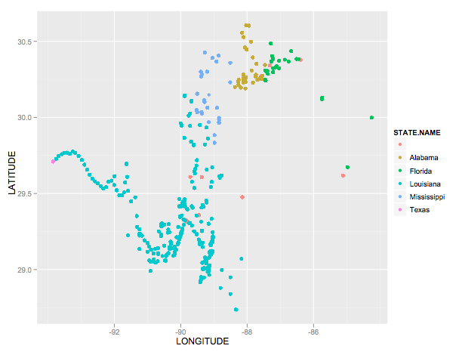
Measurements mostly along coastline

Slide 13
US Fish and Wildlife
> summary(birds)
Species Latitude Longitude Oiling Condition
Laughing Gull :3036 Min. :24.63 Min. :-95.91 Not Visibly Oiled:3744 Dead:5552
Brown Pelican : 789 1st Qu.:29.34 1st Qu.:-89.66 Unknown : 802 Live:1677
Northern Gannet: 546 Median :29.93 Median :-89.22 Visibly Oiled :2683
Unknown : 526 Mean :29.82 Mean :-88.97
Royal Tern : 321 3rd Qu.:30.29 3rd Qu.:-88.21
Black Skimmer : 258 Max. :30.98 Max. :-82.03
(Other) :1753
BirdCount Date_ Oil_Cond Date week.number
Min. :1 2010-07-19: 185 Min. :1.00 2010-07-19: 185 Min. :19.00
1st Qu.:1 2010-08-21: 183 1st Qu.:3.00 2010-08-21: 183 1st Qu.:28.00
Median :1 2010-08-22: 146 Median :3.00 2010-08-22: 146 Median :32.00
Mean :1 2010-07-30: 141 Mean :3.13 2010-07-30: 141 Mean :31.18
3rd Qu.:1 2010-08-16: 140 3rd Qu.:4.00 2010-08-16: 140 3rd Qu.:34.00
Max. :1 2010-07-18: 135 Max. :6.00 2010-07-18: 135 Max. :42.00
(Other) :6299 (Other) :6299

Slide 14
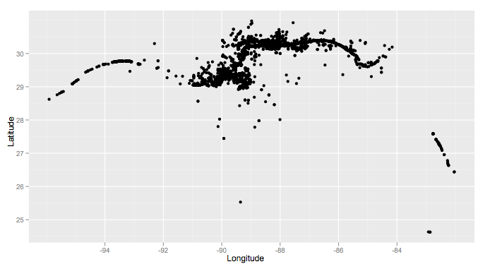
Coastline Records

Slide 15
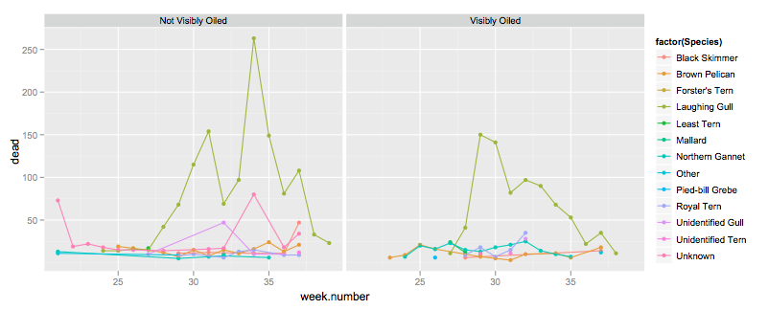
Dead Birds

Slide 16
Merging Data - visually
Data have the same context -
they share timeline and location
in ggplot2 we use layers to superimpose data from different sources or aggregation levels

Slide 17
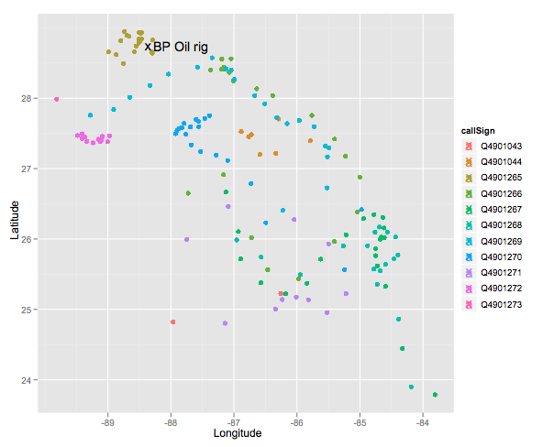
.. to give you an idea ..
qplot(Longitude, Latitude, colour=callSign, data=floats) +
geom_point(aes(x, y), shape="x", size=5, data=rig, inherit.aes=FALSE) +
geom_text(aes(x, y), label="BP Oil rig", shape="x", size=5, data=rig,
hjust = -0.1, inherit.aes=FALSE)

Slide 18
Layers
Most maps (and many plots) have multiple layers of data. The layers may be from the same or different datasets.
ggplot2 build around this same idea. Very easy to add additional layers to the plot. To do this we need to understand a little more about the underlying theory.

Slide 19
What is a plot?
Any plot is composed of:
    a default dataset and set of aesthetic mappings
    multiple layers
    a scale for each aesthetic
    a facetting specification
    a coordinate system

Slide 20
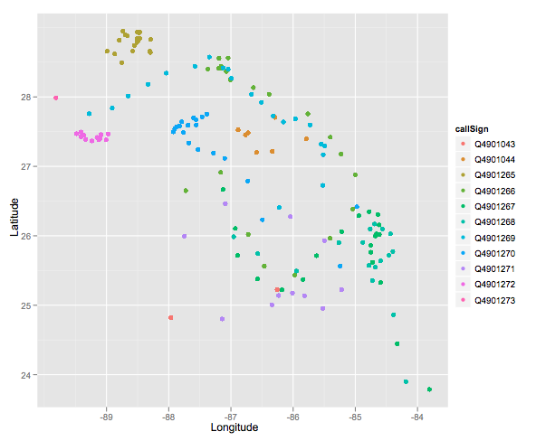
Data: floats. Mapping: x = Longitude, y = Latitude, colour = callSign. Layers: points. Scales: x & y position, discrete colour. Faceting: none

Slide 21
qplot and ggplot
qplot(Longitude, Latitude, colour=callSign, data=floats)
ggplot(data=floats, aes(x=Longitude, y=Latitude, colour=callSign)) +
geom_point() +
scale_x_continuous() +
scale_y_continuous() +
scale_colour_discrete()
qplot(Longitude, Latitude, colour=callSign, data=floats)
# But we don't need to be quite so verbose. Scales are
# added automatically and first two aes params are x and y:
ggplot(floats, aes(Longitude, Latitude, colour = callSign)) +
geom_point()

Slide 22
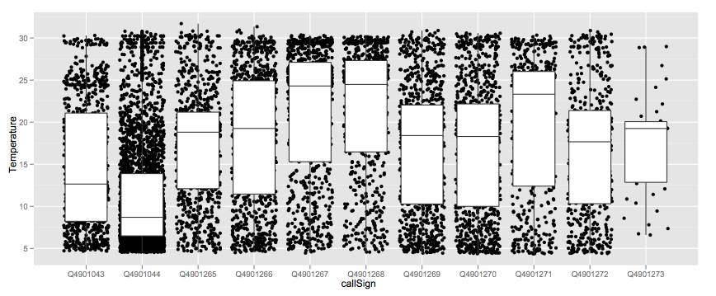
Data: floats. Mapping: x = callSign, y = Temperature.
Layers: jittered points, boxplots.
Scales: x & y position. Faceting: none

Slide 23
Temperature by callSign
qplot(callSign, Temperature, data=floats,
geom=c("jitter", "boxplot"))
ggplot(floats, aes(callSign, Temperature)) +
geom_jitter() +
geom_boxplot()

Slide 24
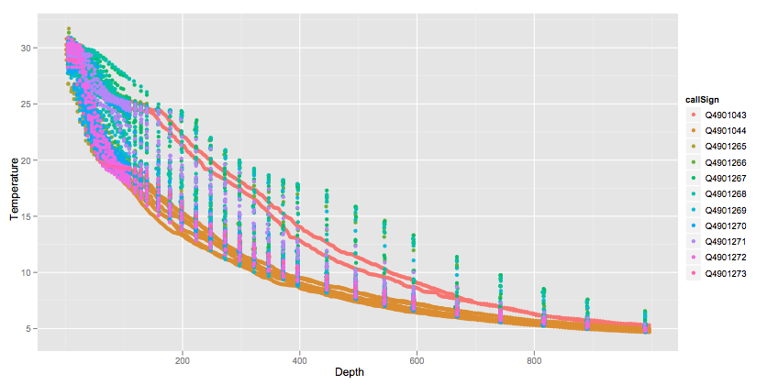
Your turn: write the ggplot() statement that creates this plot

Slide 25
What is a layer?
A dataset and aesthetic mappings (to override default)
A geom
A stat
A position adjustment

Slide 26
 | Geom | Stat
Scatterplot | point | identity
Histogram | bar | bin
Smooth | line + ribbon | smooth
2d histogram | rect | bin2d
More geoms described at
http://www.had.co.nz/ggplot2/

Slide 27
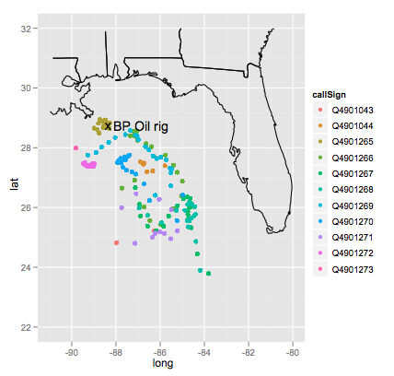
Piecing things together
ggplot() + # plot without a default data set
geom_path(data=states, aes(x=long, y=lat, group=group)) +
geom_point(data=floats, aes(x=Longitude, y=Latitude, colour=callSign)) +
geom_point(aes(x, y), shape="x", size=5, data=rig) +
geom_text(aes(x, y), label="BP Oil rig", shape="x",
size=5, data=rig, hjust = -0.1) +
xlim(c(-91, -80)) +
ylim(c(22,32))

Slide 28
Your Turn
Read in the animal.csv data
Plot location of animal sightings on a map of the region
Suggestions:
color by class of animal and/or status (Alive),
try to label states
Advanced: how could we indicate time?

