Slide 1
4 - Putting things together
R workshop
- Advanced Graphics -

Slide 2
Outline
Date and Time
- lubridate package
Finishing Touches
- options
- themes
- saving plots

Slide 3
Dates and Times
dates and times are deceptively tricky to work with
format?
June 05 2012, 2012/06/05, 5.6.12, …
‘what’s the time?’ - should be easy enough to answer, but we need location: in Ames?
local time? when you are in Taiwan?
daylight savings or standard time?
POSIXct and POSIXlt format in R is hard to figure out

Slide 4
lubridate package
available from CRAN
install.packages(“lubridate”)
written by Garett Grolemund and Hadley Wickham
associated paper in JSS: Dates and TImes made easy with lubridate
http://www.jstatsoft.org/v40/i03/paper

Slide 5
Instants of time
one moment in time, usually named:
e.g.
lubridate turns strings into instants with functions that have y, m, and d in their names.
> now()
[1] "2012-06-05 14:09:13 CDT"
order
matters!
ymd("2012-06-05")
mdy("06/05/2012")
dmy("05062012")
ymd_hms("2011:06:05 14:50:30")

Slide 6
Your Turn
The data set chicago.csv contains records fro every flight departing from Chicagor O’Hare in June 2008.
Parse the Date variable into a Date-Time Object.

Slide 7
Working with instants
standard arithmetic operations now work on dates:
> now() > ymd("1970-01-01")
[1] TRUE
> now() - ymd("1970-01-01")
Time difference of 15491.69 days
functions for extracting pieces of dates:
> month(now())
[1] 5
> wday(now())
[1] 5
> wday(now(), label=TRUE)
[1] Thurs
Levels: Sun < Mon < Tues < Wed < Thurs < Fri < Sat
What’s your age in days?

Slide 8
Accessor functions
Component | Function
Year | year()
Month | month()
Day of the year | yday()
Day of the month | mday()
Day of the week | wday( labels=F)
Hour | hour()
Minute | minute()
Second | second()
Time zone | tz()
What day of the year were you born?

Slide 9
Your Turn
For the chicago.csv data set find out, whether day of the week has an impact on departure delays (DepDelay)
(FAA defines a delay as 15 minutes or more)
How many Sundays or Mondays did June 2008 have? Give a breakdown of week day frequencies. Does that change your initial answer?

Slide 10
Plotting
ggplot2 can work nicely with time objects provided by lubridate
Example:
NASA provided a dataset with satellite measurements on a grid across central America over six years

Slide 11
Plotting
ggplot2 can work nicely with time objects provided by lubridate
Example:
NASA provided a dataset with satellite measurements on a grid across central America over six years

Slide 12
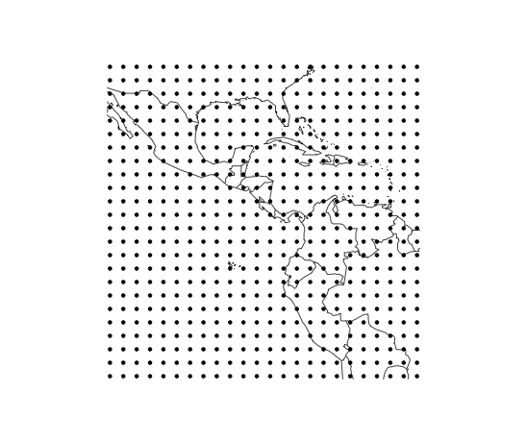
NASA Meteorological Data
24 x 24 grid across Central America
satellite captured data:
temperature (ts),
near surface temperature (tsa)
pressure (ps)
ozone (o3)
cloud coverage:
low (ca_low)
medium (ca_med)
high (ca_high)
for each location monthly averages for Jan 1995 to Dec 2000
Gridx 1 to 24
Gridy 1 to 24

Slide 13
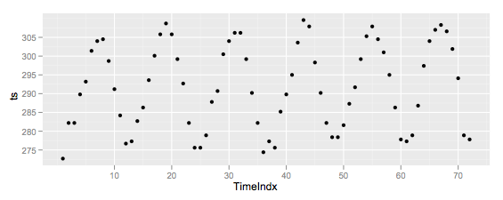
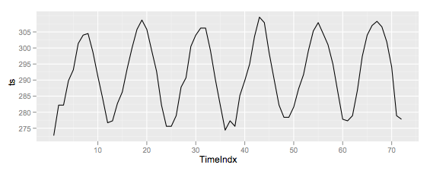
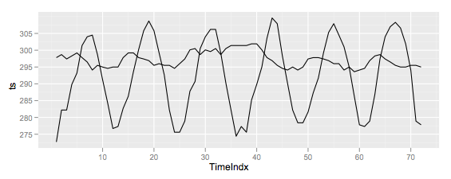
What is a Time Series?
for each location multiple measurements
qplot(TimeIndx, ts, geom="point", data=subset(nasa, (Gridx==1) & (Gridy==1)))
connected by a line
qplot(TimeIndx, ts, geom="line", data=subset(nasa, (Gridx==1) & (Gridy==1)))
but only connect the right points
qplot(TimeIndx, ts, geom="line", data=subset(nasa, (Gridx==i) & (Gridy %in% c(1,15))), group=Gridy)

Slide 14
Your Turn
Get a subset of locations, plot a time series for pressure for each location.
What is the general pattern?
For all locations, draw individual time series for pressure.
What do you expect? Are there surprising values? Which are they?

Slide 15
Your Turn
Introduce a Date (based on Year and Month) to the nasa data and
change the pressure time series plot accordingly

Slide 16
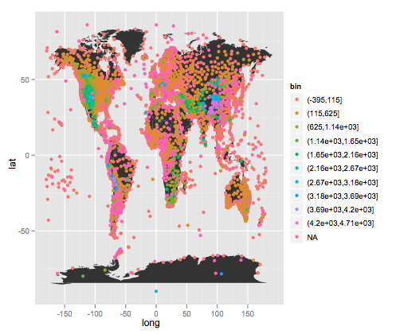
What’s wrong with this plot?

Slide 17
Some problems
Incorrect coordinate system (aspect ratio)
Bad color scheme
Unnecessary axis labels
Legend needs improvement: better title and better key labels
No title

Slide 18
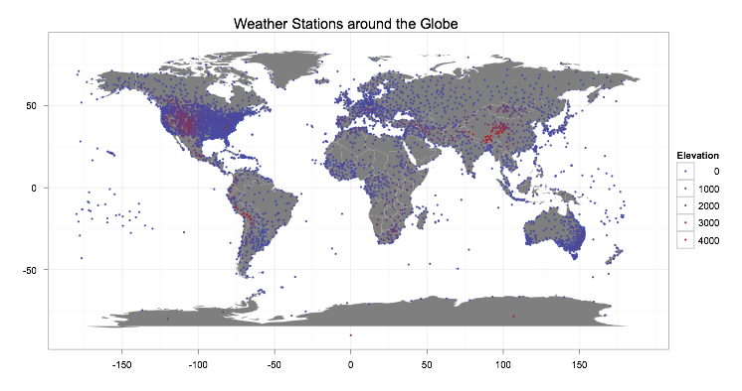

Slide 19
Outline
Themes: control presentation of
non-data elements.
Saving your work: to include in reports, presentations, etc.

Slide 20
Visual appearance
So far have only discussed how to get the data displayed the way you want, focussing on the essence of the plot.
Themes give you a huge amount of control over the appearance of the plot, the choice of background colours, fonts and so on.

Slide 21
# Two built in themes. The default:
> qplot(carat, price, data = diamonds)
# And a theme with a white background:
> qplot(carat, price, data = diamonds) + theme_bw()
# Use theme_set if you want it to apply to every
# future plot.
> theme_set(theme_bw())
# This is the best way of seeing all the default
# options
> theme_bw()
> theme_grey()

Slide 22
Plot title
The plot theme also controls the plot title. You can change this for an individual plot by adding
opts(title = "My title")

Slide 23
Elements
You can also make your own theme, or modify and existing.
Themes are made up of elements which can be one of: theme_line, theme_segment, theme_text, theme_rect, theme_blank
Gives you a lot of control over plot appearance.

Slide 24
Elements
Axis: axis.line, axis.text.x, axis.text.y, axis.ticks, axis.title.x, axis.title.y
Legend: legend.background, legend.key, legend.text, legend.title
Panel: panel.background, panel.border, panel.grid.major, panel.grid.minor
Strip: strip.background, strip.text.x, strip.text.y

Slide 25
# To modify a plot
> p + opts(plot.title =
theme_text(size = 12, face = "bold"))
> p + opts(plot.title = theme_text(colour = "red"))
> p + opts(plot.title = theme_text(angle = 45))
> p + opts(plot.title = theme_text(hjust = 1))

Slide 26
# If we want, we could also remove the axes:
> last_plot() + opts(
+ axis.text.x = theme_blank(),
+ axis.text.y = theme_blank(),
+ axis.title.x = theme_blank(),
+ axis.title.y = theme_blank(),
+ axis.ticks.length = unit(0, "cm"),
+ axis.ticks.margin = unit(0, "cm"))

Slide 27
Other Sources
Package ggExtra by Baptiste Auguie
install.packages("ggExtra",
repos="http://R-Forge.R-project.org",
type="source"
)
library(ggExtra)
?ggExtra

Slide 28
Saving your work

Slide 29
Raster | Vector
pixel-based | instruction-based
png | pdf
for plots with many points | for all other plots
ms office, web | latex

Slide 30
Output
> qplot(price, carat, data = diamonds)
> ggsave("diamonds.png")
# Selects graphics device based on extension
> ggsave("diamonds.png")
> ggsave("diamonds.pdf")

Slide 31
# Uses on-screen device size, or override with
# width & height (to be reproducible)
> ggsave("diamonds.png", width = 6, height = 6)
# Outputs last plot by default, override
# with plot:
> dplot <- qplot(carat, price, data = diamonds)
> ggsave("diamonds.png", plot = dplot)
# Defaults to 300 dpi for png
> ggsave("diamonds.png", dpi = 72)

Slide 32
Your turn
Save a pdf of a scatterplot of price vs carat. Open it up in adobe acrobat.
Save a png of the same scatterplot and embed it into word.

Slide 33
Your turn
Improve colour choices for your challenge submissions.
Save copies of your graphics as pdfs and pngs.

