Slide 1
Dimension Reduction & PCA
Prof. A.L. Yuille
Stat 231. Fall 2004.

Slide 2

Curse of Dimensionality.
A major problem is the curse of dimensionality.
If the data x lies in high dimensional space, then an enormous amount of data is required to learn distributions or decision rules.
Example: 50 dimensions. Each dimension has 20 levels. This gives a total of cells. But the no. of data samples will be far less. There will not be enough data samples to learn.

Slide 3

Curse of Dimensionality
One way to deal with dimensionality is to assume that we know the form of the probability distribution.
For example, a Gaussian model in N dimensions has N + N(N-1)/2 parameters to estimate.
Requires data to learn reliably. This may be practical.

Slide 4
Dimension Reduction
One way to avoid the curse of dimensionality is by projecting the data onto a lower-dimensional space.
Techniques for dimension reduction:
Principal Component Analysis (PCA)
Fisher’s Linear Discriminant
Multi-dimensional Scaling.
Independent Component Analysis.

Slide 5

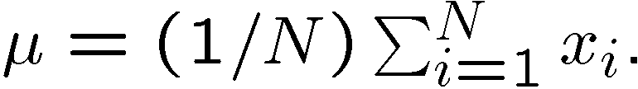
Principal Component Analysis
PCA is the most commonly used dimension reduction technique.
(Also called the Karhunen-Loeve transform).
PCA – data samples
Compute the mean
Computer the covariance:

Slide 6






Principal Component Analysis
Compute the eigenvalues
and eigenvectors of the matrix
Solve
Order them by magnitude:
PCA reduces the dimension by keeping direction such that

Slide 7
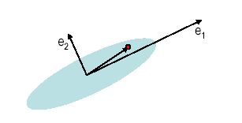

Principal Component Analysis
For many datasets, most of the eigenvalues \lambda are negligible and can be discarded.
The eigenvalue measures the variation
In the direction e
Example:

Slide 8
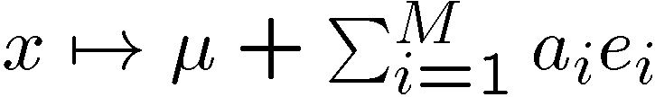

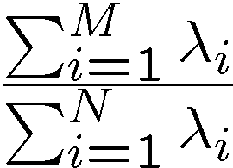
Principal Component Analysis
Project the data onto the selected eigenvectors:
Where
is the proportion of data covered by the first M eigenvalues.

Slide 9
PCA Example
The images of an object under different lighting lie in a low-dimensional space.
The original images are 256x 256. But the data lies mostly in 3-5 dimensions.
First we show the PCA for a face under a range of lighting conditions. The PCA components have simple interpretations.
Then we plot as a function of M for several objects under a range of lighting.

Slide 10
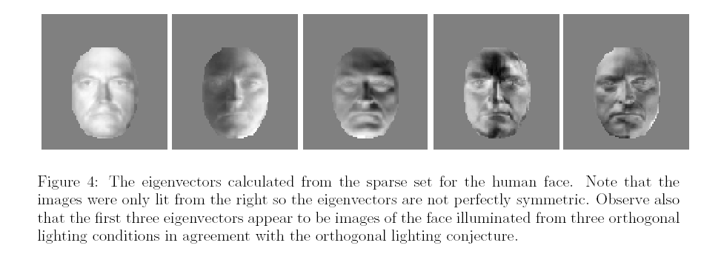
PCA on Faces.

Slide 11
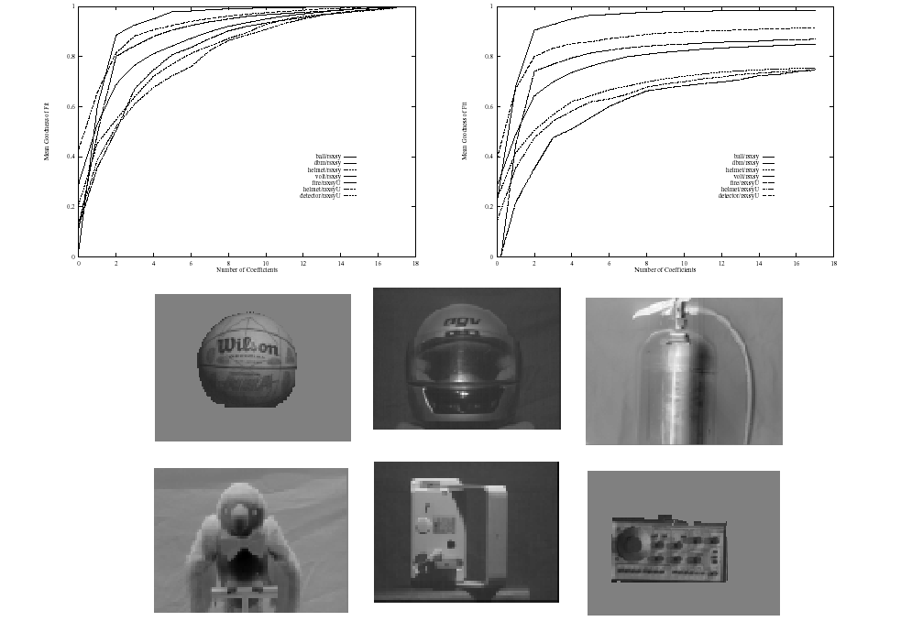
5 plus or minus 2.
Most Objects project to

Slide 12



Cost Function for PCA
Minimize the sum of squared error:
Can verify that the solutions are
The eigenvectors of K are
The are the projection coefficients of the datavectors onto the eigenvectors

Slide 13

PCA & Gaussian Distributions.
PCA is similar to learning a Gaussian distribution for the data.
is the mean of the distribution.
K is the estimate of the covariance.
Dimension reduction occurs by ignoring the directions in which the covariance is small.

Slide 14
Limitations of PCA
PCA is not effective for some datasets.
For example, if the data is a set of strings
(1,0,0,0,…), (0,1,0,0…),…,(0,0,0,…,1) then the eigenvalues do not fall off as PCA requires.

Slide 15
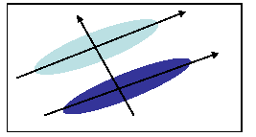
PCA and Discrimination
PCA may not find the best directions for discriminating between two classes.
Example: suppose the two classes have 2D Gaussian densities as ellipsoids.
1st eigenvector is best for representing the probabilities.
2nd eigenvector is best for discrimination.

Slide 16






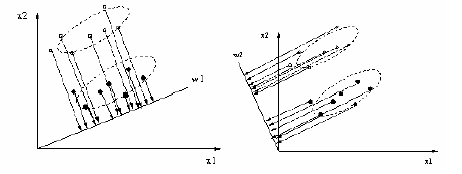
Fisher’s Linear Discriminant.
2-class classification. Given samples in class 1 and samples in class 2.
Goal: to find a vector w, project data onto this axis so that data is well separated.

Slide 17

Fisher’s Linear Discriminant
Sample means
Scatter matrices:
Between-class scatter matrix:
Within-class scatter matrix:

Slide 18
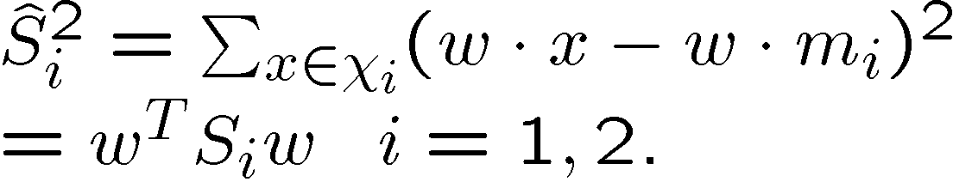
Fisher’s Linear Discriminant
The sample means of the projected points:
The scatter of the projected points is:
These are both one-dimensional variables.

Slide 19
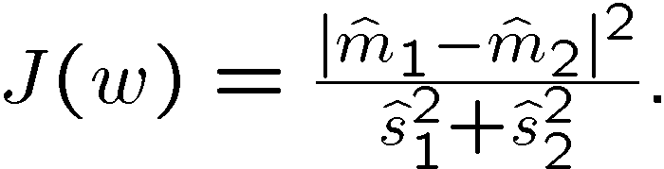
Fisher’s Linear Discriminant
Choose the projection direction w to maximize:
Maximize the ratio of the between-class distance to the within-class scatter.

Slide 20


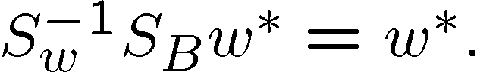

Fisher’s Linear Discriminant
Proposition. The vector that maximizes
Proof.
Maximize
is a constant, a Lagrange multiplier.
Now

Slide 21


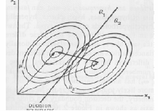
Fisher’s Linear Discriminant
Example: two Gaussians with the same covariance and means
The Bayes classifier is a straight line whose normal is the Fisher Linear Discriminant direction w.

Slide 22
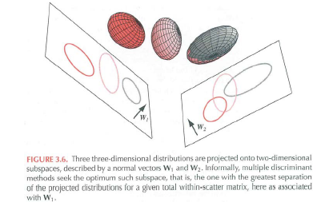
Multiple Classes
For c classes, compute c-1 discriminants, project d-dimensional features into c-1 space.

Slide 23
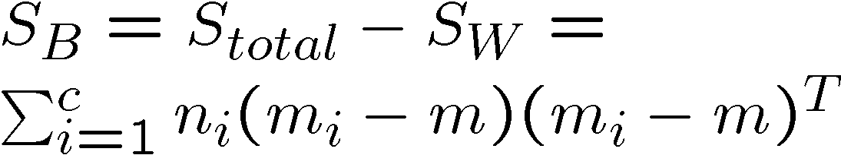

Multiple Classes
Within-class scatter:
Between-class scatter:
is scatter matrix from all classes.

Slide 24

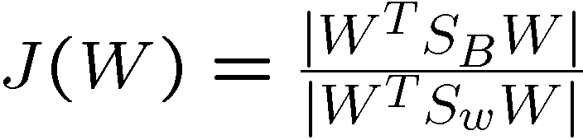

Multiple Discriminant Analysis
Seek vectors and project samples to c-1 dimensional space:
Criterion is:
where |.| is the determinant.
Solution is the eigenvectors whose eigenvalues are the c-1 largest in

