Slide 1
IOT IMPLEMENTATION RESOURCES
H Anandkumar Singh
Technical Specialist

Slide 2
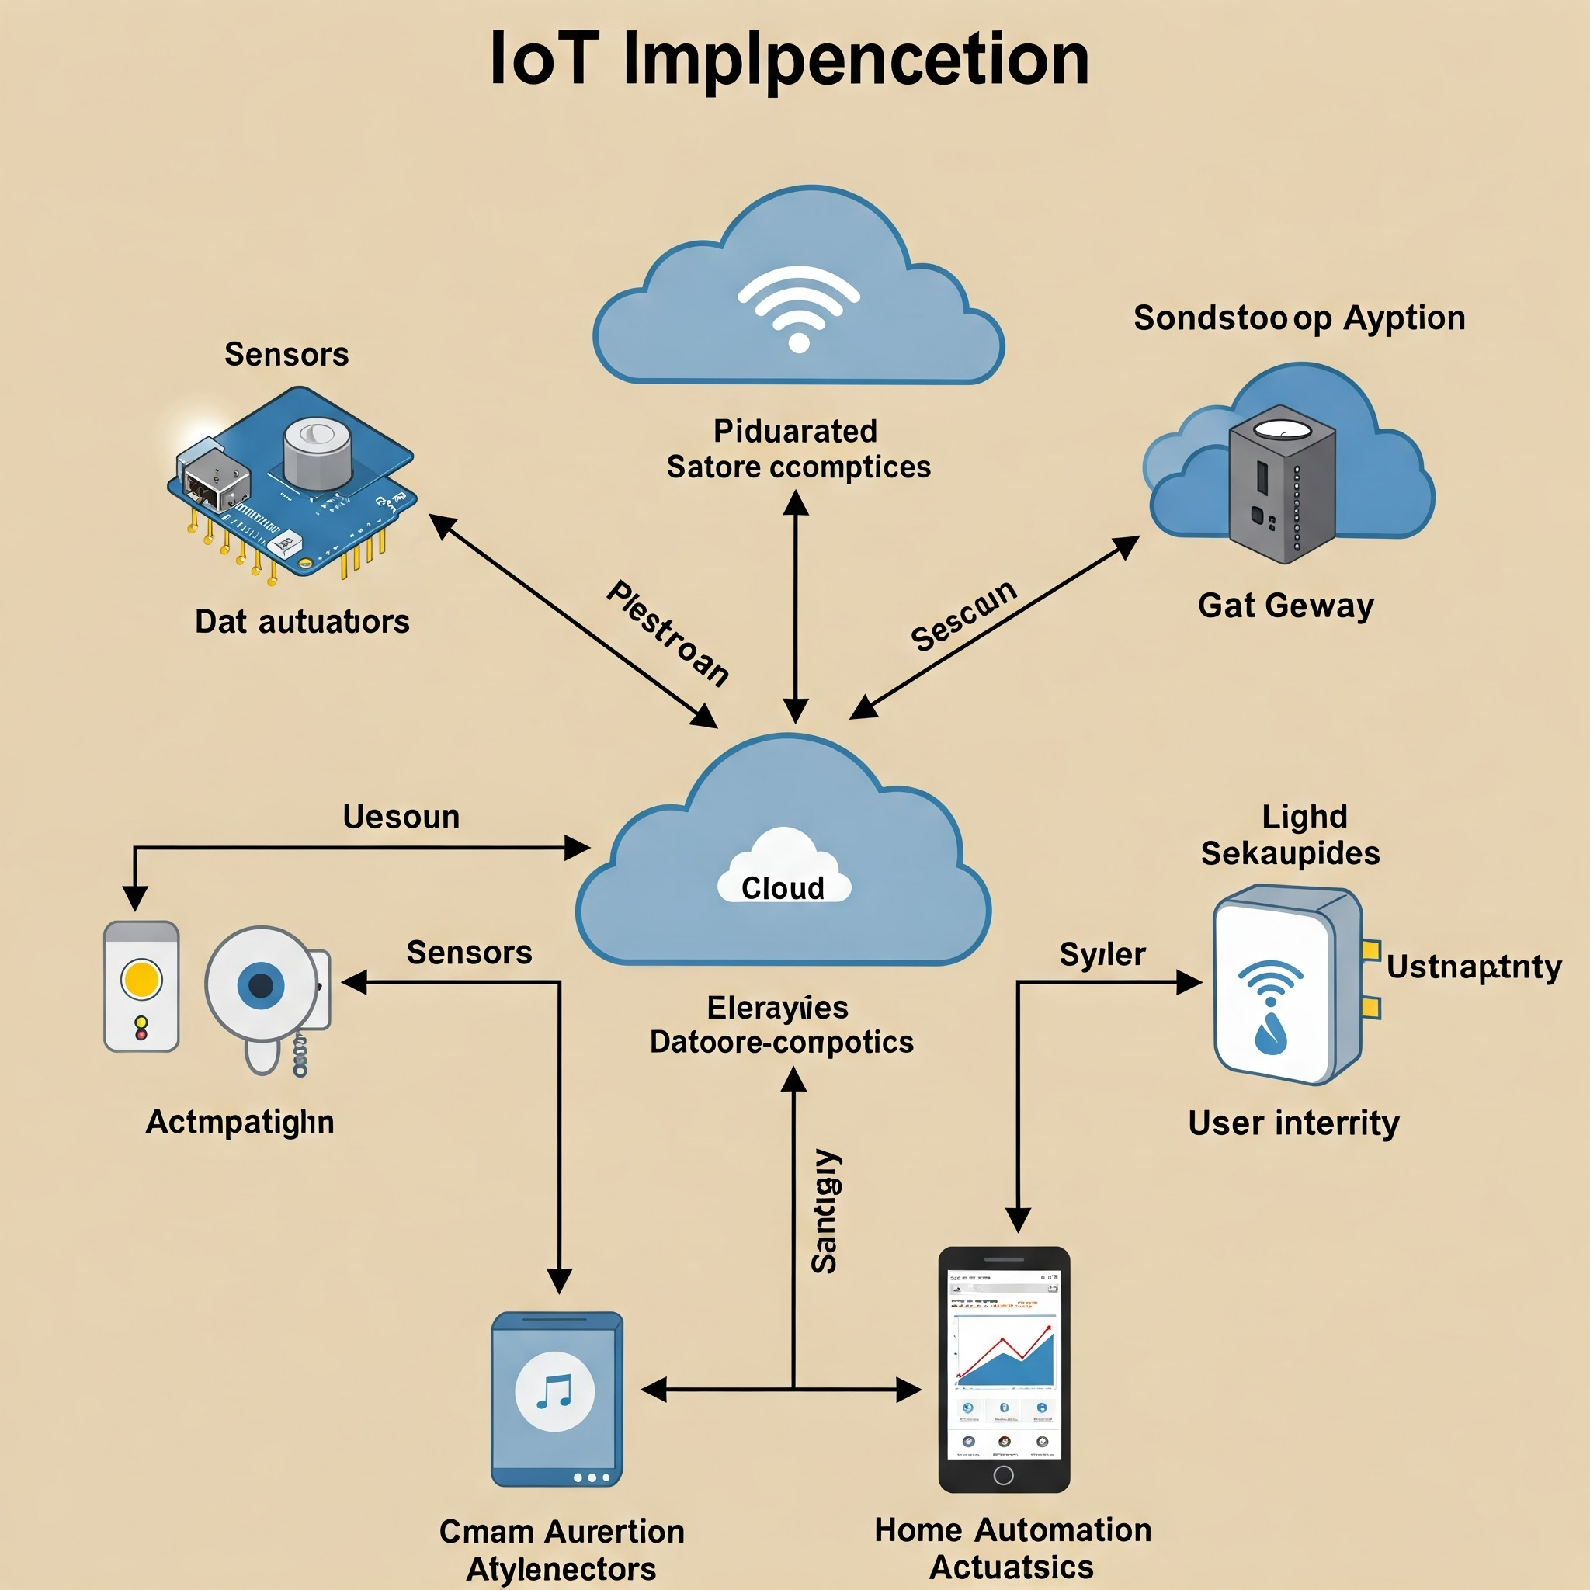
What is IOT
Internet of Things:
Example:
  smart thermostat
  fitness tracker
  smart fridge

Slide 3
Can you Make IOT Product without Cloud?
    Local Communication (Edge Computing)
    Offline Mode with Local Storage
    Direct Device-to-Device Communication (P2P)
    Edge Computing Devices
    Wi-Fi-Only or Local Network Solutions
    Key Considerations When Building IoT Without Cloud:
      Security
      Data Storage
      Power Consumption
      Scalability

Slide 4
What is Python?
1. Python is a high-level, interpreted programming language known for its simplicity and readability.
2. Here are some key features of Python:
a. Easy to Learn and Use
b. Dynamically Typed
c.Interpreted Language
d. Versatile and Cross-Platform
e. Extensive Standard Library
f. Object-Oriented and Functional
g. Wide Range of Applications
h. Large Community and Ecosystem
Example Code of Python

Slide 5
Python Code
# A simple Python program to print "Hello, World!" and add two numbers
def add_numbers(a, b):
return a + b
print("Hello, World!")
result = add_numbers(10, 20)
print(f"The result of adding 10 and 20 is: {result}")
Why Use Python?
Beginner-Friendly: Python’s readable syntax and simplicity make it an excellent choice for newcomers.
Rapid Development: Python allows developers to quickly prototype and develop applications.
Versatile: Python is used for a variety of applications across different domains, from web development to machine learning.

Slide 6
Why Use Python
Beginner-Friendly: Python’s readable syntax and simplicity make it an excellent choice for newcomers.
Rapid Development: Python allows developers to quickly prototype and develop applications.
Versatile: Python is used for a variety of applications across different domains, from web development to machine learning.
3. Performance and Efficiency
C/C++ is compiled and optimized for performance, making it the preferred choice for high-performance or real-time systems where speed and resource efficiency are critical (e.g., in battery-powered or resource-constrained devices).
Python is an interpreted language, which makes it slower than C/C++ for CPU-intensive tasks. However, in many IoT use cases, the performance gap is often negligible, especially if Python is running on relatively powerful platforms (like Raspberry Pi or Intel NUC).
C/C++ Advantage: Better for performance-critical applications and systems with stringent real-time constraints.
Python Advantage: Adequate performance for many IoT applications, especially when working with higher-level tasks like data processing or cloud communication.

Slide 7
How Python Different from C++?
Feature | C++ (Compiled) | Python (Interpreted)
Execution | Compiled to machine code (faster execution) | Interpreted line-by-line at runtime (slower execution)
Compilation | Requires a compiler (e.g., g++) | No compilation step, interpreted directly by the Python interpreter
Performance | Generally faster due to direct machine code execution | Slower, since the interpreter processes each line during runtime
Platform Dependency | Machine code is platform-specific; needs recompilation for different platforms | Platform-independent (as long as the interpreter is available)

Slide 8
How Python Different from C++?
Feature | C++ (Compiled) | Python (Interpreted)
Execution | Compiled to machine code (faster execution) | Interpreted line-by-line at runtime (slower execution)
Compilation | Requires a compiler (e.g., g++) | No compilation step, interpreted directly by the Python interpreter
Performance | Generally faster due to direct machine code execution | Slower, since the interpreter processes each line during runtime
Platform Dependency | Machine code is platform-specific; needs recompilation for different platforms | Platform-independent (as long as the interpreter is available)

Slide 9
Introduction to IOT Tools
    IoT Development Platforms
    IoT Hardware and Development Kits
    IoT Communication Protocols
    IoT Analytics and Data Visualization Tools
    IoT Device Management Tools
    IoT Security Tools
    Cloud IoT Platforms
    Edge Computing Tools for IoT

Slide 10
Developing Application through IOT Tools
    IoT Development Platforms
    IoT Hardware and Development Kits
    IoT Communication Protocols
    IoT Analytics and Data Visualization Tools
    IoT Device Management Tools
    IoT Security Tools
    Cloud IoT Platforms
    Edge Computing Tools for IoT

Slide 11
Example: Of a IOT Product
In this IoT project, you:
Connected a temperature sensor to the Raspberry Pi.
Created a Python script to read data from the sensor.
Stored the data in a MySQL database.
Set up a Flask web server to display the data on a web page using HTML templates.

Slide 12
Can you Make IOT Product without Cloud?

