Slide 1
Let us develop IOT using Raspberry Pi
Resource Person:
H Anandkumar Singh

Slide 2
Recapped
What is IOT
Can we make IOT without cloud
What is Python?
Python Code example
Introduction to IOT Tools
How to develop Application using IOT tools?
Example of IOT Application:
Reading Temperature

Slide 3
Implementation of IOT using Python and Raspberry PI
Setup development Environment
Setup Raspberry PI for demo
Write python code
Write a service code in raspberry pi
Launch application by restarting raspberry pi or Service.

Slide 4
Setup development Environment
✅ Step-by-Step: Install Python & Create a Virtual Environment
✅ Step 1: Update Your System (sudo apt update && sudo apt upgrade –y) Linux environment
✅ Step 2: Install Python (if not installed)
(Linux) sudo apt install python3 python3-pip –y
(window) 👉 https://www.python.org/downloads/
Install running exe and ✅ Add Python to PATH
✅ Install venv Module –(linux) sudo apt install python3-venv –y
✅ Create a project folder:
mkdir ~/iot_project
cd ~/iot_project

Slide 5
Setup development Environment
✅ Create a virtual environment named env:
(linux) python3 -m venv env
(window) python -m venv env
✅ Step 5: Activate the Virtual Environment
(linux) source env/bin/activate
(window) env\Scripts\activate
✅ Step 5: Install Required Python Packages
(linux) pip install flask flask-mysqldb Adafruit_DHT
(window) pip install flask flask-mysqldb Adafruit_DHT
✅ Step 7: Deactivate the Environment (When Done) : deactivate
🔁 Next Time You Work: Reactivate again:
cd ~/iot_project
source env/bin/activate

Slide 6
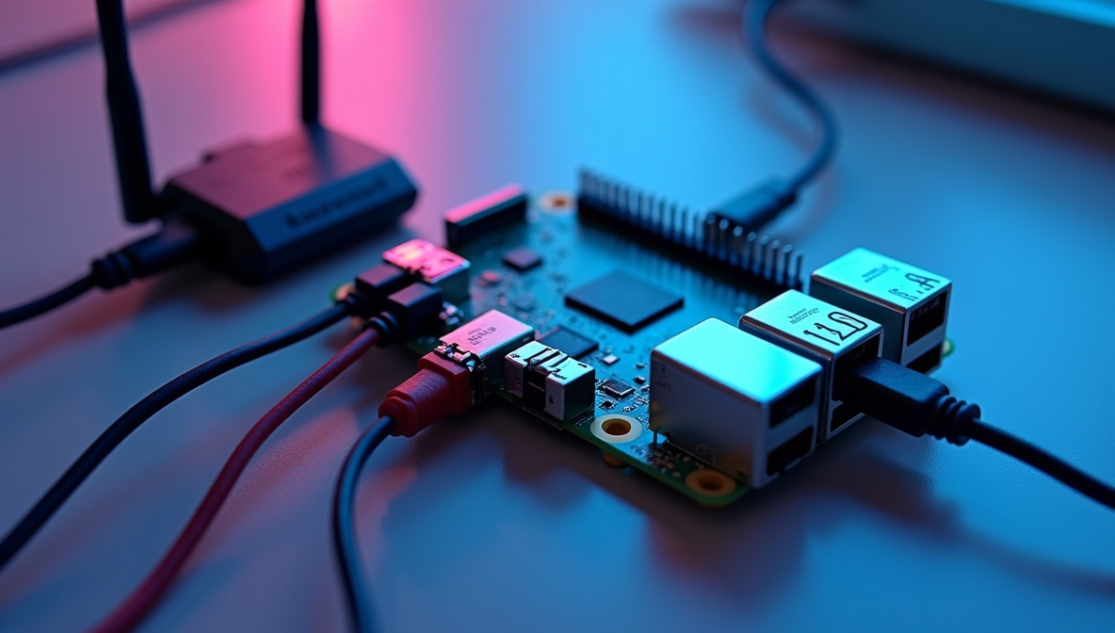
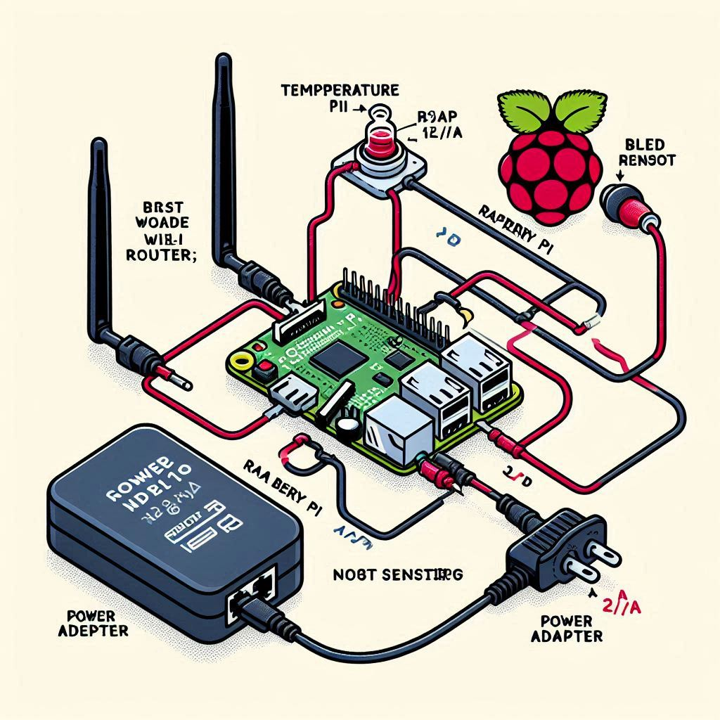
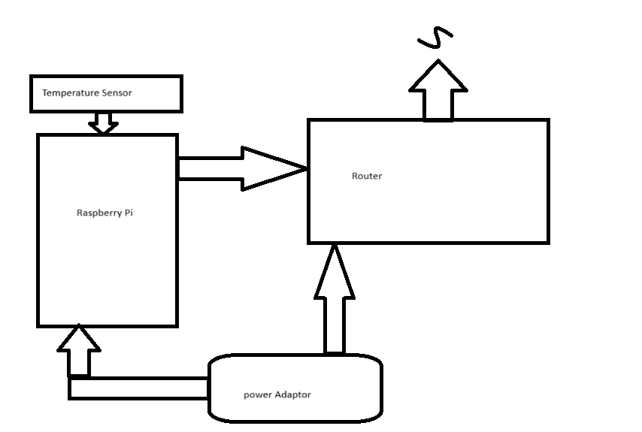
Setup Raspberry PI for demo
TEMPERATURE SENSOR
ROUTER
RASPBERRY PI
POWER ADAPTER

Slide 7
Setup development Environment
✅System Architecture Overview
Components Used:
Raspberry Pi (runs web server and reads sensor)
DHT11/DHT22/BMP180/etc. temperature sensor (connected to Pi)
Wireless Router (LAN access)
Mobile Phone (to access HTML page)
MySQL (for data storage)
Flask (Python web framework)
Chart.js (for live graph)
HTML + JavaScript (frontend)

Slide 8
Write python code setup database mysql
✅ Step 1: Set Up MySQL Database (LINUX)
sudo apt-get install mysql-server
sudo mysql_secure_installation
✅ Step 2: Set Up MySQL Database (WINDOW)
Step 1: Download MySQL Installer
Go to the official site: 👉 https://dev.mysql.com/downloads/installer/
Download the MySQL Installer for Windows (choose the "Windows (x86, 32-bit), MSI Installer", even for 64-bit systems — it works fine).

Slide 9
Write python code Setup Table in database
✅ Step 3: Start MySQL Server
(linux) mysql -u root –p
(window) Launch MySQL Workbench (optional for GUI)
✅ Step 4: Create the Database and Tables
Code link

Slide 10
Write python code Setup Sensor hardware and server
✅ Step 5: Connect Sensor to Raspberry Pi
pip install Adafruit_DHT
Code link:
✅ Step 6: Create Flask Server
pip install flask flask-mysqldb
Code link:
✅ Step 7: Create HTML Pages
Create a folder and store the file: templates/login.html
Code link:
templates/dashboard.html: code link
✅ Step 8: Access from Mobile via Router
Connect your Raspberry Pi and mobile phone to the same Wi-Fi network.
On your mobile browser, open: http://<raspberry-pi-ip>:5000

Slide 11
How to implement and improve security, reliability, and usability:
🔐 1. Use Hashed Passwords with : bcrypt
📌 Step 1: Install : pip install bcrypt
📌 Step 2: Hash Password Before Inserting into DB
Code link:
📌 Step 3: Verify Password During Login
Code link:
⚠️ 2. Add Sensor Logging & Error Handling
Code link:
🔒 3. Add Logout Functionality
Code link:

Slide 12

THANK YOU
SOURCE : https://github.com/heikhama/IOT.git

